Slide 1
Modeling Cell Signaling
Bill Hlavacek
Theoretical Biology & Biophysics Group
Theoretical Division
The q-bio Summer School, Colorado State University, Albuquerque, June 11, 2018

Slide 3
Value added by modeling of cellular regulatory systems
We can use models to organize and evaluate information
  To think with greater rigor and precision
  To discover knowledge gaps
  To identify key quantitative factors that affect system behavior
  To summarize observations and preserve knowledge
We can analyze models to obtain insights and generate hypotheses
  To elucidate general design principles
  To explain counterintuitive behavior
  To enhance experimental efforts (e.g., through experimental design)
  To guide interventions

Slide 4
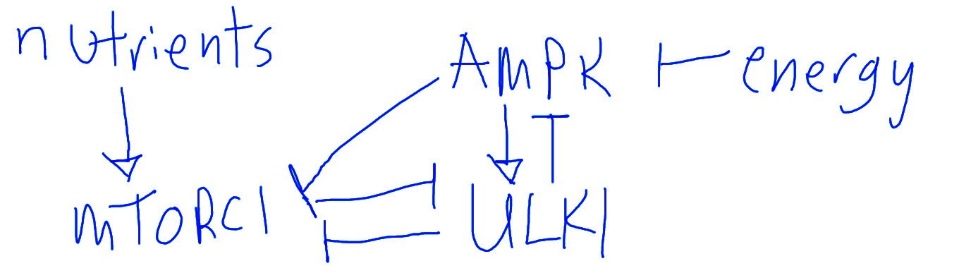
Influences within the AMPK-MTORC1-ULK1 network

Slide 5
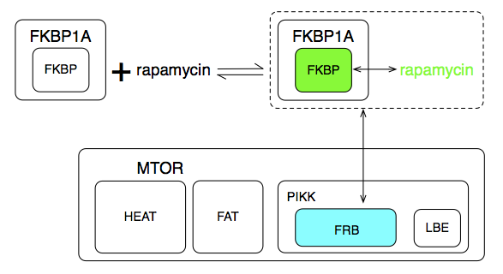
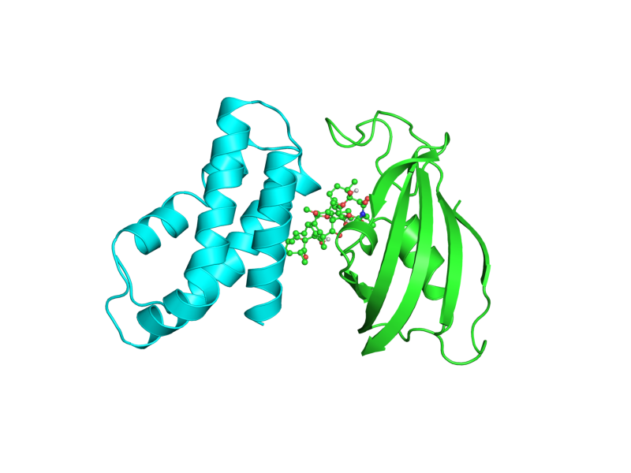
Illustration of details involved in tracking site dynamics

Slide 6
Outline
Features of signaling proteins
Combinatorial complexity: the key problem solved by rule-based modeling
Basic concepts of rule-based representation of biomolecular interactions
Simulation methods for rule-based models (indirect and direct)
Exercises (computer lab)

Slide 7
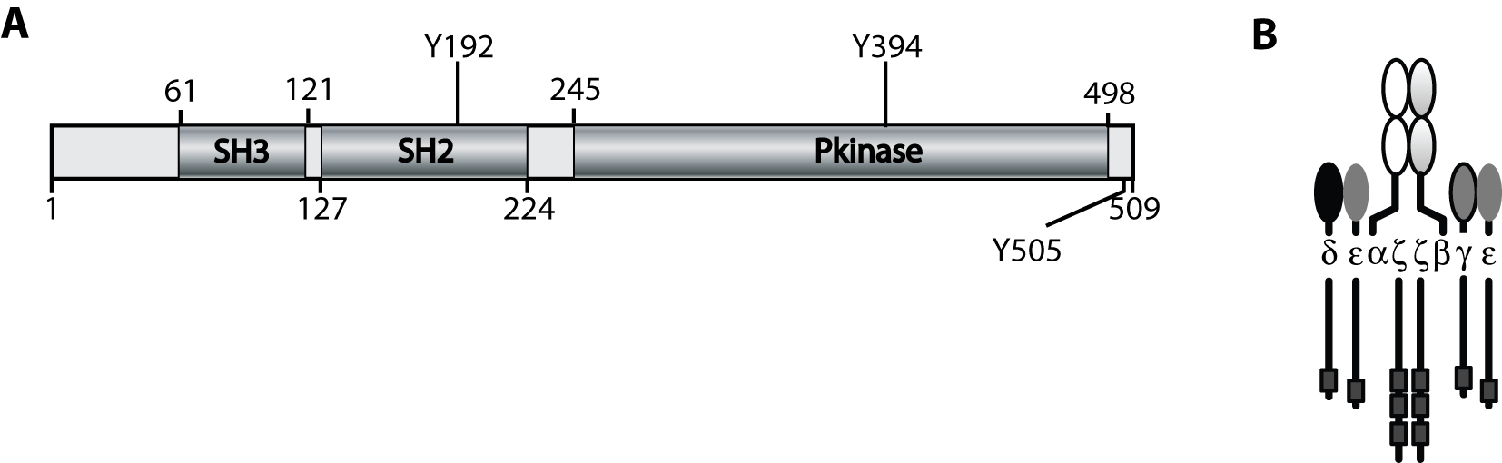
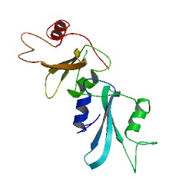
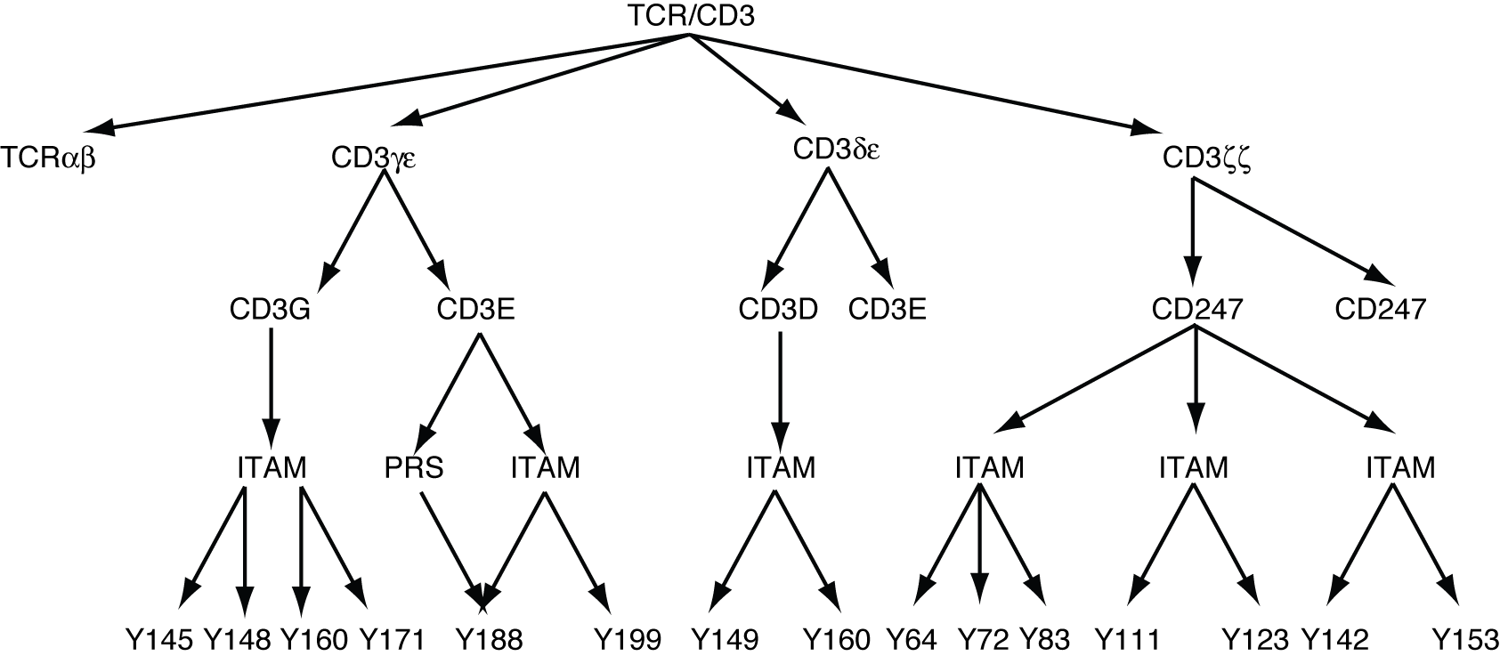
A signaling protein is typically composed of multiple components (subunits, domains, and/or linear motifs) that mediate interactions with other proteins
TCR/CD3
Lck
Lck-SH2 (1bhh)
CD3E: ¹⁸⁴PNPDYEPIRKGQRDLYSGL²⁰²
PRS: PxxDY
ITAM: YxxL/I(x₆₋₈)YxxL/I
Kesti T et al. (2007) J. Immunol. 179:878-85.

Slide 8
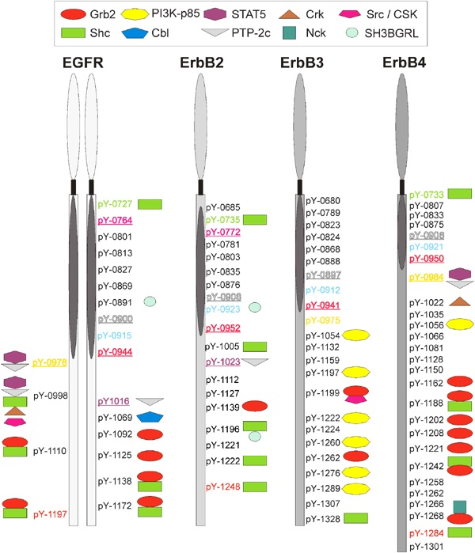
Domain-motif interactions are often controlled by post-translational modifications
Schulze WX et al. (2005) Mol. Syst. Biol.

Slide 9
Outline
Features of signaling proteins
Combinatorial complexity: the key problem solved by rule-based modeling
Basic concepts of rule-based representation of biomolecular interactions
Simulation methods for rule-based models (indirect and direct)
Exercises (computer lab)

Slide 10
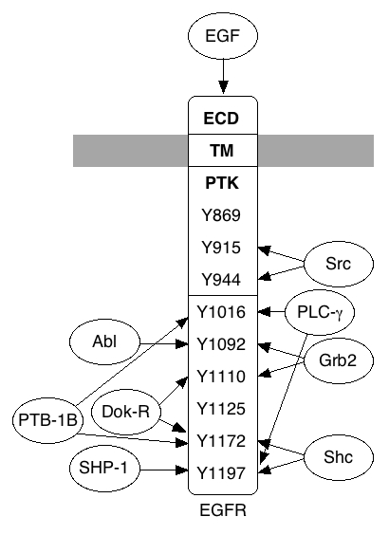
Complexity arises from post-translational modifications
Epidermal growth factor receptor (EGFR)
9 sites => 2⁹=512 phosphorylation states
Each site has ≥ 1 binding partner
=> more than 3⁹=19,683 total states
EGFR must form dimers to become active
=> more than 1.9x10⁸ states

Slide 11
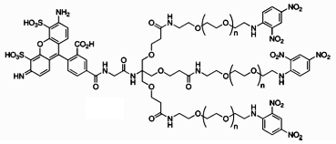
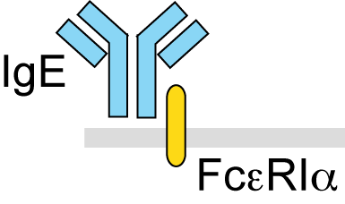
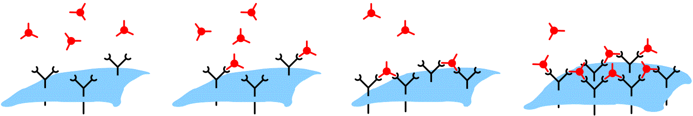
Complexity arises from oligomerization/aggregation
Mahajan et al. (2014) ACS Chem Biol 9: 1508-1519.
DF3
~13 nm
Compound 6a
Ara h 1 (major peanut allergen), PDB 3S7E
Posner et al. (2007) Org Lett 9: 3551

Slide 12
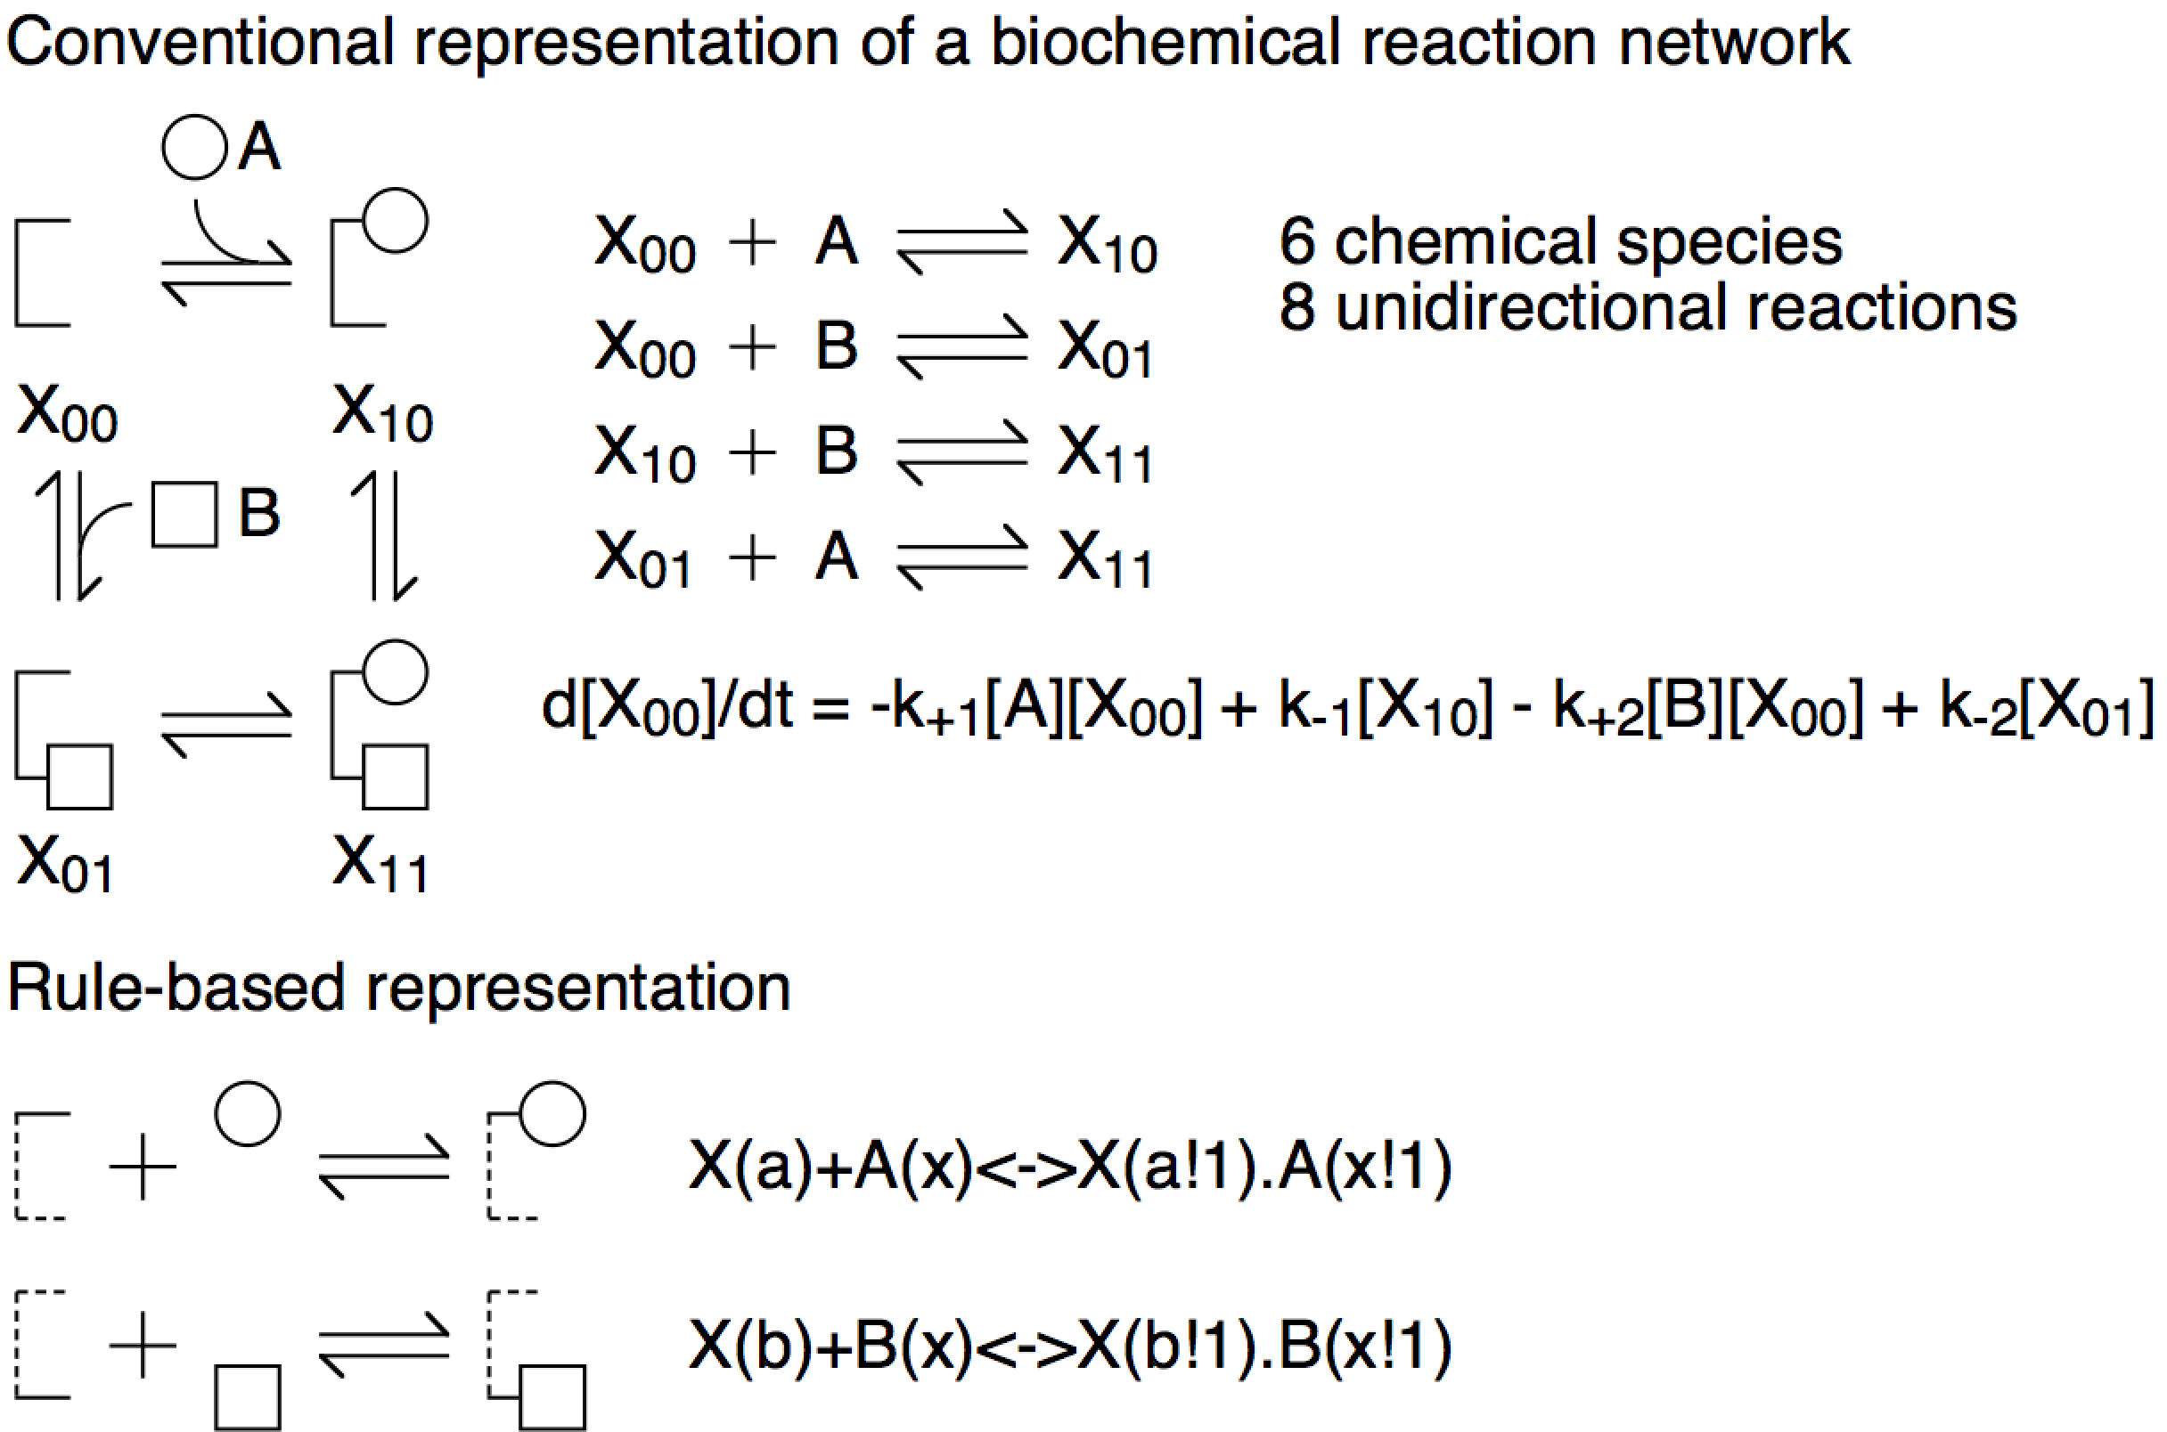
The textbook approach

Slide 13
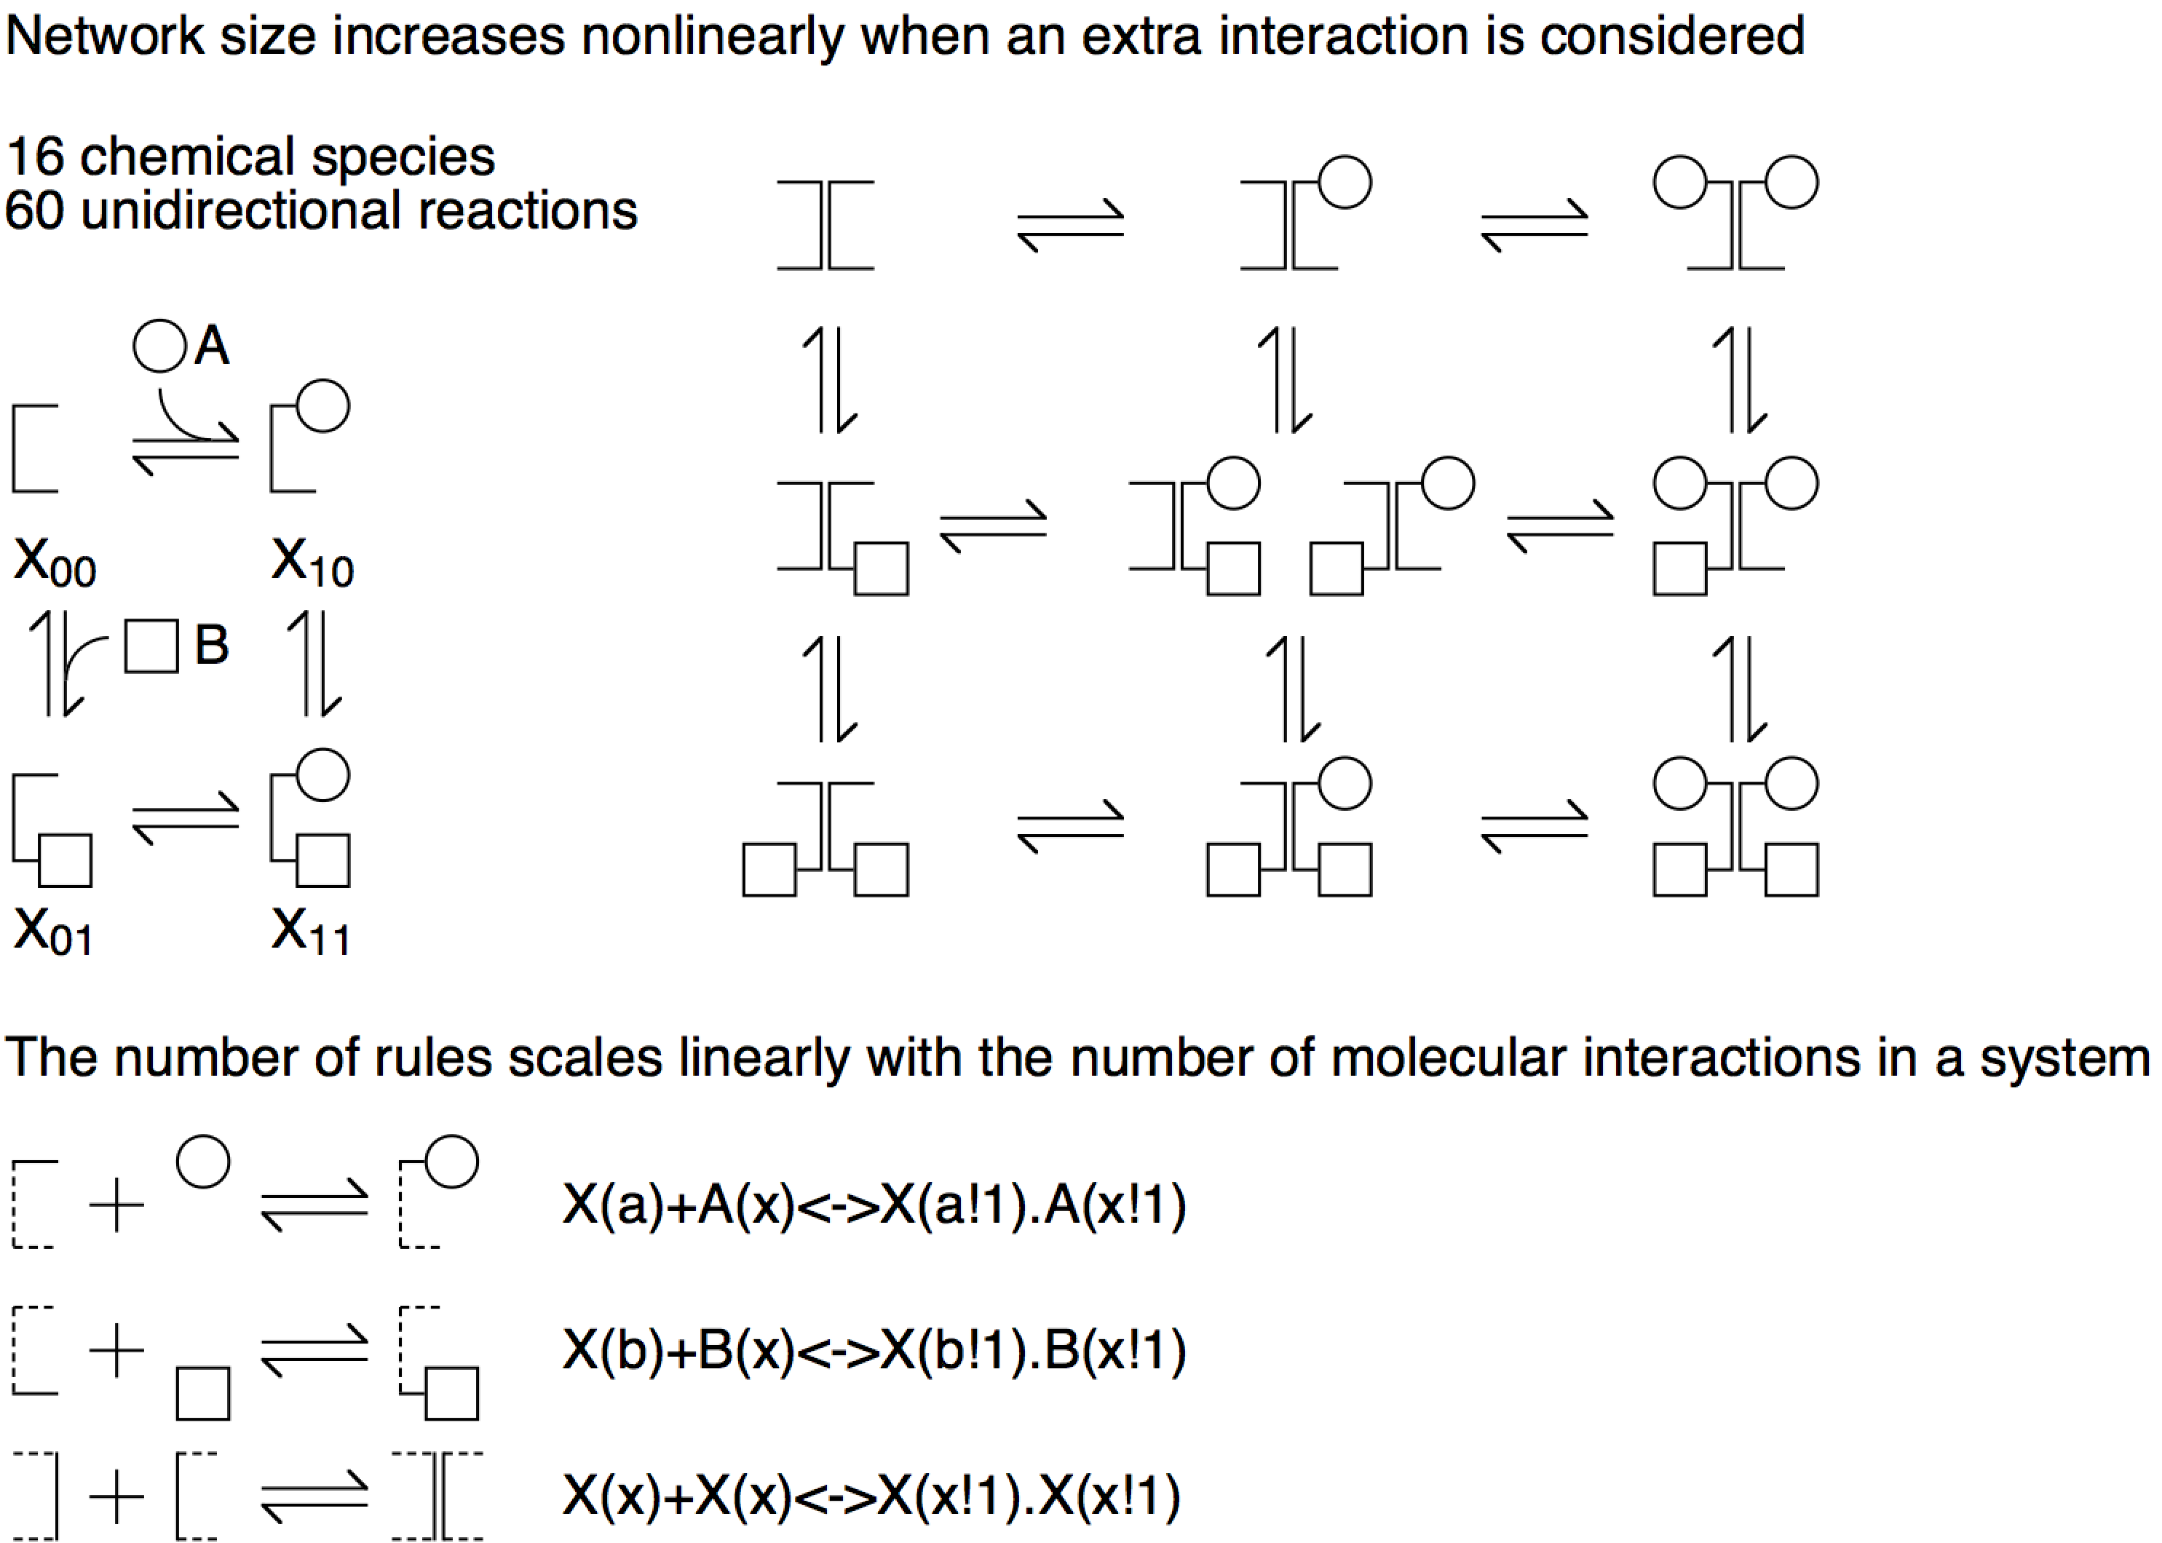
Network (model) size tends to grow nonlinearly (exponentially) with the number of molecular interactions
There are only three interactions. We can use a “rule” to model each of these interactions.
Science’s STKE re6 (2006)

Slide 14
Rule-based modeling solves the problem of combinatorial complexity
Inside a Chemical Plant
  Large numbers of molecules…
  …of a few types
  Conventional modeling works fine (a good idea since Harcourt and Esson, 1865)
Inside a Cell
  Possibly small numbers of molecules…
  …of many possible types
  Rule-based modeling is designed to deal with this situation (new)

Slide 15
Outline
Features of signaling proteins
Combinatorial complexity: the key problem solved by rule-based modeling
Basic concepts of rule-based representation of biomolecular interactions
Simulation methods for rule-based models (indirect and direct)
Exercises (computer lab)

Slide 16
Rule-based modeling: basic concepts
Graphs represent molecules/complexes, their component parts, and “internal states”
collections of same-colored vertices represent “molecule types”
vertices represent “sites”
vertex labels represent “states”
edges represent bonds
connnected molecule types represent complexes
Graph-rewriting rules represent molecular interactions
addition of an edge to represent bonding
removal of an edge to represent dissociation
change of a vertex label to represent change of state
(e.g., change of conformation, location, or PTM status)

Slide 17
The site graphs of a model for EGFR signaling
EGF
EGFR
Shc
Grb2
Sos
L1
or
P
CR1
PTB
SH2
SH3
Y317
Y1092
or
P
Y1172
or
P
No need to introduce a unique name (e.g., X₁₂₃ or ShP-RP-G-Sos) for each chemical species, as in conventional modeling
P
P
P
P
P
Blinov ML et al. (2006) BioSystems

Slide 18
A rule for EGF-EGFR binding
EGF binds EGFR
L1
k₊₁
EGF
+
CR1
k₋₁
EGFR
begin reaction rules
EGF(R)+EGFR(L1,CR1)<->EGF(R!1).EGFR(L1!1,CR1)
end reaction rules

Slide 19
A rule for ligand-dependent EGFR dimerization
EGFR dimerizes (600 reactions are implied by this one rule)
EGF
k₊₂
dimerization
+
k₋₂
EGFR
No free lunch: According to this rule, dimers form and break up with the same fundamental rate constants regardless of the states of cytoplasmic domains, which is a simplification.

Slide 20
Outline
Features of signaling proteins
Combinatorial complexity: the key problem solved by rule-based modeling
Basic concepts of rule-based representation of biomolecular interactions
Simulation methods for rule-based models (indirect and direct)
Exercises (computer lab)

Slide 21
Many different traditional simulation techniques are compatible with RBM
Ordinary differential equations (ODEs) - BioNetGen
  One equation per chemical species in the reaction network
  Each reaction contributes a negative term to a reactant’s equation and a positive term to a product’s equation
Markov chains – BioNetGen + NFsim
  Gillespie’s method or stochastic simulation algorithm (SSA) or KMC
  Each trajectory represents one sample from probability space of the chemical master equation (CME)
Partial differential equations (PDEs) - VCell
  Species concentrations are resolved in space
Particle-based stochastic spatial simulations – Smoldyn + MCell
Force field- or potential-based calculations with excluded volume and orientation constraints (molecular dynamics) - SRSim

Slide 22
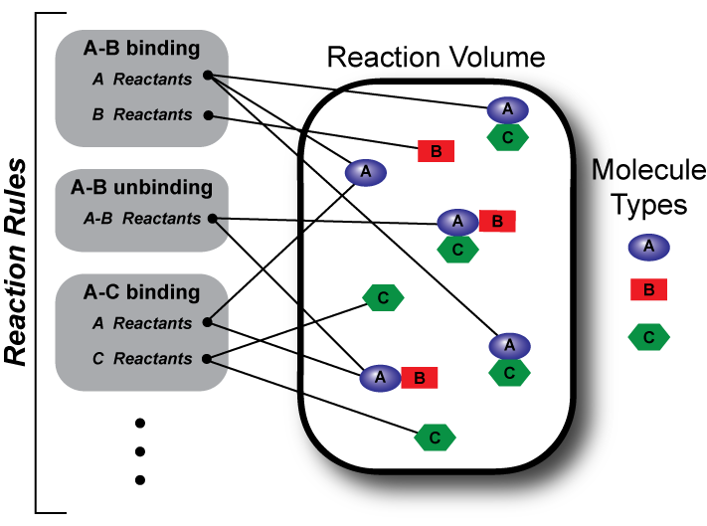
Two types of methods for simulating RBMs
Model Specification
Indirect
Direct
Network Generation
Configuration Generation
Reaction Network
Reaction Network Simulator

Slide 23
Indirect Methods – Network Generation
a b c
A
C
1
1
B
2
contact map
2
3
3
4
reaction rules
species
4
a
+
A
a
A
1
4 molecule types
3 rules
11 species
12 reactions
2
b
+
B
b
3
B
4
c
+
C
c
C
1
2
seed species
3
S,A,B,C
4
reactions

Slide 24
Direct Methods – rules generate reaction events and system configurations
reaction rules
event generation
a
+
A
a
a
+
A
a
A
a
A
6
4
6
a b c
A
A
B
C
a b c
B
B
C
b
+
B
b
B
a b c
a b c
B
A
C
a b c
B
6
5
B
C
6
C
B
a b c
a b c
A
A
a b c
c
+
C
c
a b c
C
C
A
B
A
a b c
A
B
C
7
3
5
a b c
C
B
a b c
A
B
A
system configuration
total propensity

Slide 25
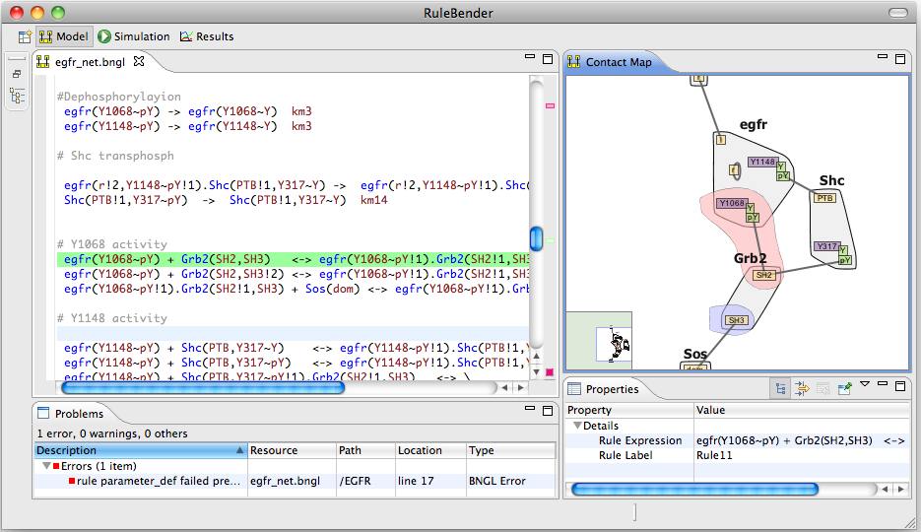
RuleBender/BioNetGen/NFsim
RuleBender – integrated development environment (IDE)
http://bionetgen.org/index.php/Download

Slide 26
Why use rule-based modeling techniques?
Concise and precise representation of biochemical knowledge
  Rules provide a convenient language for representing biomolecular interactions
  Intricate molecular mechanisms can be captured easily in rule-based models
Flexible with respect to simulation method
  Deterministic / Stochastic
  Well-mixed / Compartmental / Spatial
Model elements are modular and reusable
  Rule libraries (Chylek et al., 2014) Frontiers in Immunology
Compact and automatic visualization
  Contact map and beyond
Easy annotation
  Model elements can be directly mapped to database entries
Contact map

Slide 27
Outline
Features of signaling proteins
Combinatorial complexity: the key problem solved by rule-based modeling
Basic concepts of rule-based representation of biomolecular interactions
Simulation methods for rule-based models (indirect and direct)
Exercises (computer lab)
During the afternoon computer lab (6/11, Mon), we will build a simple rule-based model using RuleBender and look at several example models presented in this tutorial/review: Chylek et al. (2015) Phys Biol 12: 045007.
https://www.ncbi.nlm.nih.gov/pmc/articles/PMC4526164/

Slide 28
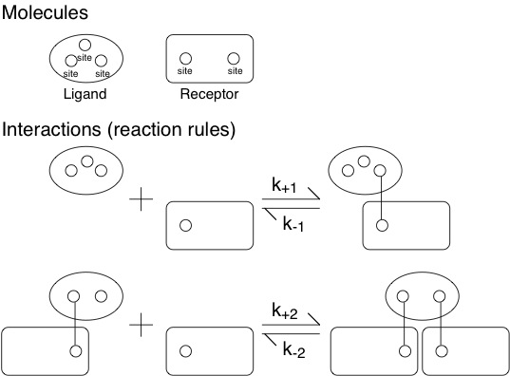
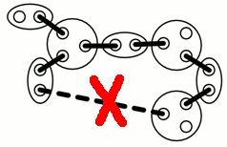
A rule-based model corresponding to the equilibrium continuum model of Goldstein and Perelson (1984)
This is the “TLBR model.”
No cyclic aggregates
Notes:
Content Slide Notes
“UNCLASSIFIED” marking of slides is not a security requirement and may be deleted from the Slide Master (View › Master › Slide Master). In general, slides should be marked “UNCLASSIFIED” if there is potential for confusion or misinterpretation of something that could be deemed classified. For guidance on marking slides containing classified and unclassified controlled information, see the Protecting Information Web site at http://int.lanl.gov/security/protectinfo/.

Slide 29
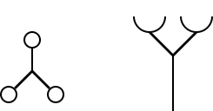
“Generate-first” method starts with seed species
Ligand
Receptor
Notes:
Content Slide Notes
“UNCLASSIFIED” marking of slides is not a security requirement and may be deleted from the Slide Master (View › Master › Slide Master). In general, slides should be marked “UNCLASSIFIED” if there is potential for confusion or misinterpretation of something that could be deemed classified. For guidance on marking slides containing classified and unclassified controlled information, see the Protecting Information Web site at http://int.lanl.gov/security/protectinfo/.

Slide 30
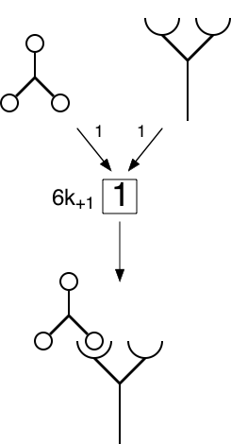
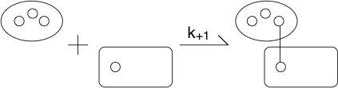
After first round of rule application
Notes:
Content Slide Notes
“UNCLASSIFIED” marking of slides is not a security requirement and may be deleted from the Slide Master (View › Master › Slide Master). In general, slides should be marked “UNCLASSIFIED” if there is potential for confusion or misinterpretation of something that could be deemed classified. For guidance on marking slides containing classified and unclassified controlled information, see the Protecting Information Web site at http://int.lanl.gov/security/protectinfo/.

Slide 31
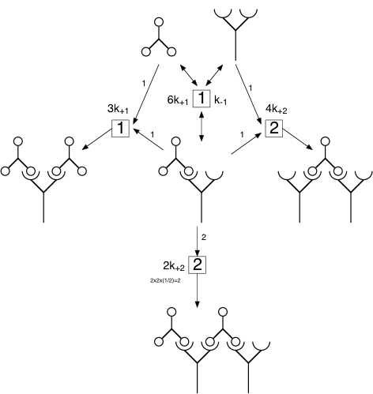
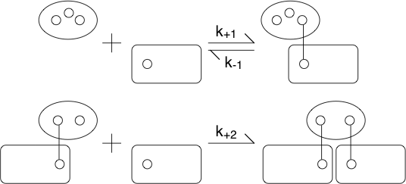
After the second round of rule application
Notes:
Content Slide Notes
“UNCLASSIFIED” marking of slides is not a security requirement and may be deleted from the Slide Master (View › Master › Slide Master). In general, slides should be marked “UNCLASSIFIED” if there is potential for confusion or misinterpretation of something that could be deemed classified. For guidance on marking slides containing classified and unclassified controlled information, see the Protecting Information Web site at http://int.lanl.gov/security/protectinfo/.

Slide 32
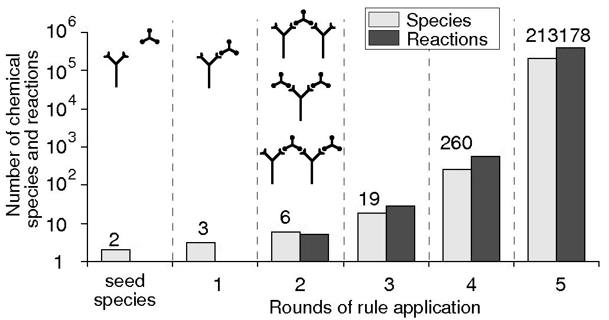
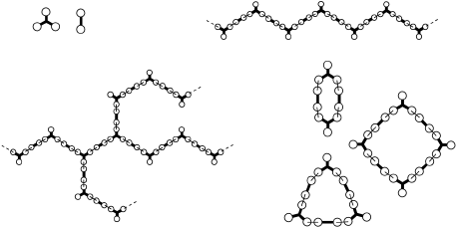
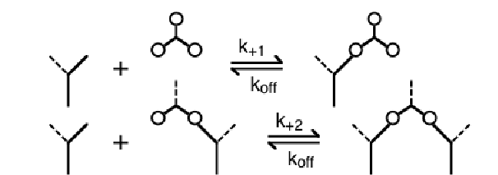
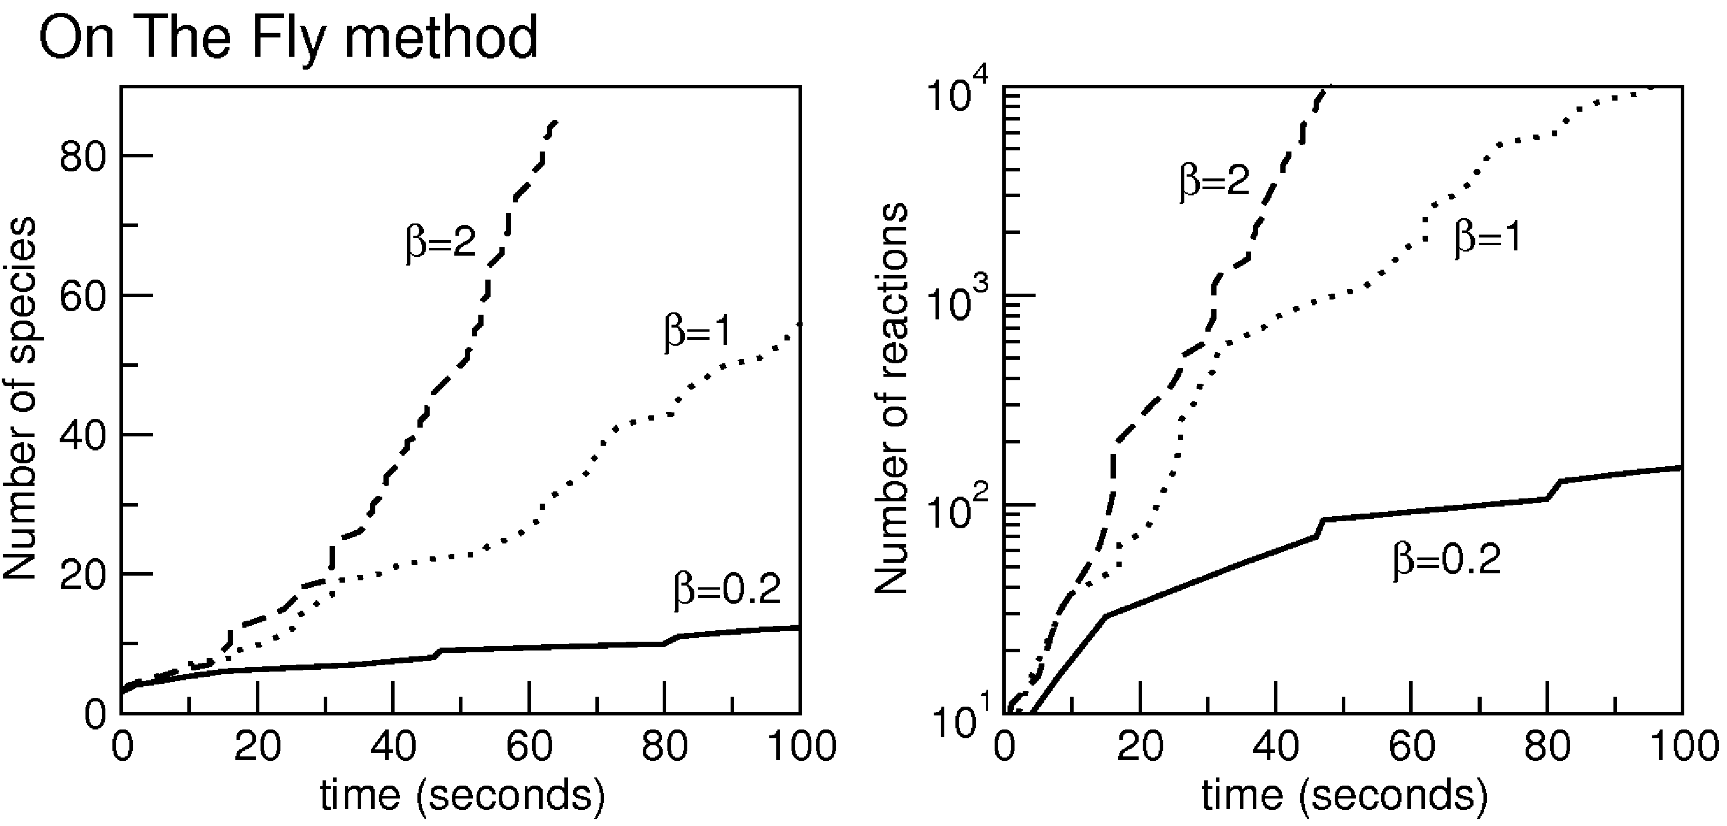
Rule-derived network can be too large to simulate using conventional population-based methods

