Slide 1
Using Ultrashort Optical Pulses to Unravel the Interplay Between Different Order Parameters in Strongly Correlated Systems
Rohit Prasankumar
Center for Integrated Nanotechnologies, Los Alamos National Laboratory
Notes:
Thank organizers for invitation. Outline: 1-2 slides on CEMs in general. Then talk about how UOS has been useful in probing the physics of these systems over the past ~15 years, but that the vast majority of these experiments have used all-optical p-p spectroscopy. This has been surprisingly insightful, resulting in quite a few PRLs, etc., but one might reasonably expect that using more selective optical techniques that directly access certain order parameters/DOF could give a lot more insight on CEM physics. These techniques have already begun to be applied to more standard CEMs like superconductors, VO2, and manganites, but there are many other classes of materials that would benefit from such approaches. So here, I will give them some overview of multiferroic and HF materials, and then start by discussing our all-optical p-p experiments on these systems. Then I will point out some unresolved issues in these classes of materials on which more advanced UOS techniques could shed some light, and our ideas/preliminary results for moving in this direction. This would start with our SHG/TR-SHG experiments on BSTO/LCMO and maybe include our all-optical experiments on YBCO/SMO (motivating other experiments, like THz), and then include a slide or two on potential other multiferroic experiments, some of which us and other groups are working on (e.g., intense THz pumping of electromagnons and soft mode phonons, pumping/probing magnons (Nphot on NiO, Pam’s work), Kerr probing, etc.) and some directions which haven’t been explored yet (e.g., TR-ARPES, TR-XRD on multiferroics). Then we could describe how HFs are even more open, showing our preliminary SHG on SmB6 results and maybe UO2 results, and go off the proposal for more ideas. It’s worth mentioning at some point how we have to study problems relevant to traditional condensed matter physicists, and continue making the case that our experiments can reveal information that other approaches simply can’t (e.g., unraveling coupling between order parameters in the time domain, revealing non-thermally accessible hidden phases, using light to control matter on timescales that are inaccessible with traditional methods (maybe use Nature attosecond papers on dielectrics here)). Make sure to mention UOM too, since one can imagine doing spatiotemporally resolved experiments on domains in CEMs.

Slide 2
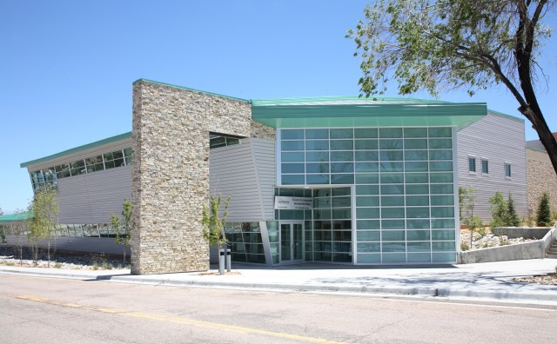
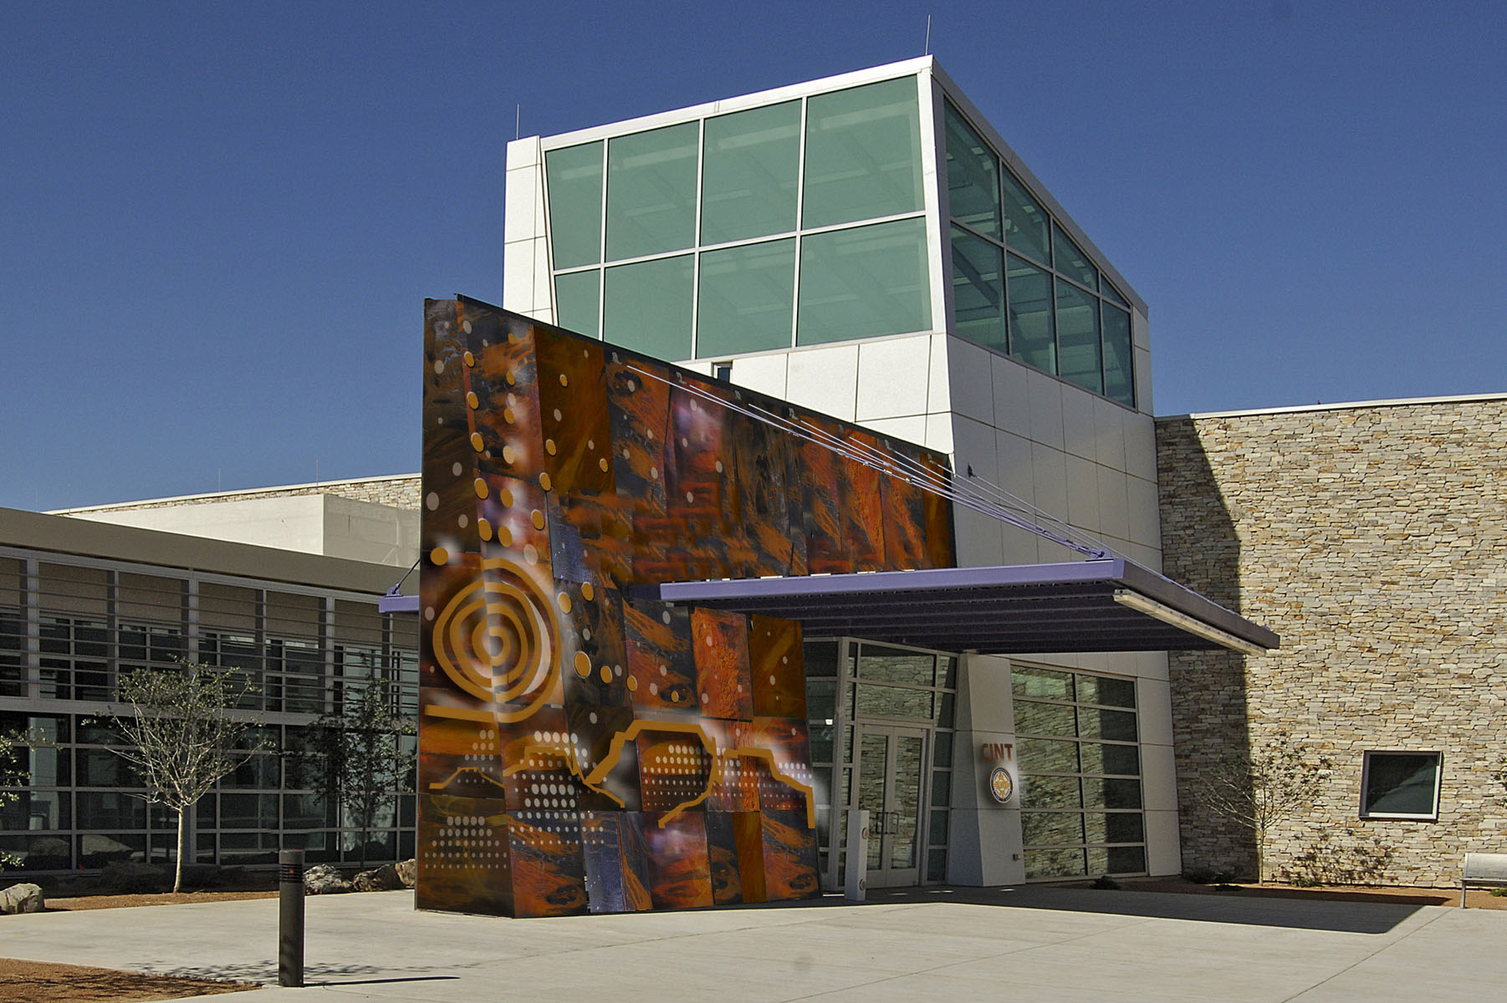
Acknowledgments
P. Bowlan
Y.-M. Sheu
P. Padmanabhan
J.-X. Zhu
D. A. Yarotski
S. A. Trugman
L. Yan
Q. X. Jia
A. J. Taylor
J. Qi
N. Hur
S.-W. Cheong
J. Yoo
Notes:
Acknowledge LDRD support

Slide 3
Open questions in SCES
Despite the intense attention devoted to strongly correlated electron systems over the past few decades, there are still several unanswered questions:
  Pairing mechanism in high-temperature superconductors
  Nature of the metal-insulator transition in various SCES
  Interplay between magnetism and coherence in heavy fermions
  Optimizing the strength and operating temperature of magnetoelectric coupling in multiferroics
Traditional approaches have not been able to definitively resolve these issues
Can ultrafast optical spectroscopy (UOS) shed new light on these questions?
J. Orenstein, Physics Today (2012)
D. Basov et al, Rev. Mod. Phys. (2011); J. Zhang and R. D. Averitt, Annu. Rev. Mater. Sci. (2014)
Notes:
Make sure to mention interplay of SC with other phases, like CDW, and also refer to Ni’s talk here and later

Slide 4
Previous Ultrafast Optical Experiments on Correlated Electron Materials
Ultrafast optical spectroscopy can unravel the interplay between various degrees of freedom at the fundamental timescales of electronic and nuclear motion
Optical pump-probe experiments on YBCO
(J. Demsar et al., Phys. Rev. Lett. (1999))
Uncovering gaps in the superconducting heavy fermion material PuCoGa₅ (D. Talbayev et al., Phys. Rev. Lett. (2010))
Observation of optical and acoustic phonons in LCMO (D. Lim et al, Phys. Rev. B. (2005))
Early experiments focused on all-optical pump-probe spectroscopy of CEM: can the sophisticated UOS techniques developed in recent years give more insight into their physics?
R. D. Averitt and A. J. Taylor, JPCM (2002); J. Demsar, et al, JPCM (2006)

Slide 5
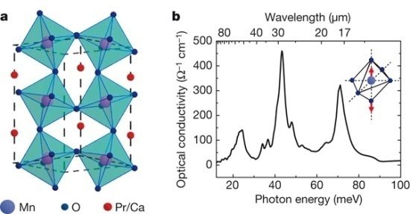
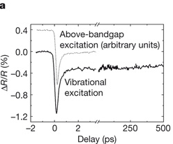
Novel Ultrafast Optical Experiments on Complex Oxides
Mn-O
Driving an IMT in PCMO with mid-IR pulses (M. Rini et al., Nature (2007))
Controlling magnetism with circularly polarized pulses of light (A. V. Kimel et al, Nature (2005))
Quantum criticality in heavy fermion materials
C. Wetli et al, Nature Phys. (2018)
Selectively photoexciting and probing specific degrees of freedom in correlated electron materials can shed more light on their intrinsic properties
Notes:
Need to say that these experiment have primarily been applied to canonical materials like HTSC, VO2, manganites so far, so the potential for doing this with multiferroics and heavy fermions is high. Possibly add a slide before this on simple p-p experiments with CEMs to lead into this one, then we can say that very few of these techniques have been applied to multiferroics/HF; initially, when we started working on this we started with simple p-p experiments on canonical materials, and only recently has the understanding been there to start pushing in new directions to selectively photoexcite and probe multiferroics/HF.

Slide 6
Overview
Ultrafast optical techniques have been used in recent years to provide more insight into, and even control, the properties of correlated electron materials
Many of these techniques have been applied to superconductors, manganites, or vanadates, but there are many other opportunities to apply them to outstanding problems in strongly correlated systems:
  Bulk and heterostructured magnetoelectric multiferroics
  Strongly correlated transition metal dichalcogenides (TMDs) with competing order parameters
Highlights from our recent work:
  Probing antiferromagnetic spin dynamics through a THz magnon resonance in HoMnO₃
  Using ultrashort optical pulses to couple FM and FE order in an oxide heterostructure
  Ultrafast optical pump-probe spectroscopy of the TMD NbSe₂
Notes:
Important to emphasize that at least at LANL, we have to do things that are relevant to traditional CMP

Slide 7
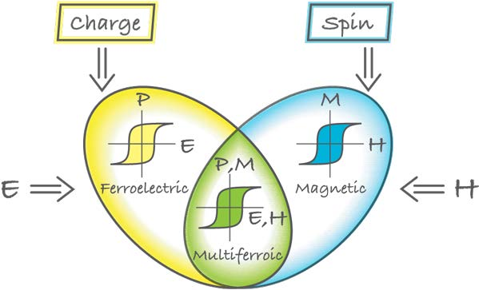
Magnetoelectric multiferroics
Magnetoelectric (ME) multiferroics: simultaneous existence of ferroelectric (FE) and magnetic order in a single material
D. Khomskii, Physics (2009)
  Potentially control FE order with H field or magnetic order with E field
  Great potential as multifunctional devices that enable applications in areas such as fast ME switching, novel memory media, and photovoltaics
S. Dong et al, Adv. Phys. (2015); M. Fiebig et al, Nat. Rev. Mat. (2016); N. Spaldin, MRS Bulletin (2017)

Slide 8
Magnetoelectric coupling in bulk multiferroics
Bulk multiferroics have different mechanisms for ME coupling
  BiFeO₃: coexisting weakly coupled AFM and FE orders at room temperature
  TbMnO₃: strongly coupled AFM and FE orders at low temperatures (<30 K)
To date, bulk multiferroics still have not demonstrated strong enough values of ME coupling near room temperature to make them practical
TbMnO₃:
T. Kimura et al, Nature 426, 55 (2003)
BiFeO₃: J. Wang et al, Science 299, 1719 (2003)
Notes:
Add Physics Today review, any other more recent reviews

Slide 9
Complex oxide heterostructures
Novel phenomena can result from combining two different oxide layers in a heterostructure, potentially overcoming problems with bulk materials
S. M. Wu et al, Nature Materials (2010)

Slide 10
Shedding light on magnetoelectric coupling in multiferroics
How can we gain insight on the underlying mechanism for magnetoelectric coupling in a given multiferroic? What are the timescales governing ME coupling in these systems?
  Important both for fundamental understanding as well as for optimizing materials for device applications (e.g., dynamic ME switching)
Experimental approach: Selectively perturb one order parameter and examine the evolution of another order parameter in the time domain
  Ultrafast optical spectroscopy (UOS) allows one to do this with high temporal resolution
    Can use nonlinear optical processes (SHG, MOKE) to directly access magnetic and electric order parameters
    Terahertz (THz) pulses can be tuned to selectively probe low energy modes representing magnetic and electric order
Probe
SHG
Pump
FE
FM
Notes:
Could mention that it is important to develop new techniques for unraveling ME coupling in multiferroics

Slide 11
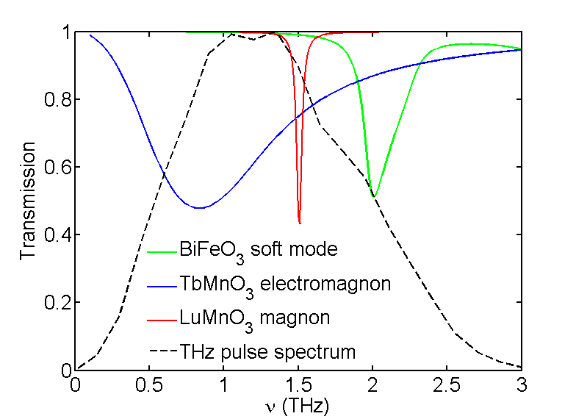


Ultrafast probing of material properties through low energy modes
Ultrashort THz pulses overlap with resonances through which magnetism or ferroelectricity can be probed or controlled
Kamba et al, PRB 75 (2007), Standard et al, PRB 85 (2012), Sushkov et al., PRL 98 (2007)
Notes:
We are working towards the bigger goal of controlling and observing the ultrafast evolution of a material’s properties, and specifically multiferroics which have simultaneous, coupled magnetic and electric dipole moments. Our approach is to do this through optically active low energy resonances. Some example are the soft mode phonons associated with the atomic displacements that result in ferroelectricity, or spin waves in magnetically ordered systems which can be either magnetic dipole active, in the case of the magnon, or electric dipole active in the case of electromagnons. In common multiferroics these modes often overlap well with the spectra of typical ultrashort THz pulses. The exciting thing about multiferroics is potentially using these modes for ultrafast magnetoelectric control. Here I will talk about probing spin dynamics through a magnon mode.

Slide 12
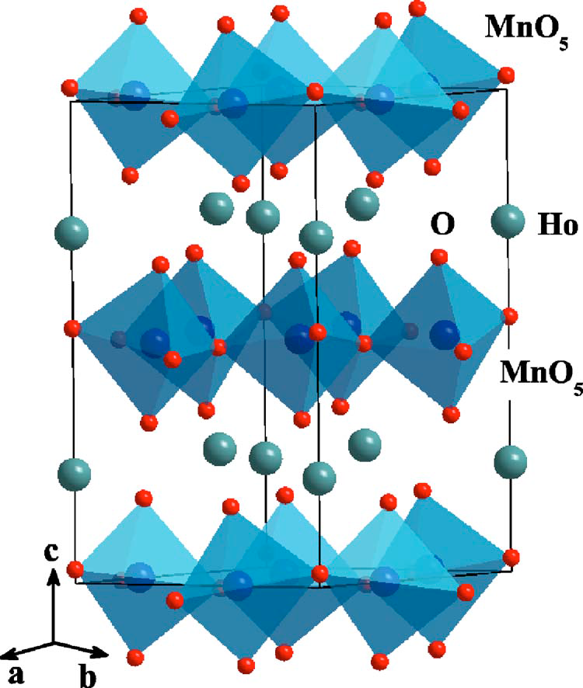
Multiferroic HoMnO₃
Hexagonal Lattice
T_{c} (FE) = 875 K
Frustrated antiferromagnet below T_{Néel}=78 K
z = 0, c/2
Mn³⁺
a
b
P6₃cm
T < T_{SR} = 42 K
P6₃cm
T < T_{Néel}
Fiebig, et al, JAP 91 (2002)
Rai, et al, PRB 75 (2007)
Notes:
We have been studying the hexagonal rare earth manganite HoMnO3. In its crystal structure the Mn3+ ions are in the center of corner sharing bipyramids of oxygen atoms forming layers. Above and below this are layers of Ho ions. Below 875 K the Ho ions alternate their c-axis coordinate and MnO5 pyramids tilt away from them forming a net polarization in each unit cell. The Mn3+ ions become antiferromagnetically ordered below 78 K where, due to their triangular lattice and frustrated exchange interaction, there are 120 degrees between each of the spins. Around 40 K the spins rotate by 90 degrees and at 8 K the Ho ions order along the c-axis.
“in the ferroelectric phase, R-ions alternate
their c-axis coordinates, producing a net electric moment
of the unit cell, and the MnO5 pyramids tilt away from
the c-axis.” from Rai et. al.
Transition temperatures
Spin waves
Optical absorption

Slide 13
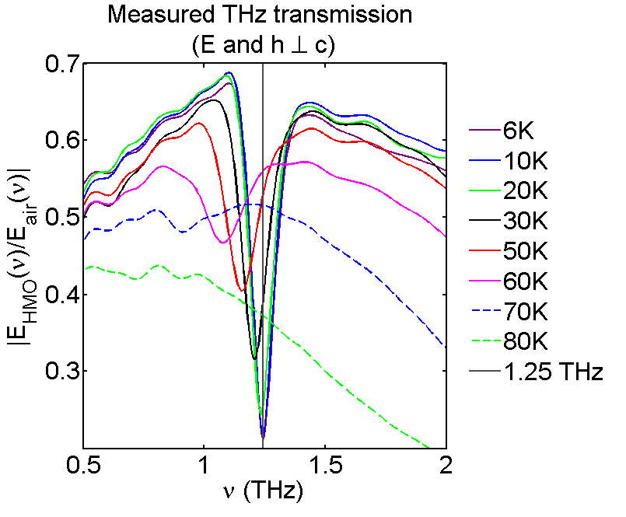
Steady-state THz transmission in HoMnO₃
a
b
Mn³⁺
As the temperature decreases, the restoring forces and order get stronger, so the magnon mode narrows and increases in frequency
P. Bowlan et al, Phys. Rev. B 94, 100404(R) (2016)
Notes:
First we measured the THz transmission to see the steady state magnon mode absorption. Note that we are exciting the spin waves with the h-field of our THz pulses. The magnon absorption shifts to lower frequencies and broadens as the temperature increases since the restoring force, which is the exchange interaction becomes weaker. The mode is no longer apparent at 80 K.

Slide 14
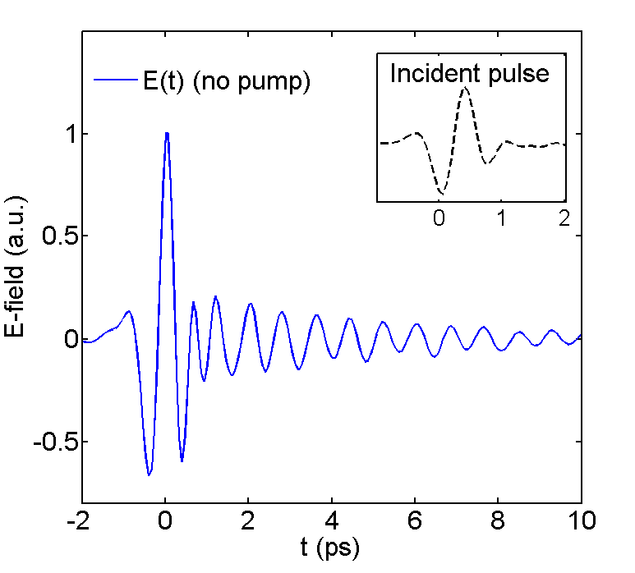
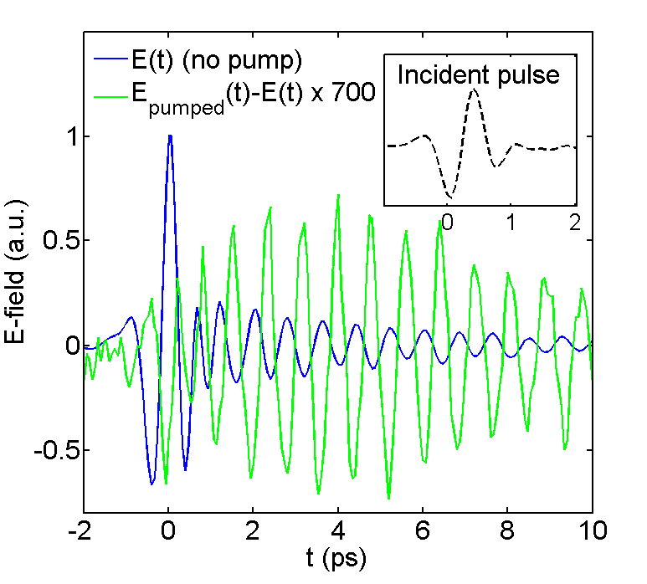
Photoexciting HoMnO₃ modifies the magnon
10 K
Photoinduced changes occur primarily at the magnon resonance, allowing us to track energy transfer from photoexcited electrons to magnons through changes in the line shape
P. Bowlan et al, Phys. Rev. B 94, 100404(R) (2016)
Notes:
The blue curve shows the transmitted THz E-field through the HMO crystal at 10 K. The oscillations after the pulse are due to the magnon absorption line. Next, we optically excited the HoMnO3 with 2 mJ/cm² pulses at 800 nm which arrived 100 ps before the THz probe pulse. At this photon energy we excite on-side d-d transitions in the Mn3+ions. The green curve shows the difference in the transmitted THz E-field due to the optical pump which occurs primarily where the oscillations from the magnons are. Or if we Fourier transform both the transmitted E-field and the difference due to pumping, we see that the difference occurs where the magnon absorption is. Optical pumping slightly reduces the magnon absorption. Unlike most optical-pump, THz-probe experiments, we do not see a significant free carrier response, which would occur across the entire THz pulse spectrum.
Here, it could be helpful to put a schematic or figure from another paper showing a typical Drude response at THz frequencies. Maybe you could include an animation that goes over the on-site d-d transition figure on the right.
How would a free carrier response vary with temperature?

Slide 15
Optically induced transparency vs delay
The signal slowly rises over 5-12 ps. Its amplitude decreases with temperature (consistent with heating), and it is gone by T_{N}
P. Bowlan et al, Phys. Rev. B 94, 100404(R) (2016)
Notes:
These plots show the delay dependence of the photo-induced transparency at the magnon resonance choosing a point in time (i.e. the gate delay) where this difference was maximal. We see a slow onset which by 40 ps was constant (within our noise level) out to the 400 ps delay that we measured to. At higher temperatures, the rise is faster. The amplitude decreases with increasing temperature which is expected since the heat capacity and reflectivity also increase with temperature. Since the pump-induced effect is only at the magnon resonance, the signal is gone by TNeel. Across the 20 ps rise time the spectrum of the photoinduced difference does not change, only its amplitude.
Our measurements are consistent with a pump-induced heating. For example, increasing the pump fluence at 10 K from 2-6 mJ/cm^2 results in a faster decay time as shown by the orange curve.

Slide 16
Photoinduced changes in magnon line shape
Photoinduced changes in the magnon line shape are consistent with spin heating through thermalization with phonons
P. Bowlan et al, Phys. Rev. B 94, 100404(R) (2016)
Notes:
This is also seen in the fluence and temperature dependence of the photoinduced magnon changes.
Lattice heating ~18 K
Fixing the fluence and increasing the sample temperature the difference spectrum broadens. This is because the magnon resonance broadens with increasing temperatures, so the photoinduced changes happen over a broader frequency range. At low fluences pumping only slightly decreases the amplitude of the magnon absorption, since 1 mJ/cm2 is only about ½ K of heating according to heat capacity measurements. As the pump fluence increases it shifts the magnon to a lower frequency resulting in the double peak in the difference spectrum.

Slide 17
Spin-lattice thermalization in AFMs vs FMs
Averitt and Taylor, et al, JPCM (2002)
The spin-lattice thermalization time decreases with temperature in AFM HoMnO₃
Previous measurements on FM manganites reveal that τ_{SL} follows the magnetic specific heat
Differences in spin-lattice thermalization between AFM and FMs:
  In AFMs, phonons directly modulate the exchange interaction by changing spin separation
  In FMs, spin-lattice thermalization is mediated by spin-orbit coupling due to spin conservation
Terahertz pulses provide a simple, table-top way to track spin dynamics in antiferromagnetic manganites
P. Bowlan et al, Phys. Rev. B 94, 100404(R) (2016)
Notes:
Heating means that the electrons, spins and phonons are all at the same temperature. Or that much like the typical picture in manganites, the spins get energy from the electrons via the hot phonons, and the rise time of our THz probe signals is the amount of time that this takes. The temperature dependence of this rise time further supports the phonon mediated transport of energy from electrons to spins, since at higher temperatures the spins heat up more quickly because there are more excited phonons for them to gain energy from.
In AFMs, lattice vibrations can directly change spin-lattice coupling by changing the separation between spins, which in turn changes the exchange interaction J(r); this is possible since both the ground and excited states have zero spin, while in FMs the excited state has lower spin so this can’t directly modulate the spin since the Hamiltonian has to conserve spin.
Mention that we see similar phenomena in TbMnO3

Slide 18
Using SHG to directly probe FE order
Second harmonic generation is a more direct probe of ferroelectric order than optical reflectivity/transmission
  SHG originates from broken crystal inversion symmetry, which exists in all FE materials
Measure signal as function of incident and SHG polarizations to determine crystal symmetry, nonlinear optical/piezoelectric coefficients
M. Fiebig, et al, JOSA B (2005); S. A. Denev et al, J. Am. Ceram. Soc. (2011)
Notes:
(incident light, SHG)=(s,p) or (45, s)
The two equations describe measured intensity in each of these SHG polarizations (p or s) as a function of the incident light polarization.

Slide 19
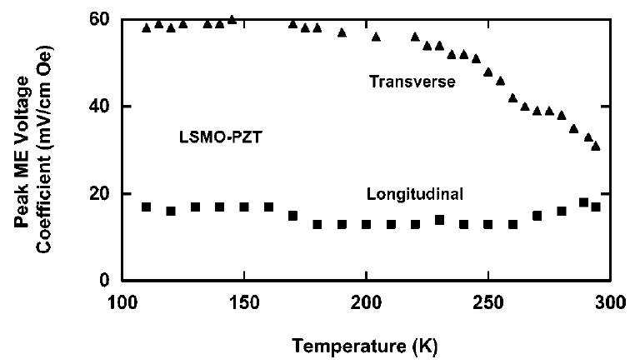
Femtosecond time-resolved SHG in BSTO/LCMO bilayers
Strain-based ME coupling has previously been demonstrated in FE/FM heterostructures
  External B field modifies magnetostriction in FM layer, affecting FE polarization
Can we use femtosecond optical pulses to couple FM and FE order in a similar manner?
Optically modify FM order in LCMO and track associated changes in FE order in BSTO with time-resolved SHG
G. Srinivasan, et al., Phys. Rev. B 65, 134402 (2002)
Probe
SHG
Pump
FE
FM
Y.-M. Sheu et al, Nature Communications 5, 5832 (2014)

Slide 20
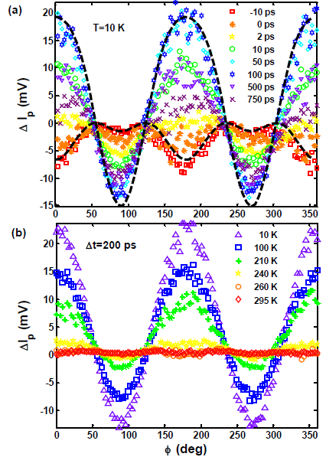
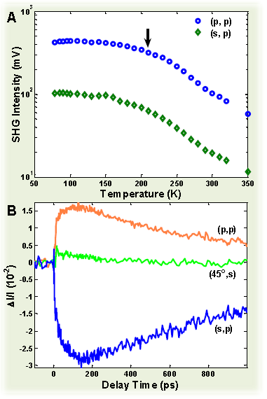
Non-thermal changes in SHG signal
Y.-M. Sheu et al, Nature Communications 5, 5832 (2014)
Notes:
Track evolution of p-polarized SHG signal as a function of incident light polarization for different time delays and temperatures
“Unipolar” change in I_{p} before t=0
Corresponds to a thermally induced change from residual heating
“Bipolar” change in I_{p} for t>0
Indicates that ΔI_{p} has a non-thermal origin

Slide 21
Concept for ultrafast interfacial ME coupling
thermal stress
after photoexcitation
ω
2ω
lattice contraction
through magnetostriction
s-l coupling
BSTO
P₀
P₂
LCMO
M₀
M₂
Δt < 0
Δt ~ 50 ps
heat dissipation
e-ph coupling
P₁
P₃
Femtosecond optical pulses induce a magnetoelectric response on an ultrafast timescale, potentially laying the groundwork for high speed optical-magnetoelectric devices
M₁
M₃
Δt ~ 1 ps
Δt > 0.5 ns
Notes:
Optically induced coupling demonstrated here is analogous to strain-based ME under external magnetic field
Temporal degree of freedom allows us to discriminate between different contributions to ME coupling (e.g., heating-induced lattice expansion vs. reduction in lattice contraction through magnetostriction)
Potential for coherent spin control to reduce timescale limiting ME coupling

Slide 22
Strongly correlated TMDs
H. Wang et al, Nature Comm. 8, 394 (2017)
X. Xi et al, Nature Nanotechnology 10, 765 (2015)
NbSe₂ is a strongly correlated transition metal dichalcogenide (TMD), with charge density wave ordering at T_{CDW}=33 K and superconductivity at T_{C}=7 K
  Transition temperatures change with layer thickness
Novel system for studying the interplay between these phases in the time domain
Notes:
Make sure to mention that this is analogous to systems like cuprates, in which the interplay between CDW and SC order is of great current interest. Also can mention that we’ve already heard about cuprates. Lots of work on the interplay between CDW and SC in NbSe2 over the years, but still not fully understood. Is pairing mechanism known? CDW believed driven by e-ph coupling. Refer to Ni’s talk.
Also mention that this hasn’t been studied yet w/pp, as far as we know

Slide 23
Conclusion
All-optical pump-probe experiments have provided much insight into the properties of correlated electron materials
More advanced UOS techniques enable selective photoexcitation and probing, shedding even more light into the intrinsic physics of these systems
  Probing a magnon mode in HoMnO₃ with THz pulses
  Using time-resolved SHG to manipulate ME coupling in a FE/FM heterostructure
  Examining interplay between CDW and SC phases in NbSe₂
Other techniques that could be applied to SCES:
  Using femtosecond x-rays to probe magnetic and structural order
  Time-resolved ARPES to examine quasiparticle dynamics and electronic structure changes throughout k-space
  Ultrafast nanoscopy to spatiotemporally resolve quasiparticle dynamics
P. Bowlan et al, Phys. Rev. B 94, 100404(R) (2016); Y.-M. Sheu et al, Nature Comm. 5, 5832 (2014)

