Slide 1
The APEX North Star Artificial Plasma Jet Experiment
R. E. Erlandson, P. K. Swaminathan, C. K. Kumar (JHU/APL),
B. G. Gavrilov, Y. Kiselev, J. I. Zetzer (Institute for Dynamics of Geospheres)
H. Stenbaek-Nielsen (University of Alaska/Geophysical Institute)
K. A Lynch (Dartmouth College)
R. F. Pfaff, Jr. (NASA/GSFC)
P. A. Delamere (LASP)
S. Bounds (University of Iowa)
N. A. Gatsonis (Worcester Polytechnic Institute)
12 Sept 2017
Active Experiments in Space: Past, Present and Future
Santa Fe, New Mexico
Notes:
Abstract
The objective of APEX North Start is to study the interaction of high speed plasma jets with the space environment at 350-400 km altitude. The experiment was launched from Poker Flats, Alaska on 22 Jan 1999. Two one-time use plasma jets were produced by an Explosive Type Generator (ETG), producing a jet of Al+ ions at speeds of > 10 km/s in the direction perpendicular to the magnetic field. In addition to in-situ measurements, ground and space based imaging and spectral sensor were used to observe the plasma jet dynamics. In this poster we summarize the experiment and highlight the observation of diamagnetic cavity and associated plasma waves associated with the jets.

Slide 2
APEX North Star Science Goals
Interaction of a high speed plasma jet with the atmosphere
  Ionization Mechanisms:
    CIV
  Neutral Ion Chemistry
  Excitation of Artificial Aurora
Interaction of a high speed plasma jet with the ionospheric plasma
  Jet Propagation & Neutralization
  Plasma Wave Generation
  Ion Heating & Acceleration

Slide 3
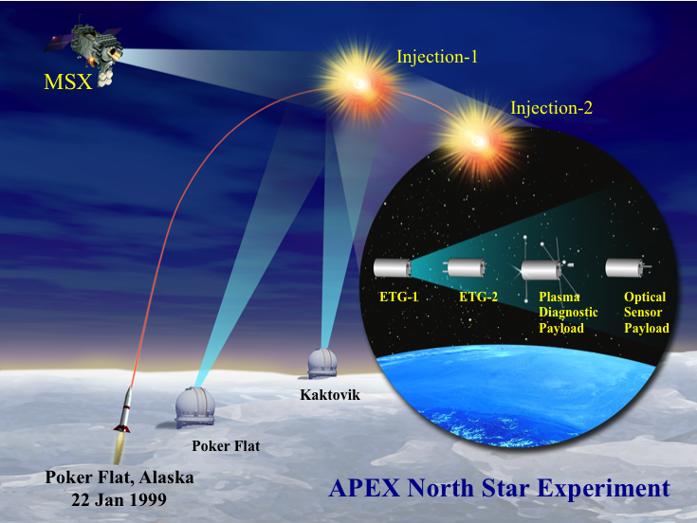
Notes:
This is an overview of the APEX North Star mission. The plasma jets were produced first on ETG-1 (Injection 1) and later on ETG-1 (Injection 2). The ETG-2, Plasma Diagnostic and Optical Sensor Payloads were instrumented with in-situ and remote sensing instruments. The MSX and ground based sensors were used to collect optical data on the plasma

Slide 4
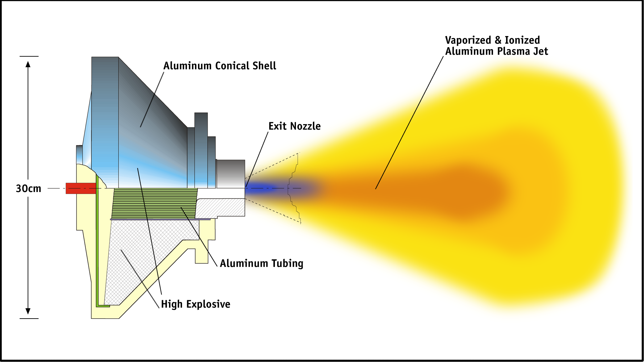
Plasma Jet Generator
ETG Parameters
Injection 1: 360 km (air)
Injection 2: 280 km (no air)
Jet Mass: 30 g
Jet Velocity: 8 -40 km/s
Jet Half Angle: 20 degrees
Notes:
Schematic of the Explosive Type Generator that produces the Al ion plasma jet.

Slide 5
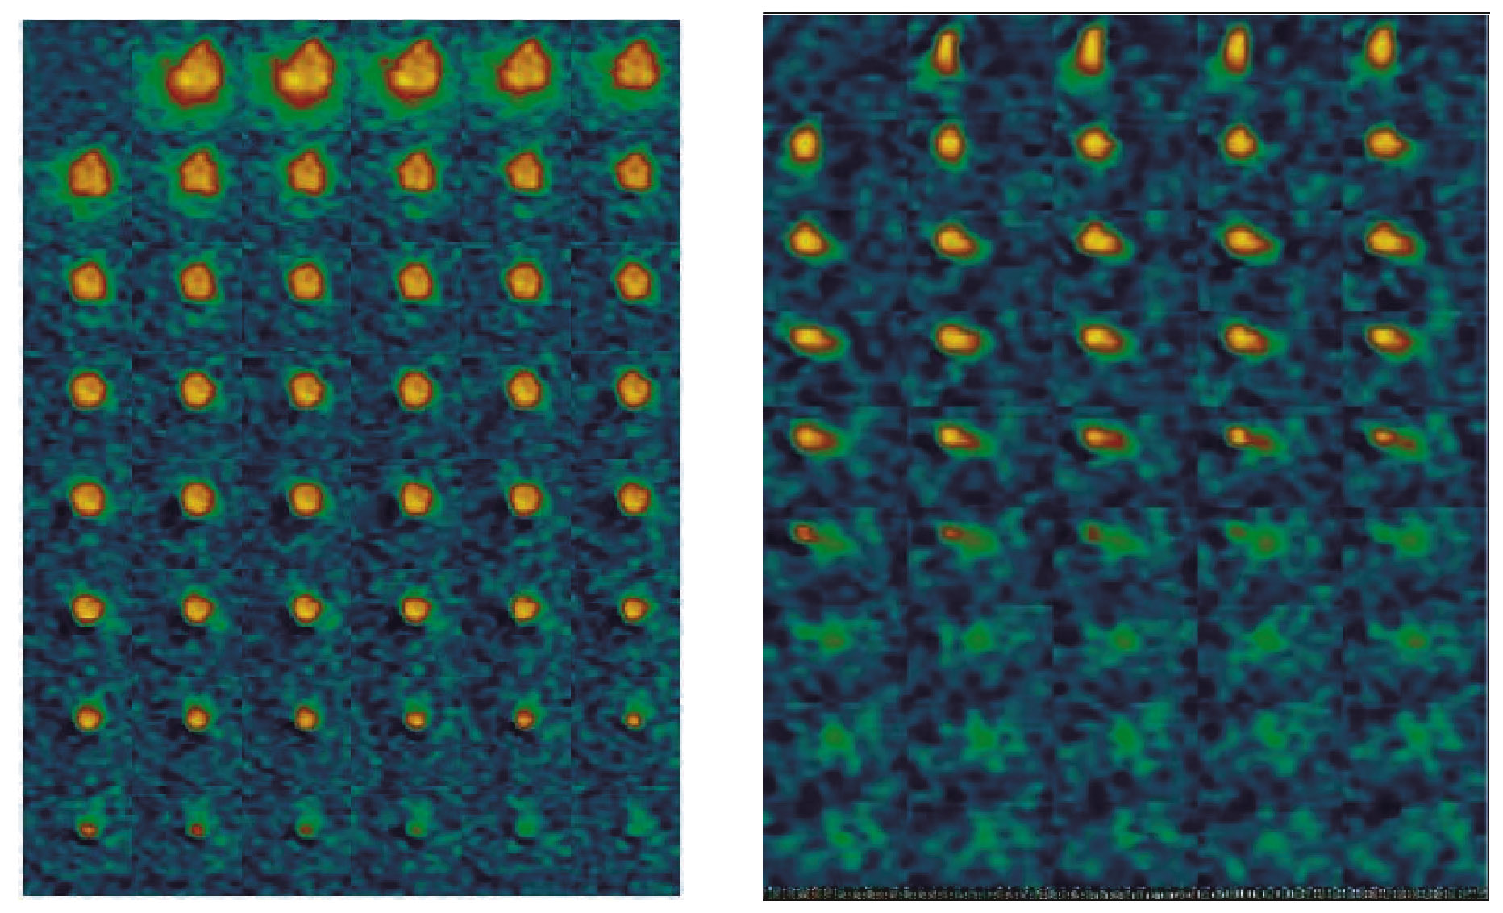
Ground Based 1 kHz Visible Imagery
ETG-1
ETG-2
Notes:
The luminosity of injection 1 was brighter than injection2. A striking difference between injections 1 & 2 is the change in direction observed during injection 2. It is possible that dynamics is associated with the motion of the jet across field lines during its “diamagnetic phase” followed by a deceleration as the jet becomes trapped on a field line (Gavrilov et al).

Slide 6
APEX North Star Sensors
1-2 km
0.5 km
0.2 km
Plasma Jet
ETG-1 Payload:
ETG
Magnetometer
ETG-2 Payload:
ETG
Langmuir Probes
Magnetometer
Photometers
Pyroelectric Sensors
Plasma Diagnostic Payload:
Ion and Electron Detectors
E & B Field Probes
Plasma Wave Receivers
Langmuir Probes
Photometer
Pyroelectric Sensor
Magnetometer
Optical Sensor Payload (OSP):
IR Radiometers (1-9 μm)
UV-Visible Photometers
UV-Visible Spectrograph
Langmuir Probe
Magnetometer
Ground Based Sensors
Ground Sites: Poker Flat and Kaktovik
Instruments:
  - High Speed Visible Photometers
  - Visible Imagery
  - Visible and Infrared Spectra
Sensor Providers
American
Russian
Notes:
This lists the instruments on the North Star Rockets and Ground Based Sensors.
The map shows the flight zones for BB XII (the rocket will be launch 4 degrees from north and land in the arctic ocean.

Slide 7
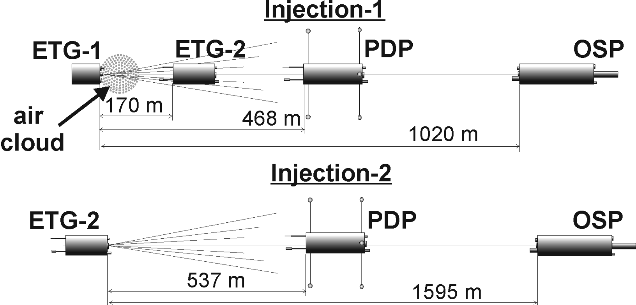
Payload Geometry
Notes:
Separation geometry at the time of Injection-1 and Injection-2

Slide 8
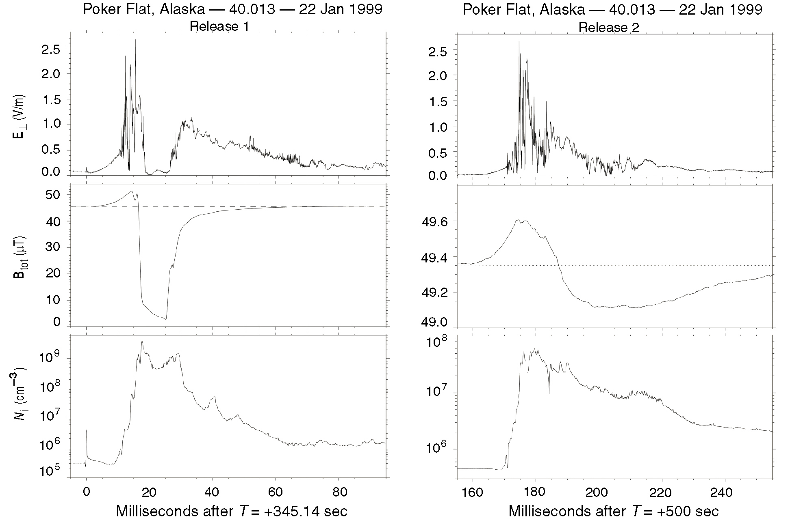
Plasma Jet 1 & 2 Comparisons
Notes:
Plasma Jet 1 & 2 Comparisons
The payload configuration associated with Injection 1 & 2. The electric field, magnetic field and plasma density are also shown above. The presence of the air cloud (0.012 kg) was found to enhance the jet’s plasma density and associated diamagnetic depression at the location of the PDP. High speed (1 kHz) ground based visible imagers looking roughly up the field lines captured the dynamics of the jet during injections 1 (left) and 2 (right).

Slide 9


Slide 10
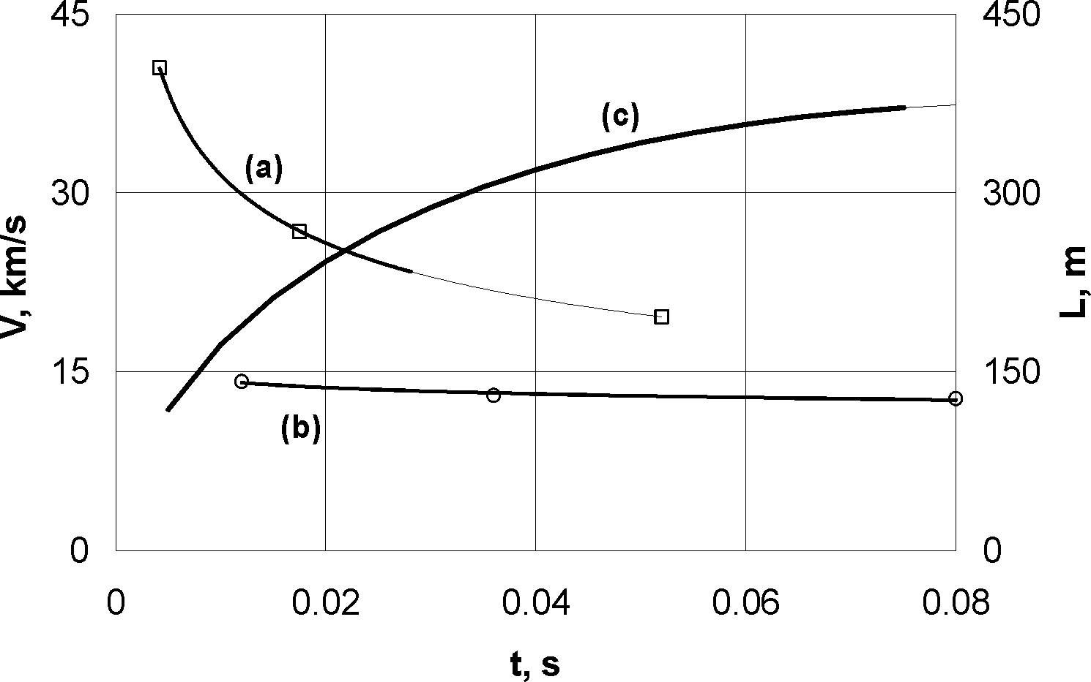
Plasma Cloud Velocity
Length
Velocity (Front)
Velocity (Trailing Edge)

Slide 11
Plasma Jet Velocity (ETG-1)
Method:
Jet velocity determined by
onset of diamagnetic cavity
observed at three different
payload locations. Injection
of jet determined by onset
of optical flash observed in
high speed photometer data.
Distance determined using
GPS data.

Slide 12
Ion and Electron Data: ETG-1
Notes:
The electron and ion data from the electrostatic analyzers on the PDP confirmed the passage of ion jet in the energy from from 15-150 eV (Lynch et al). An intense were observed as the jet reached the payload and then the detector saturated.

Slide 13
Mass Spectrum Derived From Ion ESA Time of Flight
Al+
O+

Slide 14
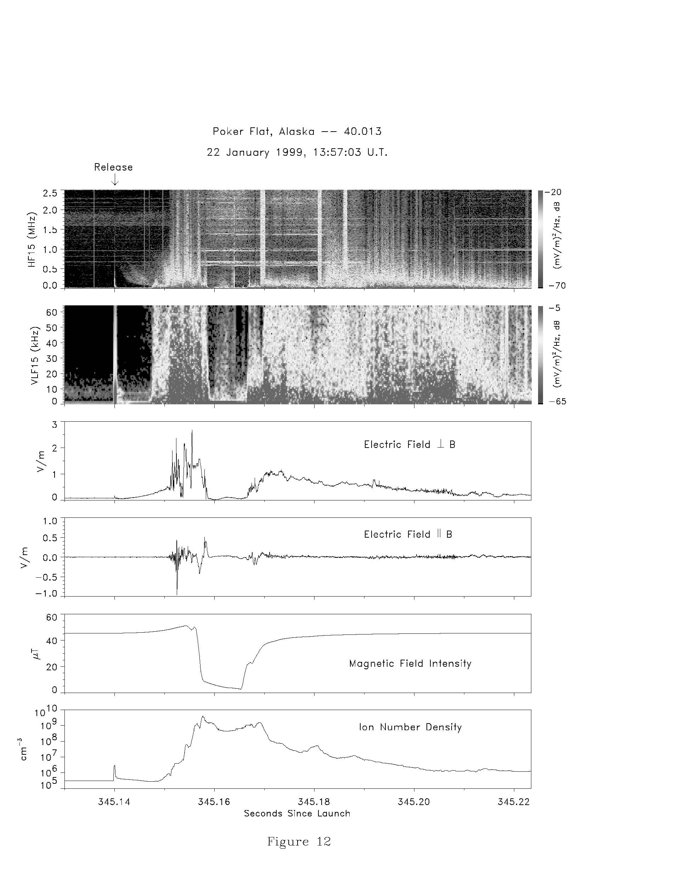
Plasma Waves /E-fields
Notes:
Intense plasma wave emissions were observed at the leading edge of the plasma jet which is the leading edge of the diamagnetic cavity.

Slide 15
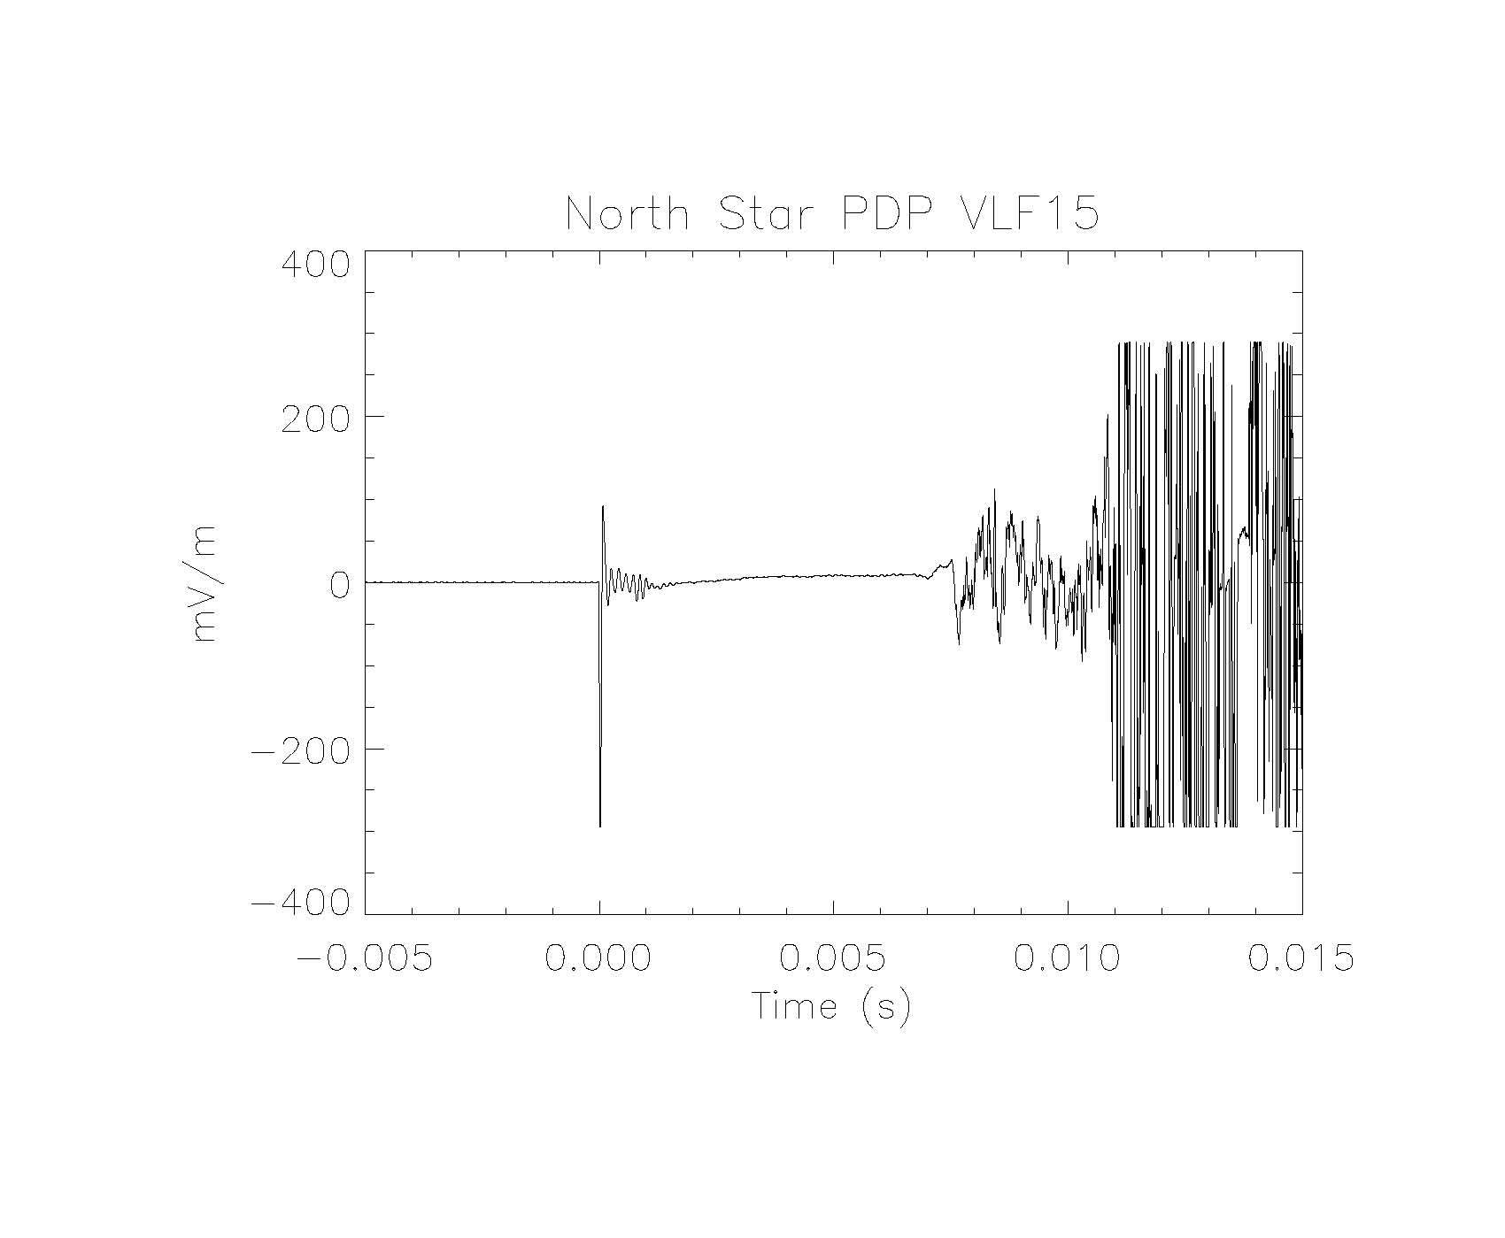
Injection-1: Wave Electric Field

Slide 16
Summary
APEX North Star Observations Contrast Jet Ionization in the presence of an “artificial air cloud” and in ambient conditions (280 km altitude).
Multi-Point Measurements Acquired That Document Jet Velocity Slow Down as a function of time (distance), allowing for detailed comparisons with model calculations
Spectral and High-Speed Optical Data Acquired, allowing investigation of neutral-ion chemistry of plasma jet - environment interactions.

Slide 17
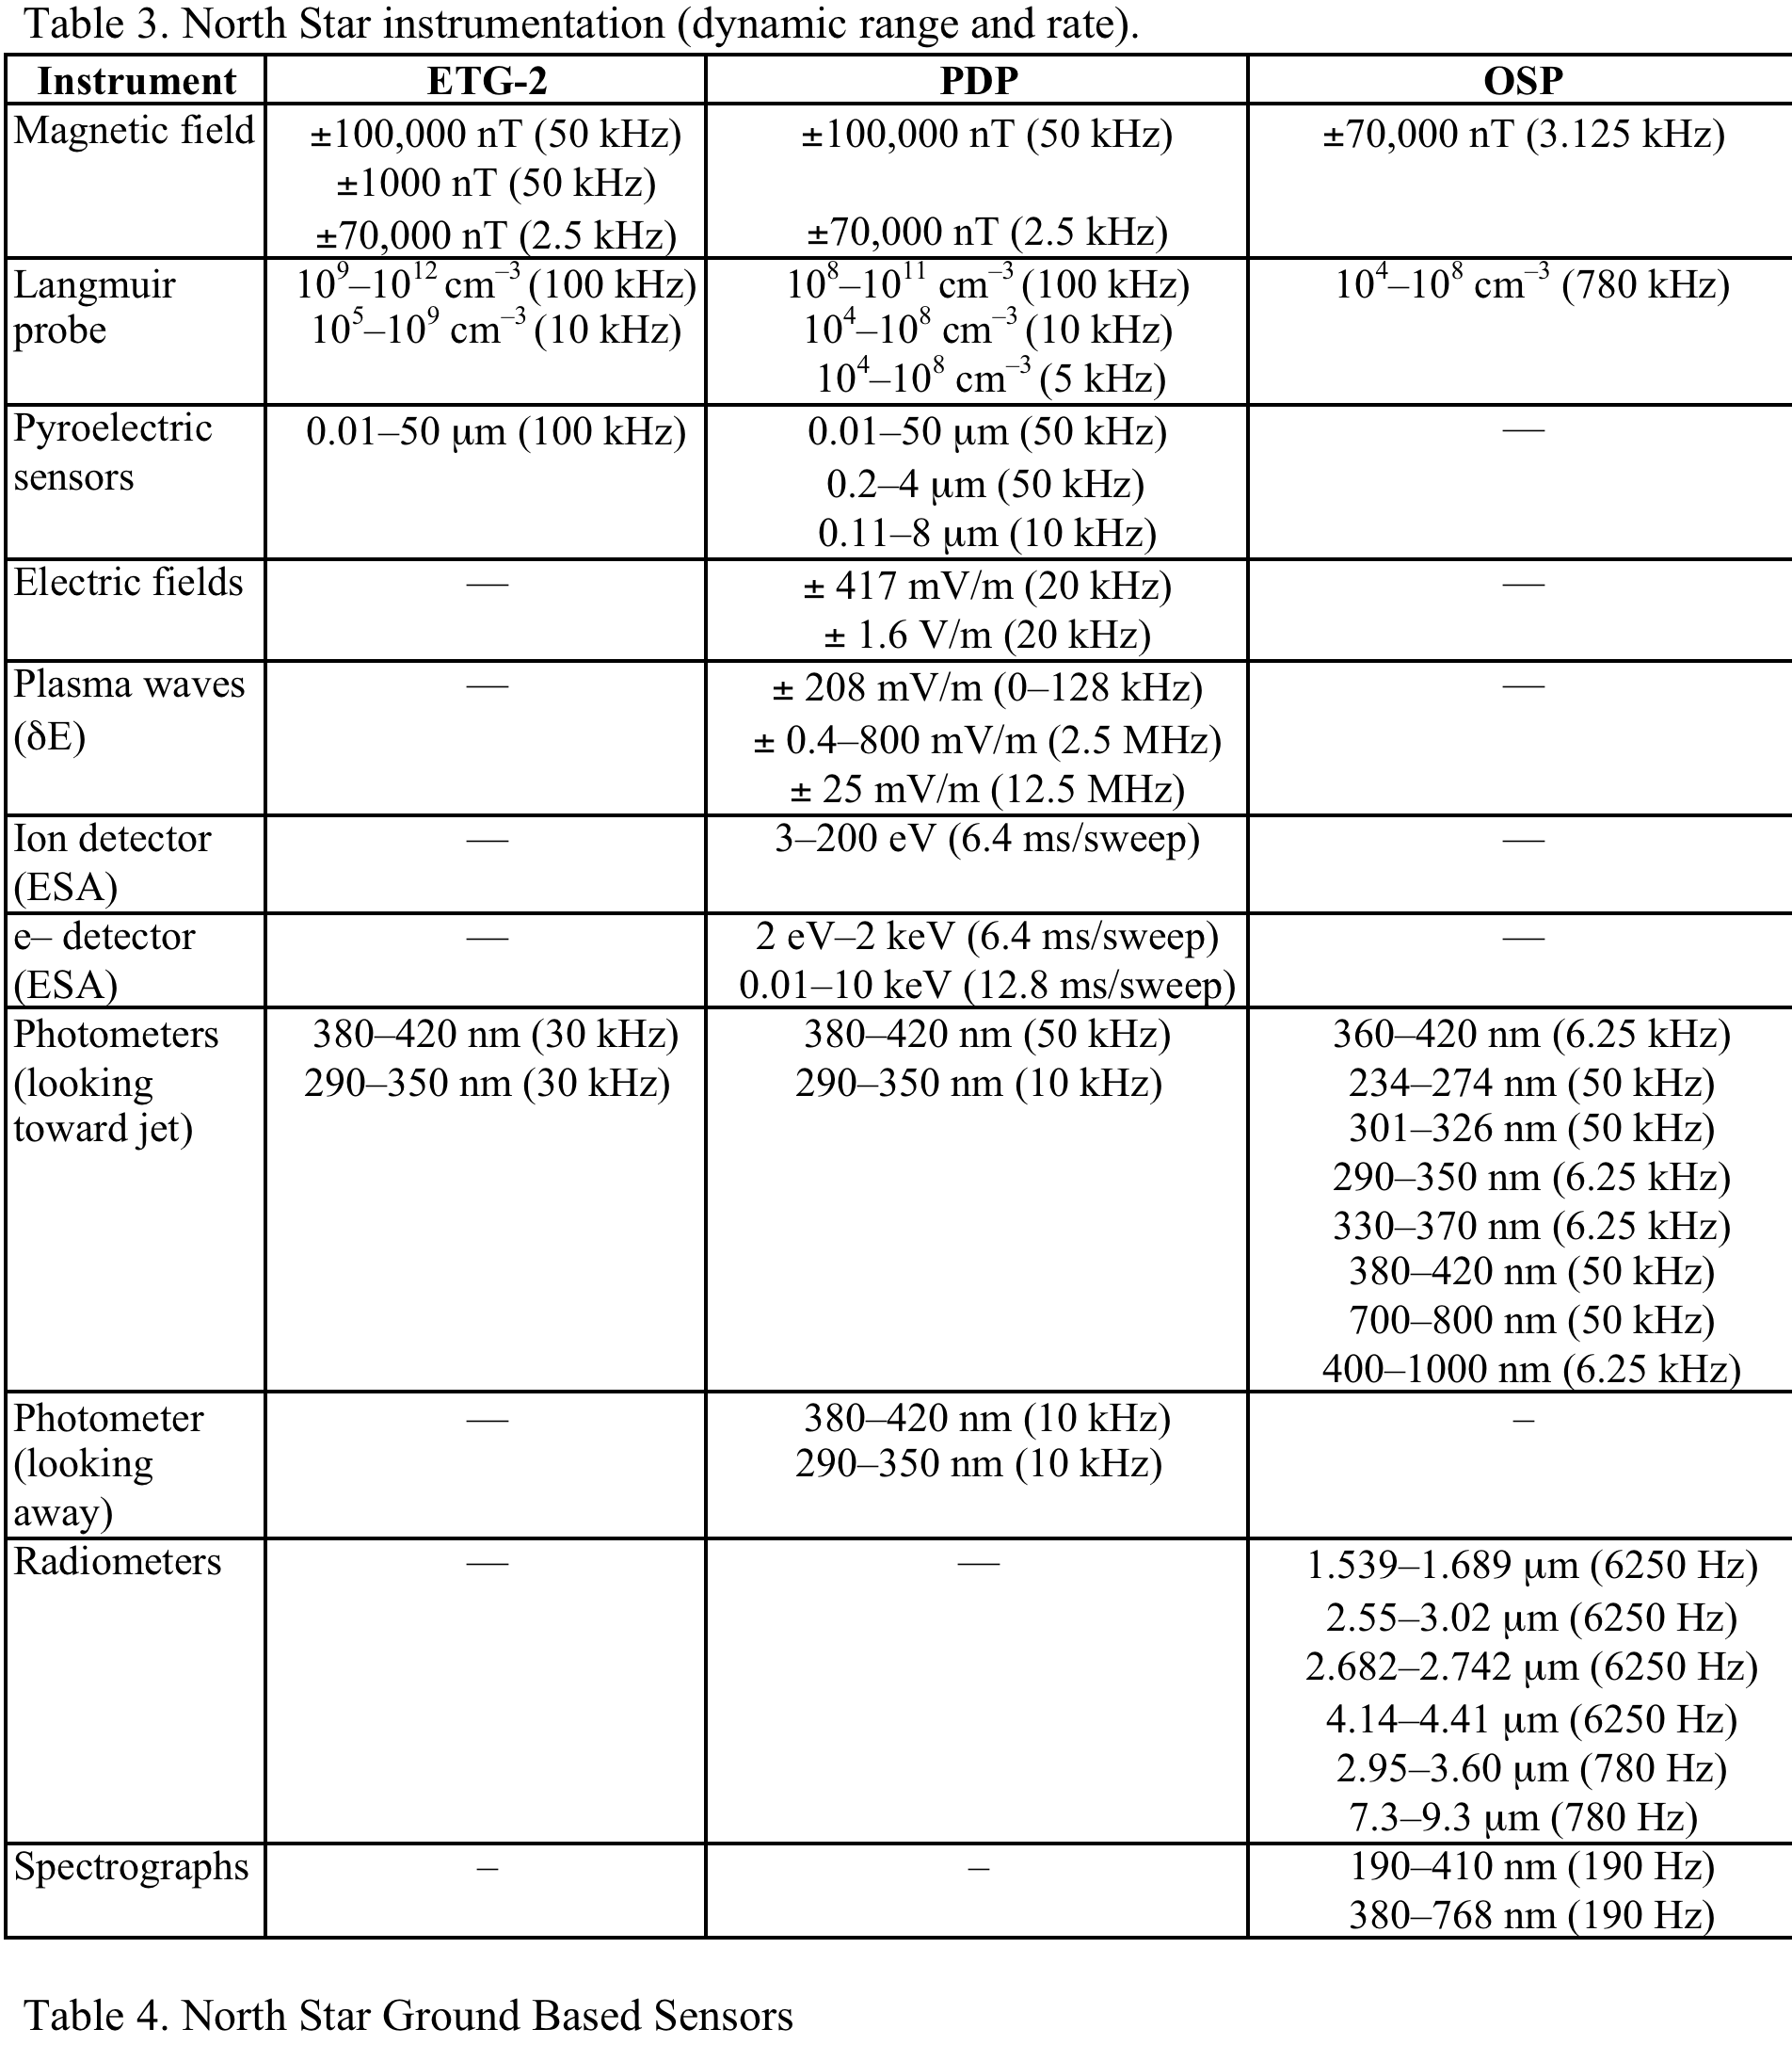
Instrumentation Summary
Notes:
Summary of instruments on the ETG-2, PDP and OSP payloads

Slide 18
The APEX North Star Artificial Plasma Jet Experiment
Robert Erlandson (JHU/APL)
Abstract
The Active Plasma EXperiment North Star mission was designed to investigate the dynamics and interactions of high-speed plasma jets in the high-latitude ionosphere. The artificial high-speed plasma jets produced during the North Star mission are relevant to plasma jets produced by electric propulsion thrusters, to electrodynamics associated with spacecraft tethers, and to advance spacecraft charging technologies. In addition, this experiment is relevant to the study of basic plasma physics problems such as momentum coupling between different plasma populations and how this coupling relates to the propagation of Alfven waves and electron acceleration. Specifically, the goals of the North Star mission were to address issues relating to the propagation of high-speed plasma jets across magnetic field lines, investigate the role of the neutral atmosphere in secondary jet ionization processes, and assess the Critical Ionization Velocity hypothesis.
The North Star mission was launched on 22 January 1999 at 1358:03 UT using a Black Brant XII sounding rocket from Poker Flat, Alaska (Figure 1). The experiment occurred just after an auroral breakup. The trajectory of the rocket crossed auroral arcs on its ascent prior to the execution of the two active plasma jet experiments. The plasma jets were produced using a device known as an Explosive Type Generator (ETG) and resulted in the generation of a high-speed jet of both neutral and ionized aluminum. The neutral aluminum is formed from the rapid recombination of aluminum ions formed at the time of the initial jet initiation. The jets were directed perpendicular to the magnetic field towards instrumented sub-payloads located 200 to 1500 m from the source. The plasma jets experiments occurred at altitudes of 360 km (ETG-1) and 280 km (ETG-2). A canister of compressed air was released prior to ETG-1 injection to simulate the neutral density at a 150-km altitude in the vicinity of the payload.
The North Star plasma jet papers reviewed in this introduction address diverse topics, such as plasma jet electrodynamics, plasma jet magnetic field perturbations, plasma jet propagation and neutralization, optical signatures of the plasma jet, and the Critical Ionization Velocity (CIV) theory.
This presentation will include an overview of the North Star mission and a review of the findings, and they discuss the high-speed optical measurements of the high-speed aluminum plasma jet injection. The emissions were dominated by line emissions due to neutral aluminum and a continuum thought to be from hot (1500 to 2000 K), micron-sized debris. The timing from detectors viewing the jet and looking away from the jet confirms an average jet speed of 20 to 25 km/s during the first tens of milliseconds. This is consistent with the in situ measurements that indicate similar speeds associated with the core of the jet.
Notes:
Abstract from:
An Introduction to the North Star Active Plasma Jet Space Experiment
Robert. E. Erlandson and Ching-I Meng
The Johns Hopkins University Applied Physics Laboratory, Laurel, MD 20723
Julius I. Zetzer
Institute for Dynamics of Geospheres, Moscow, Russia
Assistant Group Supervisor, Space Department, 11100 Johns Hopkins Road, Member AIAA.
Branch Supervisor, Space Department, 11100 Johns Hopkins Road.
Deputy Director, 38 Leninsky Prospect, Building 1.

