Slide 1
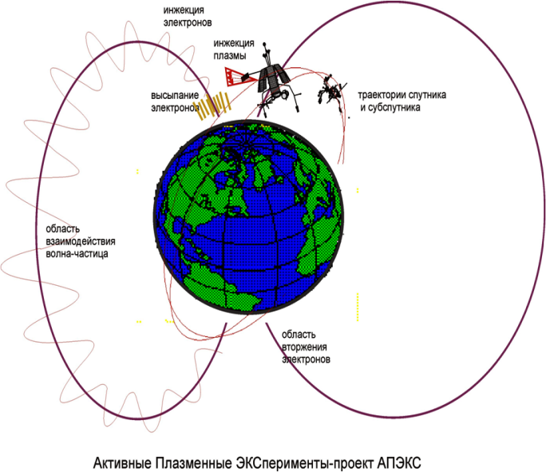
Overview OF APEX PROJECT RESULTs
АПЭКС = Активные Плазменные ЭКСперименты
(Active Plasma EXperiments 1991-92)
Lubomir Prech, Charles University Prague
with contributions of Yuri Ya. Ruzhin, Vladimir S. Dokukin (IZMIRAN),
and Zdenek Nemecek (Charles University Prague)
Active Experiments in Space: Past, Present and Future. Santa Fe, September 12th, 2017

Slide 2
Outline
APEX project introduction
APEX scientific goals
IK-25 and MAGION-3 payload
Active experiment methodology
Results overview
Spacecraft charging and neutralization during active emissions
Beam-plasma interaction
Plasma environment in the IK-25 s/c vicinity, diamagnetic cavity
ULF/VLF waves generation
HF wave generation
Ionosphere heating experiment
Distant observations
Energetic particles
HF waves
Summary and concluding remarks
Publications on APEX active experiments

Slide 3
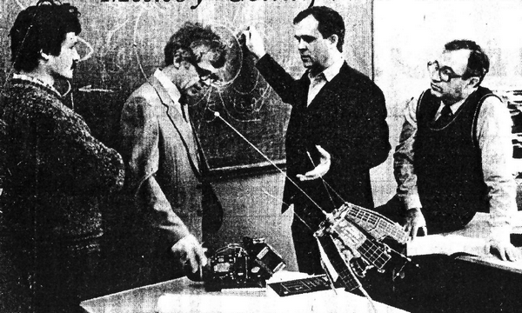
APEX project origin
International experiment in frame of the INTERCOSMOS science program suggested by IZMIRAN – Pushkov Institute of Terrestrial Magnetism, Ionosphere and Radio Wave Propagation of the Russian Academy of Sciences, Troitsk, Russia, and Geophysical Institute of Czechoslovak Academy of Sciences, Prague, CR (now Institute of Atmospheric Physics of Czech Academy of Sciences) in mid 1980’s
The project followed previous Soviet/international active experiments with sounding rockets and satellites (Stereoskop, Porcupine, Trigger, ARAKS, Zarnica, Active), this time in mother-daughter configuration and with wide international payload (Russia, Ukraine, Czechoslovakia, Poland, Rumania, Bulgaria, Hungary, eastern Germany)
The project consists of
INTERCOSMOS-25 mother s/c - AUOS-Z-AP-IK bus (KB Yuzhnoe, Dnepropetrovsk, Ukraine)
MAGION-3 subsatellite (IAP Prague, Czech Republic)
Launch Dec. 18, 1991 from Plesetsk
IZMIRAN Laboratory of Active Experiments in Space – Dr. Bershadsky, Dr. Dokukin, Dr. Ruzhin, and Prof. Blaunstein concepting the APEX experiment (Photo: Y. Ruzhin)

Slide 4
APEX mission primary science objectives
Oraevsky and Triska, ASR1993
Study of the dynamics and relaxation of modulated electron and plasma jets artificially injected into near-Earth plasma
Study of the low-frequency and MHD waves generation by heavy ions in the ionosphere
Determination of the radio emission generated by modulated beams of charged particles
Search for non-linear wave structures of the electromagnetic soliton type in a disturbed plasma environment
Study of the process of neutralization and dynamics of spacecraft charging
Study of the nature of the electrodynamic relationship between electromagnetics waves in the magnetosphere and ionosphere
Study of optical and radio emission in the auroral region
Passive mode observations – ionospheric plasma profiles under different conditions, auroral precipitation dynamics, mapping and dynamics of polar cusps
APEX project PI: Victor N. Oraevsky, IZMIRAN, Troitsk, Russia
MAGION-3 satellite PI: Pavel Tříska, IAP Prague, CR

Slide 5
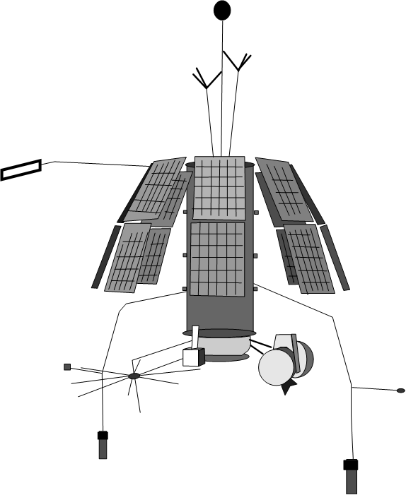
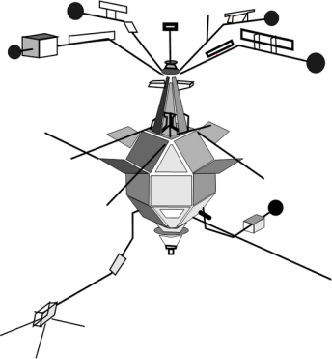
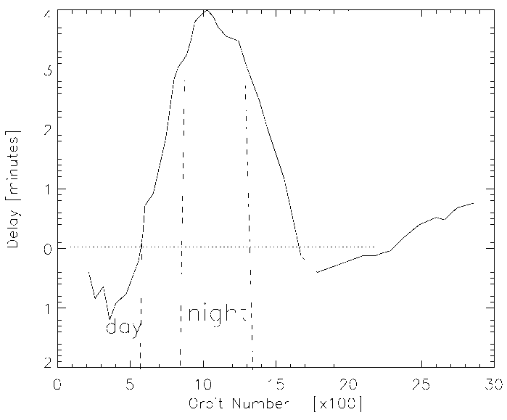
APEX orbit
(Figs: courtesy of IZMIRAN)
Initial parameters of the polar orbit after launch (Dec. 18, 1991): apogee 3080 km, perigee 440 km, inclination 82.5° , orbit period ~2 hours
MAGION-3 separation Dec. 28, 1991, drifting away ~ 5km/day, after several corrections -580 to +1900 km relative distance
~200 active experiments – Dec. 1991 – Jul. 1992 at distance 70-500 km
Planned measurements in near (>10 m – 0.4 km) and mid (~1 - 10 km) zones could not be performed for technical reasons
Two-point passive measurements at distances 100-2000 km till MAGION-3 EOL in Aug. 1992
IK-25 EOL after Jul. 1993
IK-25 to MAGION-3 delay on orbit
1920 km
-580 km

Slide 6
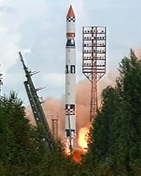
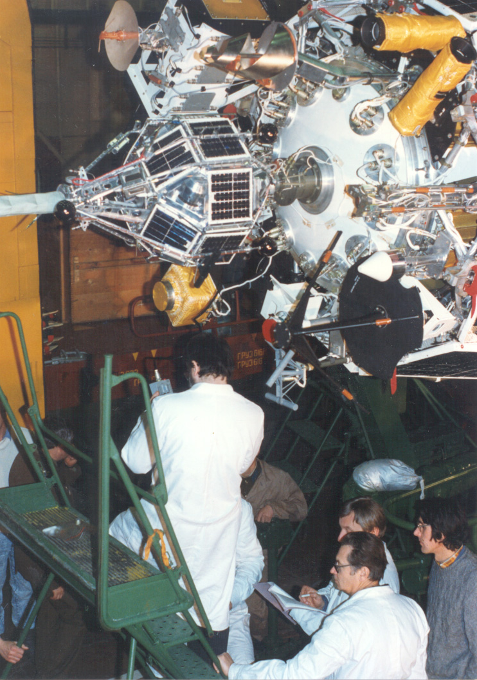
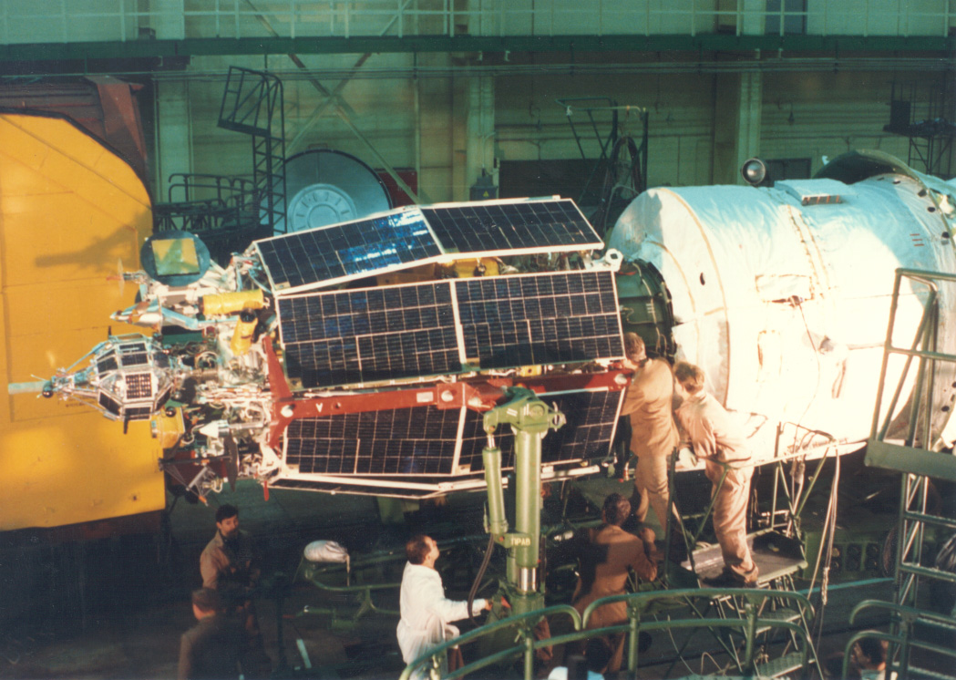
APEX assembly before launch (Plesetsk)
Tsyklon-3 rocket launch [KORONAS-F]
(Credit: KB Yuzhnoe)
Dr. P. Triska – MAGION-3 PI
Dr. J.Vojta – MAGION-3 TM
(Photo: courtesy of IAP)

Slide 7
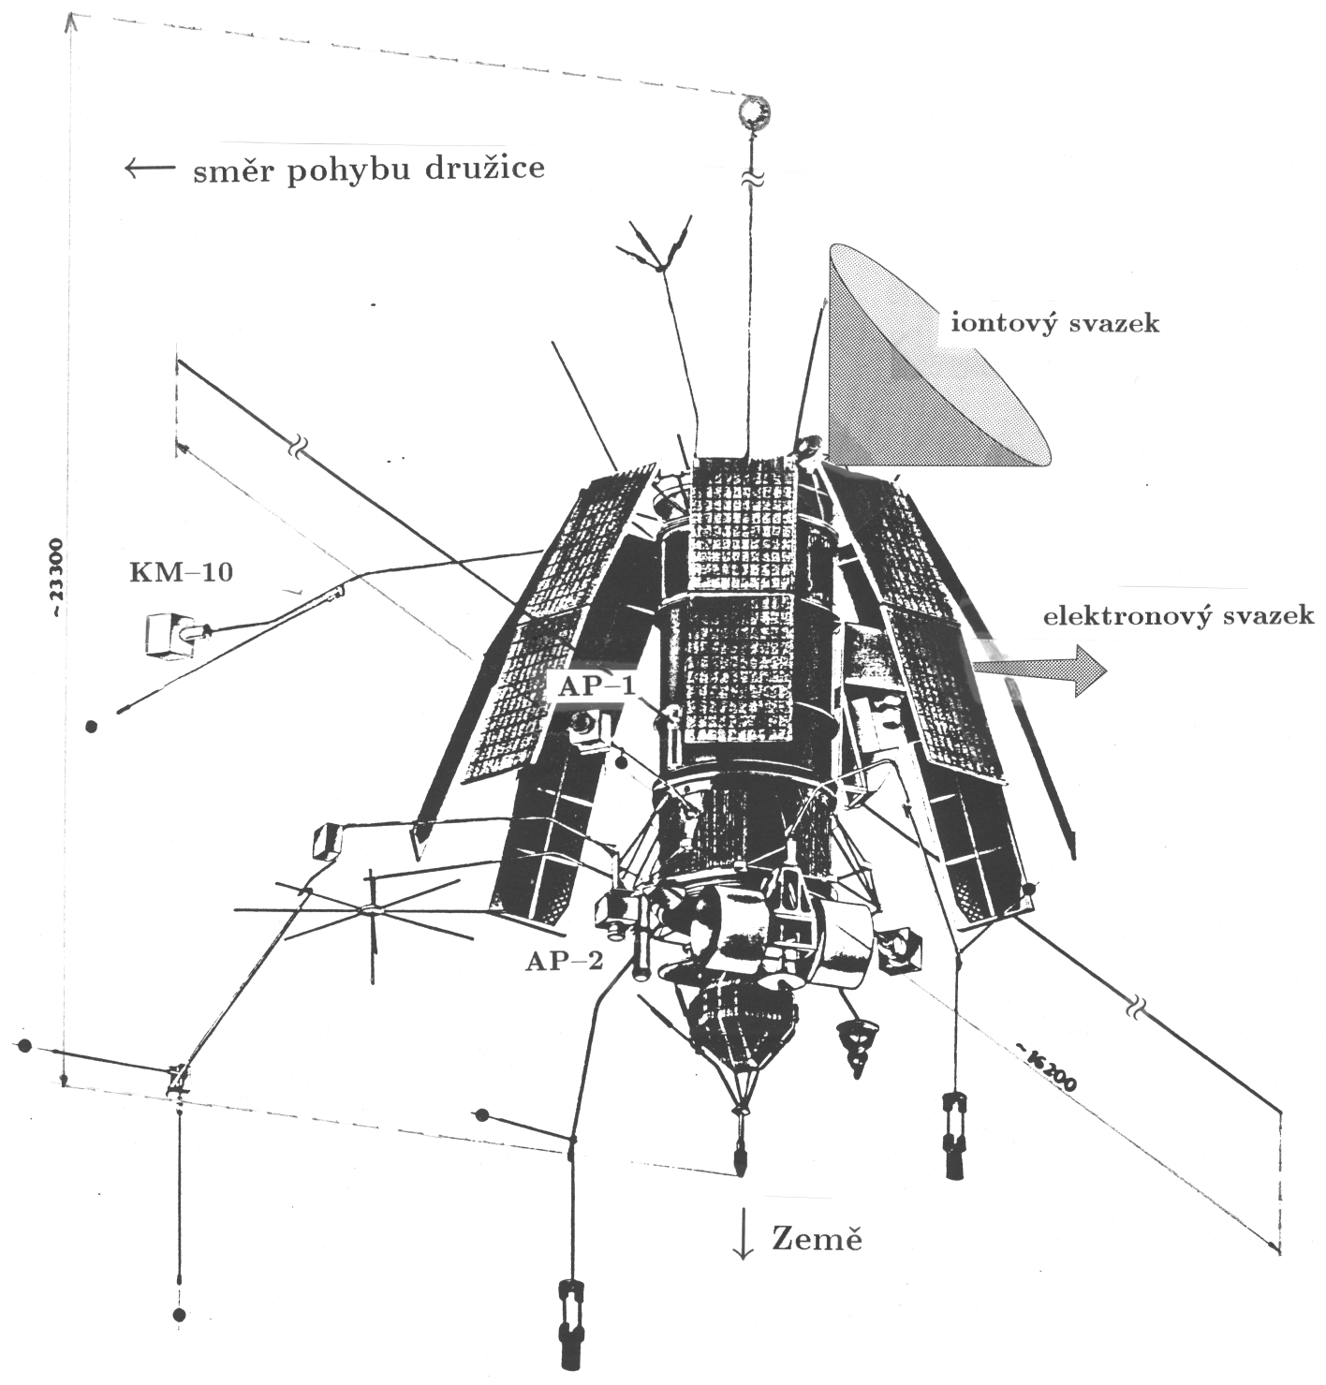
IK-25 deployed (before MAGION-3 separation)
3D-stabilization boom
Orbital velocity
Ion beam
Electron beam (G1)
PRS-3 dipole
Earth
Oraevsky and
Triska, ASR1993

Slide 8
IK-25 description
AUOS-Z platform
pressurized cylinder ~2 m x ~ø1 m
8 solar panels (~12 m²) – deployed 30° away (petal-like)
3-axis gravitational stabilization (length w. boom ~22 m)
28V power bus, + pole commutation, solar panels seem to be partially exposed to the ionospheric plasma
Notes:
The diagnostic part of the set of scientific equipment of APEX represents a complete set of scientific devices, allowing to carry out measurements of micro- and macroparameters of thermal and suprathermal plasma components, to measure space-energy distribution of particles, electric and magnetic fields, analyse variable and constant electromagnetic fields and radiations, measure optical emissions.
X-axis precision <15deg (Activny Afonin1994)

Slide 9
IK-25 - remarks to EMC, grounding, and s/c potential
S/c body painted, surface assumed equipotential but conductivity not characterized in publicly available data
Scientific payload painted or covered by MLI, connected to s/c ground – surface assumed equipotential (not guarantied)
Solar panel surfaces probably not equipotential – positive potential end assumed exposed to ionospheric plasma (dayside effects)
Charge balance analysis has to consider the stabilization boom/weight at ~20m distance. Currents across booms not monitored, unfortunately.
KM-10 sensor box (ahead of s/c in ram direction) kept floating, near ionospheric plasma potential (δΦ ~ -0.2..-0.7V for Te 0.1..0.3eV, not considering photocurrents/suprathermal electrons), but design range +/-90V is doubtful (+16 .. -10V limitation in practice)
KM-10 positive against s/c ( Ai/Ae ratios, solar panel potentials)
Debye sheath near apogee (10V, 10⁴ cm⁻³) ~ 1m, is KM-10 always out of s/c Debye sheath?
=> Difficult description of s/c charging and neutralization during AE

Slide 10
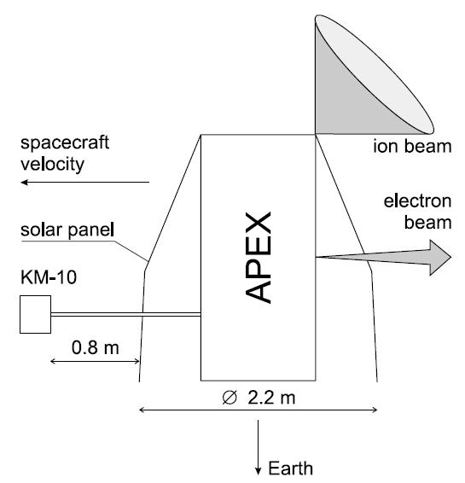
IK-25 charge balance issues
weigh
S/c body – Ie, Ii, Iph
Solar panels – Ie’, Ii’, Iph’
Boom&weight – Ie”, Ii”, Iph”
KM-10 FP – Ie*, Ii*, Iph*
Charge balance also depends on Ni, Te, eff. Ai, Ae, B orientation,Vsc, day/night (Φs,Φsc). Secondary emission affects the hot electron collection. Surface charging important, mainly for low energy ionospheric particle collection.
As to my knowledge, no detail IK-25 charging model has been developed.
~20m
Ufp
Φfp
Φs
Φsc

Slide 11
IK-25 payload
Dokukin, 1992
Experiment | Function | Provider
UEM-2 Electron gun | Injection of modulated beam (30Hz – 250kHz) More than 200 injection sessions | IZMIRAN, Troitsk, Russia E.O.Paton’s Electrical Welding Institute NAS, Kiev, Ukraine
UPM Plasma generator | Injection of Xe plasma modulated beam (32/1000 Hz), neutral Xe injections More than 250 injection sessions | IZMIRAN, Troitsk, Russia Design bureau FAKEL Institute of Physics and Mechanics NAS, Lvov, Ukraine
KM-10 Cold plasma analyzer | Electron temperature, ion energy distribution and density, s/c floating potential | Space Research Institute RAS, Moscow Geophysical Institute (IAP) CAS, Prague, CR
NAM-5 Mass spectrometer | Ion composition (RF analysis) | Space Research Institute RAS, Moscow Geophysical Institute (IAP) CAS, Prague, CR
PEAS Hot ion / electron analyzer | Ion/electron energy distribution, 2 planes, 12 sectors | Space Research Institute RAS, Moscow Geophysical Institute (IAP) CAS, Prague, CR Charles University, Prague, CR Research Institute of Nuclear Physics, MSU, Russia

Slide 12
IK-25 payload
Experiment | Function | Provider
DANI Low energy electron /ion spectrometer | Energy/pitch angle LE electron/ion spectrum, Langmuir probe and Rogovsky coil | IZMIRAN, Troitsk, Russia Space Research Central Laboratory BAS, Sofia, Bulgaria
OVK-ONCH ELF wave complex | Electric and magnetic components of LF EM radiation (0.1-15000Hz) | IZMIRAN, Troitsk, Russia
PRS-3 (VCH-VK) Radiospectrometer | HF EM radiation 0.1-10MHz, spectral analysis and waveforms, dipole electric antenna 15 m, 2-64 s spectrum resolution | IZMIRAN, Troitsk, Russia Space Research Center, PAS, Warsaw, Poland
DEP-2 Electric field experiment | DC e-field and 3 components 0.1 – 10 Hz | IZMIRAN, Troitsk, Russia Space Research Institute, BAS, Sofia, Bulgaria
SGR-5 Fluxgate magnetometer | DC m-field 3 components, +/- 60000 nT, 0.64 (0.16) s | IZMIRAN, Troitsk, Russia Space Research Institute, BAS, Sofia, Bulgaria
MNCH-2 LF search coil magnetometer | LF m-field 3 components 0.1-10 Hz | IZMIRAN, Troitsk, Russia
Service / ADO Magnetometers | AUOS bus service magnetometer (attitude control) to RTS, 0.64 (0.16) s ADO magnetometer to STO 2 s | KB Yuzhnoe ? IZMIRAN, Troitsk, Russia

Slide 13
IK-25 payload
Experiment | Function | Provider
FS Photometer | Scanning photometer 3194-6563 A – peak and spatial spectrum | Optical Laboratory of Space Research Institute BAS, Staraja Zagora, Bulgaria
UF-3K 3-channel photometer | 8 sectors photometer, 3194,5577,6300A | IZMIRAN, Troitsk, Russia Kiev State University, Kiev, Ukraine

Slide 14
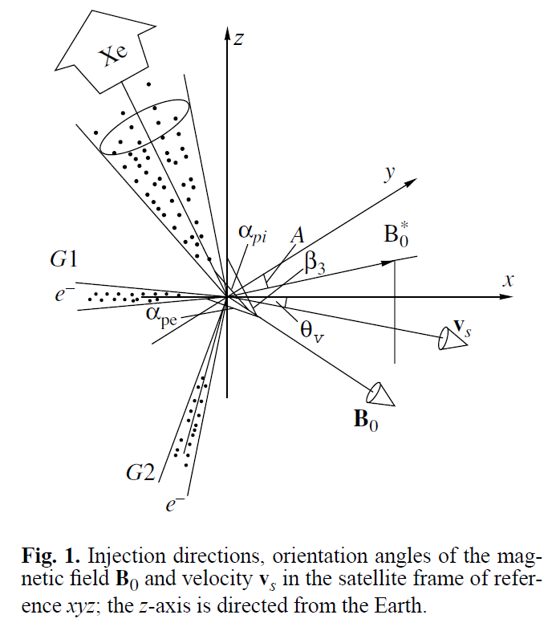
UEM-2 – electron gun
Oraevsky et al., PPR2001
Two electron injectors
G1 (-X),
G2(-X+Z, -X w. magnetic deflector)
(-X ~ p.a. 50°-80°)
Beam energy
8-10 keV (unstabilized)
Peak current
~30, 70, 100 mA
Beam width
4 mm at output aperture
Modulation modes
Fixed frequency F40K, F15.6K, F976 (2μs), F3906, F30.5(32μs)
Sweeping frequency
S250 – 30.5Hz-250kHz (2μs), 1 DC + 11 steps (1s each)
S15.6 – 30.5Hz – 15.6kHz (32μs), 1 DC + 11 steps (1s each)
HK data time resolution 0.32/0.08s
,G2 w. MD

Slide 15
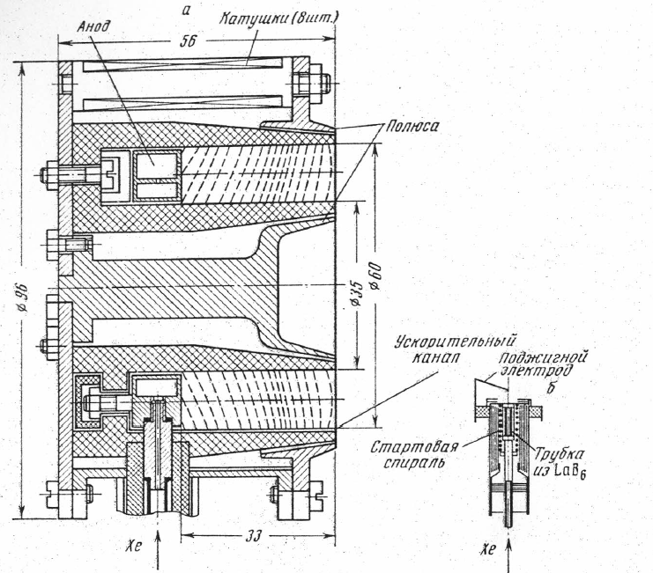
UPM – xenon plasma injector
Stationary plasma thruster of Hall type (close electron drift and extended acceleration zone) - similar in PORCUPINE experiment
Injection cone ~60° wide, 45° from +Z, 22.5° from -XZ
2 external hollow cathodes LaB₆ for beam neutralization, Te ~ 2 eV
Ion energy 200-250 eV (unstabilized), Ti ~50 eV
Ion current ~2A (10¹⁹ ions/s), ~100% ionization degree
Modulation modes
Neutral Xe ~ 3 mg/s (Xe-A)
F0 – Xe+ plasma, DC emission
F1000 – Xe+ plasma, 1:1 current modulation 1kHz, also F125 and F63 (125 / 63 Hz)
UPM cycle
Hollow cathode preheating ~35-45 s
~100 s plasma injection (Xe+)
~50 s neutral Xe release (Xe-B)
HK data 0.32/0.08s
Arcimovich et al., KI1974

Slide 16
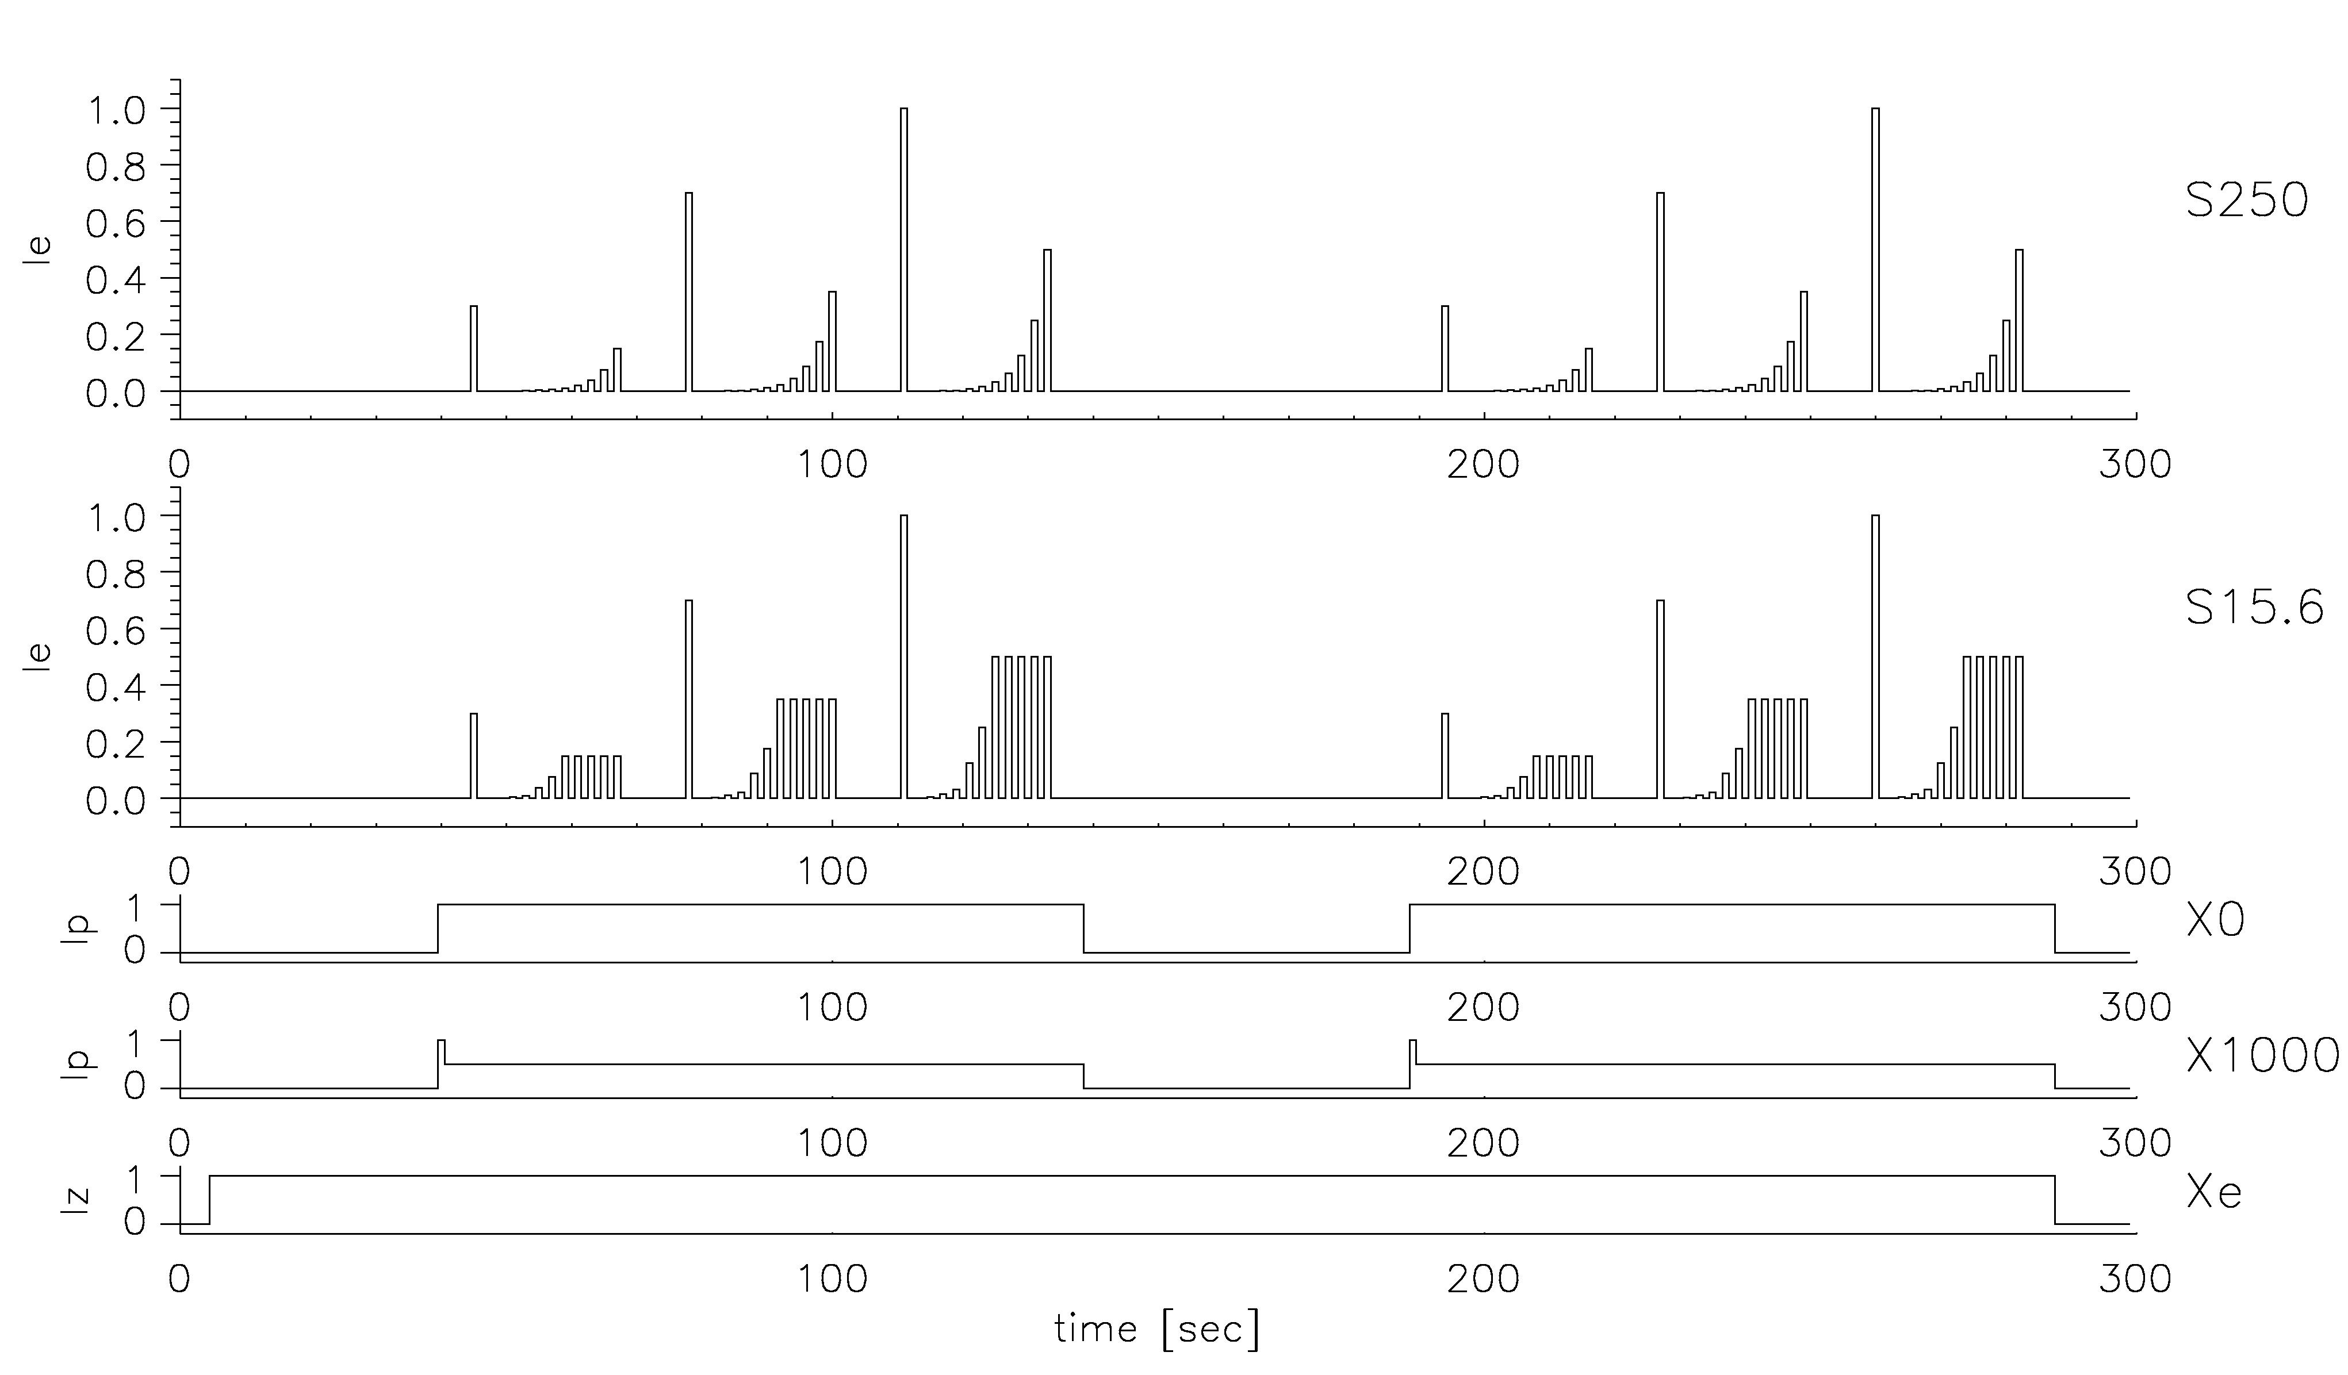
UEM-2 and UPM modulation profiles
UEM-2 : F40K – quasi-steady mean electron beam current w. 2μs pulse modulation (40kHz)
UEM-2 : S250,S15.6 (F30.5-F15.6K) – basic cycle 23s (1s gaps, 1s modulated beam current, 2μs/32μs puls)
Electron beam peak current preset in steps within ~30-100 mA range
UEM-2 and UPM cycles not synchronized, total AE length ~3-5 min
UPM : X0 – steady DC emission, X1000 – 1kHz Xe+ current modulation, square wave 1:1 (F62,F125,F250,F500)
Internal or external feedback? => additional ~0.12Hz Xe+ current modulation (up to 20%)
Neutral Xe injection and hollow cathode emission starts several tens of seconds earlier
S250: DC, 30.5, 122, 488.3, 976.6, 3906.2, 7812.5, 15625, 31250, 62500, 125000, 250000 Hz
UEM-2
UPM
Xe+
Xe-B
Xe+
Xe-A

Slide 17
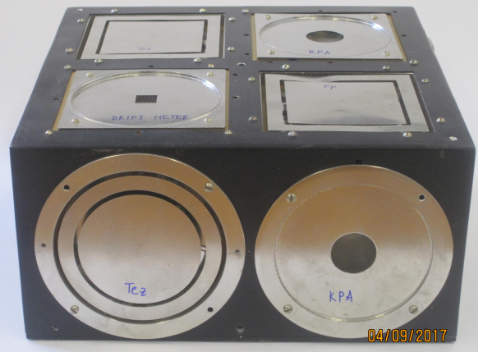
KM-10 - cold plasma monitor
Sensor and main electronics boxes
Sensor on a boom (~0.8m in front of solar panels) in the ram direction out of Xe/electron beams, its box isolated from AUOS bus, conductive surface
Total 7 probes
Ion flow Jx,Jz - planar RPAs, sweep 0-12V or 0/20V=> retarding characteristics => Ni,Tix,Tiz
Ion driftmeter – 1 planar trap with divided collectors
Floating potential measurement => complete KM-10 box biased to the same voltage (+/-90V range not achieved)
Electron temperature - 3 planar probes w. RF bias => Tex,Tey,Tez (during some AE fluctuations over full range, mostly in saturation => data not credible)
KM-10 sensor EM (Photo: courtesy of IAP)
Output | Range | STO resolution | RTS resolution | Note
FP coarse | -90 - +90 V | 0.2 s | 0.64 (0.16) s | Error readouts
FP fine | -10 - +16 V | 0.2 s | 0.64 (0.16) s | OK
Te (x,y,z) | 600 – 120000K | 0.1 s | 0.32 (0.08) s | Often unusable during AE
Ni (x,z) | 10² – 5x10⁶ cm⁻³ | 0.2 s | 0.64 (0.16) s | RPA sweep ~4s
+X,Vs/c

Slide 18
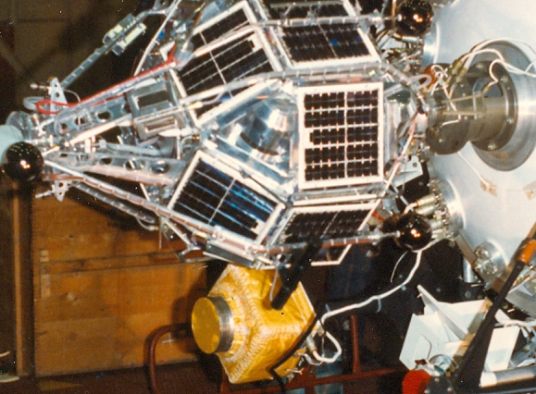
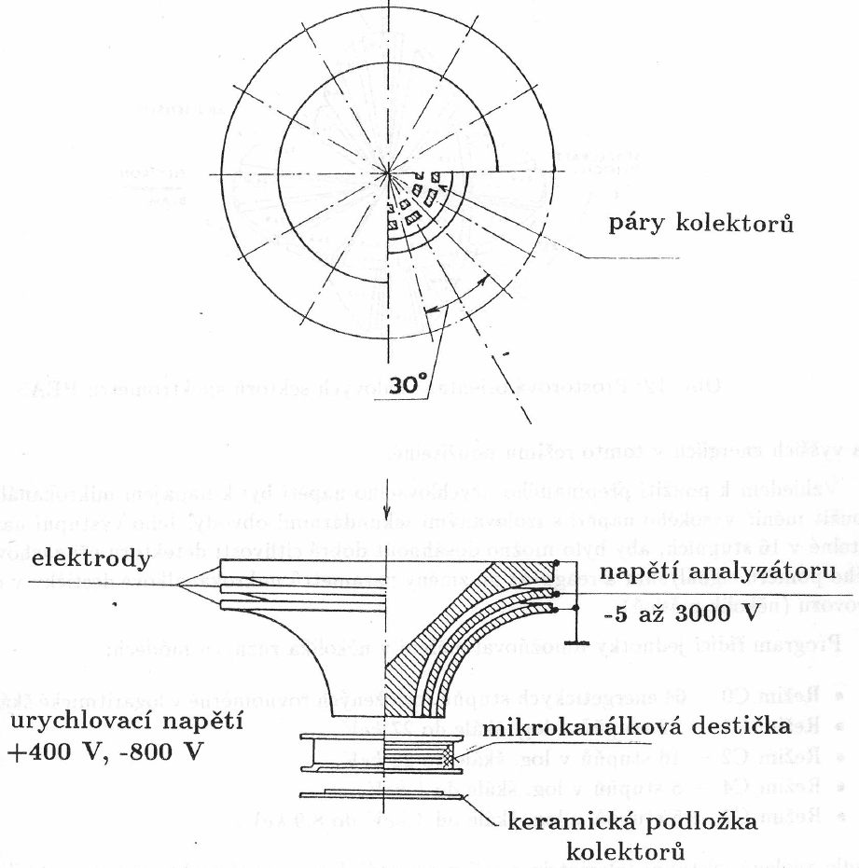
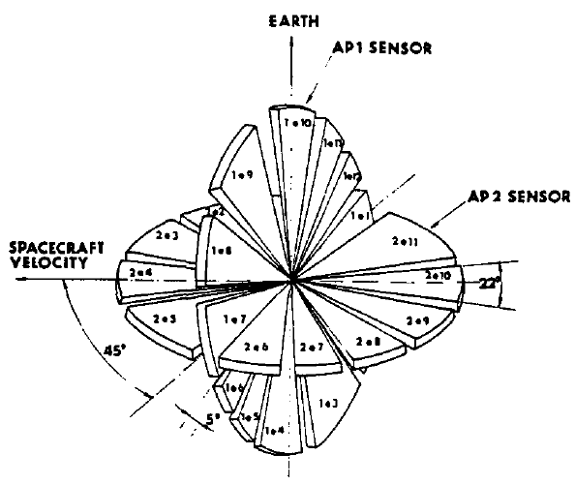
PEAS electron/ion spectrometer
collector pairs
PEAS AP2
2 blocks
AP1 on 1m boom ahead (45° to XZ plane)
AP2 0.5m above nadir side (XY plane)
block distance ~3m
Double toroidal analyzers, 12 angular sectors
Energy range 50 eV – 30 keV, max. 64 steps, ions or electrons
Output to STO-AP or RTS telemetries
Modes
C0 64 steps to 30keV, C1 32 steps to 27keV, C2 16 steps to 22keV (AP1) 13keV (AP2)
Ion, electron, swapped ion/electron mode
Time resolution C2 to STO-AP
80 ms accumulation interval x 16 steps x 2 (i/e) ~2 .6 s
(RTS MEM1 40 ms, MEM2 200 ms, MEM3 800 ms, MEM4 ~5 s => ~1.3 s, 6.4 s, 26 s, ~164 s)
Sampling not synchronized w. UEM-2
Pitch-angle distributions (using ADO magnetometer)
Polar regions : AP1 wide/ AP2 narrow around 90°
Equatorial regions : AP2 wide/ AP1 narrow, trapped part.
During flight several channels noisy - data cancelled
electrodes
analyzer voltage
-5V to -3kV
acceleration voltages
MCP
ceramic collector plate
AP1/AP2 FOV
Nemecek et al., ASR1993

Slide 19
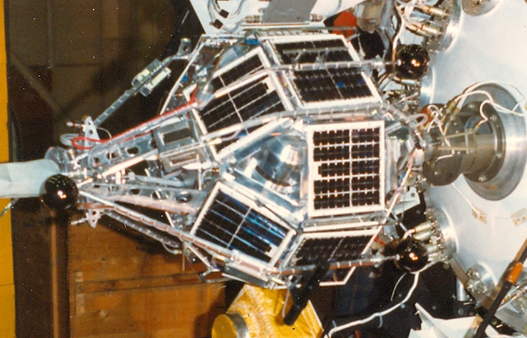
MAGION-3 description
Triska et al., ASR1990
52 kg, 0.850 m x ø0.60 m (2m deployed), pressurized neutral gas orbit control
Magnetic stabilization (perm. magnet 30Am²) week dumping
137/400 MHz TM 40.96 kbit/s max., 1-4MB MEM buffer
129 MHz TC, 128 bit/s, 256 commands
MAGION-3 attached to IK-25
Notes:
The important peculiarity of APEX is the presence of a subsatellite MAGION, equipped by its own complex of scientific equipment, which have practically the same opportunities to a plasma and fields measurements as the main one.

Slide 20
MAGION-3 payload
Triska et al., ASR1990
Experiment | Function | Provider
SGR-6/7 Fluxgate magnetometer | 3D fluxgate magnetometer 0-20Hz, 2/16 nT Magnetic variometer 0.1-20Hz, 50pT 3D e-field 0.01-20Hz 0.05-8000mV/m | Polytechnical Institute, Bucharest, Rumania
KEM-1 ELF wave complex | Exyz 0.1Hz-120kHz, Bx 10Hz-20kHz (w. 60kHz analog wide-band TM) 8 filter banks 17Hz-15kHz spectrum analyzer 1-125kHzs 32 steps, 2 s | Geophysical Institute (IAP) CAS, Prague, CR
KM-13 ZL-A-S DANI-S Cold plasma analyzer | Temperature and density of cold plasma Langmuir probe, HF-probes (Te-par, Te-perp, s/c potential, EED), spherical ion trap | Geophysical Institute (IAP) CAS, Prague, CR Space Research Institute, Berlin, Germany Space Research Institute, Sofia, Bulgaria
PRS-2-S Radiospectrometer | Radio spectrometer (HF) 0.1-10MHz, 0.2s (Δf 50kHz) / 2s (Δf 15kHz) , dipole antenna 3m, 0.1 or 1 s | Space Research Center, PAS, Warsaw, Poland
FDS Photometer | Optical radiation at 5577,6300A | Space Research Institute, Sofia, Bulgaria

Slide 21
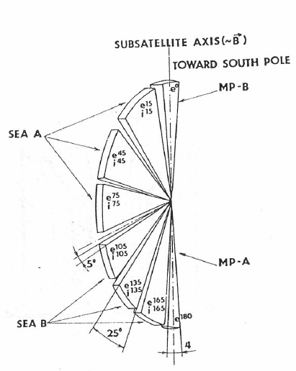
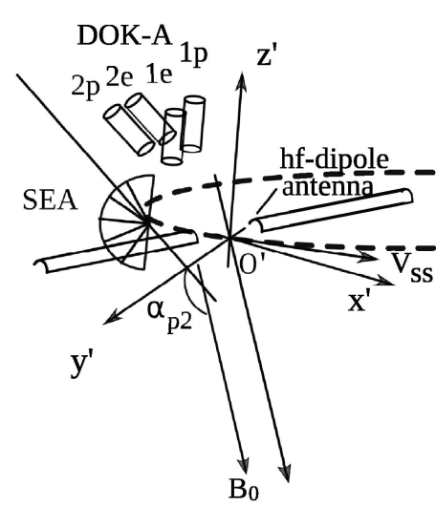
MAGION-3 payload
Experiment | Function | Provider
DOK-S energetic particle silicon detector | Two e/i channel pairs (par.+perp. to s/c axis), 20keV-1MeV, 8 steps, 0.1 s | Institute of Experimental Physics, SAV, Kosice, SR
MPS/PPS suprathermal particle spectrometers | 2 narrow e channels 0,180°, 0.05-20keV (M11) or 0.05-5keV (M1), 16 steps, 0.8s, 6 fan e/i channels 15,45,74,105,135,165°, 0.05-20keV or 0.05-5keV, 16 steps, 0.8s | Charles University, Prague, CR Research Institute of Nuclear Physics, MSU, Russia
DOK-S
MPS/DOK-S/PRS-S sensor arrangement
MPS/PPS fields of view

Slide 22
Telemetry reception
Russia stations (Troitsk, Apatity, …)
IK-25 s/c control, service and science telemetry RTS (analog/ digital channels) reception (mostly MEM, during visibility RTT)
Few sessions IK-25 science STO-AP TM reception (also in Germany)
Panska Ves observatory (Czech Rep.), 137/400 MHz bands
MAGION-3 s/c control and STO TM reception – mostly RTT, some MEM data via onboard circular buffer memory (when s/c not observable) but volume limited
IK-25 science STO-AP TM reception (selected higher TM volume instruments – PEAS switched to STO-AP over Panska Ves )
RTT mode 5120B/s (10 frames/s) – affected during active experiments w. Xe+ plasma – short drop-outs or wide data gaps
MEM modes 100, 12.5, 3.125, 0.39 frames/s – only for some selected sessions
(Photo: courtesy of IAP)
Notes:
Except the active means and diagnostic equipment APEX also includes an additional ( to the basic configuration of the spacecraft) telemetry system STO-AP,which was developed by the experts of Hungary, former USSR, Poland and Czech Republic.. The system STO-AP provides the interface for the devices, management of modes of operations, preliminary processing of the scientific information, independent control of onboard experiments, formation of the TM-frames and transfer of the telemetry information to the groundbased stations at Czech Republic, Russia and Germany.

Slide 23
Active experiments methodology
Certain injection configuration to be repeated several times under different ambient conditions, but in reality many configurations in one usable dataset
IK-25
Data stored to MEM and downloaded via RTS to ground ~1 per day
RTS in high speed modes during visibility from reception stations (RTT)
Most of STO-AP telemetry RTT to Panska Ves (when visible)
MAGION-3
Most of STO telemetry in RTT to Panska Ves (when visible)
But not all AE in visibility from the Panska Ves station (partial/no MAGION-3 data and STO-AP tm data, gaps in data during TM switchover – start of AE missing)
For larger separations IK-25/MAGION-3 visibility intervals do not 100% overlap
Telemetry slower for large altitudes
=> not all data in best time resolution and well overlapping
Panska Ves visibility requirement makes Altitude, LAT, INL / L, MLT + day/night, up/down injection AE conditions bound => difficult to separate some dependences

Slide 24
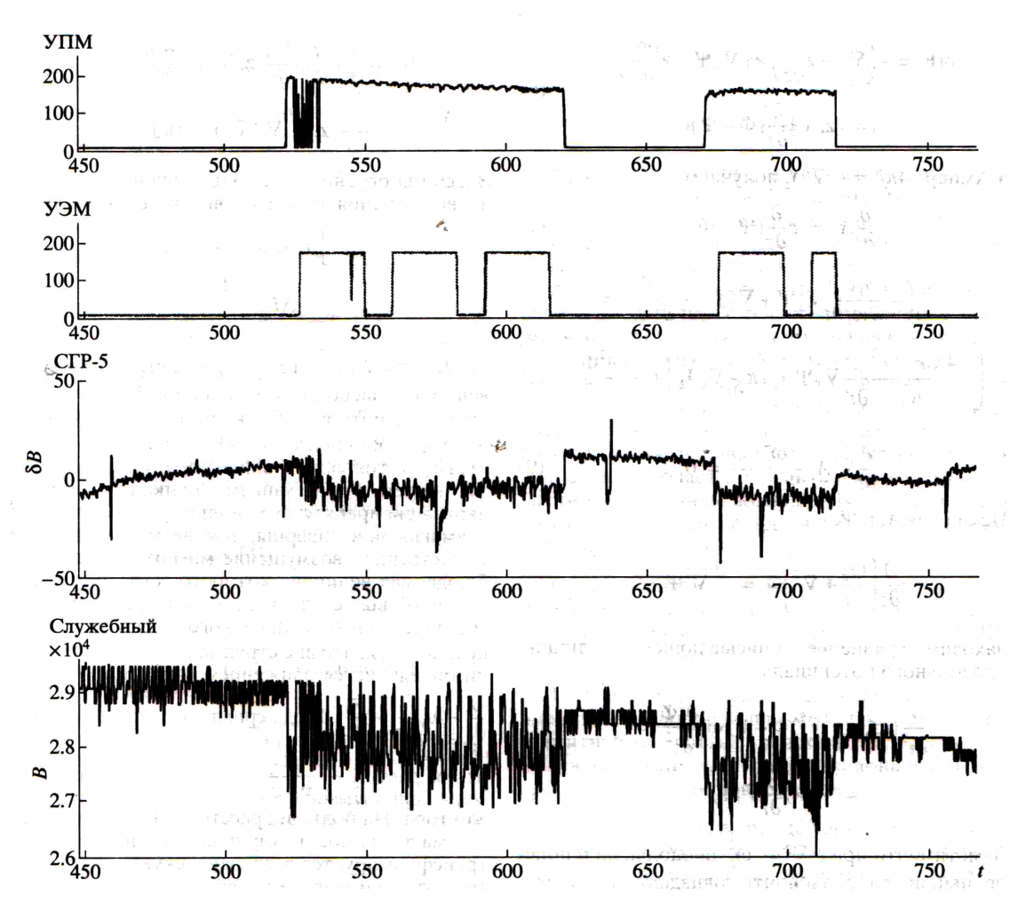
Diamagnetic cavity during the Xenon plasma injection
Volokitin et al., GA2000
Diamagnetic cavity formation observed during the Xe plasma release, based on the SGR-5 and service magnetometers data.
SGR-5 magnetic field intensity drop ~10nT (magnetometer 7-12m from the beam)
Service magnetometer nearby the UPM thruster, fluctuations 1500-2000nT => diamagnetic cavity on the initial stage of Xe beam expansion created and mg. field pushed outside
Based on UPM injection properties diamagnetic cavity size estimated to 5-10m
Xe plasma cloud density expected to decrease to the ambient plasma d. (10¹⁰ m⁻³) at distance 300-400m
Experimental data compared with a theoretical model based on analysis of the PORCUPINE (Hausler et al., 1986; Oraevsky et al., 2003) and АМРТЕ (Mishin et al., 1988) plasma injections
I_bi
I_be
δB SGR-5
B serv.mag

Slide 25
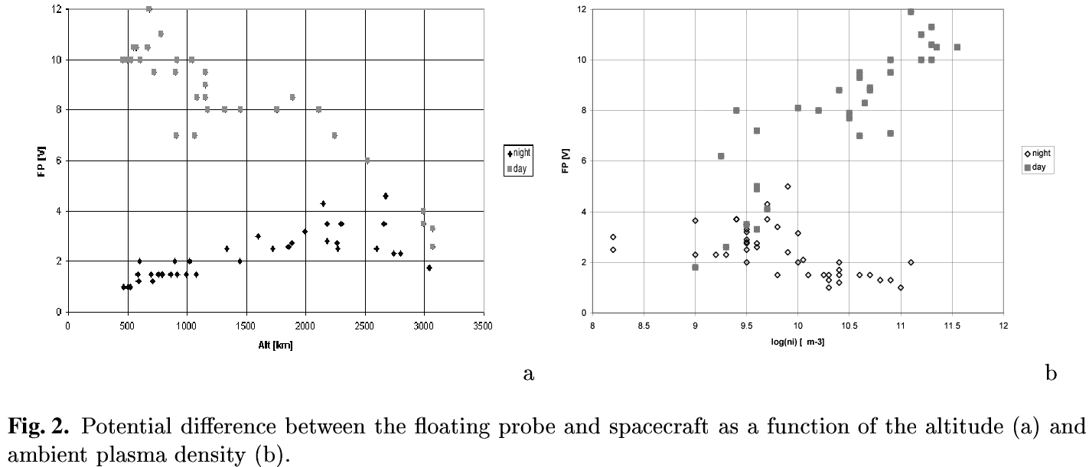
IK-25 s/c potential – KM-10 measurements (outside of active experiment intervals)
KM-10 box (ahead of s/c in ram direction) kept floating, near ionospheric plasma potential (δ ~ -0.2..-0.7V for Te 0.1..0.3eV, not considering photocurrents/suprathermal electrons). Diference can be larger in auroral zone when hot electron population present
KM-10 floating potential monitor gives s/c potential with this small offset.
Day side – solar panel influence
s/c negative
-φ_{s}
-φ_{s}
s/c positive
Te rises, Ni falls
Prech et al., ASR1999

Slide 26
IK-25 s/c potential during the electron beam injections with neutral Xe/Xe+ plasma
Ni > 10¹¹ m⁻³ – good electron beam charge neutralization, Φs <15V for S250 and F40 max. currents , Ni is not further increased
Ni < 10¹¹ m-3 – Xe+ plasma release forces Ni ~8×10¹⁰ m⁻³ (day), ~1.5×10¹¹ m⁻³ (night), good electron beam charge neutralization
For low Ni, neutral Xe-A/Xe-B releases – ~20V < Φs < ~50V, FP shortly in negative, than in positive saturation –> FP not usable, accelerated cold ionospheric electrons not observed by PEAS
Electron beam modulation (S250) – 1s Φs positive pulses, level rises with mean current, τ_{r}(Φs ) <~0.2s, pulses larger for Xe-B than with Xe+ plasma
Φs during night – fast relaxation to quite values after AE end, during day relaxation lasts ~10² s

Slide 27
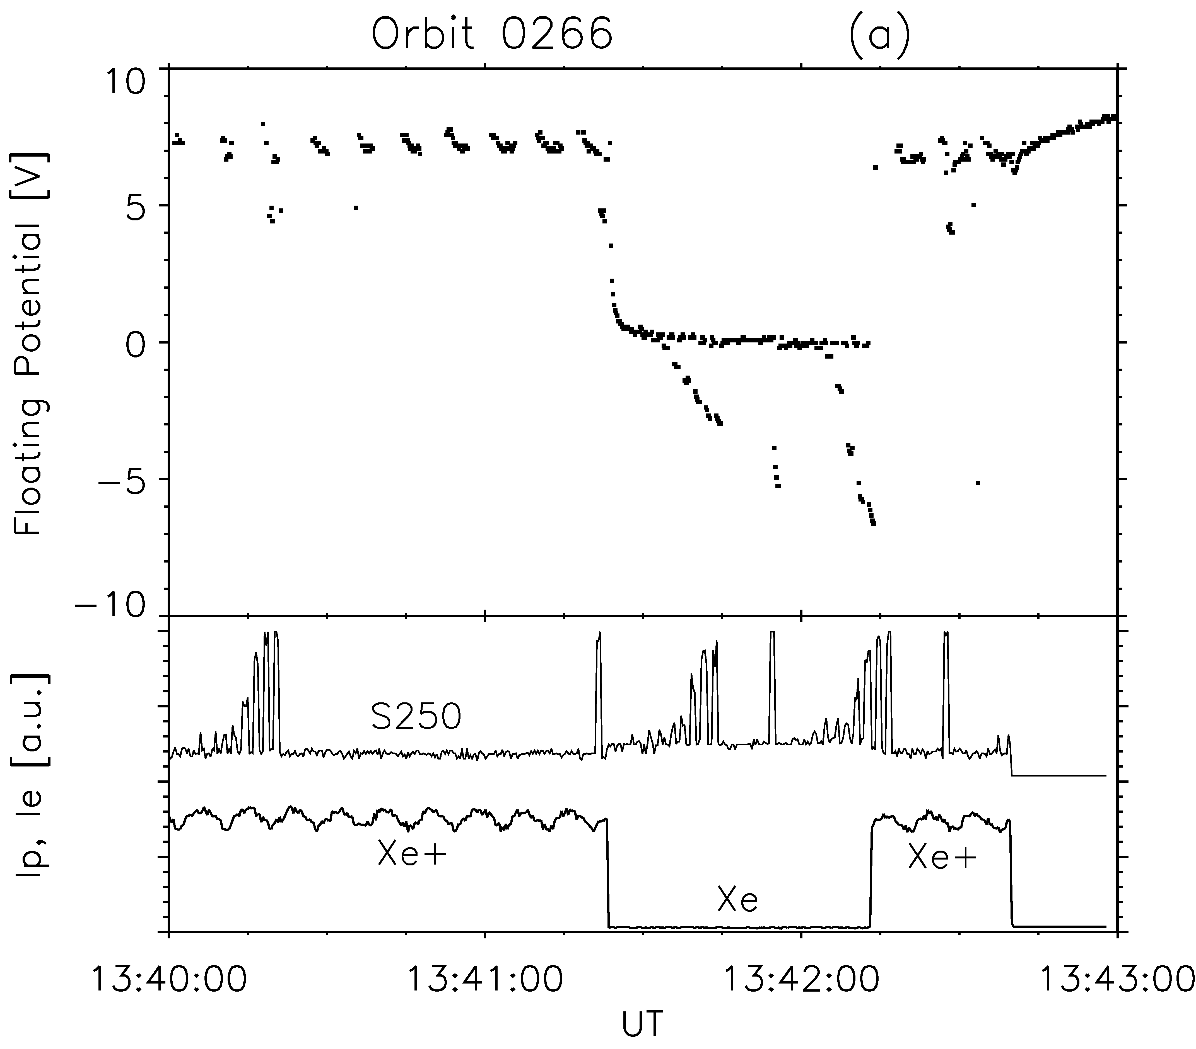
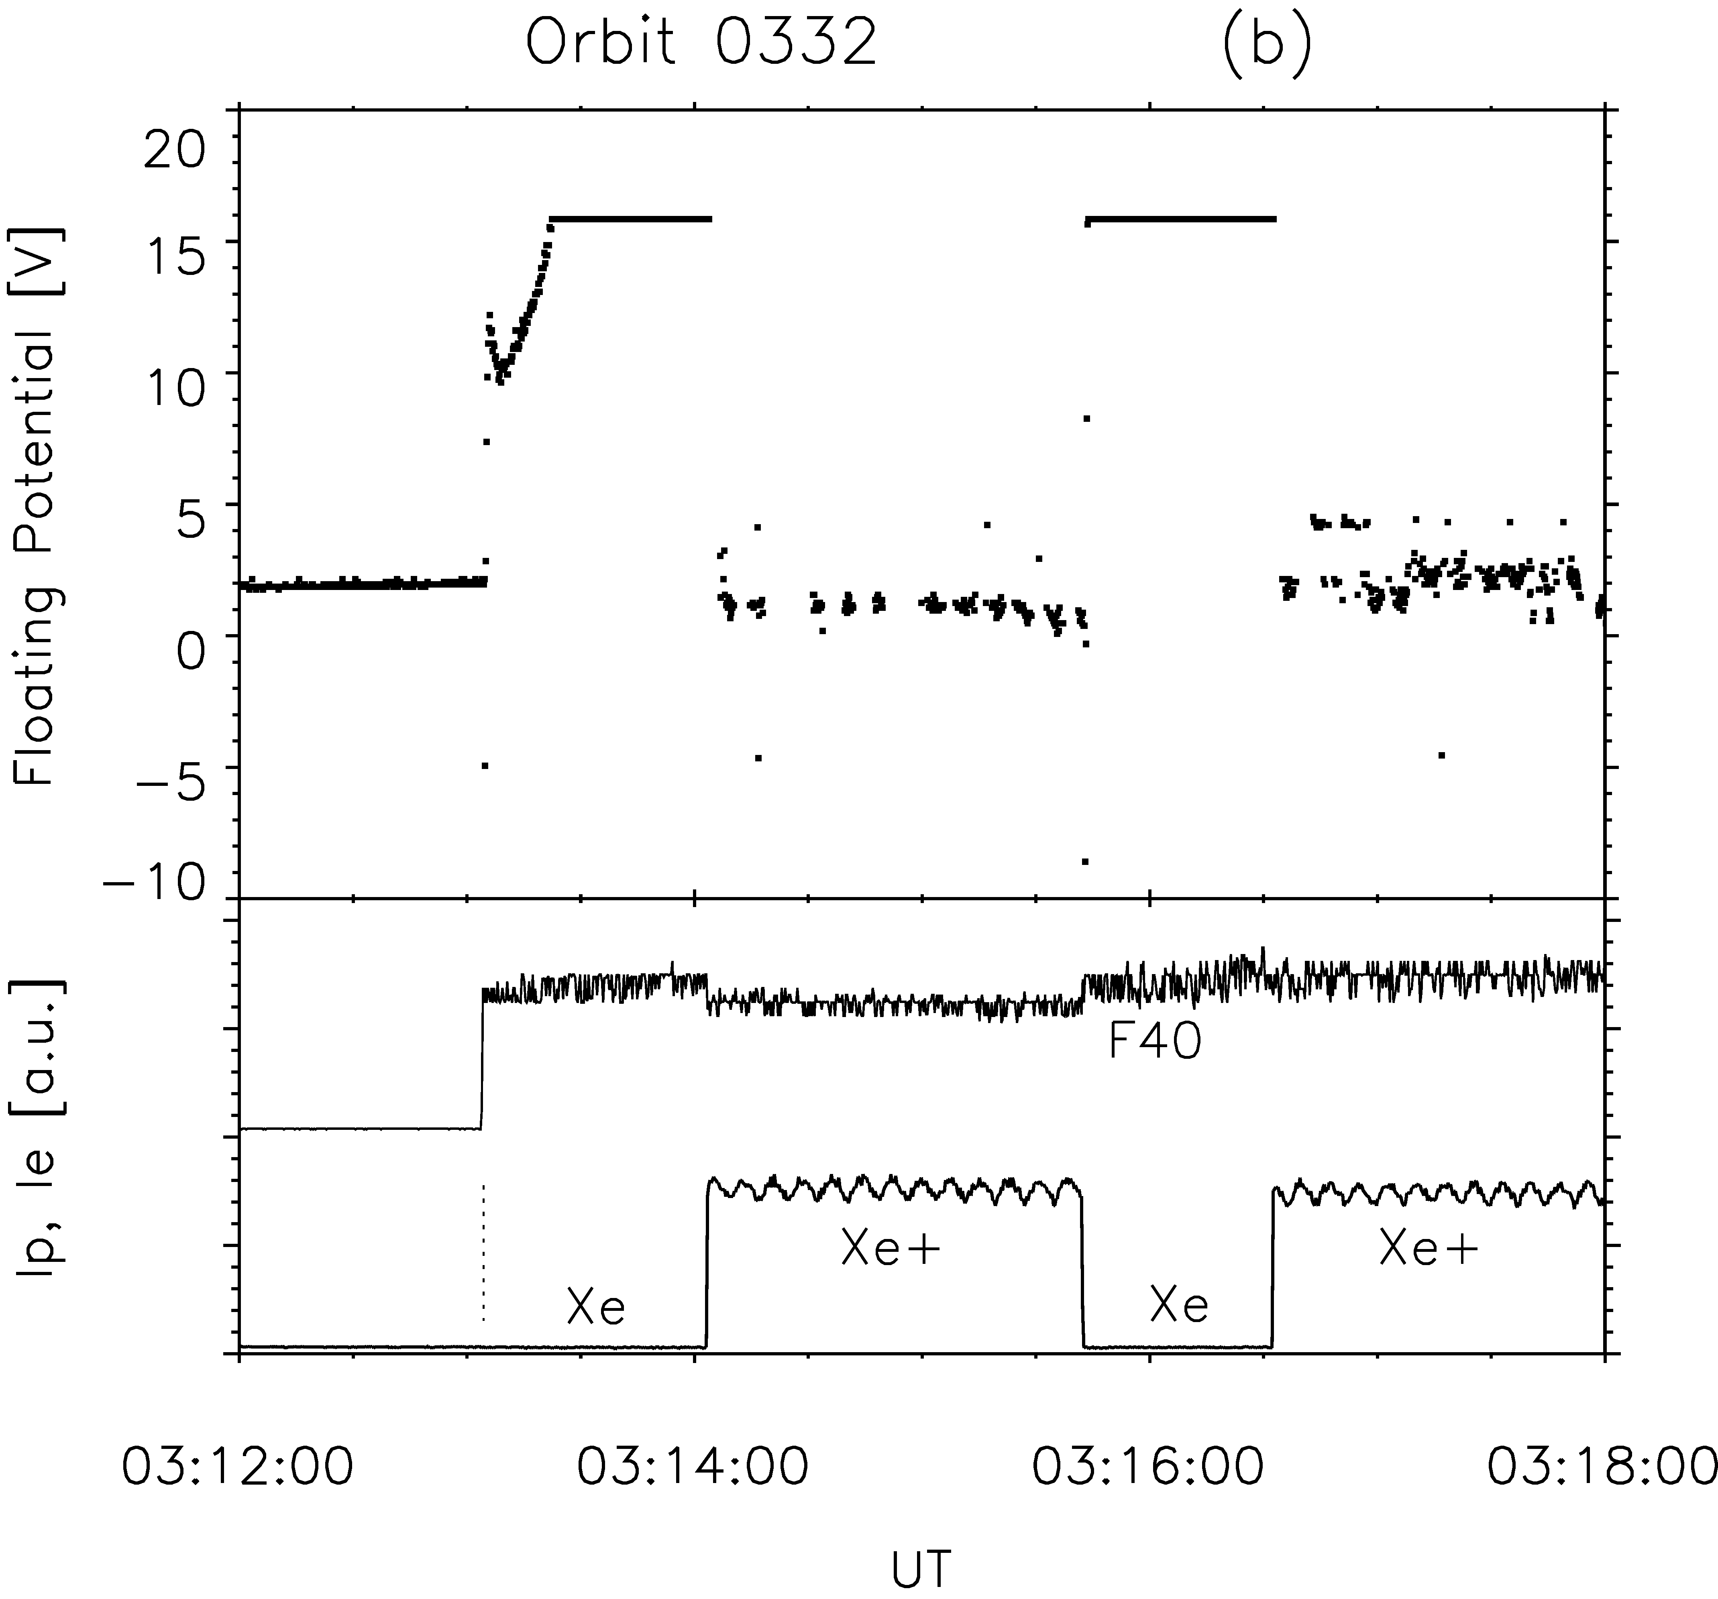
IK-25 s/c potential during the electron beam injections - example
Přech et al., ASR1995
1 2
S/c potential negative
S/c potential positive
I_be
Ni ~ 2×10¹¹ m⁻³ day
I_bi
S/c potential negative
S/c potential positive
I_be
Ni ~ 3×10¹⁰ m⁻³ night
I_bi

Slide 28
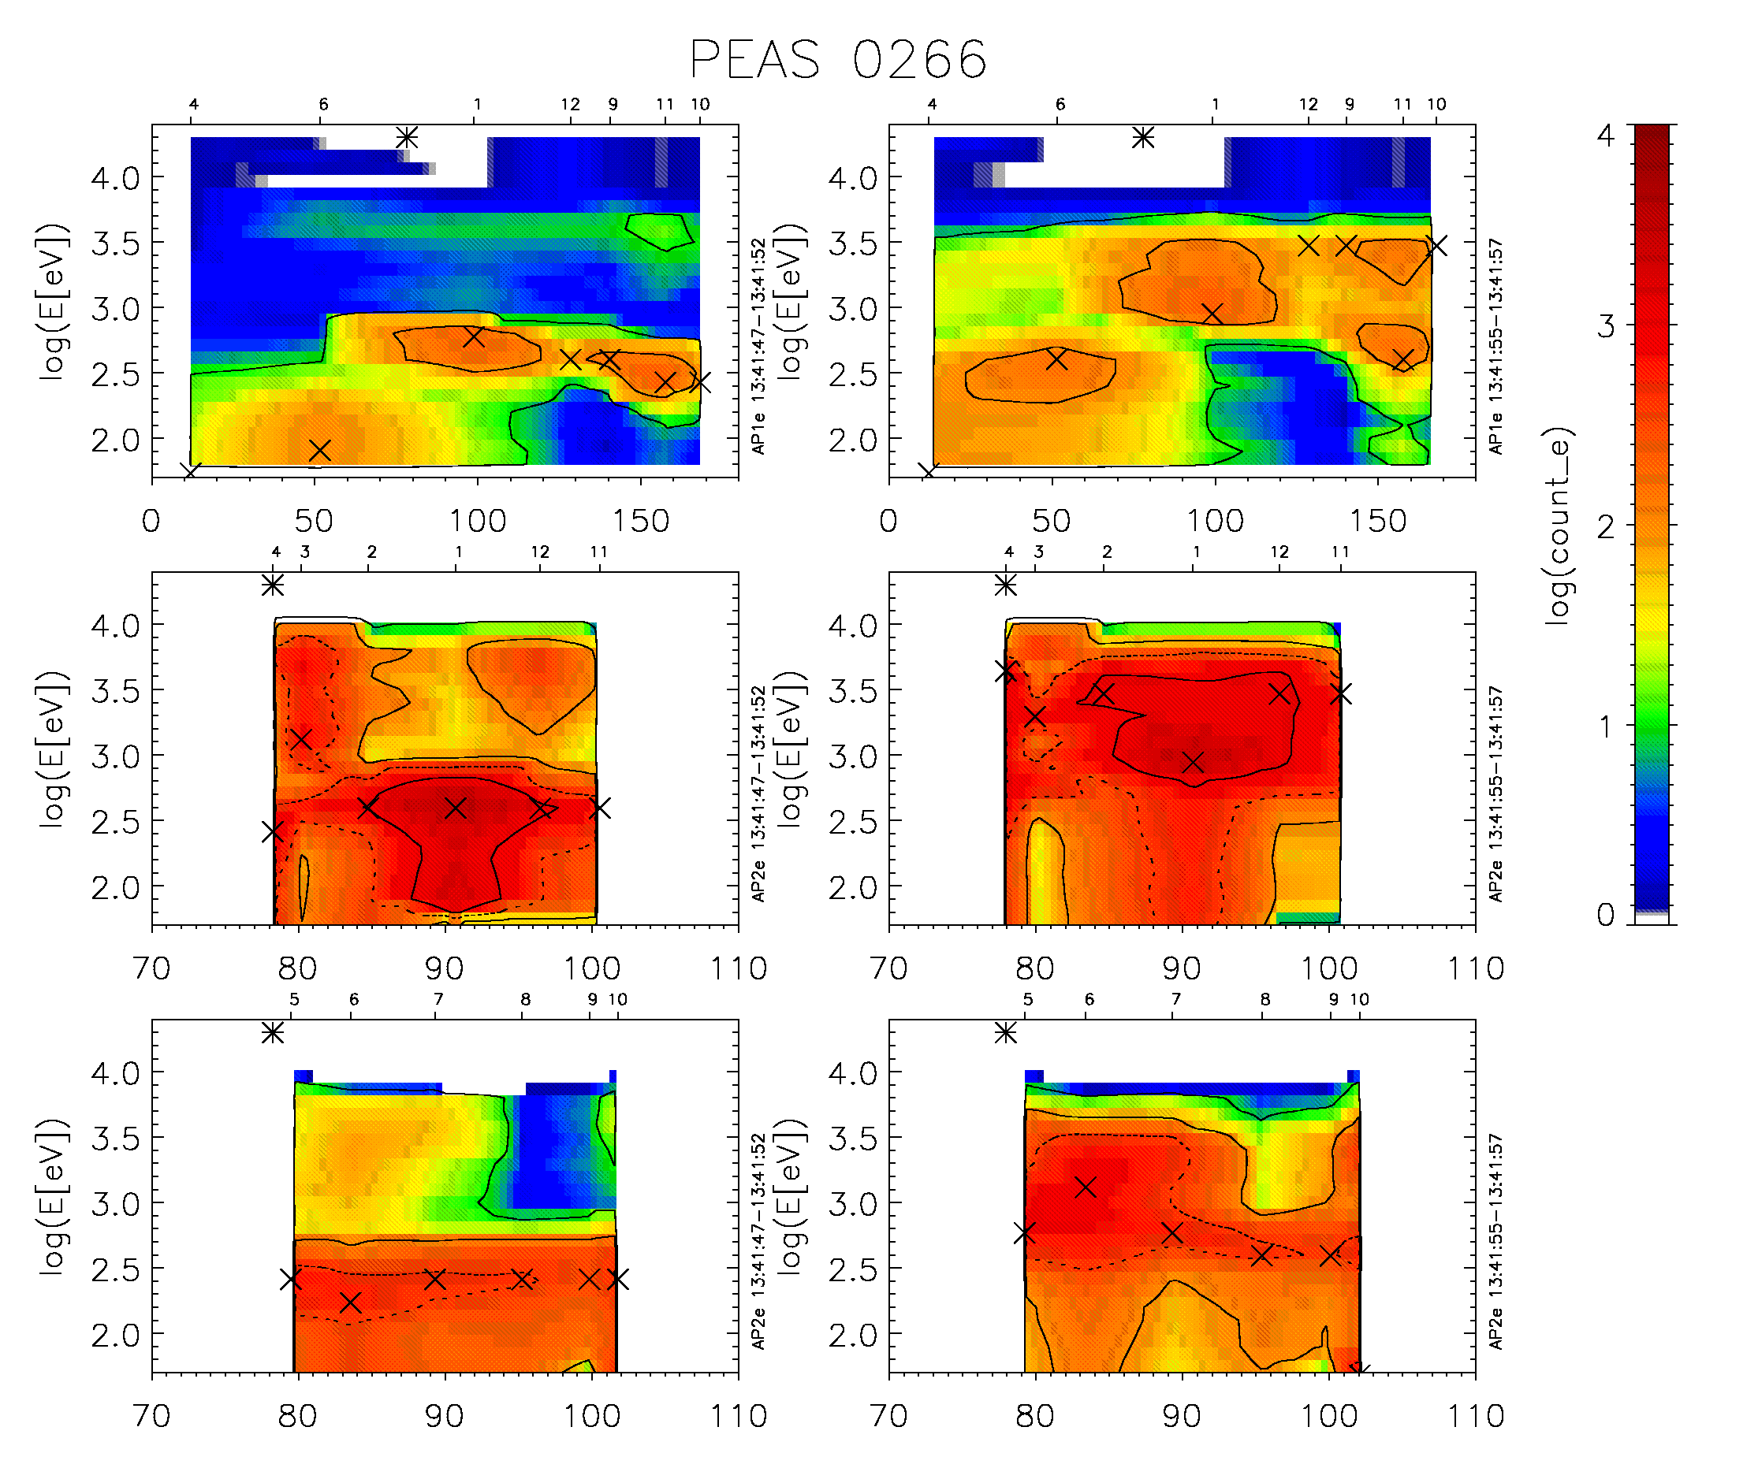
Hot electron pitch-angle distributions during electron beam injections (S250 / F0 Xe-B)
See also
Nemecek et al., JGR1997
Přech et al., ASR1998
Electron beam evolves to a hollow cylinder, return currents w. hot electrons from both behind/ahead of s/c
S250 / Xe
el. beam p.a. 78º - downward
PEAS AP-1
Inside hot
electron cylinder
PEAS AP-2
Near hot electron
cylinder edge
Inner sectors
Outer sectors
Ni ~ 2×10¹¹ m⁻³
1 - UEM beam base current
2 - UEM beam max. current (DC pulse)

Slide 29
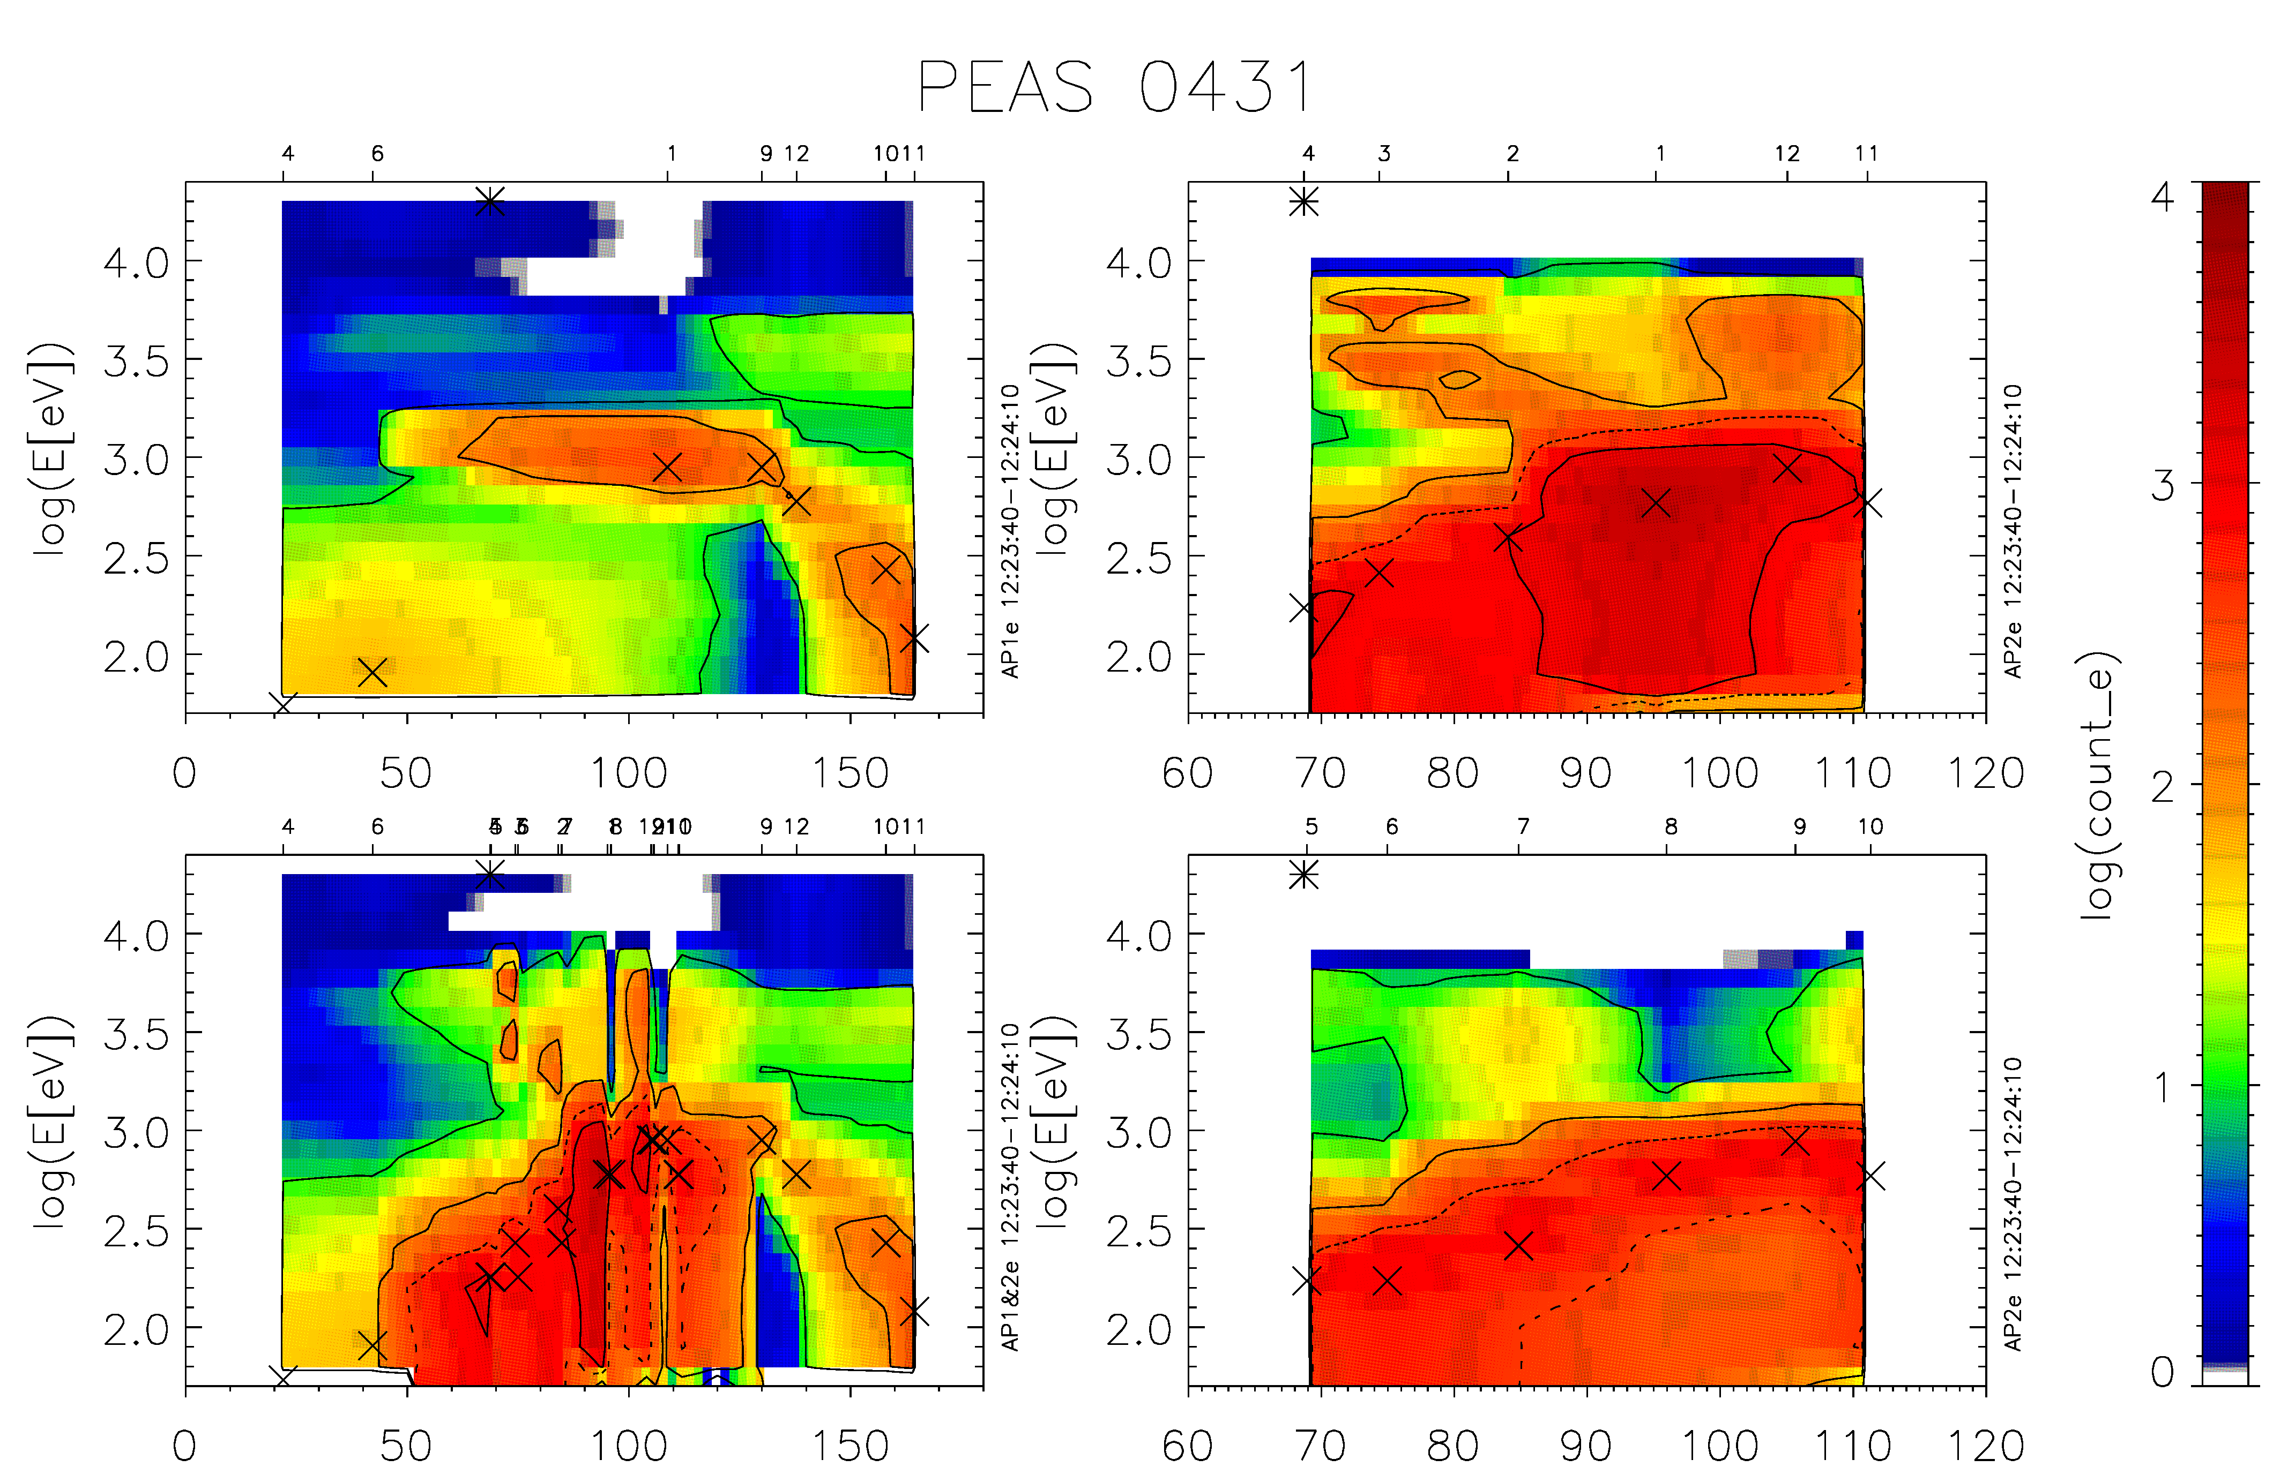
Hot electron pitch-angle distributions during electron beam injections (F40K / Xe-A)
See also
Nemecek et al., JGR1997
Přech et al., ASR1998
Electron beam evolves to a hollow cylinder, return currents w. hot electrons from both behind/ahead of s/c
F40K / Xe
el. beam p.a. 69º - downward
PEAS AP-1
Inside hot
electron cylinder
PEAS
AP-1 + AP-2
All sectors
PEAS
AP-2
Inner sectors
Outer sectors
UEM-2 beam max. current (2us/40kHz pulses)
Ni ~ 4×10¹⁰ m⁻³

Slide 30
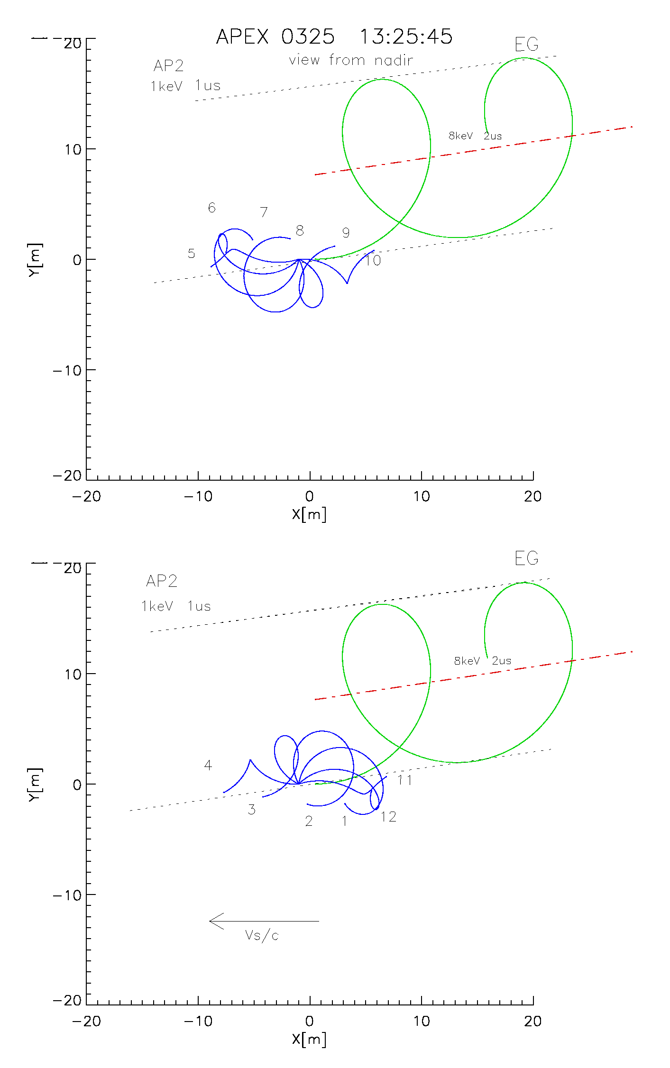
Přech et al., 1998
Return current w. hot electrons
Shell of cylinder contains hot electrons accelerated to ~10³ eV – energy rises w. mean UEM-2 current, acceleration more efficient for p.a. near 90º, weaker during simultaneous Xe+ plasma emission
Angular distribution of electrons in the cylinder shell asymmetric against B – strong electric fields, ExB drift –> AP2 inner/outer sectors differ
Scattered/decelerated beam electrons observed both from upward/ downward directions (several keV)
Acceleration of electrons above beam energy not observed locally, no resonance effects related to changing S250 beam modulation frequency (but PEAS has low time resolution 2.6s)
Hot electron flux observed by PEAS (~0.02 mA/m²) cannot provide full beam neutralization, electrons below 50eV important
B
AP2 – outer sectors
AP2 – inner sectors
V_{s/c}

Slide 31
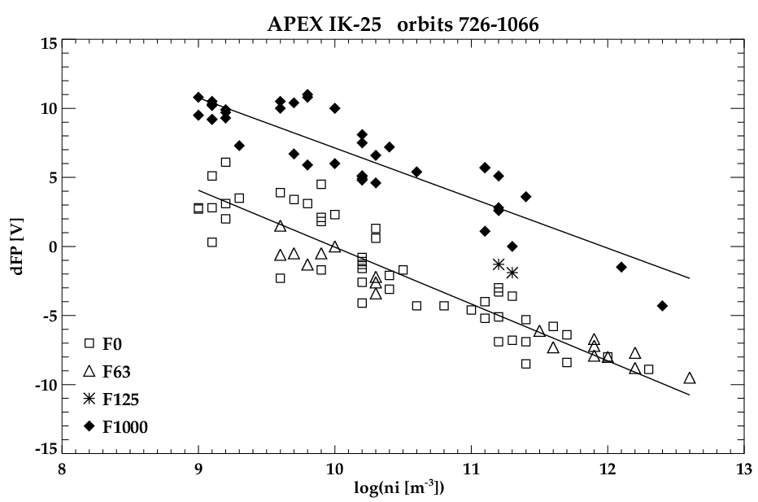
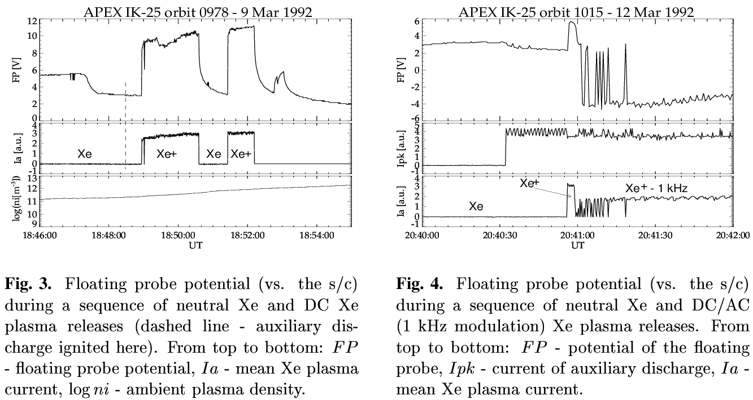
IK-25 s/c potential – Xe+ plasma injections
S/c potential change up to +/-10V, depending on plasma density and UPM modulation frequency
Altitude, plasma temperature, day/night dependencies small
DC xenon plasma emission studied in a simple model of FP, S/C and plasma cloud by Zilavy et al.(AnGeo2002) - importance of suprathermal electron tail and ion mass composition (cmp. H+, O+ ion ram energy) of ionospheric plasma for charge balance
Day
Day, ~2900km
Night, ~440km
Prech et al., ASR1999

Slide 32
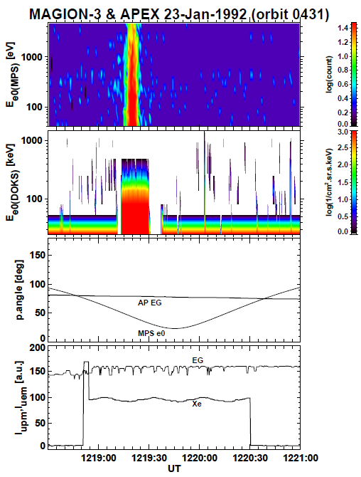
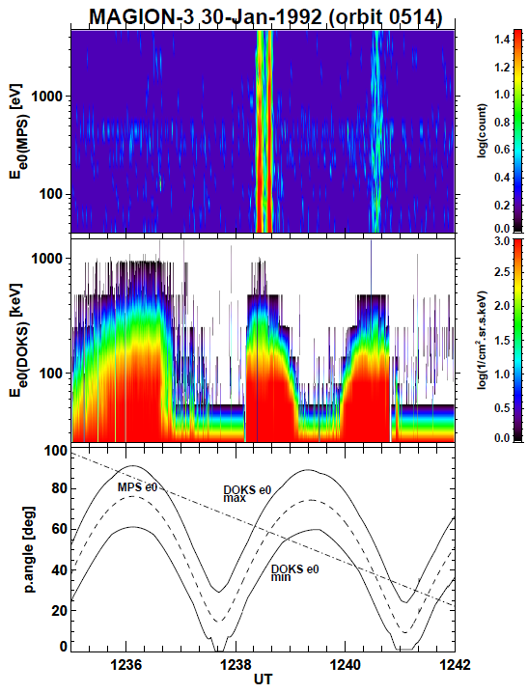
Remote observation of high-energy electron bursts during electron beam injections
Prech et al., AnGeo2002
~20 events recorded by MAGION-3 when simultaneous electron emission from IK-25

Slide 33
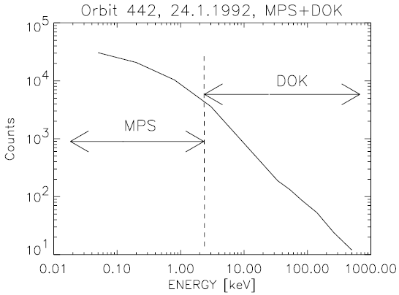
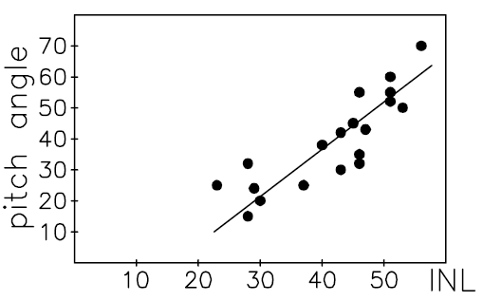
High-energy electron bursts during electron beam injections – event characterization
Prech et al., AnGeo2002
Events recorded by MAGION-3 in middle and low latitudes at distances 70 – 550 km when simultaneous electron emission from IK-25 (F40K downward, not during S250/others!; neutral Xe or Xe+ F0/F1000 release with the electron beam)
~34 F40K sessions scheduled on IK-25 during Jan-Feb 1992, but not all 100% successful and not with a full MAGION-3 coverage. Burst observation probability per session ~0.25
MPS energy flux > 3x10⁵ [cm².sr.s.keV]⁻¹ No similar events observed directly by IK-25
Events outside auroral oval (INL < 57°)
Event length 4-10 s in a MPS channel, some events doubled or tripled in one session
Energies from MPS/PPS to DOK-S range up to 500 keV
Pitch-angle width < 10° (smaller than DOK FOV ~15°)
Pitch-angle 20-70°, rising with INL (B is rising at given altitude with INL as well)
Practically no time-energy dispersion => source closer than 5000km
IK-25 and MAGION-3 (ahead or behind) Alt 800-1500 km, separated only in INL (+5.6° to -2°), same MLT after local noon (same magnetic meridian plane)
MPS/DOK common
spectrum fit
Event p.a. distribution

Slide 34
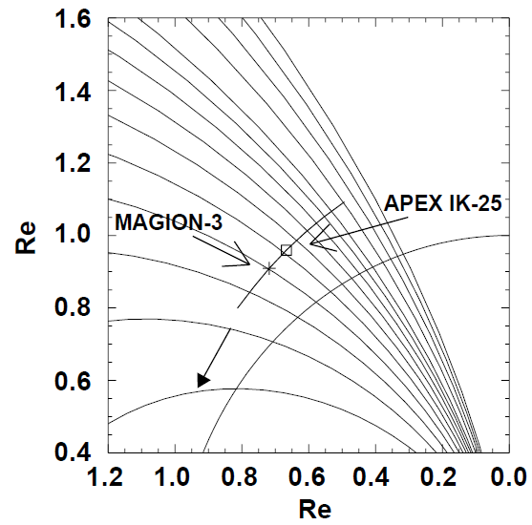
High-energy electron bursts during electron beam injections – discussion
Prech et al., AnGeo2002
Two possible sources of the bursts
Energization of the electrons emitted from the IK-25 satellite or electrons from ambient plasma due to beam-plasma interactions
Anomalous precipitation from the ring current particles induced by beam-plasma interaction
IK-25 electron gun can provide enough energy for acceleration of observed electron bursts but which of many proposed mechanisms is effective in this case is unclear. Some computer simulations [e.g., Pritchett, JGR1990] shows the beam-plasma interactions can accelerate electrons highly above the gun energy but a question is to what extent they are related to the real situation. Accelerated electron observed in OEDIPUS-C (Huang et al. JGR2001).
Another difficulty is to explain the necessary cross-field transport of accelerated electrons from the primary beam affected region to the MAGION-3 orbit and observations both ahead/behind IK-25.
It could be also that the primary beam-plasma interaction generates outward propagating waves that can support acceleration via particle-wave interactions in a wider neighborhood of the beam (magnetic field line crossing IK-25)
IK-25 observed enhancements of waves radiation at the local upper hybrid resonance and its harmonics during the F40K electron gun operation (e.g. , orbit 0431)
Electromagnetic emissions detected remotely (see further Rothkaehl et al., ASR1995)

Slide 35
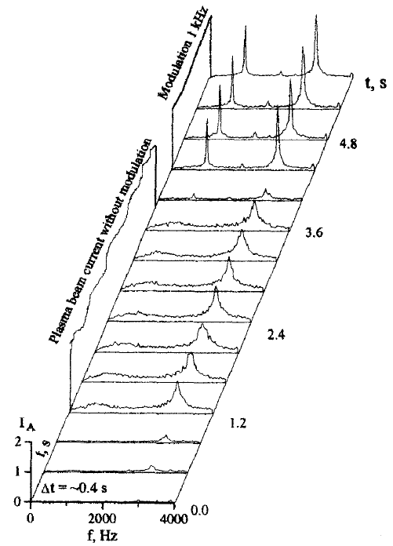
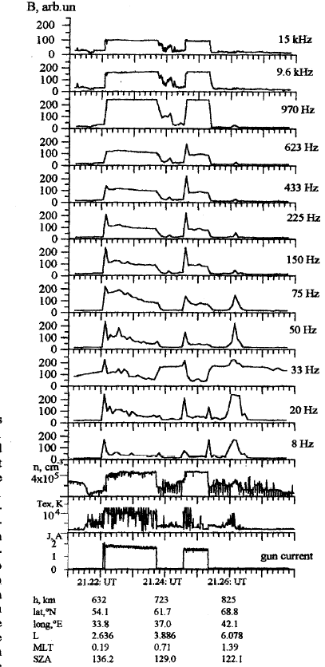
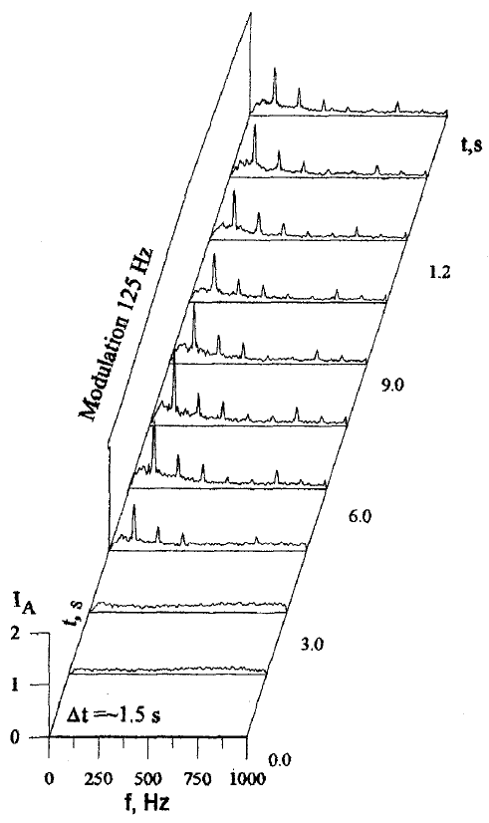
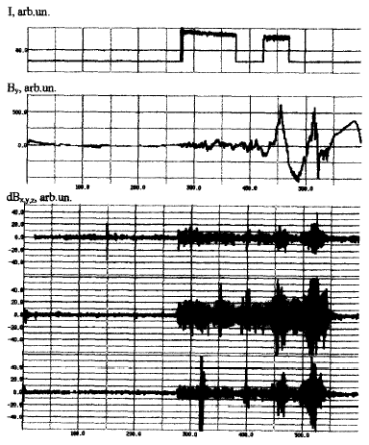
Waves generated during the Xe+ plasma emission – near zone
Mikhailov et al., PCE(C)2000
DC emission – broad VLF noise increase (3kHz S/C interference?)
F1000 – VLF emission at 1kHz and 3rd harm. (larger) /2nd harm. (smaller)
F125 – ELF emission at 125Hz and harmonics
Environment disturbed >1min (ELF) after Xe+ off (? Subauroral background, L~6, interaction of Xe plasma current with longitudinal currents)
Xe plasma cloud size estimated ~1 x ø0.5 km, total B of near zone ~1nT, Alfven waves generated in interaction with ambient plasma
OVK-ONCH (mgf)
Envelope peaks at 0.04-0.08, 0.125, 0.17Hz
SGR-5/MNCH-2
saturation
Xe+ current
1kHz
DC
Ni
TexXe+
VLF, orbit 767 2122UT 632km
ELF, orbit 756 2102UT 560km
Orbit 767 2120UT

Slide 36
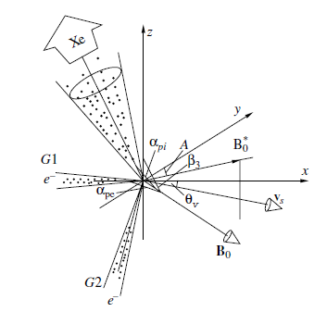
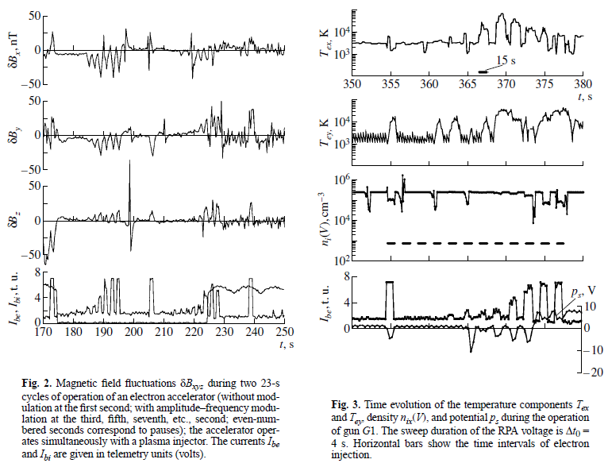
Waves generated during the DC/modulated electron beam emission – near zone
Oraevsky et al., PPR2001
Baranets et al., ASR1999
UEM-2 S250, UPM neutral/F0 mode, at day side, alt 450-470km, ω_{pe}/2π ~4.8-4.9MHz, ω_{ce}/2π ~1.1-1.2MHz
Alfven wave excitation in VLF range, transverse plasma heating, Ni perturbations
Beam-plasma discharge not occurred during this quasi-transverse injection, conditions for the beam-plasma instability development / suppression investigated in the paper
BPI => excitation of waves ω≤ω_{ci} (growth of VLF waves)
Thermal spread of beam electrons => decay of these VLF waves
Anisotropic plasma heating and modulation of ion flows near s/c, its efficiency decreases when e-beam edge p.a. >90° (for DC injection)
Decrease of integral ion flux densities j_{ix} at 7-9 (~O+) and 13-15eV (~ NO+/O2+) interpreted as a result of resonant coupling with the excited VLF waves
Observed anomalous resonant |δB| -> 500nT (calc. value from beam current and size ~10-12nT), δBz -> 70 nT – primary beam /return currents w. BPI
pa_e 74-78°
pa_xe 121-132°
SGR-5/ONCH
KM-10
15.6kHz dc S250
dc S250
neutral Xe
Xe+
neutral Xe

Slide 37
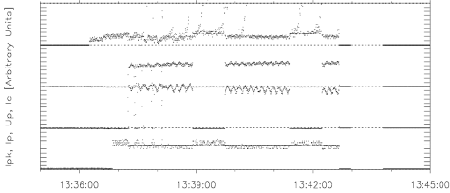
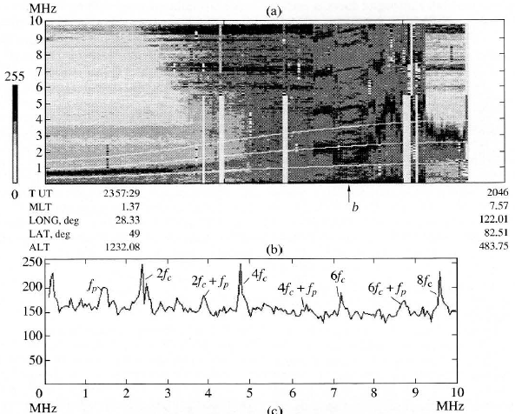
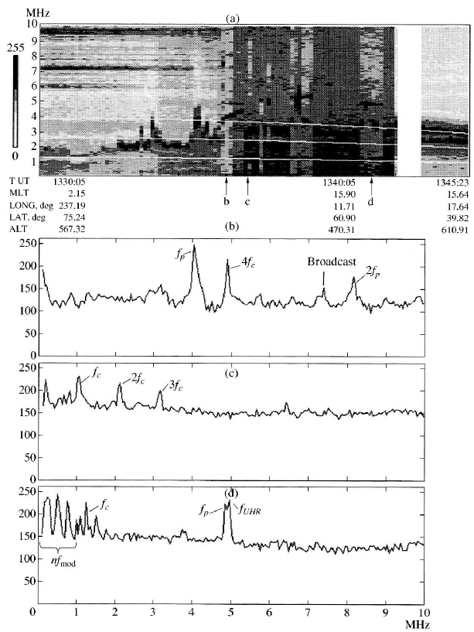
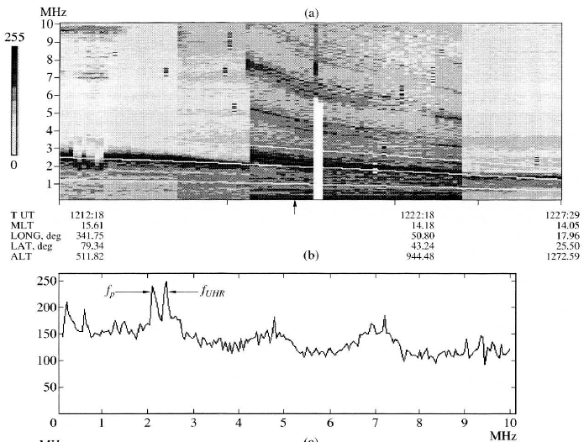
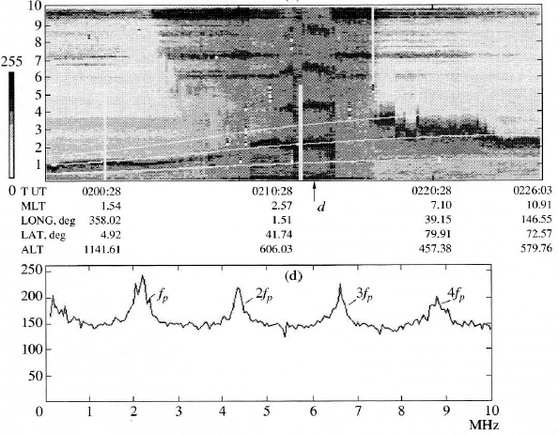
HF waves excited by the pulsed electron beam – near zone
For various ambient conditions and injection configurations different patterns of harmonics of ω_{ce}, ω_{pe,} ω_{UHR} are resolved in the HF spectra (PRS) obtained at IK-25. Harmonics of the beam modulation frequency resolved in the S250 mode.
Orbit437,
F40K, high.lat
Ibe
Ibi
Orbit266,
S250
Orbit431,
F40K
Ibe
S250/Xe+
Orbit438,
F40K, mid.lat
S250/Xe
Budko et al., GA2003

Slide 38
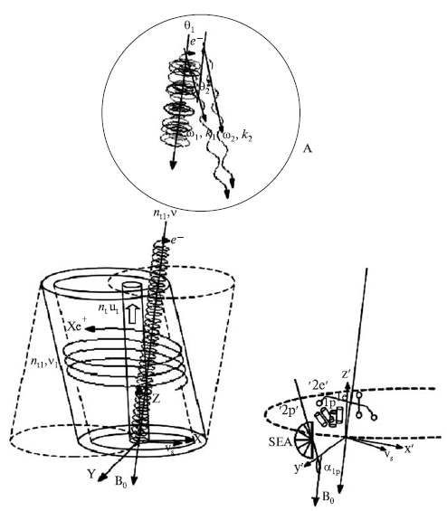
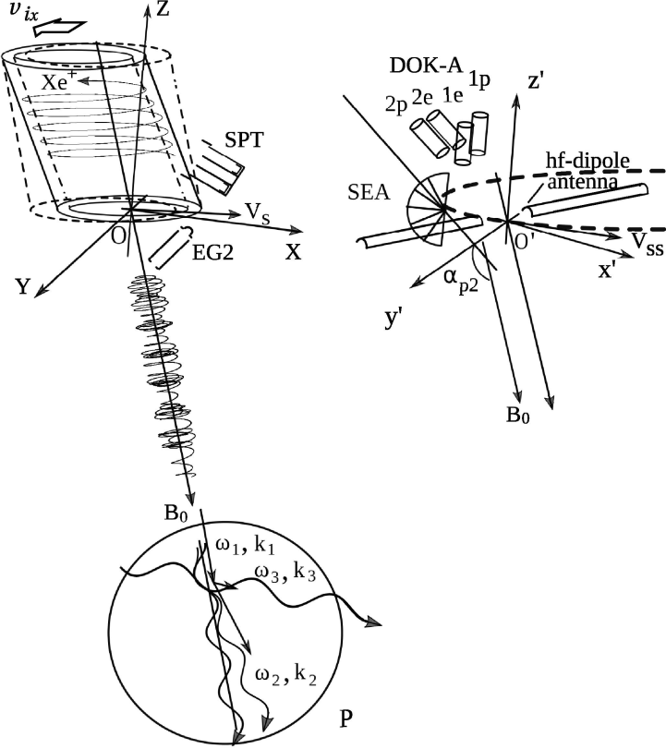
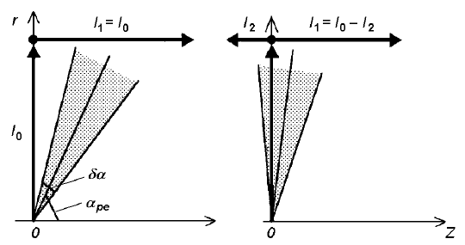
Wave processes during electron and neutral xenon/ xenon plasma beam injections
Detail analyses of beam-plasma instability development, excitation of VLF/LF and HF waves, coupling of waves, particle heating and acceleration related to APEX experiment configurations (injections through/opposite the Xe plasma cloud, quasi-perpendicular electron beam injection, injections of modulated electron beam (~ S250, F40K modes) have been performed in a series of papers by Baranets et al.
Comparison of theoretically derived quantities with data obtained by IK-25 (VLF emissions, plasma param.) , MAGION-3 (HF emissions, , accelerated electrons)
Baranets et al., ASR2012, KNIT2014
Orbits 201,202, S250
Baranets et al., KNIT2000
Orbit 266, S250
Baranets et al., ASR2017
Orbit190, F40

Slide 39
Acceleration of energetic particles by whistler waves, resonance effects
Baranets et al., ASR2012, KNIT2014
Injection axially asymmetric (Xe+ ions velocity comparable to the s/c velocity). Authors do not consider Xe cloud a diamagnetic cavity in the vicinity of s/c, describing it as a hollow beam acting as a damping layer for waves induced by the electron beam.
Electron beam current profile – a hollow flow after several gyro-turns due to electrostatic repulsion, electron beam modulation is commented
Dispersion relation for the whistler-mode wave excitations for the beam-driven electromagnetic instability is derived and the growth rate (in a weak beam approach) estimated in the paper
Anomalously large disturbances 400-500nT registered by MAGION-3 (~100km from IK-25) during S250 pulsed electron emission
Observed fluxes of fast electrons (MAGION-3/DOK-S) explained as a result of excitation of electromagnetic waves via the electron-cyclotron resonance within the beam and subsequent scattering in a wave-particle interaction (Cherenkov resonance)
The DOK-S fast electron fluxes presented here do not resemble well the events from Prech et al. AG2002 – here burst with highly fluctuating wide (scattered) p.a. distribution – simultaneous detection in DOK-S 1e,2e channels (but S250 vs F40K mode)
Orbits 201,202, S250

Slide 40
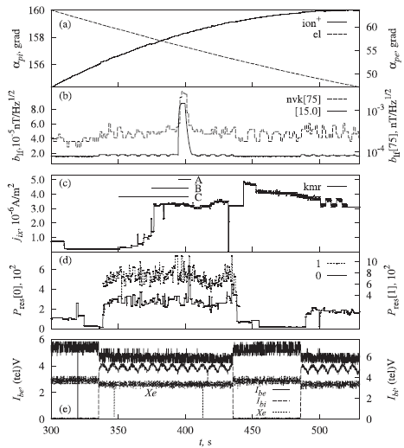
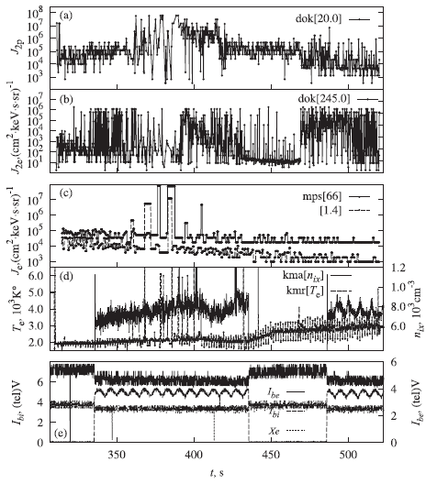
Beam-plasma interaction for constant frequency modulated electron beam injections (F40K)
Baranets et al., ASR2017
Experimental data at IK-25:
Sudden VLF amplification ~7-8s. Analysis shows the burst is observed near the linear stability boundary for the slow beam mode excited due to a dissipation of beam kinetic energy.
MAGION-3:
HF disturbed during electron beam/Xe injection
Correlated with the VLF burst@IK-25 – amplification of HF in the range ~ 0.6-1.1MHz (ω_{ce}, ω_{pe} ,k₀u) and 2.0-2.3MHz (~2k₀u)
Narrow bursts within 2.20-2.3MHz range modulated by VLF-LF wave activity in accord with the Xe ion beam current I_{bi}
Stimulated soft electron fluxes explained as disturbed due to Cherenkov wave-particle interaction (acceleration/scattering) : 50-70eV ~ excited waves near 0.1MHz, >0.5keV ~ beam-induced waves near k₀u near the linear stability boundary for longitudinal waves
Orbit 190, F40K
HF
VLF
MAGION-3 DOK-S, MPS , PRS-S
Ibe
Ibi
IK-25
Xe+ Xe
IK-25

Slide 41
Beam-plasma interaction for constant frequency modulated electron beam injections (F40K)
Baranets et al., ASR2017
Anomalous wave effects and stimulated electron fluxes registered at MAGION-3 during F40K electron beam injection from IK-25 (dist. ~ 110km)
To explain the effects the BPI for two wave longitudinal interaction is considered
The instability growth depends on frequency and wavenumber detunings between the longitudinal waves. The coupling of them (one :a slow beam mode wave with negative wave energy - pumping wave) leads to excitation of plasma waves. Depending to temporal/spatial detuning 2-wave interaction can transform to 3-wave one.
Orbit 190, F40K
HF
MAGION-3 DOK-S, MPS, PRS-S
Ibe
Ibi
Xe+ Xe
IK-25
IK-25

Slide 42
HF waves excited by the pulsed electron beam – remote zone observations
Rothkaehl et al., ASR1995
During UEM-2 F40K(+neutral Xe) electron pulsed injection RF emissions observed simultaneously on IK-25 and MAGION-3 :
Strong electrostatic emission at the upper hybrid plasma frequency and its harmonics at IK-25 (fp,fc,fu & harmonics reported by Kiraga et al. ASR1995, Kiraga et al., GM1998)
Spikes in MAGION-3 RF range – stable in freq. 2.15MHz and harmonics, half-width 50kHz ~ beam modulation frequency => electromagnetic emissions of oscillating current created by the injected electron beam
e-burst detected
PRS-3
PRS-2-S
F40K
30db/μV
UT
0 db/μV

Slide 43
Interaction of the electron beam with VLF signals transmitted from ground
Oraevsky et al., JATP1994
Spectral broadening of signals from ground-base VLF transmitters observed on MAGION-3 during electron beam injection (UEM-2 in S250 mode) from IK-25
Altitudes 1175/1580km, distance ~ 250 km, VLF ground signals 16.5, 12.6, 11.3 kHz
Broadening ~ 300-500Hz correlated with 2s modulation sequence of the S250 mode, for mod. frequencies 30.5Hz to 31.25kHz, no effects for 62.5,125,250kHz modulation
The data interpreted in terms of the scattering of whistler-mode waves into quasi-electrostatic waves by periodic small-scale plasma inhomogeneities or ELF plasma turbulence created by the pulse-modulated electron beam in the ionosphere. The reception of those waves aboard moving satellite provides the Doppler shift responsible for the spectral broadening.
17.5kHz
SOA-30 transmitter near Warsaw @ 16.5kHz
S250:
Intensity of 16.5kHz signal modulation
15.5kHz

Slide 44
Waves observed during the neutral xenon injections
Choueiri et al., JGR2001
Oraevsky et al., GA1999
~20 sessions with neutral Xe only + other periods during e-beam injection (UPM w/o ionization voltage).
E_{k}(Xe) ~20eV > U_{i}(Xe) ~12-13eV, but total mass flow small ~3mg/s => full CIV effects not observed, but some partial processes
HF emissions 3-10MHz during Xe p.a. 85-115°/dayside, intensifications not observed for p.a. 57-71°/nightside, the frequency does not depend on B
HF emissions in 8-10MHz band
? Stable photoionization => HF emission freq. stable
No changes in plasma density observed, week electron temperature enhancements detected
KM-10
PRS-3 orbit 419
Cloud of injected Xe to 60° cone 5-8 km/s vs. background plasma => est. gas density ~10⁹ (10⁷) cm⁻³ at 100 (1000) m
Seed ions by – Xe charge exchange collisions, impact ionization by ambient electrons, photoionization
Further processes assessed in the papers – elastic collisions ions/Xe neutrals (scattering/reflection), electron heating
Reflected ions near injector – bump-on-tail distr. => ion-ion instability (LH waves at 3-100m distance) => electrons could be accelerated to 10-20Te, for IK-25 case est. 1% of Xe in 1000s ionized
Expected suprathermal electron flux/ collision rate w. Xe will not increase density
Neutral Xe
ω_{ce} harmonics

Slide 45
Main results (IZMIRAN web)
For the first time during space experiments it was shown an opportunity of ballistic transformation of a wave through an ionospheric wave barrier. A qualitative theory of this phenomenon has been built.
New nonlinear electromagnetic structures like collisionless shock waves ( "jumps" of electric and magnetic fields, plasma density "jumps") are found.
In the polar area new types of ionospheric throws, so-called "slanting" ionospheric throws are discovered.
It has been proved experimentally, that the generation of kilometer radiation is produced by ascending flows of electrons.
It has been shown, that the modulated beam of electrons can be used for nonlocal determination of electron density and the magnetic field value.
The possibility has been shown of an injection of the beam of electrons under conditions of insufficient neutralization of electric charge of the spacecraft.
(Results of active experiments in red)

Slide 46
Main results 2 (IZMIRAN web)
It has been proved that the modulated beam of electrons is an effective virtual antenna for the generation of VLF waves in space. The emission properties of electron beams were studied and measurements of the modulated electron beam radiation were done on the remote subsatellite controlled by its own thrusters.
The observations are carried out in a wide range of magnetospheric conditions: from equatorial up to the high latitudinal auroral zones, including magnetic force tubes extending from the surface over a few Earth radii.
For the first time the VLF emission of a modulated electron beam is registered on a subsatellite at distances of tens of km.
Researches of the phenomenon of critical ionization velocity of neutral gas offered by Alfven were carried out. The possibility of critical ionization of an injected neutral gas was studied experimentally.
At injection of an electron beam from main spacecraft, artificial broadening of a spectrum of a VLF signal of the ground-based transmitter registered on remote subsatellite was found out.
Complex experiments, coordinated with ground-based radiophysical and geophysical observatories, were carried out. Among them series of correlated experiments with satellite measurements of plasma parameters over the ionospheric plasma heating facilities (over powerful ground radio stations) were performed.
Measurements of plasma parameters in the auroral area in the range of heights of 450 -3000 km/s were done and extensive volume of data on the plasma particle flows, wave activity, variations of electrical and magnetic fields has been obtained.
Auroral precipitation dynamics, mapping and dynamics of polar cusps depending on the variable interplanetary conditions have been studied.

Slide 47
Critical remarks
After a battle everybody can be a general.
The APEX active experiments performed only during the first 6 months, with certain recurrent technical issues of the active payload UEM-2/UPM, which probably did not allow to obtain complementary data during the second half year or to repeat unsuccessful AE configurations.
Ambitious project with many configuration options. But RTT sessions (RTS, STO-AP, STO) over east European ground TM stations limited choice of location/ambient parameters (some of them interdependent). IK-25 / MAGION-3 key/best resolution data many times do not overlap which could be improved should more stations were used simultaneously and more sophistically.
Coordination, exchange of data, and communication between science teams were sometime slow. Various technical details hidden (could be a problem of knowledge transfer from IK-25 s/c & payload designers to scientists) => difficult unambiguous data interpretation .

Slide 48
Selected publications
Experiment description:
Oraevsky and Triska, Active plasma experiment – project APEX, Adv.Space.Res. 13, No.10, 1993
Triska et al., A subsatellite for mother-daughter active experiments, Adv.Space.Res. 10, No.7, 1990
Dokukin VS, The APEX project scientific facility orbital complex, in “Project APEX, scientific purposes, simulation, technology and equipment of experiment”, eds. Oraevsky and Ruzhin, NAUKA, Moscow, 1992 (in Russian)
Oraevsky et al., APEX project: Scientific problems, modeling, technique, and equipment of the experiment, in “Project APEX, scientific purposes, simulation, technology and equipment of experiment”, eds. Oraevsky and Ruzhin, NAUKA, Moscow, 1992 (in Russian)
S/c charge neutralization, hot particle response to electron/ion beam emissions:
Nemecek et al., A behaviour of electron and ion energy and angular distribution during the active APEX experiment, Adv.Space.Res. 13, No.10, 1993
Nemecek et al., Artificial electron ad ion beam effects: Active Plasma Experiment, J.Geophys.Res. 102, A2, 1997
Prech et al., Response of the electron energy distribution to an artificially emitted electron beam: APEX experiment, Adv.Space.Res. 15, No.12, 1995
Prech et al., Observations of the beam-plasma interaction during the APEX artificial electron beam emission, Adv.Space.Res. 21, No.5, 1998
Prech et al., Artificial ion beam effects on spacecraft potential, Adv.Space.Res. 24, No.8, 1999
Zilavy et al., Spacecraft potential during active experiment: a comparison of experimental results with a simple model , Ann. Geophys. 21, 2003
Remote observations:
Nemecek et al., Short time high energy electron fluxes in day-side magnetosphere, Adv.Space.Res. 17, No.10, 1996
Prech et al., Actively produced high-energy electron bursts within the magnetosphere: the APEX project, Ann. Geophys. 20, 2002
Rothkaehl et al., Remote spacecraft observations of waves excited by the pulse electron beam injected into ionosphere, Adv.Space.Res. 15, No.12, 1995

Slide 49
Selected publications
Waves and turbulence during electron beam emissions:
Baranets et al., Active experiments in space for the investigation of beam-plasma interactions. Results of the APEX project, Adv.Space.Res. 24, No.8, 1999
Baranets et al., Electron beam injection quasi-perpendicular to magnetic field according to the satellite INTERCOSMOS-25 data: project APEX, Kosm. Nauka i Tech. 6, 2000 (in Russian)
Baranets et al., Development of beam–plasma instability during the injection of low-energy electron beam into the ionospheric plasma, Plasma Phys.Rep. 33, No.12,2007
Baranets et al., Excitation of HF and ULF-VLF waves during charged particle beams injection in active space experiment, J. Plasma Fusion Res. SERIES 8, 2009
Baranets et al., Acceleration of Energetic Particles by Whistler Waves in Active Space Experiment with Charge Particle Beams Injection, Adv.Space.Res. 49, 2012
Baranets et al., Resonance effects of wave-particle interactions during artificial charges particle beam injections in ionospheric plasma, Kosm. Nauka i Tech. 20, 2014 (in Russian)
Baranets et al., Injection of 40kHz-modulated Electron Beam from the Satellite: I. Beam-Plasma Interaction near the Linear Stability Boundary, Adv.Space.Res. 59, 2017
Oraevsky et al., Magnetic field excitation during electron beam injection from the Intercosmos-25 satellite (APEX), Plasma Phys. Rep., 27, No.4, 2001
Budko et al., Some features of the plasma turbulence region in the active experiment on board the APEX satellite, Geomagn. and Aeronomy, 43, 2003

Slide 50
Selected publications
HF waves during electron beam emissions:
Kiraga et al., Observation of fundamental magnetoplasma emissions excited in magnetosphere by modulated electron beams, Adv.Space.Res. 15, No.12, 1995
Kiraga et al., Electromagnetic emissions in the ionosphere – pulsed electron beam system, Geophys. Monogr. 103, 1998
Kiraga, On the performance of a cylindrical dipole antenna in diagnostics of wave phenomena in space plasma, Adv.Space.Res. 32, No.3, 2003
Waves during xenon plasma injections:
Volokitin et al., Modulation of VLF waves by ion-cyclotron oscillations during heavy-ion injection into ionosphere, Geom. and Aeronomy 35, No.6, 1995 (in Russian)
Mikhailov et al., Waves generated in the vicinity of Xenon plasma gun in the APEX experiment, Phys. Chem. Earth (C) 25, No.1-2, 2000
Volokitin et al., Magnetic effects of plasma cloud injection into ionosphere (Experiment APEX), Geom. and Aeronomy 40, No.3, 2000 (in Russian)

Slide 51
Selected publications
Active experiments w. neutral xenon emissions:
Oraevsky et al., APEKS: neutral xenon release experiments, Geom. and Aeronomy, 39, No.5, 1999
Choueiri et al., Observing and modeling of neutral gas releases from the APEX satellite, J.Geophys.Res. 106, A11, 2001
Active experiments w. ground-based transmitters:
Oraevsky et al., Effects of artificially injected electron beams on the characteristics of ground VLF transmitter signals in the ionosphere, J. Atm. Terr. Phys., 56, No.3, 1994
Oraevsky et al., Modification natural and manmade EM environment due to ionosheric plasma barrier transparency for ground-based transmitter emission, in Magnetospherics research with advanced techniques (ed. Xu and Lui), COSPAR Coll. Ser. 9, 1998
Oraevsky et al., Emissions stimulated in the upper ionosphere by the SURA heating facility, Adv. Space Res. 21, No.5, 1998

Slide 52
End
Thank you for your attention.
Any questions?

