Slide 1
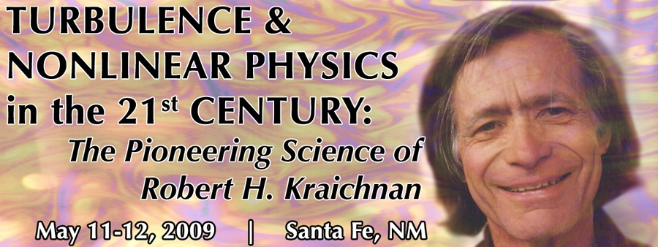
Lagrangian Turbulence
Misha Chertkov
May 12, 2009

Slide 2
Eulerian vs Lagrangian [Kolmogorov, Richardson]
Kolmogorov/Eulerian Phenomenology
Kraichnan/Lagrangian Phenomenology
Passive Scalar = Rigorous Lagrangian Stat-Hydro
Attempts of being rigorous with NS
[Wyld, Martin-Siggia-Rose, L’vov-Belinicher, Migdal, Polyakov]
Instantons [Falkovich,Kolokolov,Lebedev,Migdal]
= potentially rigorous … but in the tail … more to come
Tetrad Model = back to Lagrangian Phenomenology
Where do we go from here?
[Lagrangian: experiment,simulations should lead]
Outline
sweeping, quasi-Lagrangian variables
Lagrangian [Richardson] dispersion
[MC, Pumir, Shraiman]

Slide 3
Rayleigh-Taylor Turb.
Burgulence
MHD Turb.
Collapse Turb.
Navier-Stocks Turb.
Kinematic Dynamo
Wave Turb.
Chem/Bio reactions
in chaotic/turb flows
Elastic Turb.
Polymer
stretching
Passive Scalar Turb.
Spatially
non-smooth flows
(Kraichnan model)
Spatially
smooth flows
(Batchelor model)
Intermittency
Dissipative anomaly
Cascade
Lagrangian Approach/View

Slide 4
Lagrangian
movie
Eulerian
snapshot
E. Bodenschatz (Cornell) Taylor based Reynolds number : 485
frame rate : 1000fps
area in view : 4x4 cm
particle size 46 microns
Curvilinear channel in the
regime of elastic turbulence
(Groisman/UCSD,
Steinberg/Weizmann)
[scalar]
[scalar]
Equilibrium steady state
vs
Non-Equilibrium steady state
(turbulence)
Fluctuation Dissipation Theorem
(local “energy” balance)
Cascade
(“energy” transfer over scales)
Gibbs Distribution
exp(-H/T)
??????
Need to go for dynamics (Lagrangian description) any case !!!

Slide 5

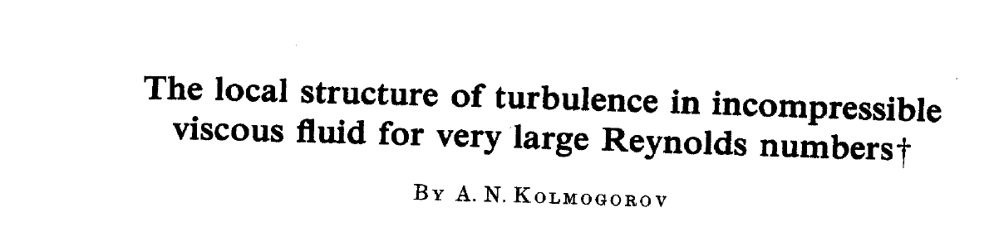
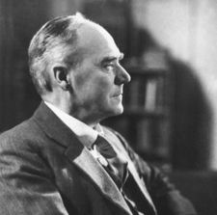
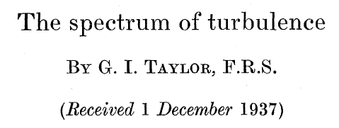
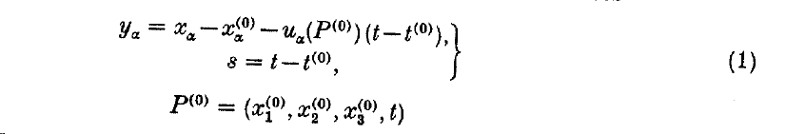
Kolmogorov/Eulerian Phenomenology
viscous
(Kolmogorov)
scale
integral
(pumping)
scale
cascade
Kolmogorov, Obukhov ‘41
Quasi-Lagrangian variables were
introduced but not really used (!!)
in K41
``Taylor frozen turbulence” hypothesis
Combines/relates Lagrangian and Eulerian
Quasi-Lagrangian !!

Slide 6

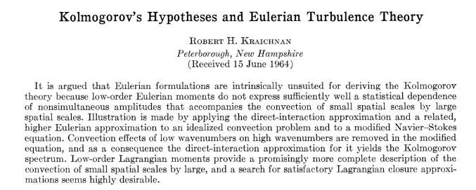

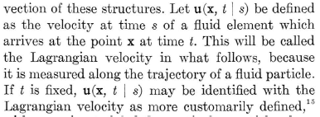
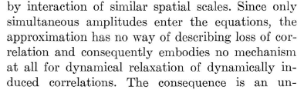

Kraichnan/Lagrangian Phenomenology
[sweeping, Lagrangian]
Eulerian closures are not consistent – as not accounting for sweeping
Lagrangian Closure in terms of covariances

Slide 7
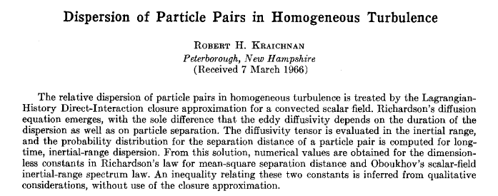
Kraichnan/Lagrangian Phenomenology
[Lagrangian Dispersion]
Starting point: ``Abridgement” LHDI = ``Lagrangian Mean-Field”
N.B. Eyink’s talk
Coefficient in Richardson Law (two particle dispersion)
Obukhov’s scalar field inertial range spectrum
Relation between the two

Slide 8
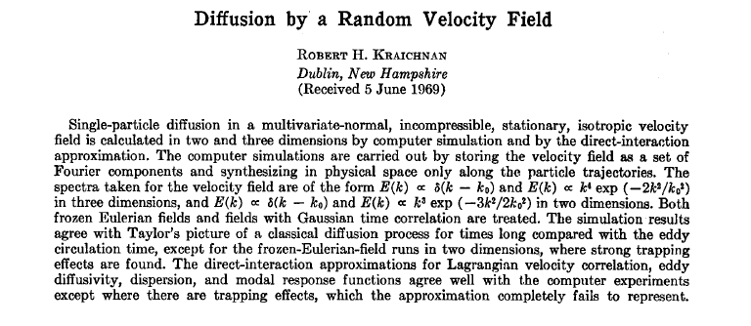
Kraichnan/Lagrangian Phenomenology
[Random Synthetic Velocity]
DIA for scalar field [no diffusion] in synthetic velocity vs simulations
Eulerian velocity is Gaussian in space-time. Distinction between fozen and finite-corr. ?
Focus on decay of correlations (different time) integrated over space quantities
Reproduce diffusion [Taylor] at long time and corroborate on dependence on time-corr.
DIA is good … when there is no trapping (2d)
DIA is asymptotically exact for short-corr vel. [now called Kraichnan model]

Slide 9
From Eulerian to Lagrangian [PS]
Average over “random”
trajectories of 2n particles
Closure ?
r
L
Field formulation
(Eulerian)
Particles (“QM”)
(Lagrangian)

Slide 10
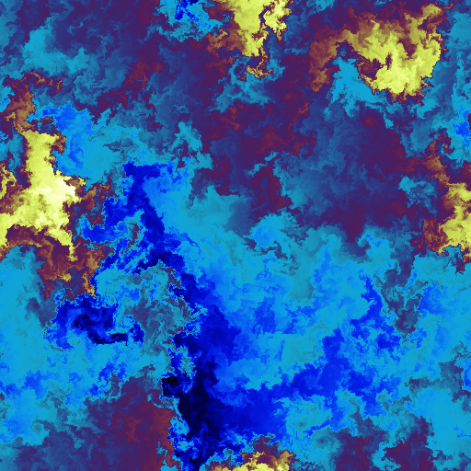
Kraichnan model
‘74
Lagrangian (path-integral)
Eulerian (elliptic Fokker-Planck), Zero Modes, Anomalous Scaling
Kraichnan ‘94
MC,G.Falkovich, I.Kolokolov,V.Lebedev ’95
B.Shraiman, E.Siggia ’95
K.Gawedzki, A.Kupianen ’95
1/d-expansion MC, GF, IK,VL ‘95
``almost diffusive” limit KG, AK ‘95
``almost smooth” limit BS, ES ’95
instantons (large n) MC ’97; E.Balkovsky, VL ’98
Lagrangian numerics U.Frisch, A.Mazzino, M.Vergassola ’99
Fundamentally important!!!
First analytical confirmation
of anomalous scaling in
statistical hydrodynamics/
turbulence

Slide 11
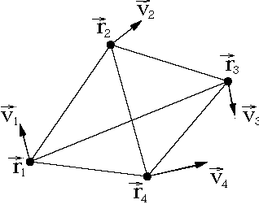
Lagrangian phenomenology of Turbulence
QM approx. to FT
velocity gradient tensor
coarse-grained over the blob
tensor of inertia of the blob
Stochastic minimal model verified against DNS
* motivation
* results
Chertkov, Pumir, Shraiman
Phys.Fluids. 99 ++
stochastic
Steady, isotropic Navier-Stokes turbulence
Intermittency: structures corr.functions
Challenge !!! ``Derive” it … or Falsify
Develop Lagrangian Large-Eddy Simulations

Slide 12
And after all … why “Lagrangian” is so hot?!
Soap-film 2d-turbulence:
R. Ecke, M. Riviera, B. Daniel
MPA/CNLS – Los Alamos
Now
1930s
High-speed digital cameras,
Promise of particle-image-velocimetry (PIV)
Powefull computers+PIV -> Lagr.Particle. Traj.
Promise (idea) of
hot wire anemometer
(single-point meas.)
…
Taylor, von Karman-Howarth,
Kolmogorov-Obukhov
“The life and legacy of
G.I. Taylor”, G. Batchelor

Slide 13
Fundamentals of NS turbulence
Kolmogorov 4/5 law
Richardson law
Intermittency
rare events
more (structures)

Slide 14
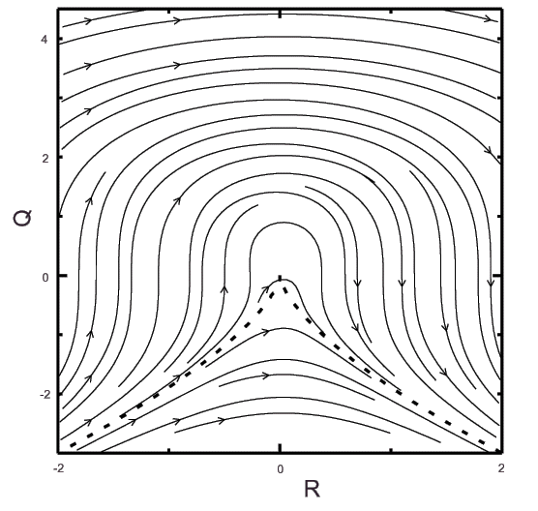
Less known facts
Restricted Euler equation
Viellefosse ‘84
Leorat ‘75
Cantwell ‘92,’93
Isotropic, local
(Draconian appr.)

Slide 15
Restricted Euler. Partial validation.
DNS on statistics of vorticity/strain alignment is compatible
with RE ** Ashurst et all ‘87
DNS for PDF in Q-R variables respect the RE assymetry
** Cantwell ‘92,’93; Borue & Orszag ‘98
DNS for Lagrangian average flow resembles
the Q-R Viellefosse phase portrait **
Still
Finite time singularity (unbounded energy)
No structures (geometry)
No statistics

Slide 16
How to fix deterministic blob dynamics?
To count for concomitant evolution of and !!
velocity gradient tensor
coarse-grained over the blob
Energy is bounded
No finite time sing.
tensor of inertia
of the blob
* Exact solution of Euler in the domain bounded by perfectly elliptic
isosurface of pressure

Slide 17
Where is statistics ?
self-advection
Verify against DNS
small scale pressure and
velocity fluctuations
coherent
stretching
Stochastic minimal model
+ assumption:velocity statistics
is close to Gaussian
at the integral scale

Slide 18
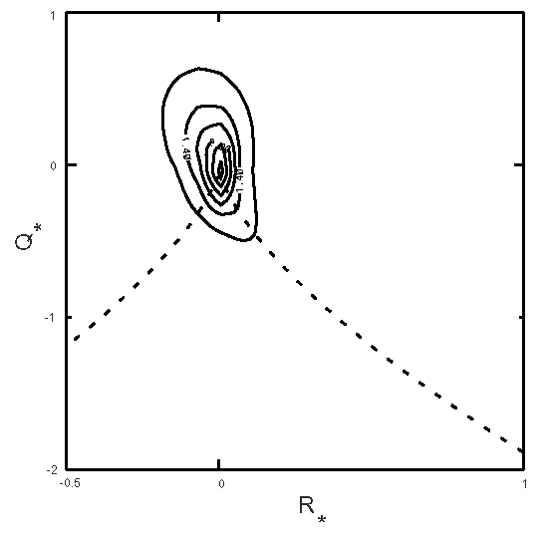
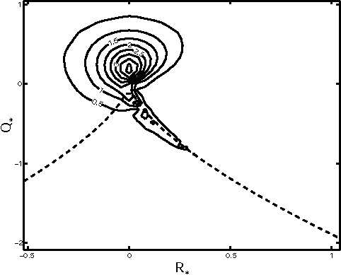
Enstrophy density
DNS
Model

Slide 19
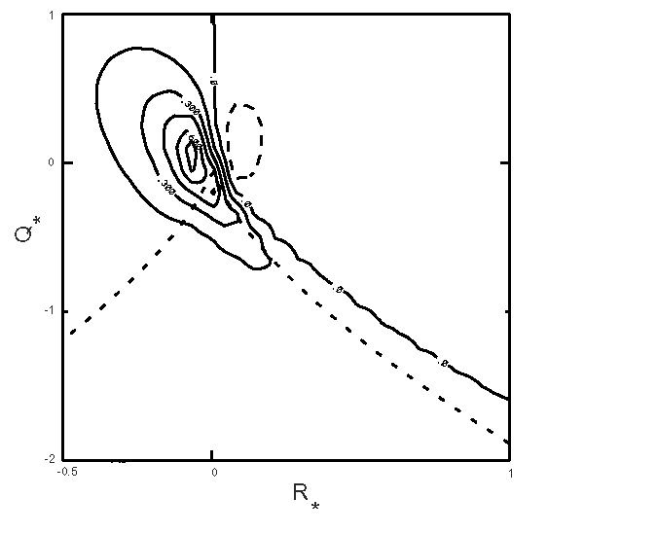
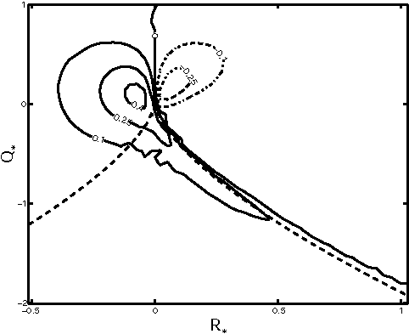
Enstrophy production
DNS
Model

Slide 20
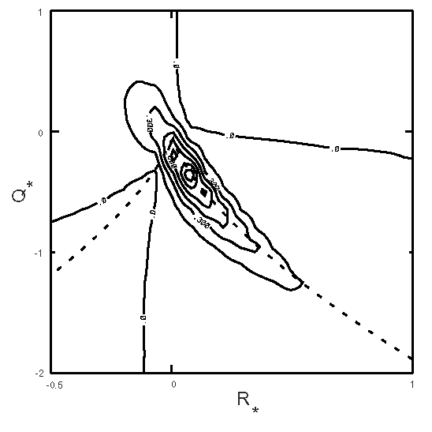
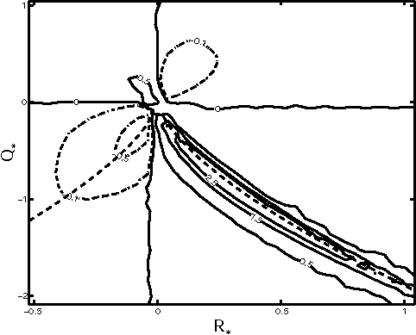
Energy flux
DNS
Model

Slide 21
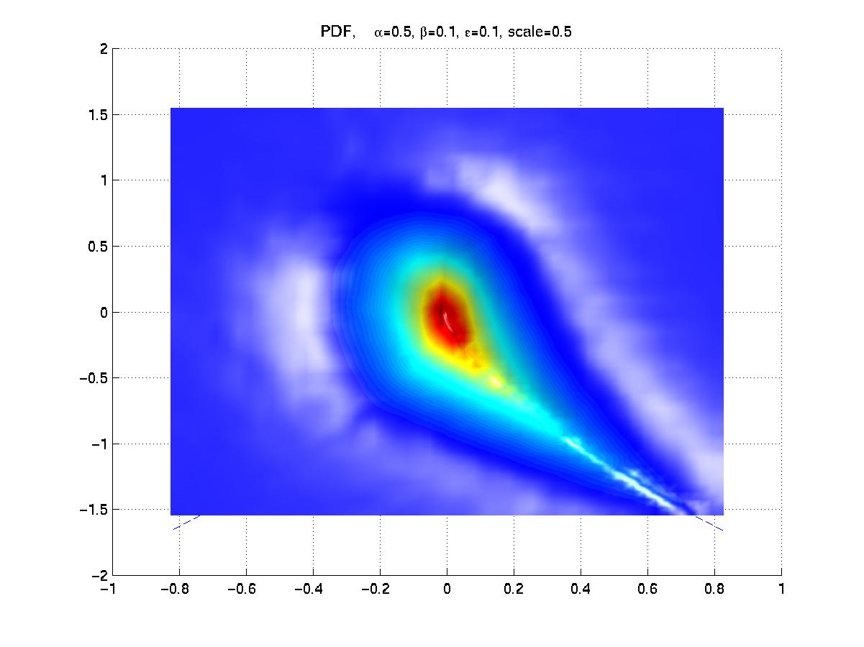
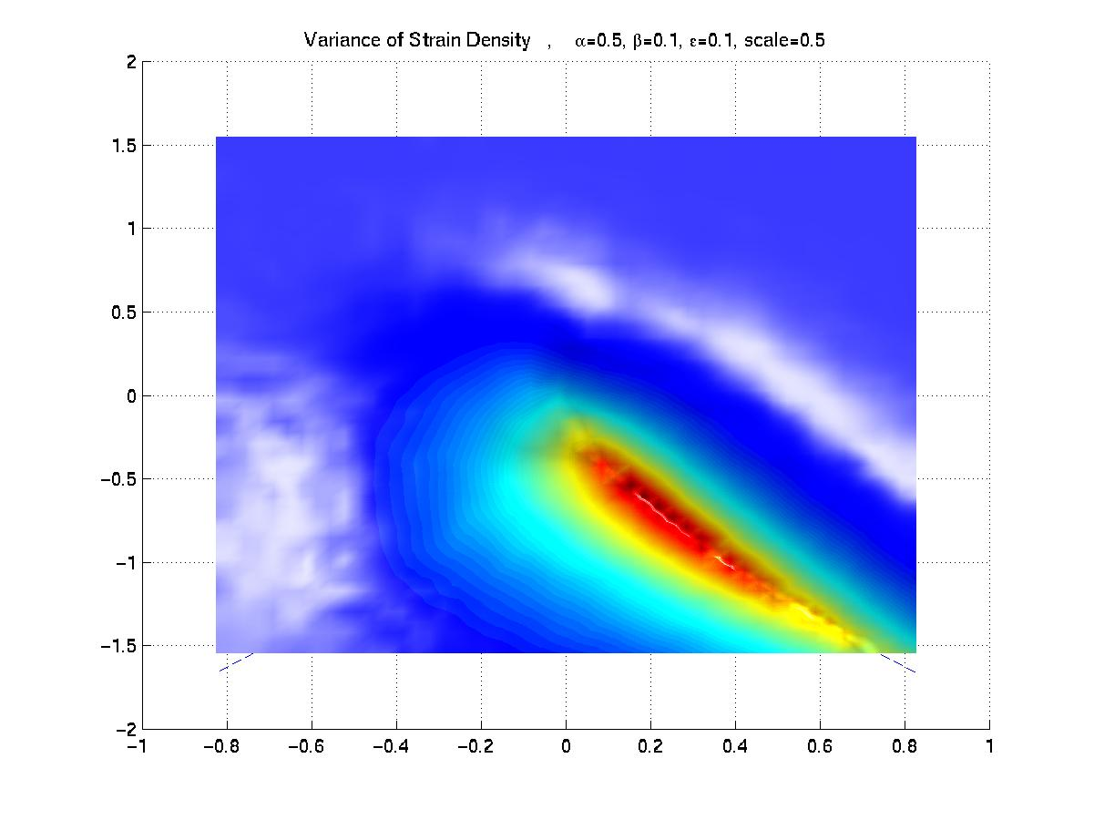
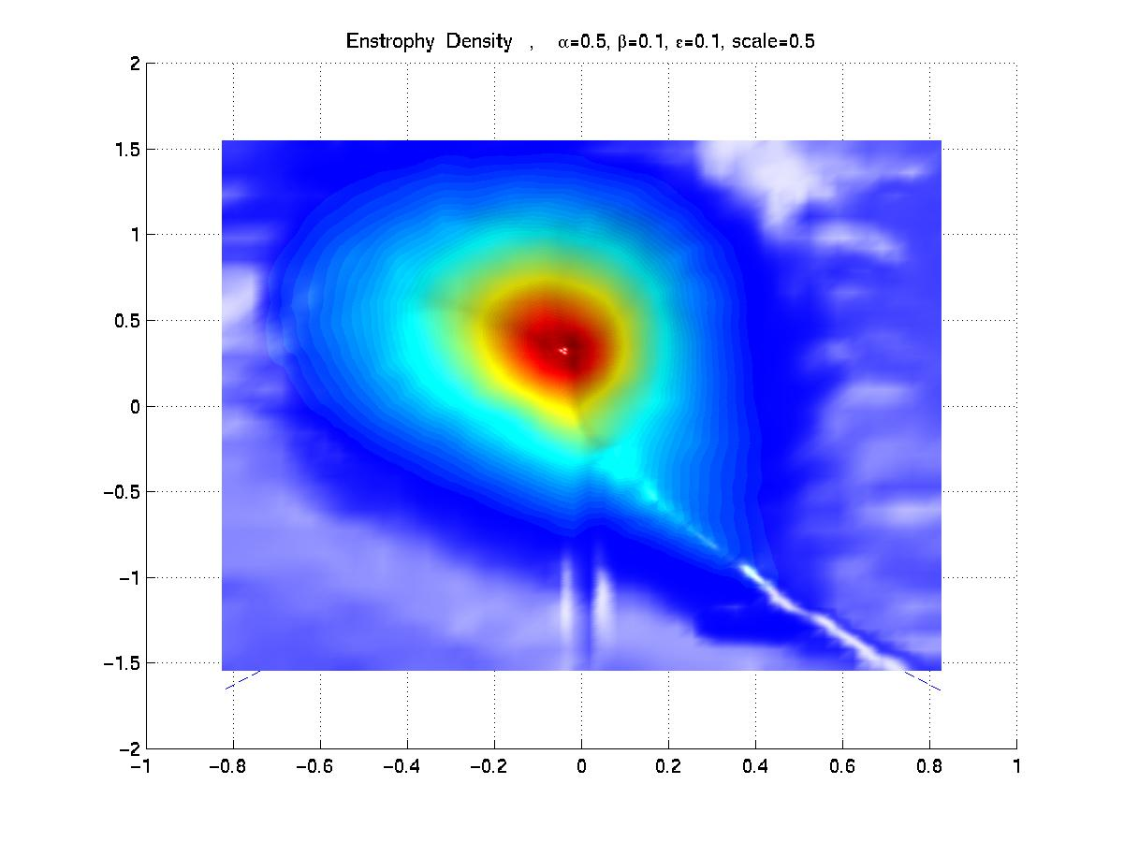
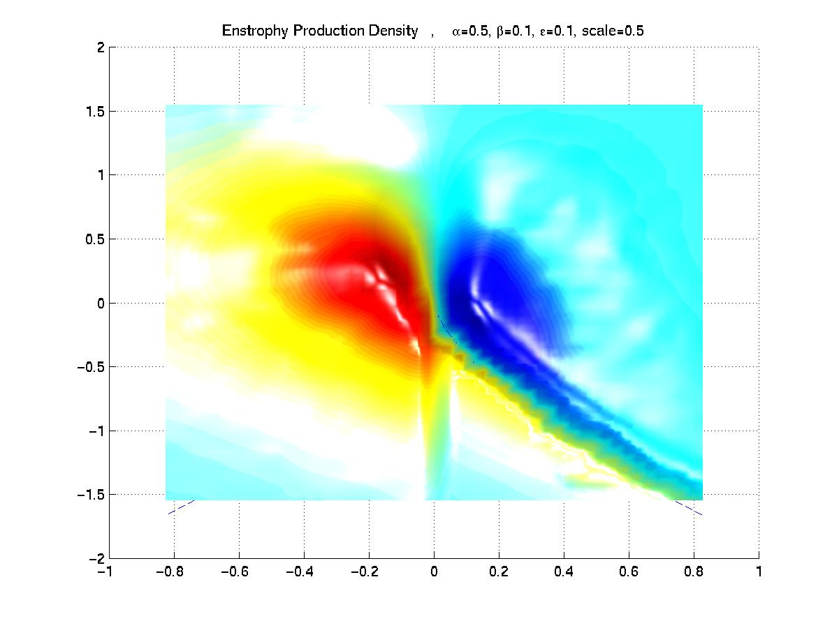
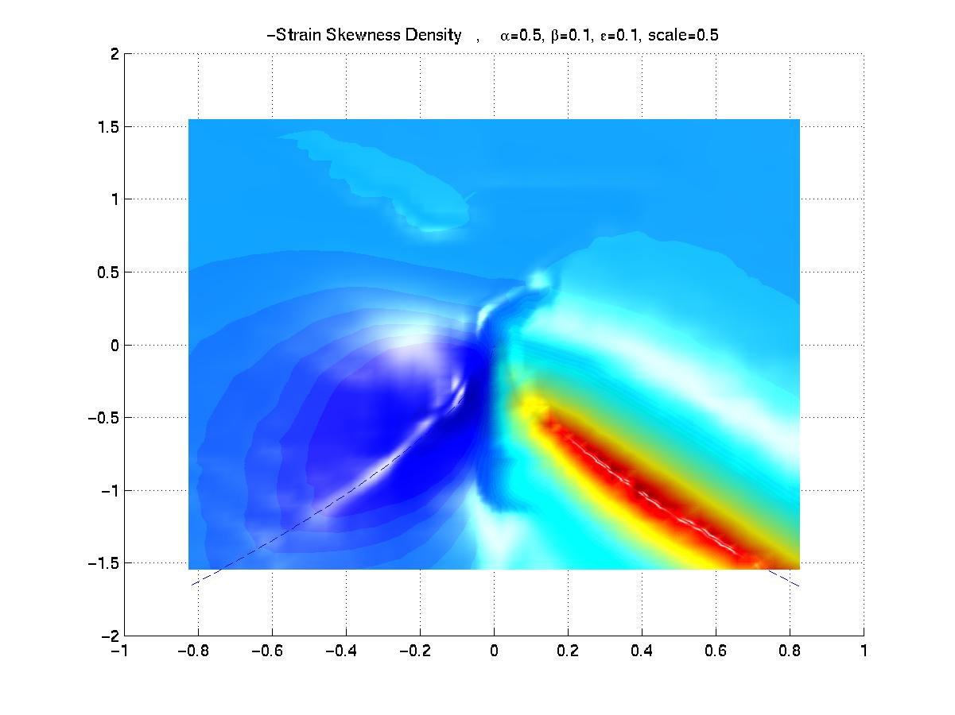
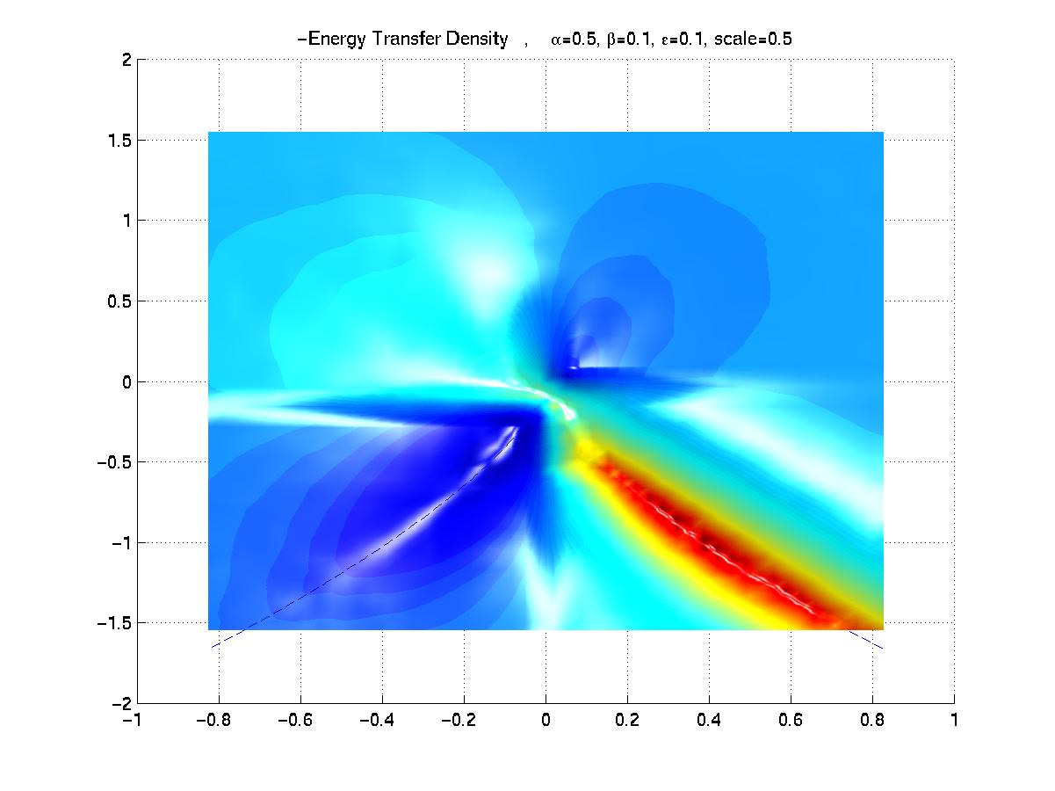
Statistical Geometry of the Flow
Tetrad-main

