Slide 1
Dynamics of Skyrmions in Chiral Magnets
Charles Reichhardt, Cynthia Reichhardt, Dipanjan Ray, S.Z. Lin
Los Alamos National Laboratory

Slide 2
courtesy of A. Saxena

Slide 3
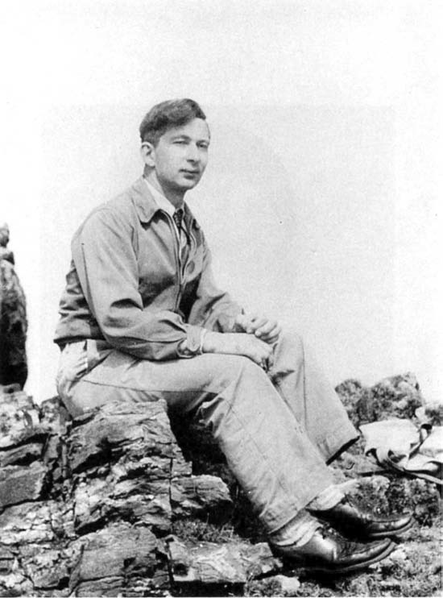
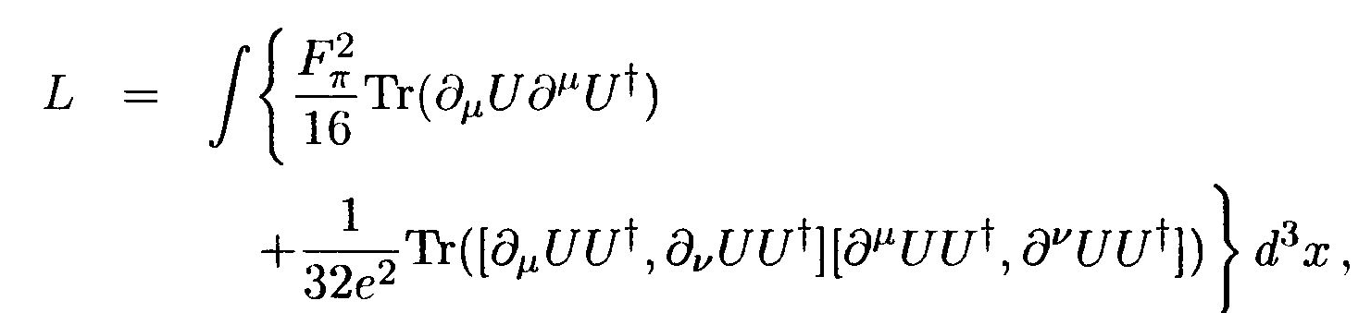

Skyrmions
Tony Hilton Royle Skyrme, (1922–1987)
1961 Formulated a nonlinear field theory of massless pions in which particles can be represented by topological solitons
“Skyrmions”
1961-1984 Skyrmions generally ignored
Witten demonstrates connection between Skyrme’s model and QCD in the low-energy, large-Nc expansion.
2009 Experimental realization of skyrmions in chiral magnet (TMU)
Low energy effective field for QCD
Chiral Lagrangian
Stabilizing fourth-order term
$U(t,r)$: SU(2) field
T. H. R. Skyrme, Proc. R. Soc. London, Ser. A 260, 127 (1961).
Supports topological soliton, now known as skyrmion.
Skyrmions are realized in condensed matter systems, such as He³A, quantum Hall systems, Bose-Einstein condensates, multiband superconductors, liquid crystal and magnets.

Slide 4
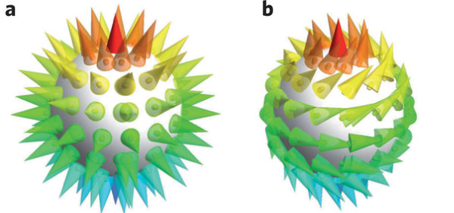
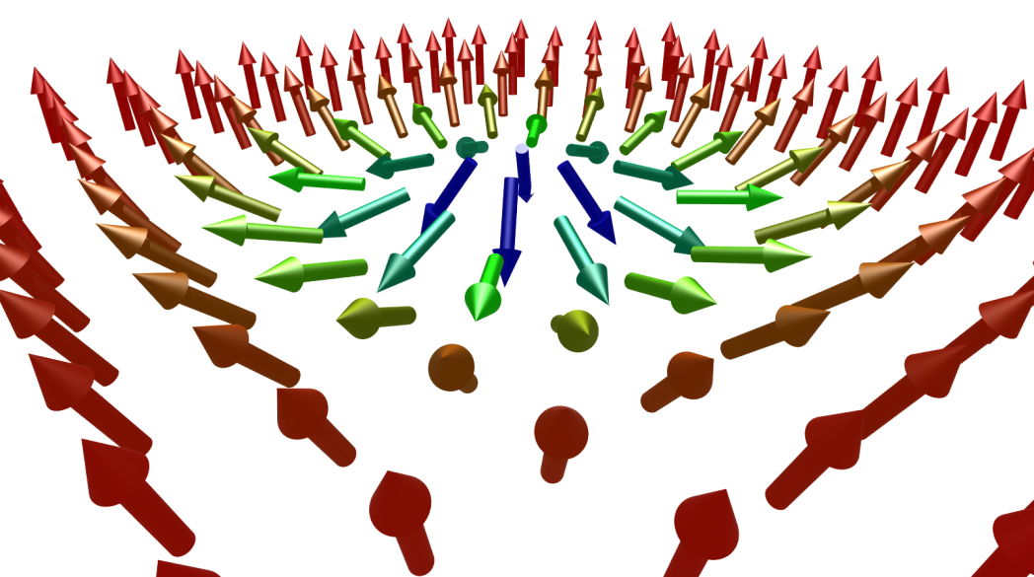
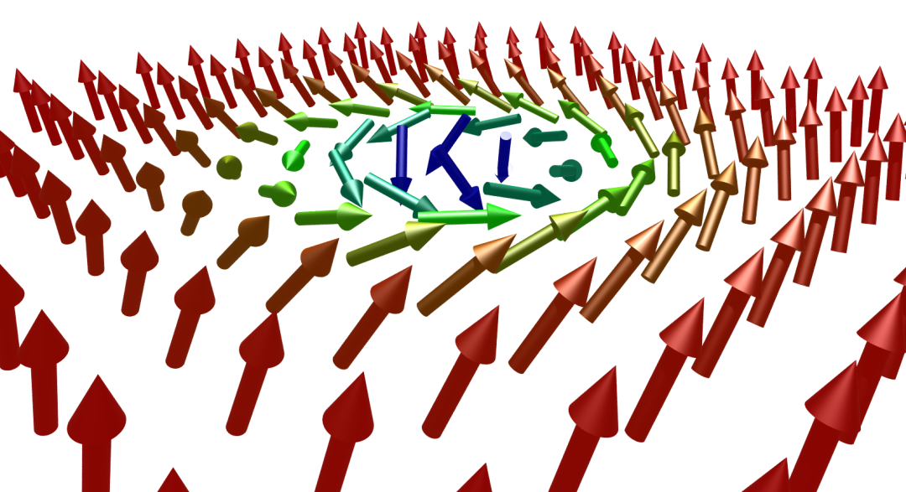
Skyrmions in magnets
Spin configurations can wrap a sphere
Can have chirality
Spin shifts by π away from skyrmion core
Solitons in field theories with no massless fields: Vortices
Solitons in field theories with massless fields: Monopoles, skyrmions

Slide 5
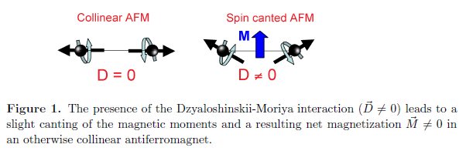
DM interaction: broken inversion symmetry
Example: Atomic crystal of (cubic B20) MnSi lacks space-inversion symmetry.
Result: Weak spin-orbit coupling
Generates slow rotations of all magnetic structures
Rotation scale: 190A; lattice constant: 4.56A.
Magnetic structures are effectively decoupled from atomic lattice.
Application of a magnetic field breaks time-reversal symmetry.

Slide 6
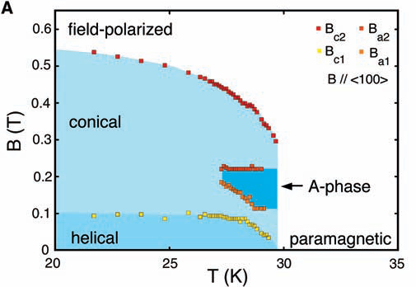
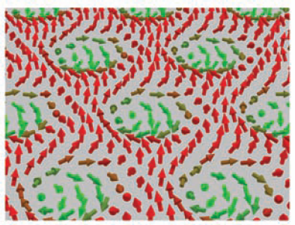
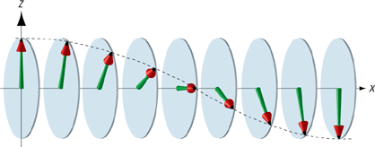
First experimental observation
SANS
Bulk chiral itinerant-electron magnet:
MnSi
S. Mühlbauer, et al. Science 323, 915 (2009).
K . Kadowaki et al J. Phys. Soc. Jpn, 51, 2433 (1982)

Slide 7
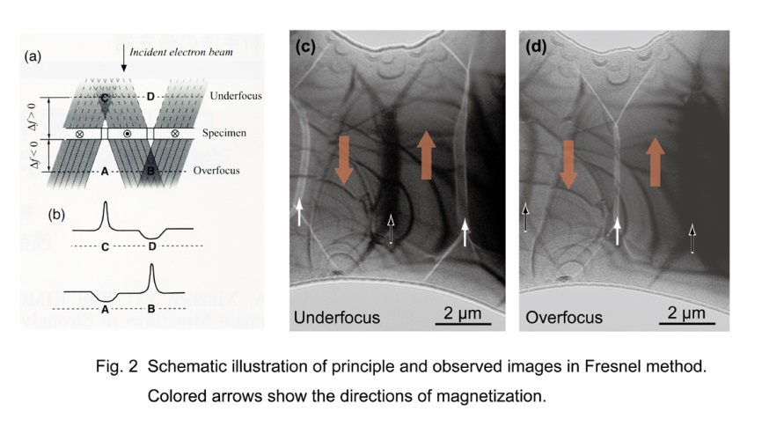
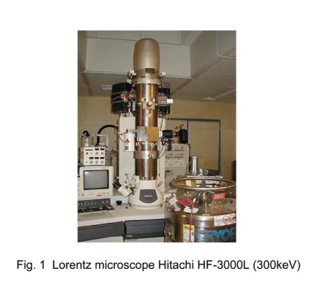
Direct visualization of magnetic structure
Lorentz Transmission Electron Microscopy
National Institute for Materials Science, Japan

Slide 8
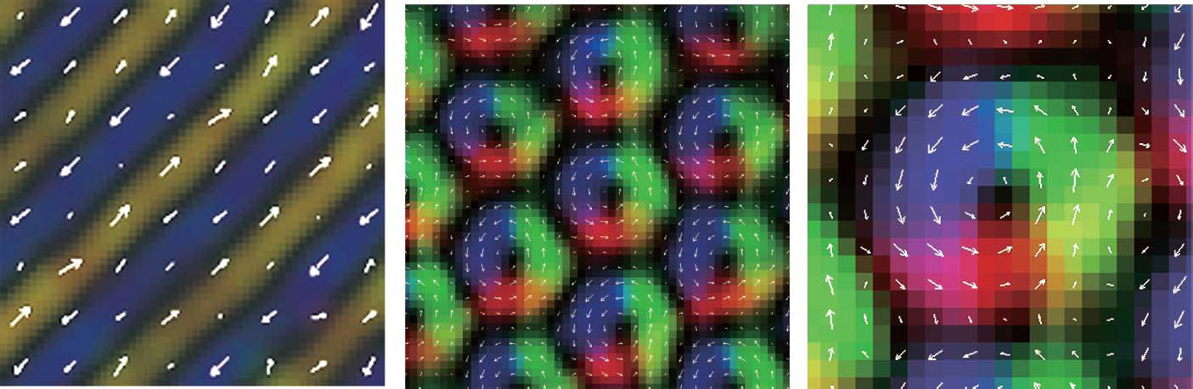
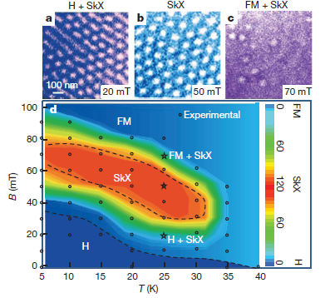
Real space observation of skyrmions in thin films
Helical
Skyrmion crystal
Close-up
Lorentz transmission electron microscopy;
measure the in-plane component of spin.
Materials: Fe_{0.5}Co_{0.5}Si
Three-dimensional helical magnet
B30 w/ cubic but non-centrosymmetric structure
X. Z. Yu et al. Nature 465, 901 (2010).

Slide 9
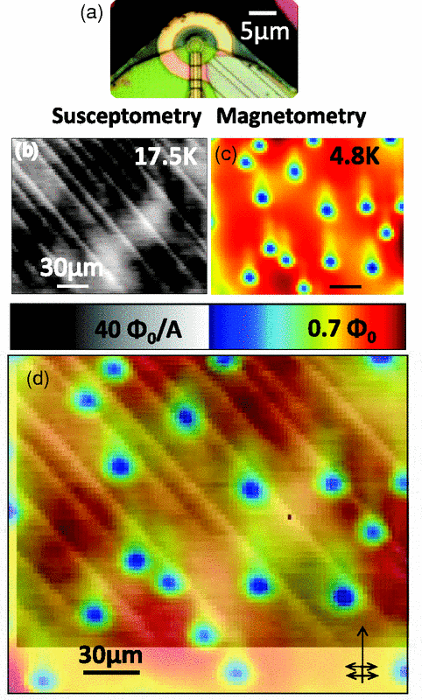
Skyrmions have some similarities to superconducting vortices
B. Kalisky et al, PRB 83, 064511 (2011)

Slide 10
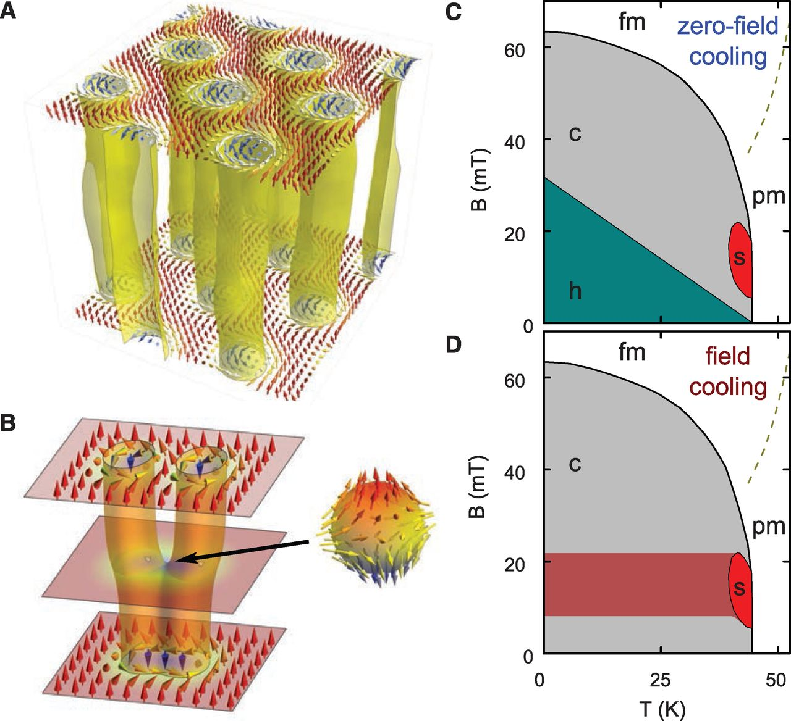
In bulk samples, skyrmions are 3D objects
P. Milde et al, Science 340, 1076 (2013)

Slide 11
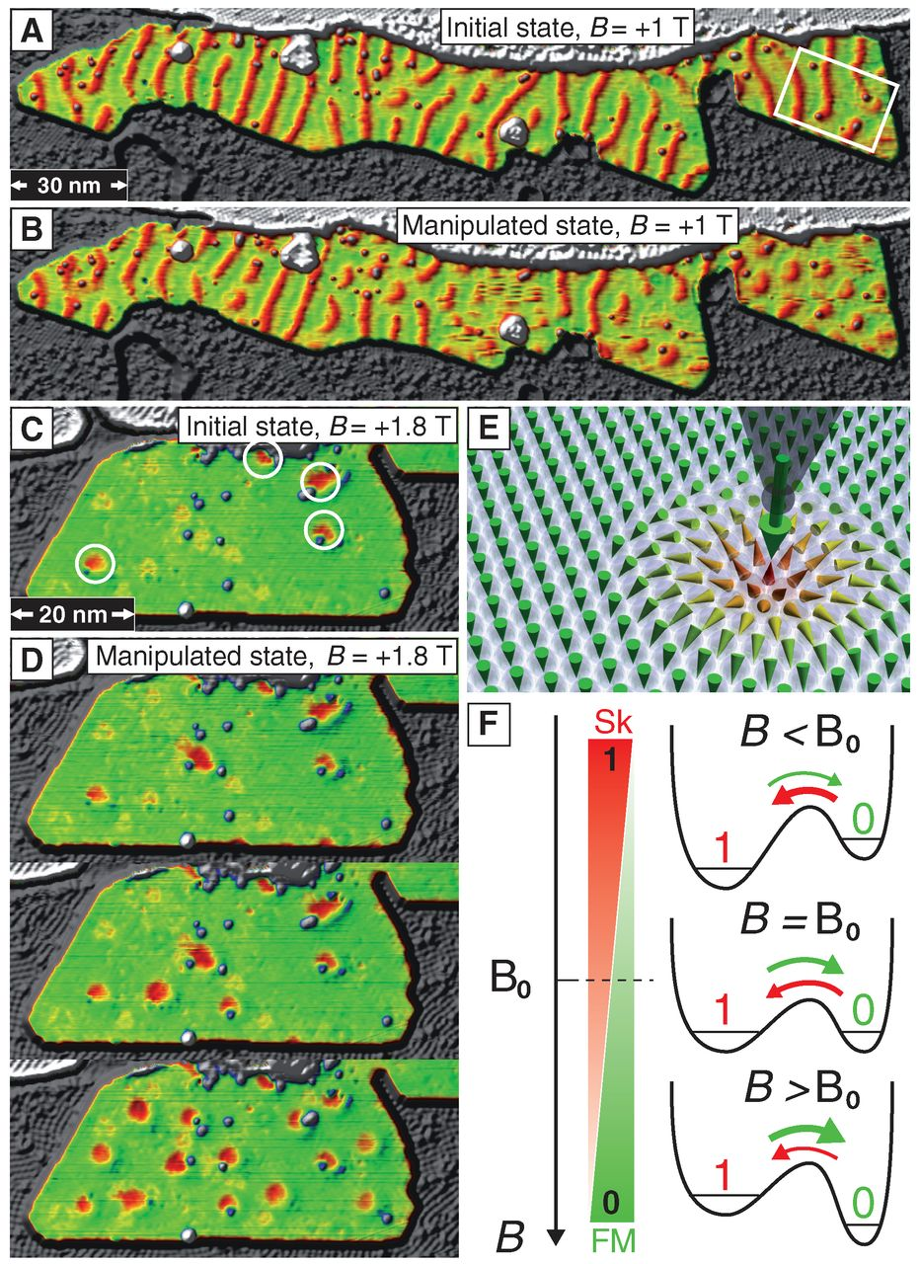
Individual skyrmions can be created and destroyed
N. Romming et al, Science 341, 636 (2013)

Slide 12
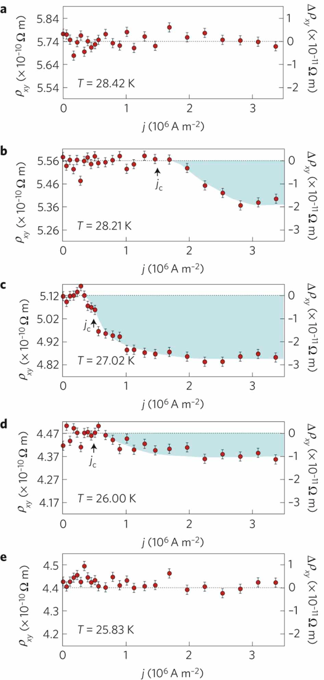
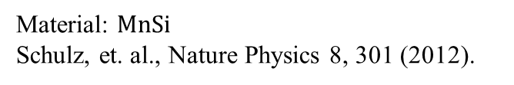



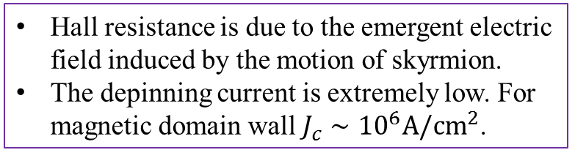
Driven skyrmions by current
Material: $MnSi$
Schulz, et. al., Nature Physics 8, 301 (2012).
Hall resistance measurement
Depinning current J_{c} ~ 10² A/c m²
$$E$$
$$v$$
$$J$$
Hall resistance is due to the emergent electric field induced by the motion of skyrmion.
The depinning current is extremely low. For magnetic domain wall $J_{c}∼{10}^{6}A/cm^{2}$.
J_{c} ~ 10⁶ A/cm²
Jonietz, et. al., Science 330, 1648 (2010).
Yu et. al, Nature Communications 3, 988 (2012).

Slide 13
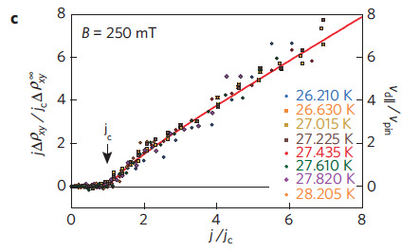
Why Skyrmions are interesting
Can be manipulated by current => applications in spintronics, such as memory
Importantly, the threshold current to move a skyrmion is
10⁴ to 10⁶ [10² A/cm²] times smaller than that of magnetic domain wall. => less heating
They can exhibit depinning transitions just like vortices; however, pinning is very low and skyrmions are very mobile
T. Schultz et. al., Nature Phys. 8, 301 (2012)
Similar to IV curve for vortex depinning
Skyrmion velocity (2015) Beach group 8m/s 10^11A/m^2 room temperature

Slide 14
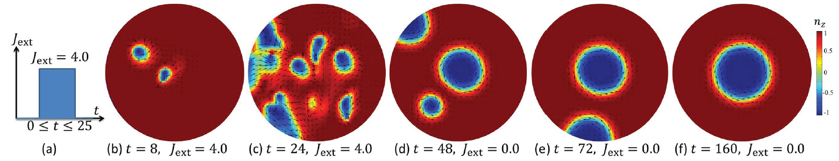
Another reason for excitement: Huge potential for applications
Need to understand the dynamics and how to control with pinning, but no one knows.
High density memory
Novel low-dissipation logic devices
Can be driven with a low current density ➔ Extremely low dissipation
Tremendous advantages over domain walls. Threshold current 10⁵ or 10⁶ less than that for domain wall
Once we understand skyrmion motion, sensing devices and hybrid structure can be constructed.
Proposed skyrmion racetrack memory
Fert et. al., Nature Nanotechnology 8, 152 (2013)
Controlled creation and removal of skyrmion by a current pulse in a nanodisk
S. Z. Lin, C. Reichhardt and A. Saxena, Appl. Phys. Lett. 102, 222405 (2013)

Slide 15
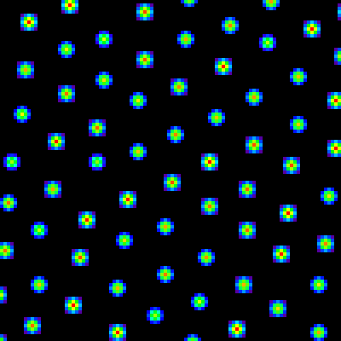
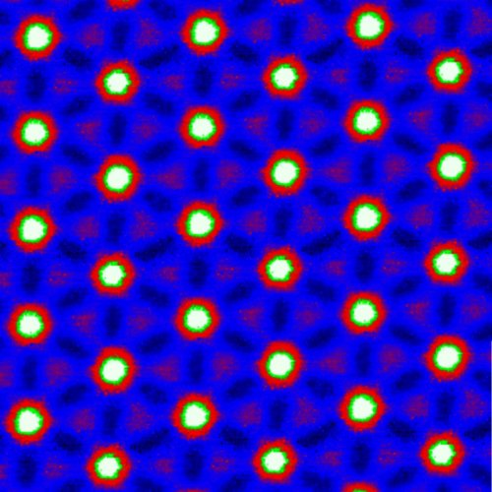


Statics and Dynamics of Skyrmions May Have Overlap With Other Systems in Hard and Soft Condensed Matter
Colloids: Ideal system to study a variety of
basic problems in condensed matter systems
Colloid Lattice (D Grier, NYU)
Superconducting vortex lattice
(JC Davis, Cornell)
Vortices in superconductors, Bose Einstein condensates

Slide 16
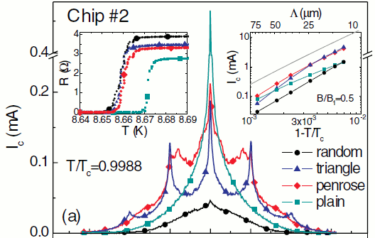
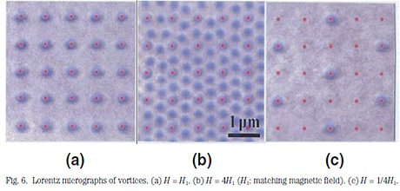
Can similar pinning effects occur for skyrmions ? Could one control the skyrmion lattice structure with pinning?
Kemmler et al, PRL 2006
Harada et al
Pinning arrays can stabilize different types of vortex crystals and have commensurability effects.
There are already many known results regarding pinning vortices, manipulating them with structured landscapes, and a wealth of collective dynamics.

Slide 17
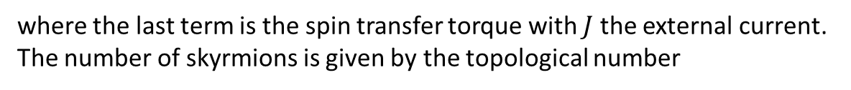

Continuum model for skyrmions
We consider a 2D chiral magnetic film w/ Dzyaloshinskii-Moriya interaction, w/ Hamiltonian
where J_{ex}: exchange interaction, D: spin-orbit DM interaction, B: external field, A: Anisotropy, n: unit vector. Equation of motion for spin: Landau-Lifshitz-Gilbert equation
δ_{t}n=-gnxH_{eff} – αnxδ_{t}n – (J.∇)n
With H_{eff}=-δH/δn=J_{ex} ∇²n – 2D∇xn + B + J_{A}n_{z}z
where the last term is the spin transfer torque with $J$ the external current.
The number of skyrmions is given by the topological number
Phase diagram at $T=0$
Spiral
Skyrmion
ferromagnetism
$$B$$
First order phase transition
Upon increasing the magnetic field, the skyrmion density first increases and then drops.

Slide 18
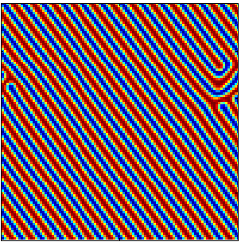
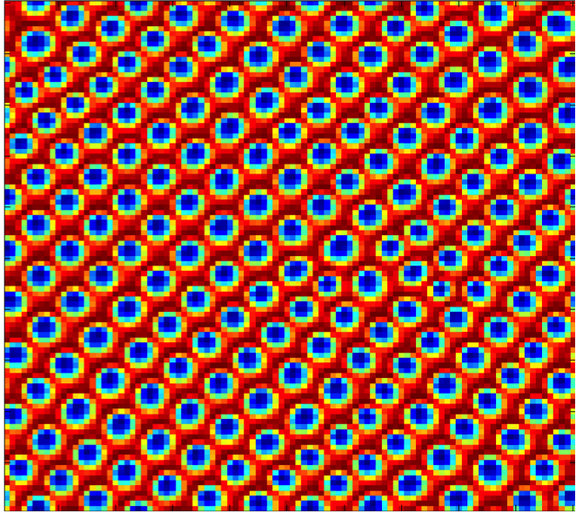
S.Z. Lin, C. Reichhardt, C.B. Batista, A. Saxena, PRL 110, 207202 (2013)
Magnetic spiral structure at small B
Triangular lattice of skyrmions at intermediate B

Slide 19
Dynamic phase diagram for chiral magnet: No pinning
In the spiral phase, if one applies strong current, the spiral structure becomes unstable and evolves into skyrmion lattice.
In skyrmion phase, the IV is linear and the slope depends on the number of skyrmions.
S.Z. Ling, C. Reichhardt, C.B. Batista, A. Saxena PRL 110, 207202 (2013)

Slide 20
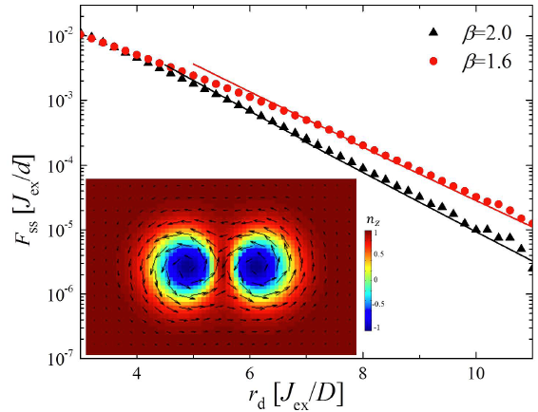
Can we make a particle-based model for skyrmion dynamics?
External field induces a spin wave excitation gap, so that spins in skyrmion tail recover exponentially to fully polarized state.
The interaction between two skyrmions is short-ranged
F~K₁(r/ξ) with ξ=(D²/J_{ex}B)^{0.5}, similar to vortex
β=2/ξ²=2H_{a}J_{ex}/D²
Proportional to applied field and exchange energy
Inversely proportional to spin-orbit coupling

Slide 21
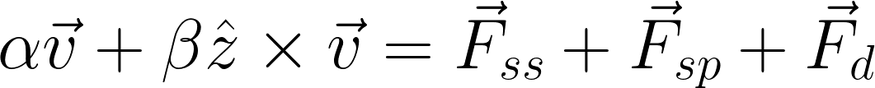
Skyrmion Particle-based model
Equation of motion
α: damping constant
β: Magnus term strength
F_{ss}: isotropic skyrmion-skyrmion repulsion
F_{sp}: skyrmion pinning force
F_{d}: external drive

Slide 22
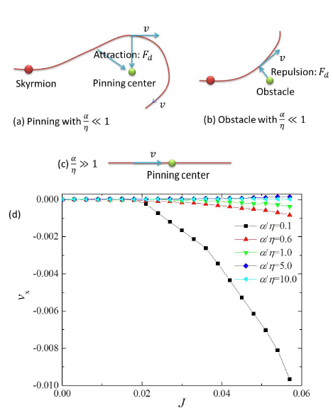
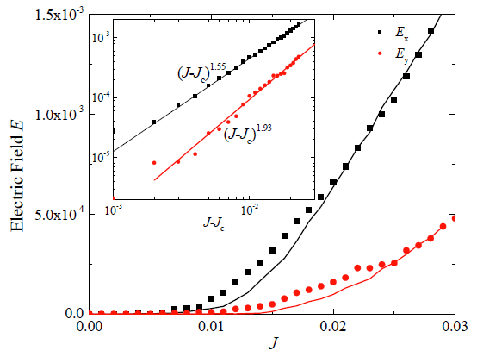
Magnus Force Effects Dynamics
Magnus force is responsible for the weak pinning of skyrmions
Comparison between the continuum and particle-model
S.-Z. Lin, C. Reichhadt, Batista, PRB (2013)
Similar conclusion obtained by continuum model:
Iwasaki et al., Nature Communication 4, 1463 (2013)

Slide 23
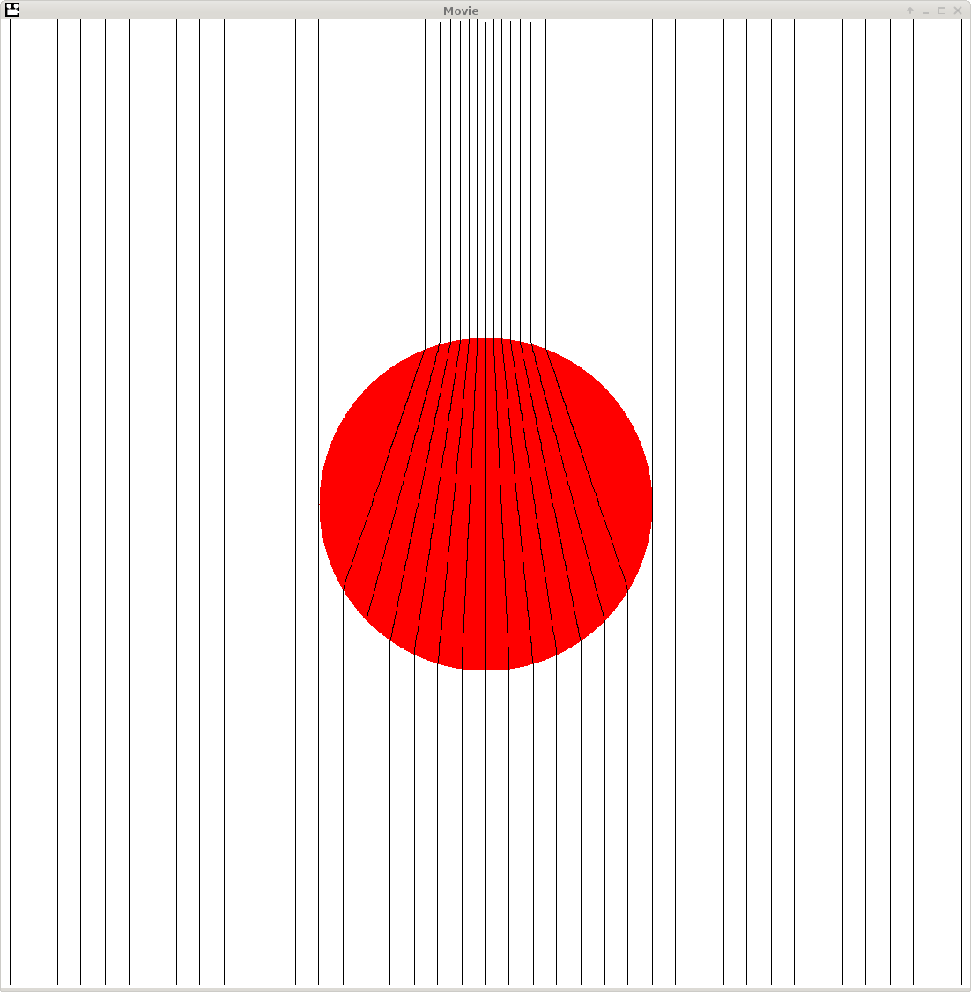
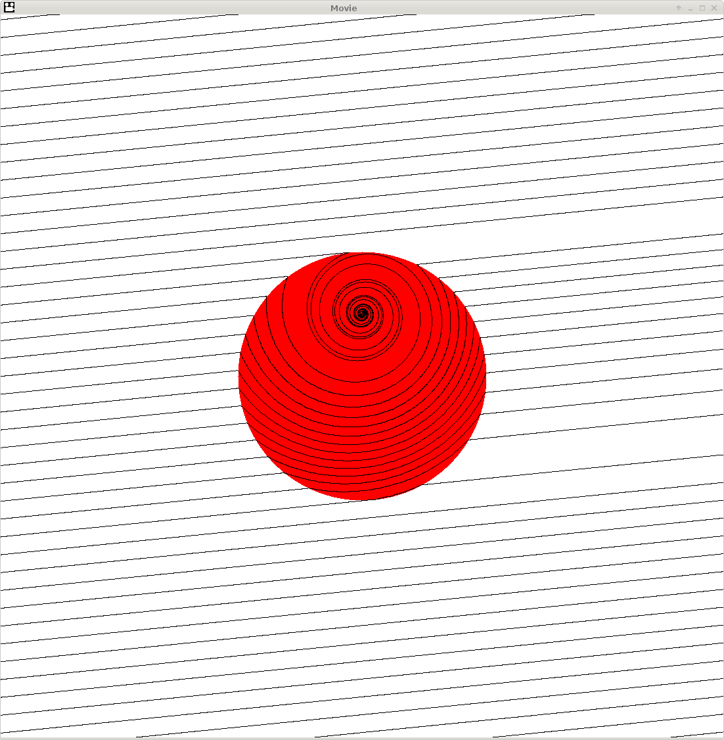
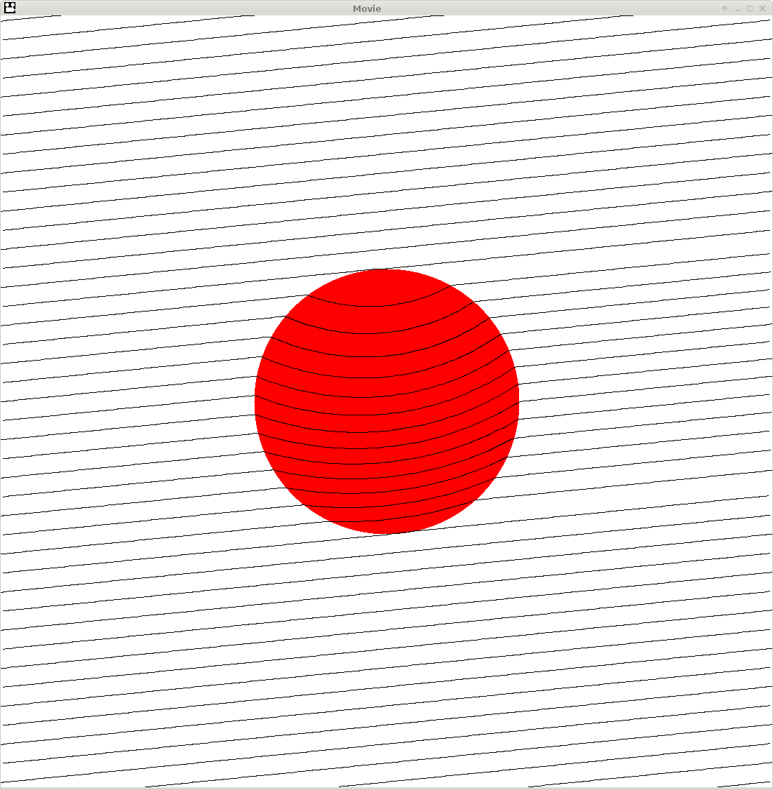
Particle trajectories through an attractive pinning site for a vortex vs a skyrmion
Overdamped limit
β/α=0 F_{d}=0.20
Vortex limit
Skyrmion
β/α=10 F_{d}=0.20
β/α=10 F_{d}=0.05
C. Reichhardt, D. Ray, and C.J. Olson Reichhardt PRB (2015)

Slide 24
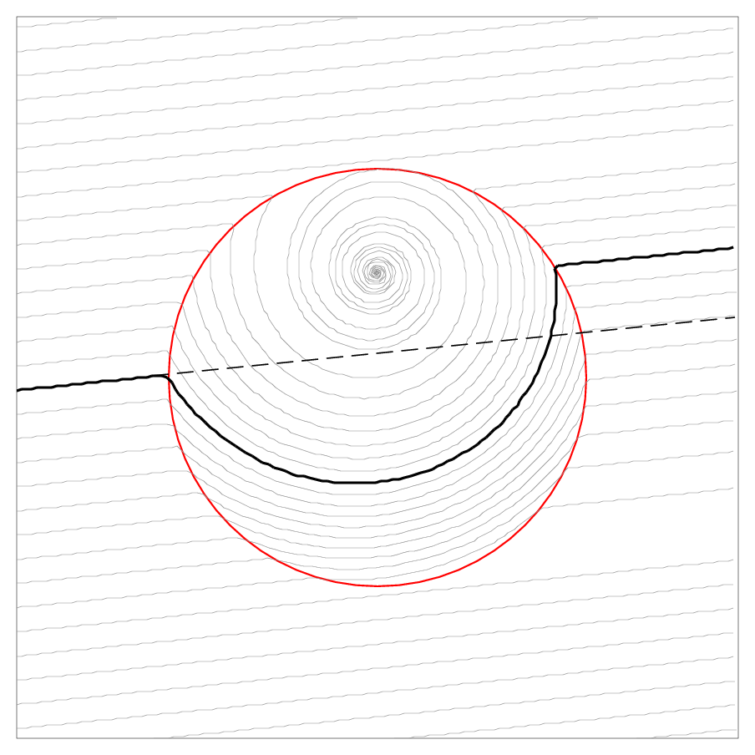
Pinning induced side-jump effect on skyrmion motion, implies that pinning or disorder will
affect the measured Hall angle.
β/α=10. F_{d}=0.05. F_{p}=0.10.

Slide 25
Skyrmion motion shows much more winding orbits

Slide 26
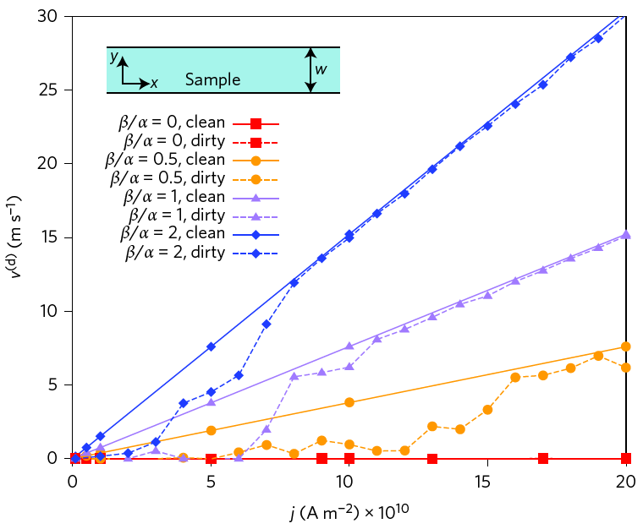
Skyrmion velocity-force curves also observed in other continuum simulations
J. Iwasaki, M. Mochizuki, N. Nagaosa, Nature Nanotechnol. 8, 742 (2013)

Slide 27
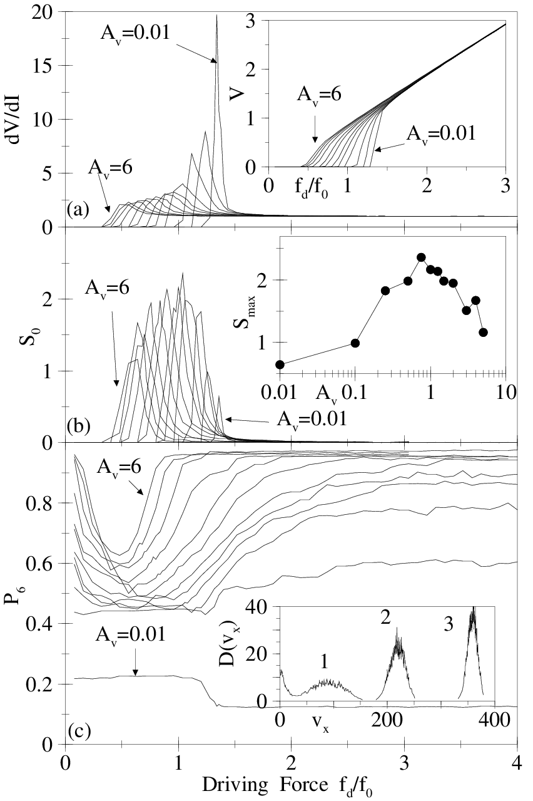
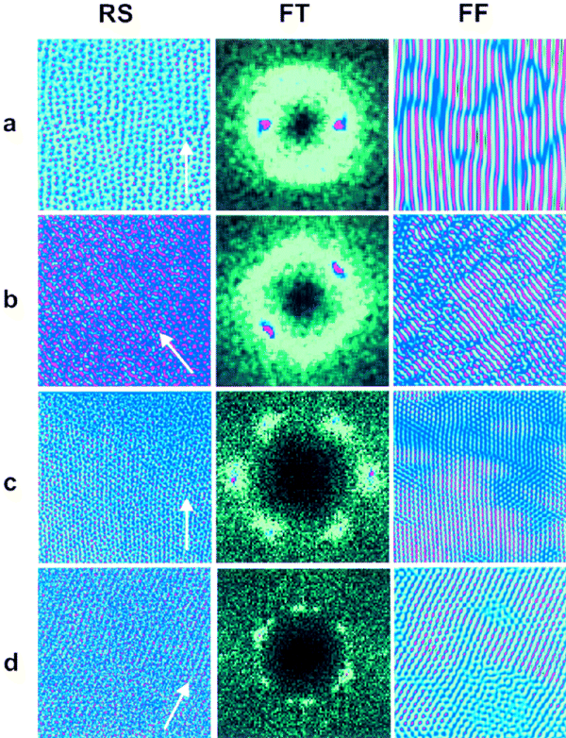
Vortices in the presence of quenched disorder can exhibit elastic or plastic depinning and can undergo dynamical reordering transitions in the moving state.
C.J. Olson et al, PRL 81, 3757 (1998)
A. Koshelev and V. Vinokur, PRL (1994).
F. Pardo et al, Nature 396, 348 (1998)

Slide 28
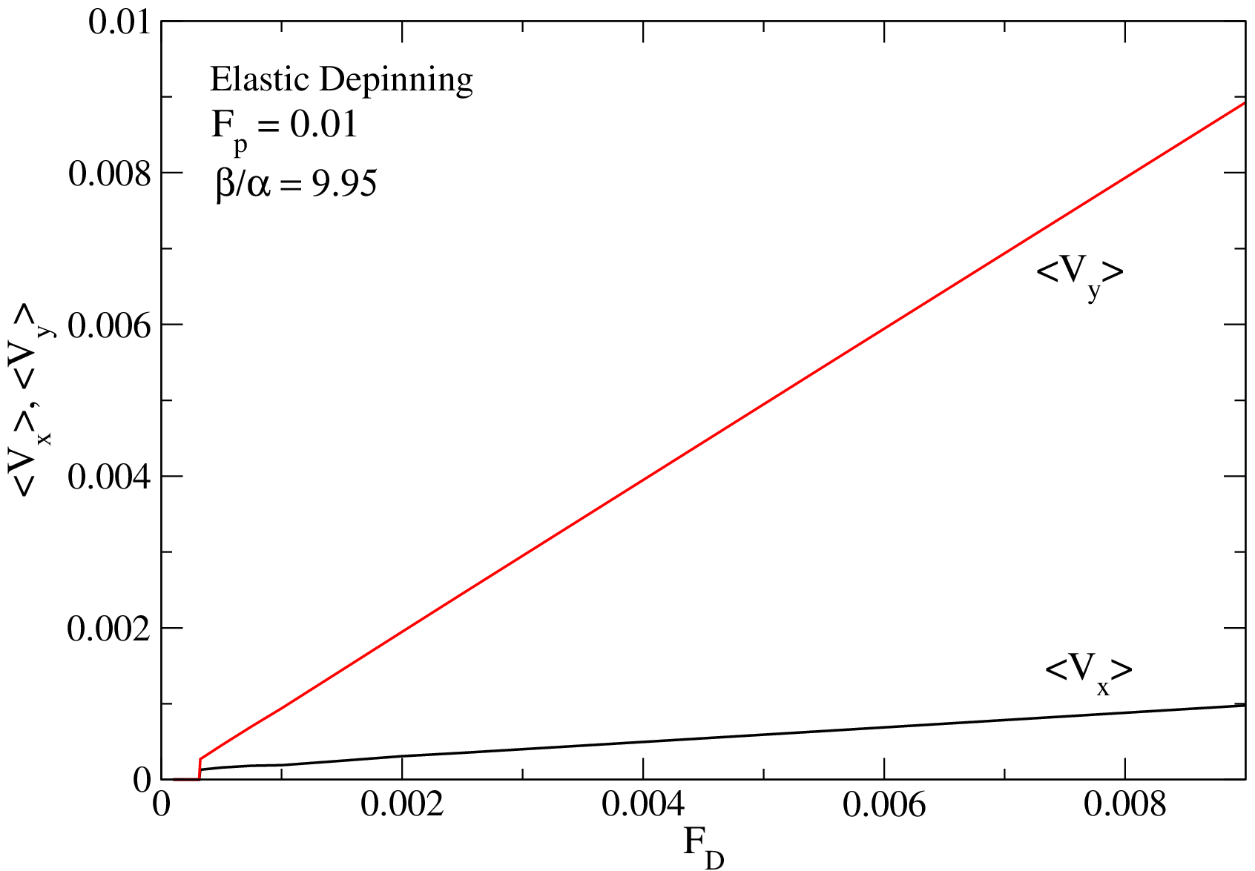
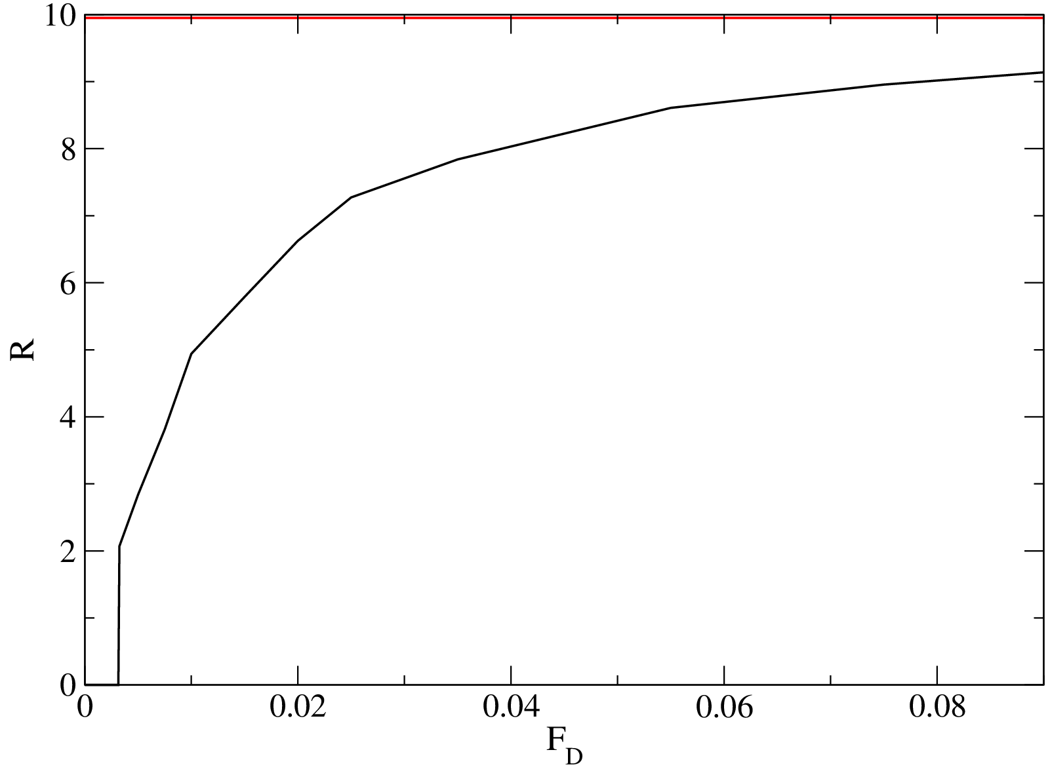
Drive in x direction, Elastic Depinning, Skyrmions move as a Lattice
R = V_{y}/V_{x}
Hall angle changes with drive
Particle-based simulation of elastic depinning

Slide 29
Skyrmion velocity vs force curves in the presence of random pinning: Dynamical
reordering transition, Hall angle depends on drive.
C. Reichhardt, D. Ray, and C.J. Olson Reichhardt PRL in press

Slide 30
Dynamic phase diagram: MC moving crystal, ML moving liquid, PC pinned crystal,
PG pinned glass, No moving smectic state due to Magnus term
C. Reichhardt, D. Ray, and C.J. Olson Reichhardt, PRL in press

Slide 31
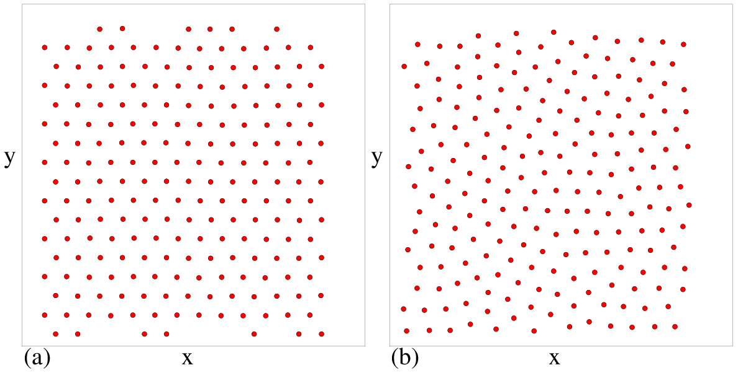
Pinned skyrmion crystal
Pinned skyrmion glass

Slide 34
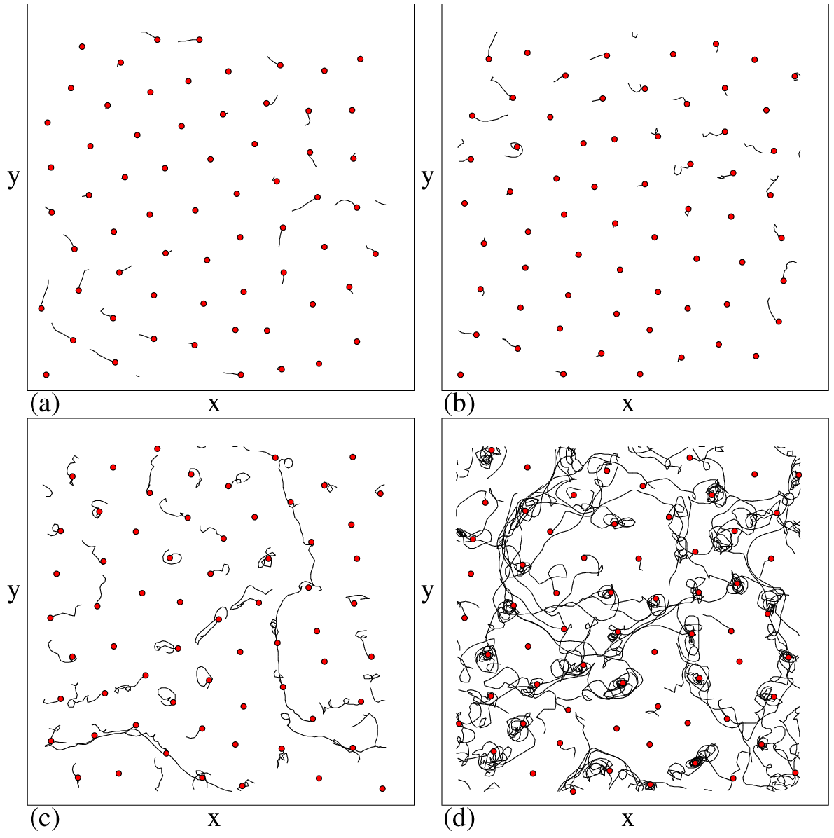
Quench on random disorder from triangular lattice
Increasing
Magnus
term

Slide 35
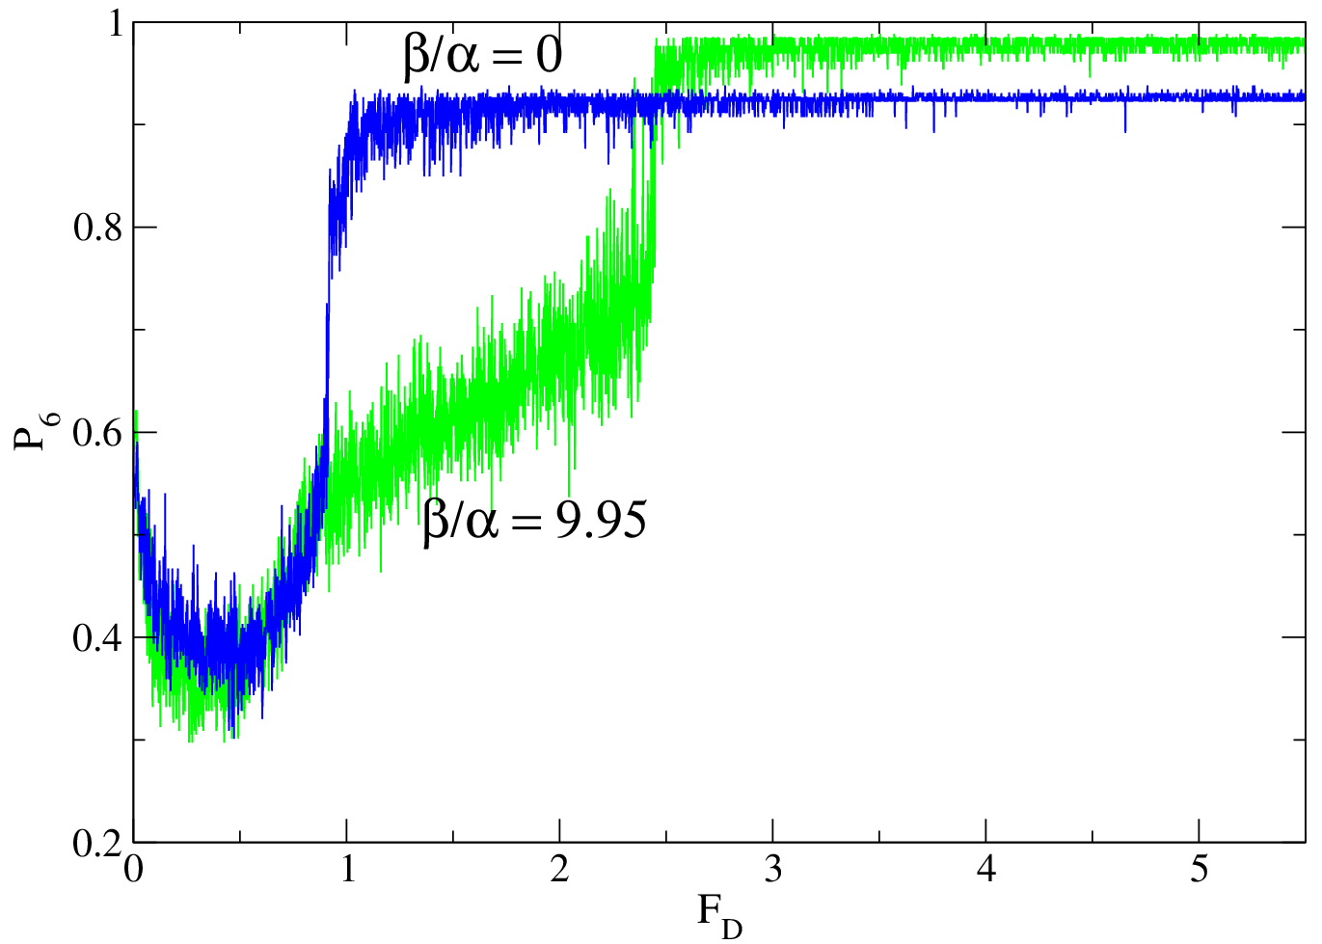
Dynamic Reordering of Skyrmions
Fraction
of particles
with six neighbors
Disordered skyrmions reorder at higher drives than vortices,
but order into a crystal rather than a moving smectic as for vortices

Slide 36
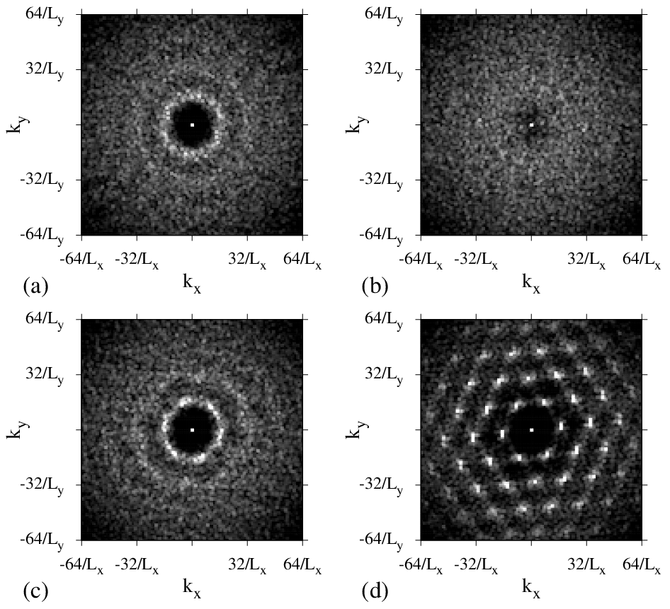
Structure Factor S(k) for Driven Skyrmions
F_{d} = 0.0
Pinned skyrmion
glass
F_{d} = 0.5
Moving liquid
F_{d} = 1.0
Moving liquid
F_{d} = 4.0
Moving crystal
C. Reichhardt, D. Ray, and C.J. Olson Reichhardt PRL in press

Slide 37
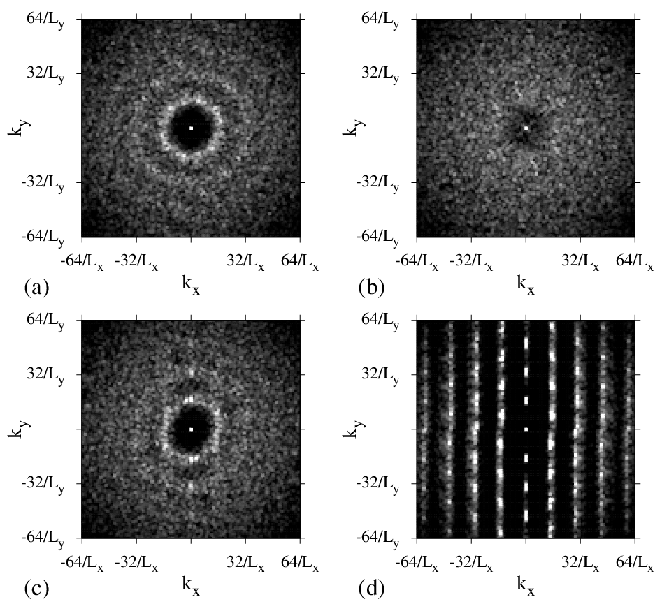
Structure Factor S(k) for Driven Vortices
F_{d} = 0.0
Pinned
vortex
glass
F_{d} = 0.5
Moving liquid
F_{d} = 2.0
Moving liquid
F_{d} = 4.0
Moving smectic

Slide 38
Controlling skyrmion motion with patterning: for applications and for new basic science of skyrmions
Periodic pinning potential
Commensuration effects
Asymmetric pinning potential:
Skyrmion diode/ratchet
Guided skyrmion motion
I
V
V
Longitudinal motion
I
I
Skyrmion density
Transverse motion

Slide 39
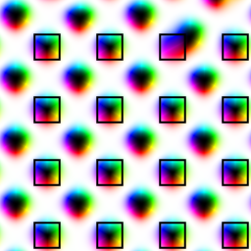
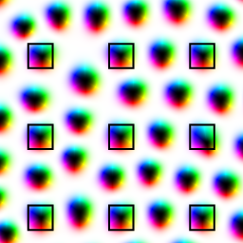
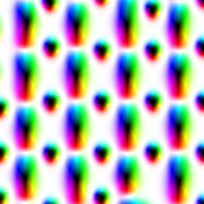
Periodic pinning structures with changes in local anisotropy
Commensurate
Incommensurate
1D Periodic

Slide 40
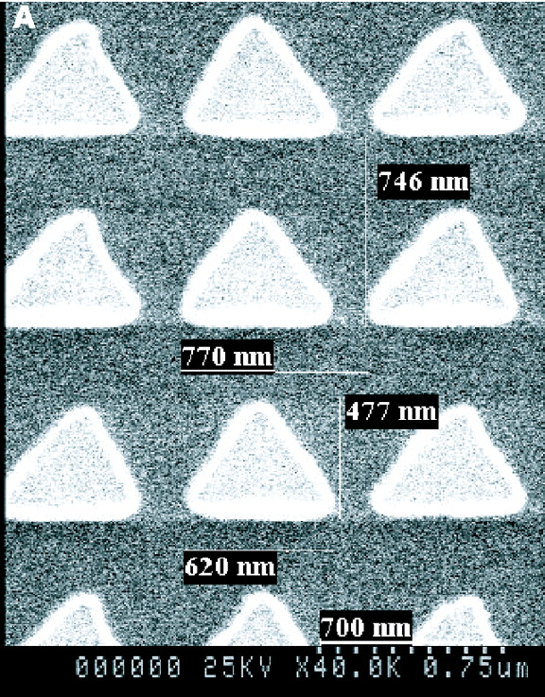


Vortex motion can be controlled with asymmetric structures: Vortex ratchets
B. Plourde, Syracuse
J.E. Villegas et al, Science 302, 1188 (2003)
An ac drive induces a dc motion of the vortices. Could something like this be done for skyrmions?
C.C. de Souza Silva et al, Nature 440, 651 (2006)

Slide 41

Skyrmion on a quasi-1D asymmetric substrate with ac drives parallel or perpendicular to substrate asymmetry
C.S. Lee et al, Nature 400, 337 (1999)
V.A. Shklovskij, O.V. Dobrovolskiy, PRB 84, 054515 (2011)
I. Guillamon et al, Nature Physics 10, 851 (2014)

Slide 42

AC driving in parallel direction. Red-Parallel, Blue-Perpendicular

Slide 43

Phase diagram of ratchet effect for AC driving in parallel direction

Slide 44

AC driving in perpendicular direction. Magnus induced ratchet effect

Slide 45

Ratchet orbits for AC driving in the perpendicular direction
n = 2
n = 1
n = 0
n = 2

Slide 46

Ratchet dependence on Frequency
Perpendicular AC
Parallel AC

Slide 47



Magnus-induced trajectory shift upon passing through pinning site
β/α=10
β/α=0
β/α=1

Slide 48


Negative differential conductivity observed for vortices moving in periodic defect arrays
Experiment
Simulation
C. Reichhardt et al, PRL 78, 2648 (1997)
J. Van de Vondel et al, PRB 79, 054527 (2009)

Slide 49




Single skyrmion moving in square pinning array: Varied Hall angle
Vortex case

Slide 50


Changing Hall angle = changing skyrmion orbit

Slide 51


Changing Hall angle = changing skyrmion orbit

Slide 52


Quantized
Hall angle

Slide 53
Comparison between skyrmions and vortices in type II superconductors
 | skyrmions | vortices
Homotopy class | : | :
Emergent EM fields | Yes | No
Thermodynamic phase | Triangular lattice | Triangular lattice
Current drive | In metals yes | yes
Equation of motion | Mangus force dominates | Dissipative force dominates
Pinning | Weak | Strong
Unstable at high current drive | Yes | Yes
Magnetoelectric coupling | In insulators yes | No

Slide 54


Future
Skyrmion transformers
Skyrmion jamming
Skyrmion mass: shock waves, nonlinear waves, phonon modes in skyrmion crystals?

Slide 55

Future: Single skyrmion manipulation similar to that achieved for vortices
O. Auslaender et al, Nature Physics 5, 35 (2009)

Slide 56
Conclusions
Continuum skyrmion model captures known phases
We construct effective pairwise skyrmion-skyrmion and skyrmion-defect interaction potentials.
Interaction of an assembly of particles with Magnus force and quenched disorder has never been explored.
Skyrmions interacting with periodic or random pinning exhibit rich features in the velocity-force curves, including Hall response and negative differential resistivity.
Experiments on skyrmions are in their infancy. Field can benefit from what is already known about vortex transport, such as controlled pinning for skyrmions.

