Slide 1
Machine learning interatomic potentials for multicomponent systems
Konstantin Gubaev
Skolkovo Institute of Science and Technology (Skoltech)
Russia

Slide 2
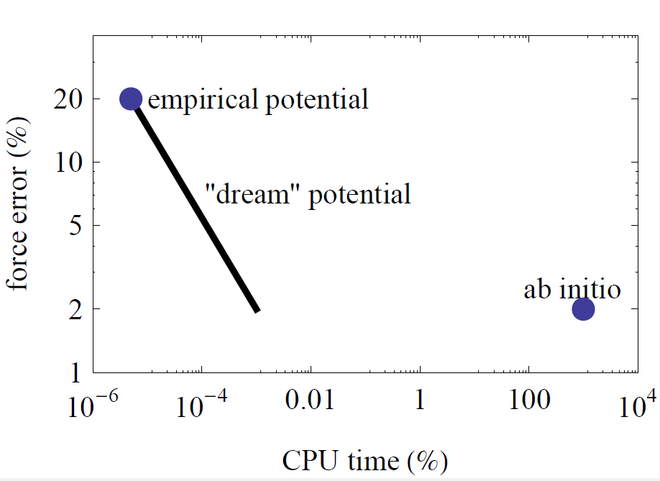
Motivation
Construction of systematically improved potential
What MD simulation is capable of doing?
Empirical potentials: 10⁶ – 10⁹ atoms, up to 1ms
Ab-initio models: 10² – 10³ atoms, up to 1ps
Goal is to construct an interatomic potential:
Ideally: whose efficiency is comparable to the empirical, but accuracy is comparable to ab-initio.
At least: whose accuracy can be systematically improved at the cost of increasing computational complexity.

Slide 3
Machine learning interatomic potentials
Problem statement
Picking of the training set | Selection of some representative set of configurations $z$. Often experience-based
Training (finding optimal parameters of the model) | Solving the minimization problem: $θ^{∗}−?$ $$L\left(θ,z\right)=\sum_{i=1}{{\left(E_{i}^{qm}−E_{i}\left(θ,z_{i}\right)\right)}^{2}, L→min}$$
Validation (checking accuracy of the model) | On a set $y$, such as $y∩z=∅:$ $$MAE=\sum_{i=1}{\frac{\left|{E_{i}^{qm}−E}_{i}\left(θ^{∗},y_{i}\right)\right|}{n}}$$
Calculation of desired values (usage of the model) | $$E_{i}^{}=E_{i}\left(θ^{∗},x_{i}\right)$$

Slide 4
Machine learning interatomic potentials
Assumptions
Partitioning scheme for energy of some configuration $x$:
$$E\left(x\right)≈\sum_{k=1}^{N_atoms}{E_{k}\left(x\right)}=\sum_{k=1}^{N_atoms}{V\left(θ,u\left[k\right]\right)}$$
where $u\left[k\right]$ is the neighborhood of the atom k
Atom interacts with its
neighborhood within some R_{cut}
Function $V\left(θ,u\left[k\right]\right)$ is called
interatomic potential
III
$$r_{4}$$
II
$$r_{1}$$
$$r_{3}$$
R_{cut}
I
I
$$r_{2}$$
II
$$u\left[k\right]$$

Slide 5
Machine learning interatomic potentials
Moment tensor potentials: functional form
System energy:
$$E= \sum_{i}^{N_atoms}{V^{mtp}}(u_{i})$$
Site energy:
$$V^{mtp}\left(u\right)=\sum_{k=1}^{basis_size}{c_{k}b_{k}\left(u\right)}$$
Basis functions $b_{k}\left(u\right)$ are scalar contractions of tensor moments:
$$M_{ν,µ}\left(u\right)=\sum_{j=1}^{neighb_size}{g_{µ}^{t_{i}t_{j}}\left(\left|r_{ij}\right|,d_{µ}^{t_{i}t_{j}}\right){r_{ij}}^{⊗ν}}$$
Tensor moments up to rank ν
$$θ=\{c,d\}$$
- fitting parameters
Radial functions enumerated with µ
$$\left({{0≤ν≤ν}_{max} \atop 0≤µ{≤µ}_{max}}\right)$$
- hyperparameters

Slide 6
Machine learning interatomic potentials
Moment tensor potentials – radial functions
Radial functions $g_{µ}\left(r,t_{1},t_{2}\right)$ depend on atomic species
They capture the “orbital configuration” between atomic pairs
- intense interaction
- weak interaction
$$g_{µ}\left(r,t_{1},t_{2}\right)$$
$$t_{2}$$
$$r$$
$$t_{1}$$
$$R_{min}$$
$$R_{cut}$$

Slide 7
Machine learning interatomic potentials
Moment tensor potentials - descriptors
$u_{i}=\{r_{i1},$..., $r_{in}\}$ – atomic neighborhood
$$M_{ν,µ}\left(u\right)=\sum_{j=1}^{neighb_size}{g_{µ}\left(\left|r_{ij}\right|\right){r_{ij}}^{⊗ν}}$$
Let $g_{0}\left(r\right)≡1$
Examples of tensor moments:
$M_{0,0}\left(u_{i}\right)=1+…+1$ (rank 0 tensor)
$M_{1,0}\left(u_{i}\right)=r_{i1}+…+r_{in}$ (rank 1 tensor)
$M_{2,0}\left(u_{i}\right)=r_{i1}⊗r_{i1}+…+r_{in}⊗r_{in}$ (rank 2 tensor)
Examples of basis functions:
$b_{0}\left(u\right)=M_{0,0}\left(u\right)$ (scalar)
$b_{1}\left(u\right)=M_{1,0}\left(u\right)∙M_{1,0}\left(u\right)$ (scalar)
$b_{2}\left(u\right)=M_{1,0}\left(u\right)\left(M_{2,0}\left(u\right)∶M_{2,0}\left(u\right)\right)$ (scalar)
$$r_{i1}$$
$$i$$
$$r_{i2}$$
$$r_{i3}$$
$$i$$
$$M_{ν,µ}\left(u_{i}\right)$$
$M_{ν,µ}$– inertia tensor, invariant to translation, rotation and permutation of equivalent atoms

Slide 8
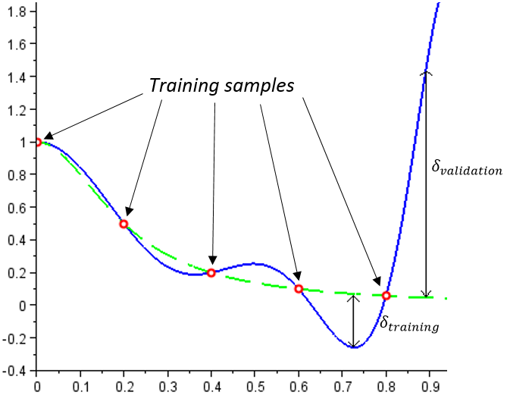
Machine learning interatomic potentials
Active Learning
With ML potentials the error inside training domain is much lower, then outside
AL provides the numerical “measure of extrapolation” for a given configuration
AL allows to include only extrapolative configurations in the training set
Relies on the MaxVol algorithm

Slide 9
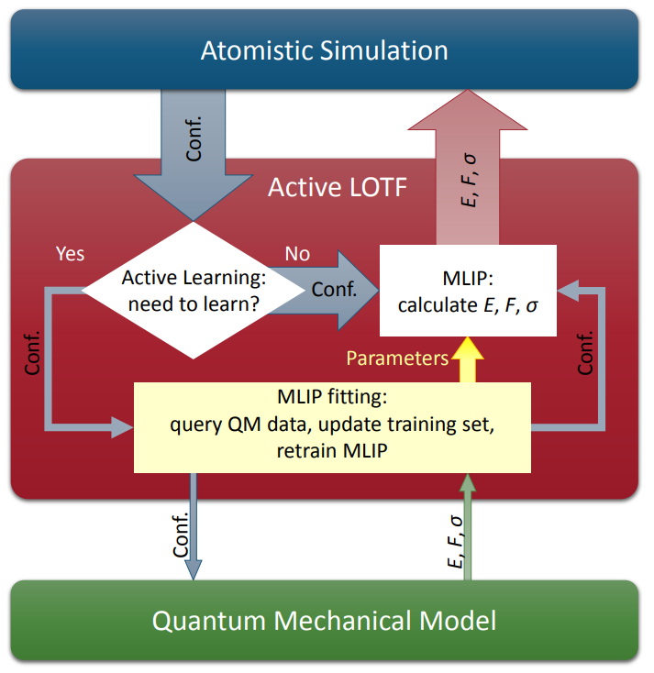
Machine learning interatomic potentials
Learning on the fly
Each occurring configuration is either:
Extrapolative, then we get a QM data for it
Interpolative, then we provide $E, F, σ$ for it

Slide 10
Applications
Crystal structure prediction
Goal | Find the most stable alloys in a given composition range
Tools | Empirical selection of candidate structures Screening of the structures based on their energy
Success criteria | Locating of stable structures Experimental confirmation

Slide 11
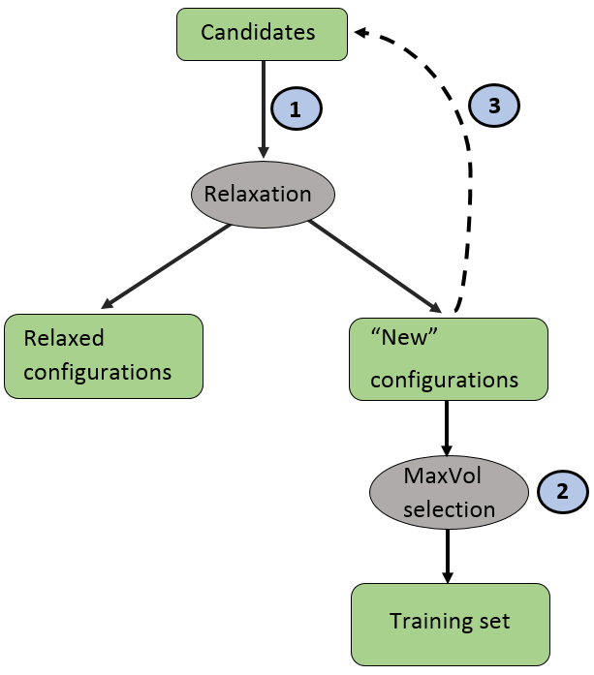
Applications
Crystal structure prediction
Usage of MTP
Relaxation via MTP (new configuration = termination)
Active selection of the training set from the relaxation trajectories
Retraining of the potential
Restarting the terminated relaxations

Slide 12
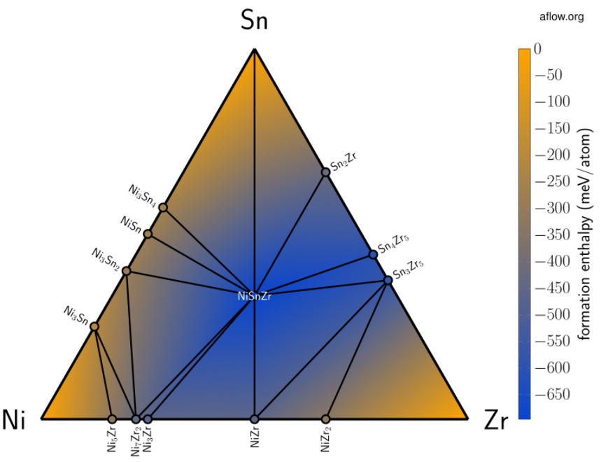
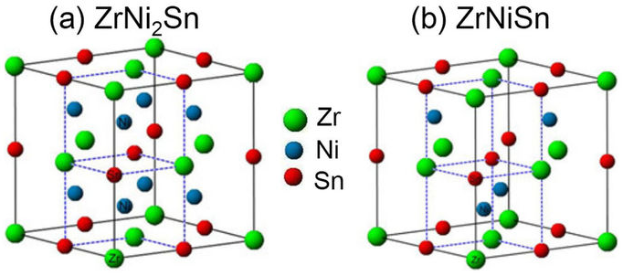
Applications
Crystal structure prediction
AFLOW database*
Contains millions of structures
Relaxation is done with DFT
*Curtarolo S. et al. AFLOW: an automatic framework for high-throughput materials discovery //Computational Materials Science. – 2012. – Т. 58. – С. 218-226.

Slide 13
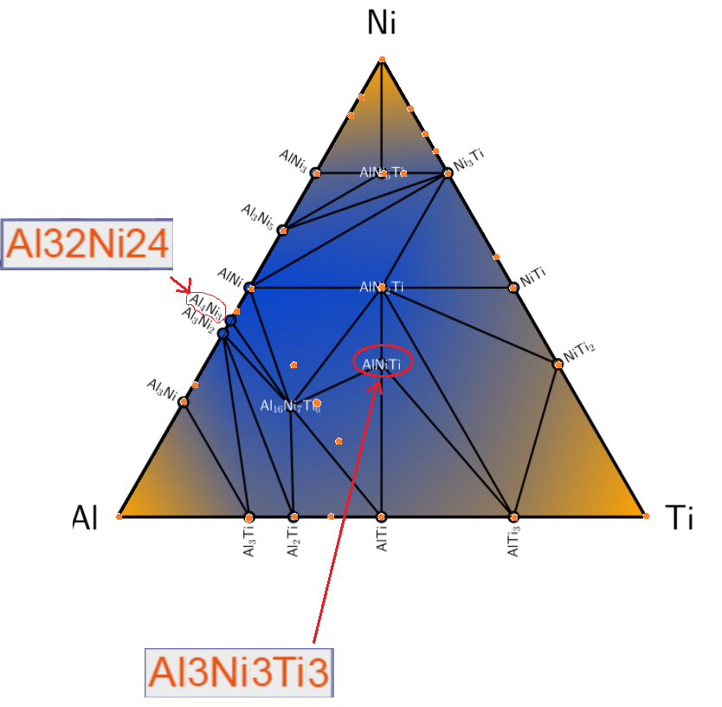
Applications
Crystal structure prediction
Al-Ni-Ti convex hull
300 000 candidates* with 1-12 atoms (excl. 7,9,11)
Time consumed – 30 hours (~400 VASP calculations on 64 cores)
Result: most of the structures from AFLOW are found
*Samples were given by the group of Gus Hart from BYU

Slide 14
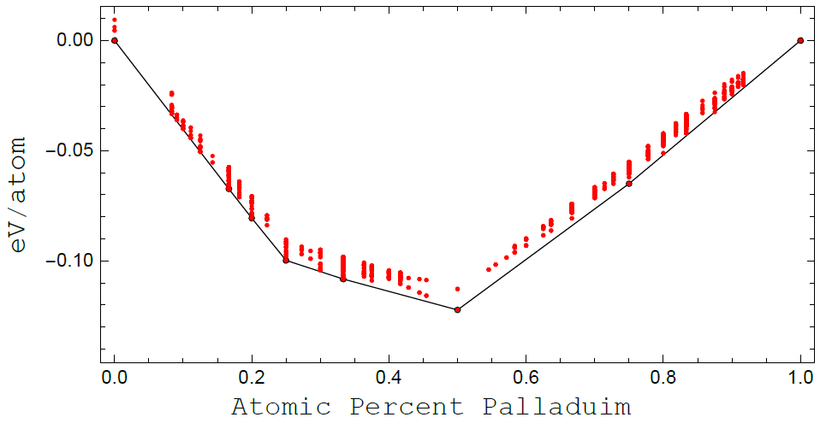
Applications
Crystal structure prediction
Cu-Pd convex hull
40 000 initial candidates with different types of lattices and Pd content
Convex hull has FCC lattice on the edges and BCC lattice in-between
Result: all the structures from AFLOW are found

Slide 15
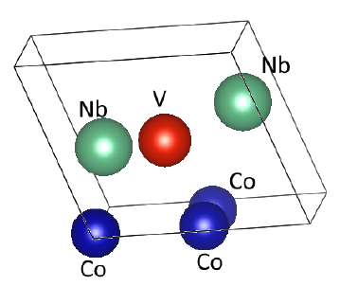
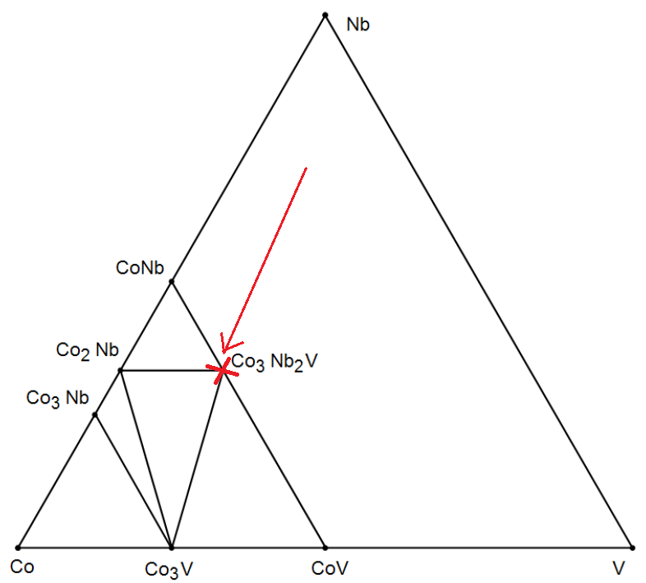
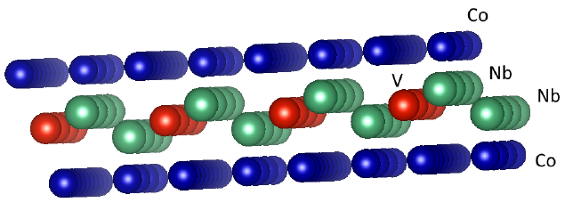
Applications
Crystal structure prediction
Co-Nb-V convex hull
40 000 initial candidates with Co content higher than 50%
$${Co}_{3}{Nb}_{2}V$$
Result: the new structure is found, which is missing in AFLOW (Checked on VASP)

Slide 16
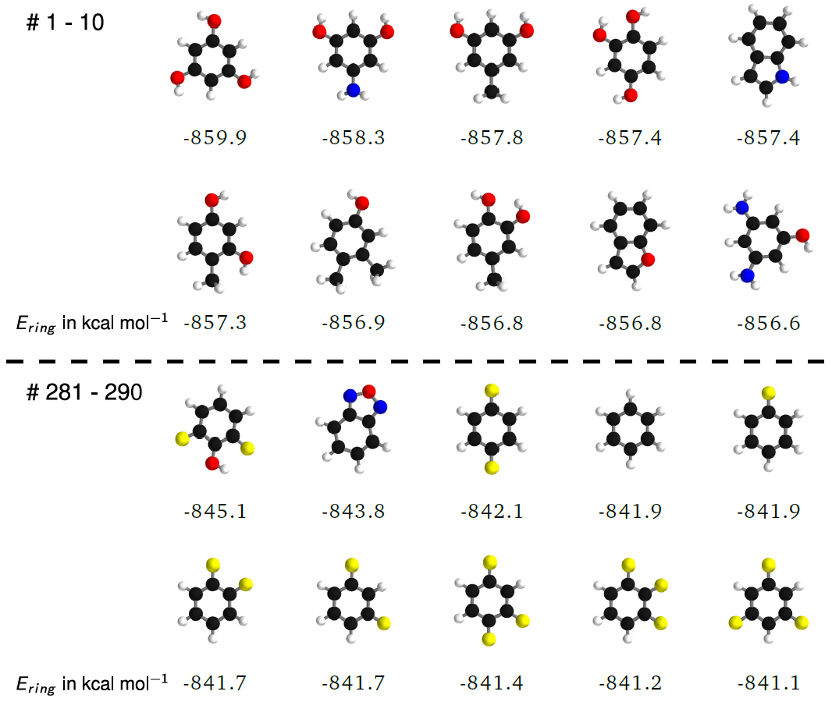
Applications
Cheminformatics
Goal | Prediction of molecular properties based on their structure and composition
Tools | Machine learning models: Kernel methods Neural networks
Success criteria | Prediction accuracy Amount of input data required

Slide 17
Applications
Cheminformatics
QM9 database*
130 000 organic molecules (С,H,N,O,F), each includes not more than 9 heavy (С,N,O,F) atoms
14 properties per molecule (we consider only enthalpy), computed at B3LYP/6-31G(2df,p) level of theory
Benchmark test for comparing of models in cheminformatics
*Ramakrishnan R. et al. Quantum chemistry structures and properties of 134 kilo molecules //Scientific data. – 2014. – Т. 1. – С. 140022.

Slide 18
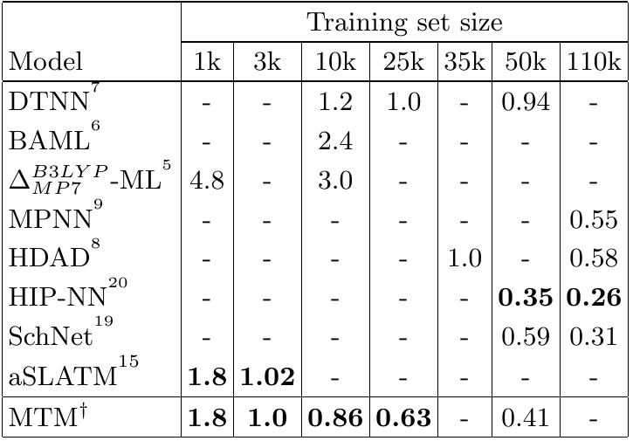
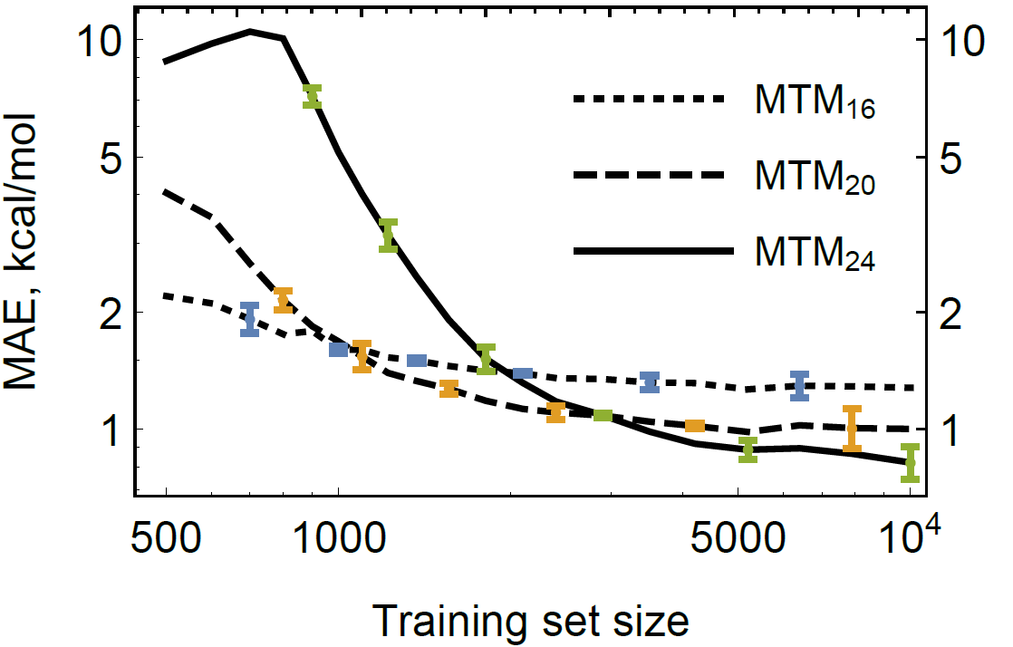
Applications
Cheminformatics
Database QM9
(Training set + Validation set) – 130k molecules
Comparison of moment tensor model MTM ( = MTP) with the others:
For a 1 kcal/mol accuracy MTM requires not much data
Deep NNs are good for big training sets
Accuracy (MAE, kcal/mol) provided by different models versus the Training Set size

Slide 19
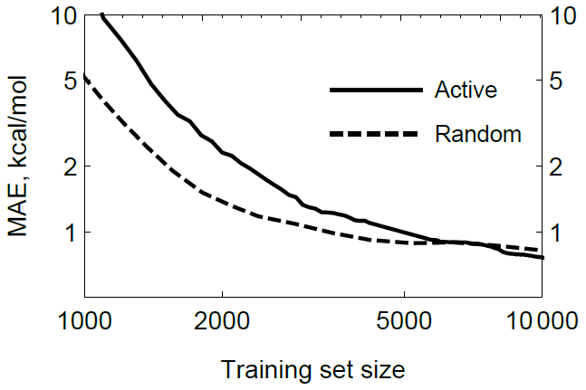
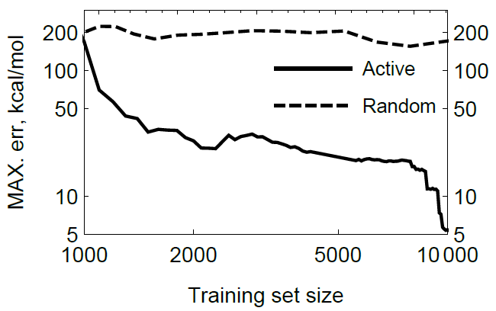
Applications
Cheminformatics
Active learning
Selection of optimal training set
Calculation of ab-initio data (not required in this case)
Retraining of the model
Accuracy check, move to step 1 or end
Active vs random picking: the maximal error is much lower with active learning

Slide 20
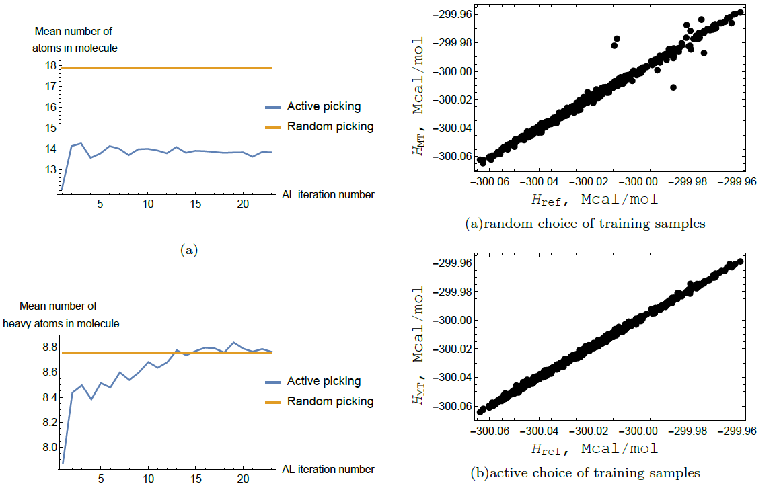
Applications
Active learning
Cheminformatics
Active learning

Slide 21
Summary
Key elements of the model:
Parameterized interatomic potential for multicomponent systems (MTP)
Active learning algorithm
Interpolation of QM data
Prediction of the properties of metallic alloys and organic molecules
Running MD/relaxation with trained potential or learning on the fly
Big systems clustering ---> Large-scale modelling
(We cannot get QM data for large systems directly, thus we need to split them)
Applications of the model:
Coming next:

Slide 22
Thanks for attention! Any questions?
Contact me:
Konstantin.gubaev@skoltech.ru

