Slide 1
Electrostatic to Electromagnetic Conversion through Nonlinear Scattering*
Erik Tejero
erik.tejero@nrl.navy.mil
Plasma Physics Division, Naval Research Laboratory
*Work supported by NRL base program

Slide 2
Collaborators
Laboratory Experiments
Bill Amatucci
Dave Blackwell
Theory
Chris Crabtree
Guru Ganguli
Manish Mithaiwala
Leonid Rudakov

Slide 3
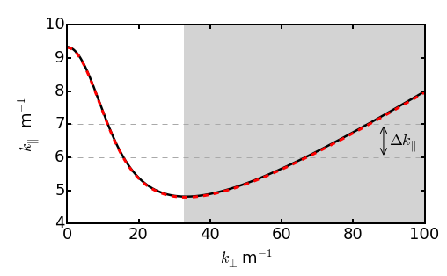
Nonlinear Wave-Particle Scattering Mechanism
10 MHz
9.96 MHz
$$k_{⊥}δ_{e}>1$$
$$\frac{Δω}{Δk_{∥}v_{te}}\sim 1$$

Slide 4
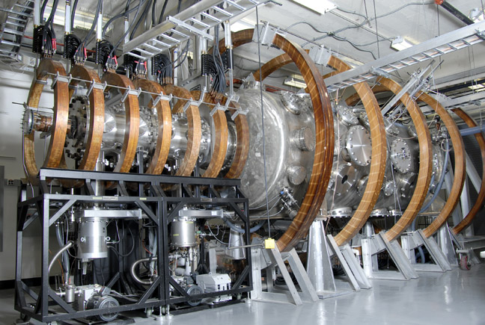
NRL Space Physics Simulation Chamber
3.7 m
7.6 m

Slide 5
Dimensionless Parameters Covered in SPSC
Space Plasma - Space Chamber Parameter Comparison
parameter | ionosphere | RB (L = 2) | NRL SPSC
plasma density (cm⁻³) | 10³ – 10⁶ | ~10³ | 10⁴ – 10¹²
electron temp. (eV) | ~0.3 | ~1 | 0.1 – 4
ion temp. (eV) | ~0.3 | 0.3 | 0.05
magnetic field strength (G) | ~0.3 | ~0.04 | up to 750 G (SC) & 250 G (MC)
plasma freq. (Hz) | 10⁵ - 10⁷ | 5 × 10⁵ | 10⁶ – 10¹⁰
ion gyrofrequency (Hz) | ~30 (O⁺) | 3.8 × 10⁴ (H⁺) | ~10³- 10⁵ (Ar⁺)
electron gyrofrequency (Hz) | ~10⁶ | 10⁵ | 10⁶ – 10⁹
ω_{pe}/Ω_{e} | 0.1 – 10 | 5 | 0.01 - 50
ω/ν_{en} | > 1 | >> 1 | ~5 - 600
β | 10⁻⁷ – 10⁻⁴ | 10⁻⁵ | 10⁻⁷ – 10⁻³

Slide 6
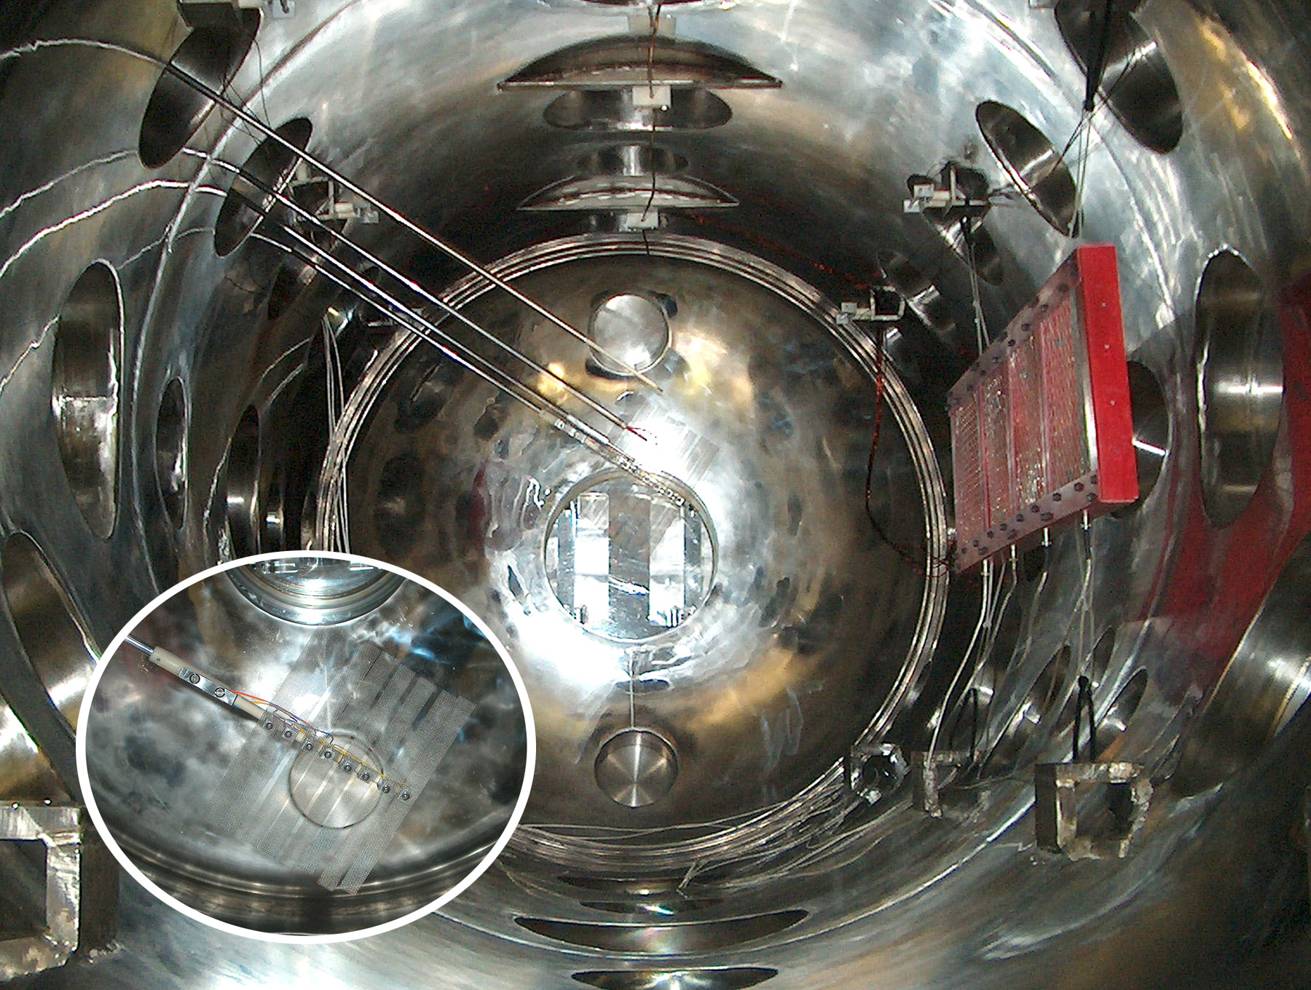
Predominantly Electrostatic Waves are Launched
30 cm
panels
θ~85˚
Several distinct antenna techniques are used for wave launching
B
plasma

Slide 7
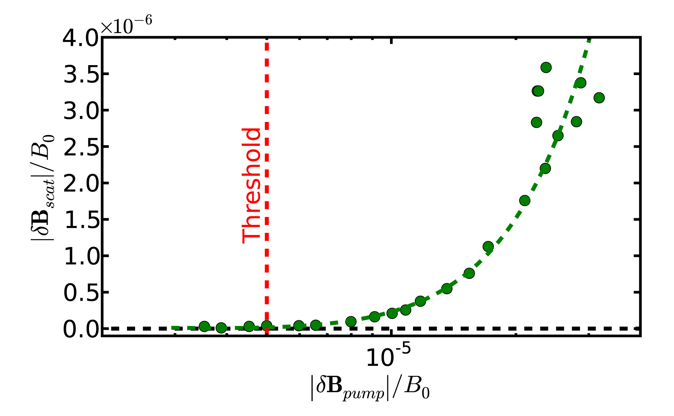
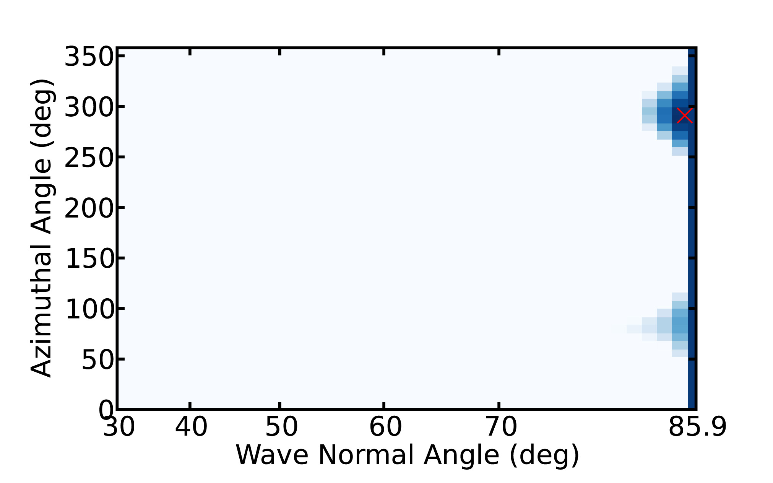
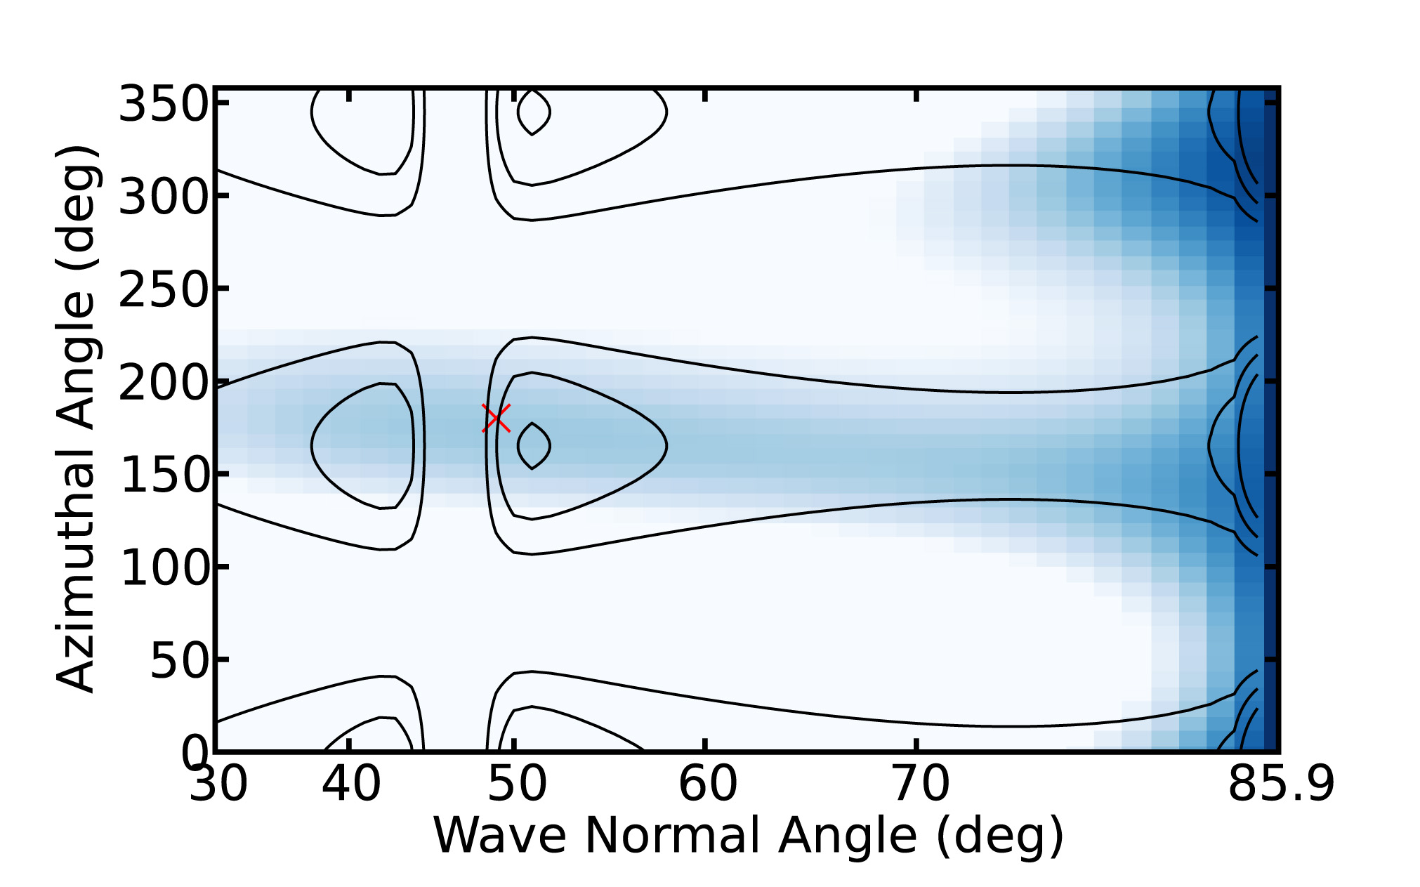
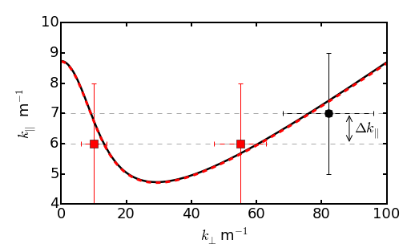
Verification of Nonlinear Conversion from ES to EM
δB/B₀ ~ 5×10⁻⁶ , γ_{NL}= γ_{L}
Threshold
10 MHz – Pump Wave
$$γL\left(k,ω\right)=γNL\left(k,ω,W\right)$$
Amplitude Scaling
90° turning
9.96 MHz – Scattered Wave
10 MHz
9.96 MHz
$$k_{⊥}c/{ω_{pe}}>1$$
$$\frac{Δω}{Δk_{∥}v_{te}}\sim \frac{1}{2}$$
Resonance Condition
Experiment agrees with theory in detail
Tejero et al., Sci. Rep., 5, 17852 (2015) and Tejero et al., Phys. Plasmas, 23, 055707 (2016)

Slide 8
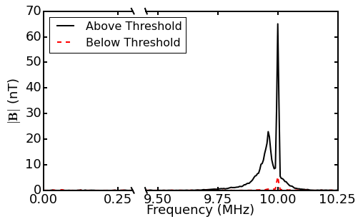
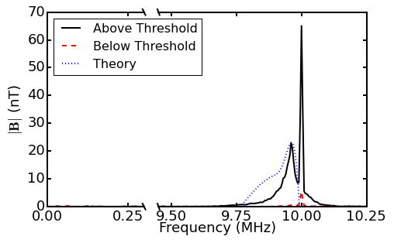
Spectral Features Indicative of NL Scattering
pump
scattered waves
plasma density =3 x 10¹⁰ cm⁻³ (argon)
B = 50 G
ω_{pe}/Ω_{ce} = 11
pump = 10.0 MHz ~ 20 ω_{LH}

Slide 9
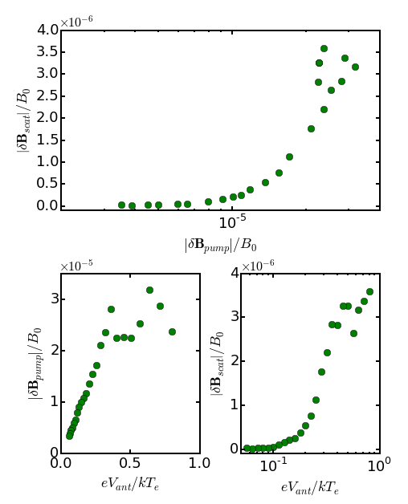
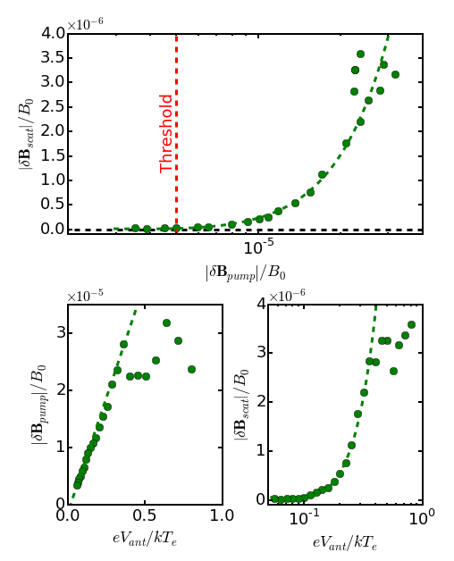
Exhibits Expected Dependence on Pump Amplitude
Pump wave amplitude increases
linearly with antenna voltage
Scattered wave amplitude depends
on the square of pump amplitude
Low nonlinear threshold
δB/B₀ ~ 5×10⁻⁶

Slide 10
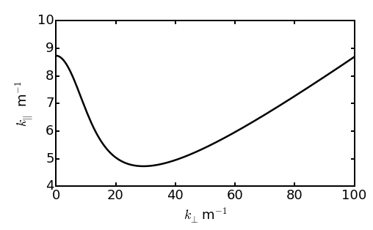
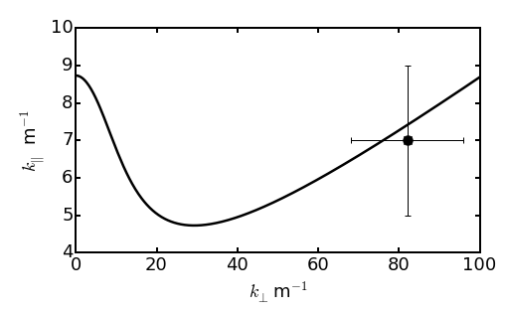
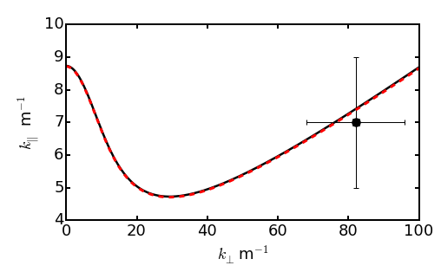
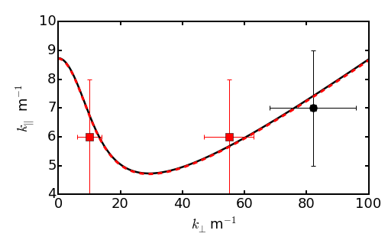
Experiment Directly Demonstrates ES Conversion
10 MHz
9.96 MHz
$$k_{⊥}δ_{e}>1$$
Pump Wave: θ ~ 85°
NL Landau Resonance
$$\frac{Δω}{Δk_{∥}v_{te}}\sim \frac{1}{2}$$
Scattered Waves: θ ~ 59° and θ ~ 84°

Slide 11
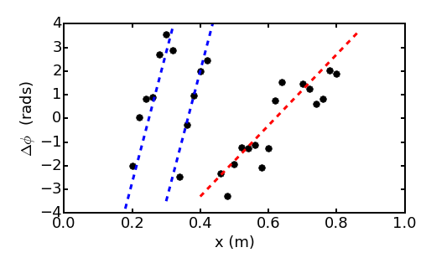
ES Scattered Waves Indicate Scattering Region
~ 40 cm
k⊥ ~ 55 m⁻¹
k⊥ ~ 15 m⁻¹

Slide 12
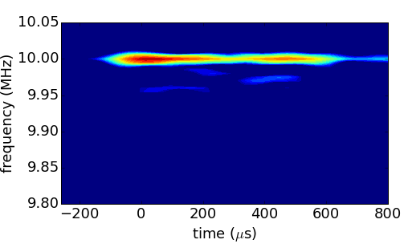
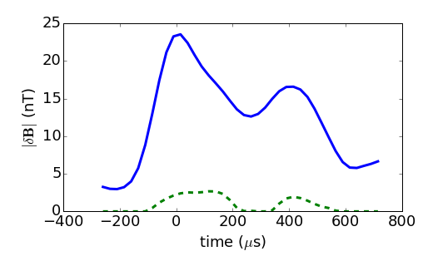
Pulsing the Driver Reveals Generation Details
10 MHz
9.96 MHz
Predator-Prey Model
$$\frac{dW_{p}}{dt}=S−γ_{NL}W_{p}W_{s}−γ_{Lp}$$
$$\frac{dW_{s}}{dt}=γ_{NL}W_{p}W_{s}−γ_{Ls}$$

Slide 13
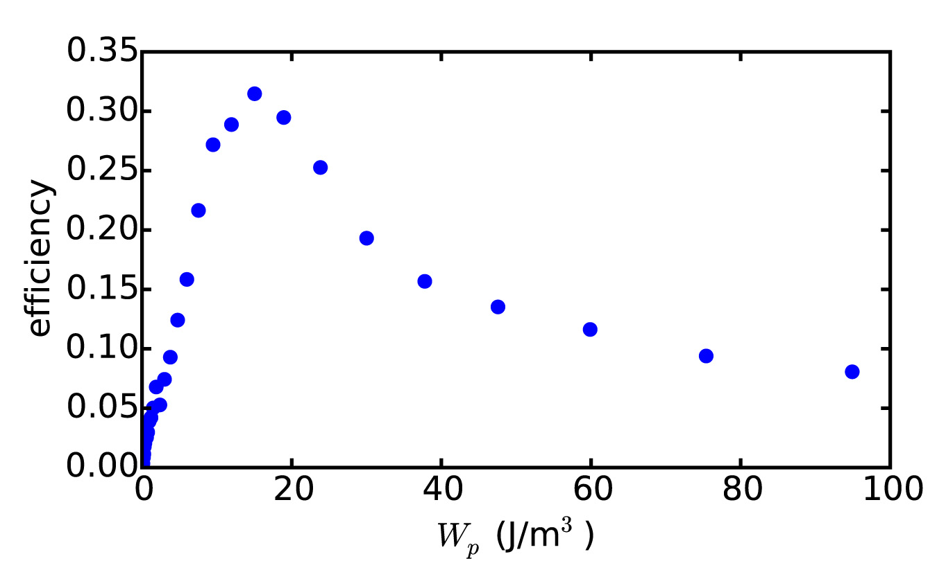
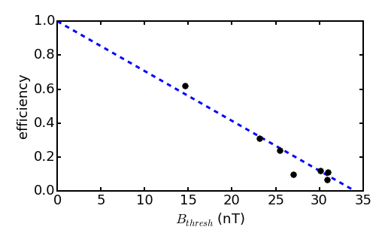
Relative Strength of Whistler Wave Nonlinearity
$${δB}/{B_{0}\sim 4×{10}^{−6}}$$
Efficiency Dependence on Pump Wave Energy Density
Efficiency Dependence on Damping Rate
$\frac{∂f}{∂t}=\frac{∂}{∂v}$ $D\left(W,k\right)\frac{∂f}{∂v}$
$$\frac{dW}{dt}=γ_{L}W\left(f,k\right)+γ_{NL}\left(f,k\right)WW$$
$$\frac{dW}{dt}=γ_{L}W\left(f,k\right)$$
For a full working model, the usual quasilinear picture is incomplete, and NL scattering should be taken into account.
Tejero et al., Phys. Plasmas, 23, 055707 (2016)

Slide 14
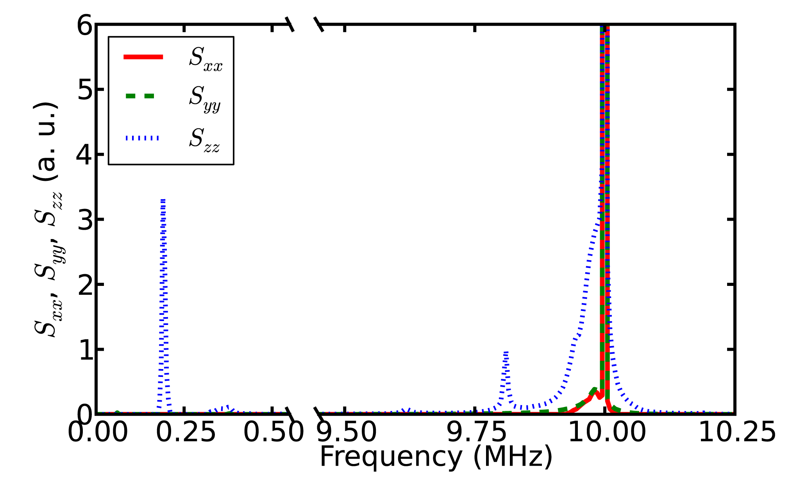
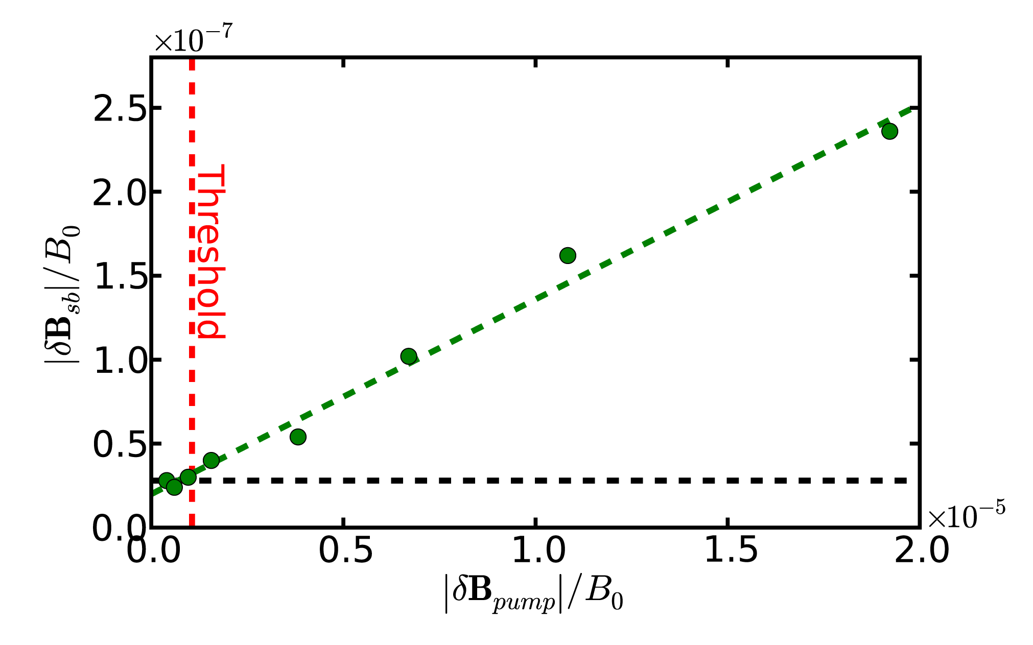
Three-Wave Decay Provides Contrast to NL Scattering
Spectra show simultaneous three-wave
decay and NL scattering
Three-wave matching conditions more
stringent than NL scattering
Sideband amplitude depends linearly
on pump wave amplitude
Threshold lower than NL Scattering
δB/B₀ ~ 7×10⁻⁷

Slide 15
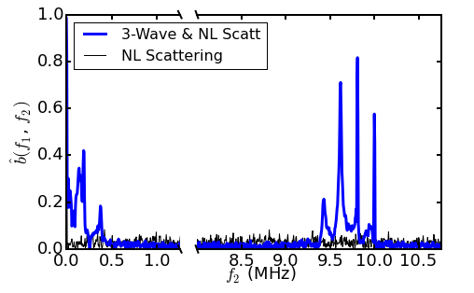
Bicoherence Illustrates Satisfied Matching Conditions
1) Decay of Pump into
f₁: Perpendicularly Propagating
Magnetosonic Wave
f₂: More Electrostatic Whistler Wave
$${\hat{b}}^{2}\left(f_{1},f_{2}\right)=\frac{{\left|\left\langle X\left(f_{1}\right)X(f_{2})X^{∗}(f_{1}+f_{2})\right\rangle \right|}^{2}}{\left\langle {\left|X\left(f_{1}\right)X(f_{2})\right|}^{2}\right\rangle \left\langle {\left|X(f_{1}+f_{2})\right|}^{2}\right\rangle }$$
f₁ = 190 kHz
1
2) Decay of Lower Sideband into
f₁: Perpendicularly Propagating
Magnetosonic Wave
f₂: More Electrostatic Whistler Wave
2
3
3) Coalescence to form Upper Sideband
f₁: Perpendicularly Propagating
Magnetosonic Wave
f₂: Pump Wave

Slide 16
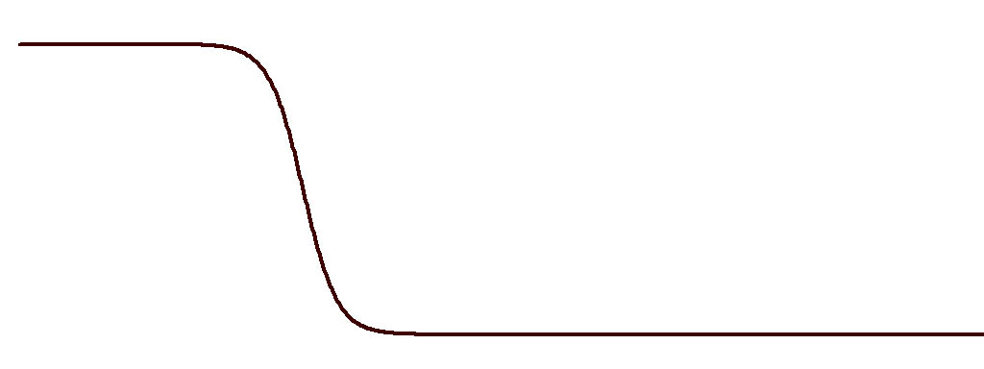
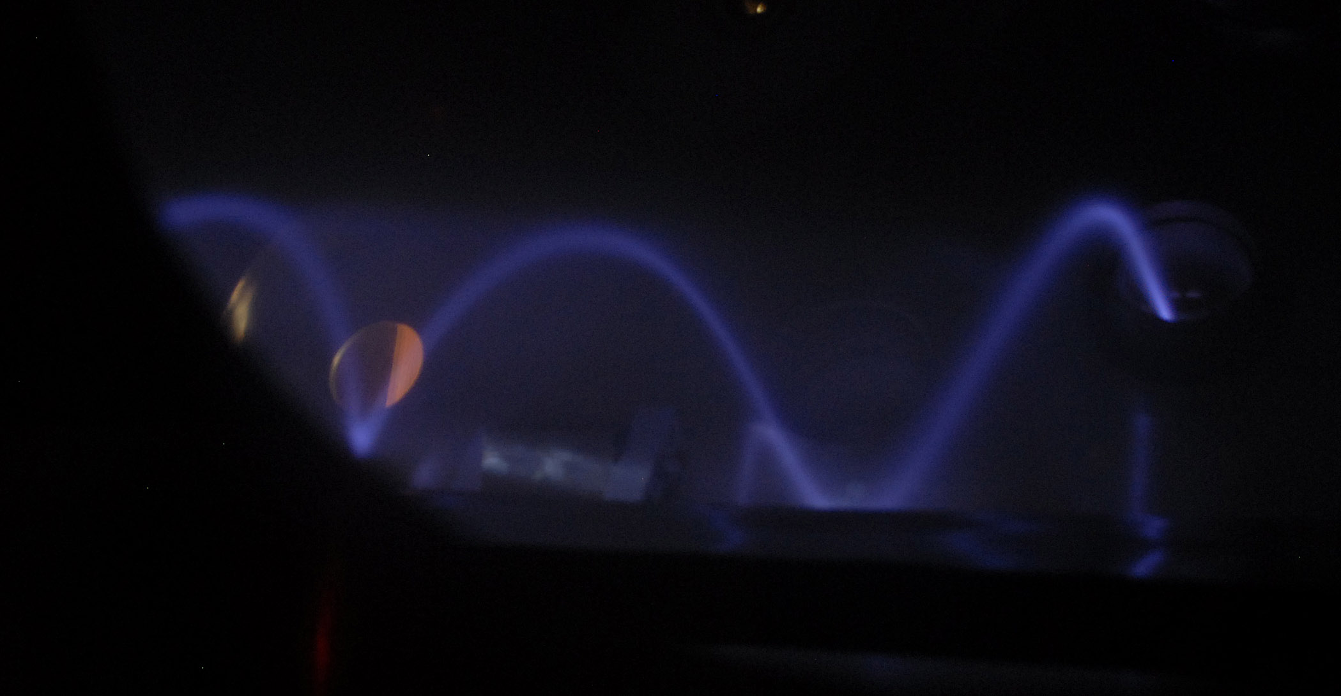
Triggered Emissions Experimental Setup
B_{z}
mirror point
420 G
20 G
SPSC Main Chamber
helical antenna
hollow cathode
Plasma
Source
SPSC Source Chamber

Slide 17
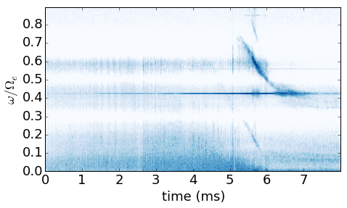
Triggered Emission Observed in Laboratory
$$E_{b}=1.8 keV$$
$$I_{b}=20 mA→ {n_{b}}/{n_{0}=0.5−13\%}$$
$$α=40°$$
$${ω_{pe}}/{Ω_{e}=1.75−9.2}$$
$${ω_{0}}/{Ω_{e}=0.425}$$

Slide 18
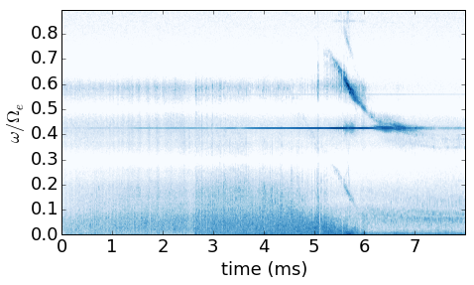
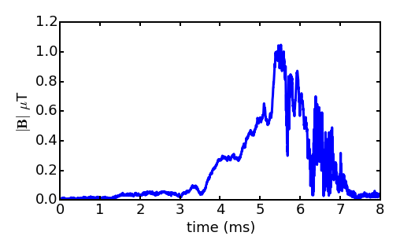
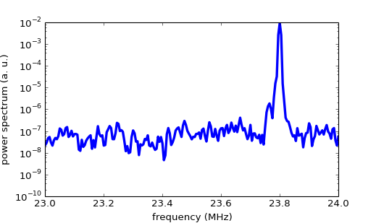
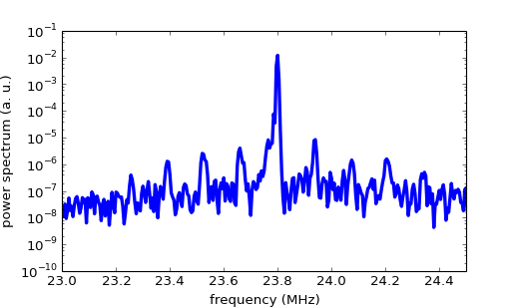
Nonlinear Scattering in Triggered Emission Data
23.8 MHz
$$γ=860 s^{−1}$$

Slide 19
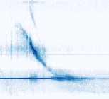
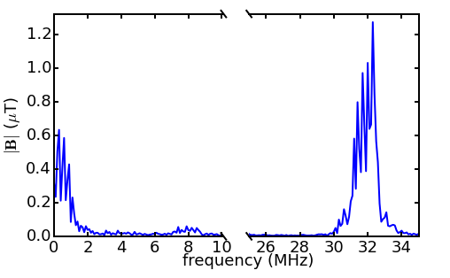
Three Wave Decay in Triggered Emission Data

Slide 20
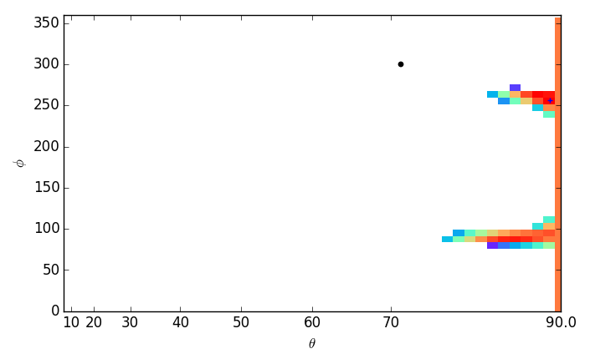
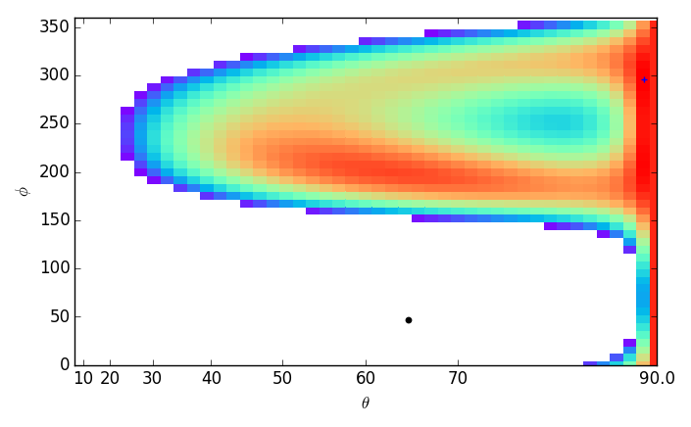
Comparison with Space Observations
10 MHz – Pump Wave
547 Hz – Pump Wave?
Lightning Generated Whistlers
2000
1800
1600
1400
Frequency (Hz)
1200
9.96 MHz – Scattered Wave
512 Hz – Scattered Wave?
1000
800
600
1
2
3
4
5
time (s)

Slide 21
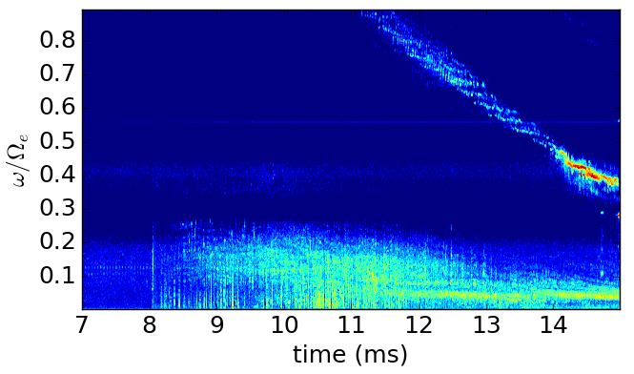
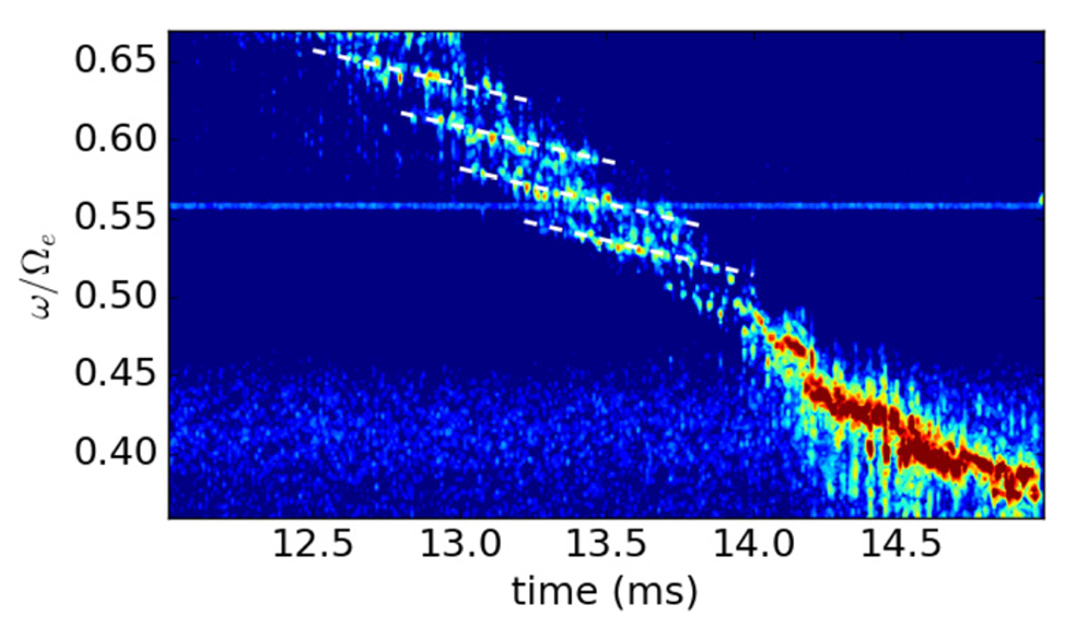
Chorus-like Emissions Exhibit Subpacket Structure
Beam Generated Mode
Chorus-like emissions observed in laboratory experiments.

Slide 22
Summary
Demonstrated nonlinear conversion of electrostatic pump waves into electromagnetic whistler waves
Demonstrated that the generation region is confined to the location of the pump waves
Observed that the scattering process is stochastic
Observations of nonlinear scattering are consistent with theory
Contrasted nonlinear scattering with parametric decay
Showed preliminary results which suggest that nonlinear scattering is present in space data

