Slide 1
J. Neilson ,E. Nanni, M. Franzi SLAC J. Lewellen, D. Nguyen, B. Carlsten LANL
RF Gun For Electron Accelerator in Space

Slide 2
Outline
Introductory background
Electron Beam Sources for Accelerators
Field Emission RF Gun
Thermionic Emission RF Gun
Next steps

Slide 3
RF Electron Accelerator Surfing Analogy
Only those electrons in a narrow region of the RF cycle are continuously accelerated
“Capture ratio” is number of particles that are continuously accelerated (and exit accelerator) divided by the number injected

Slide 4
Why Do We Care About Capture Ratio?
Electrons not carried out accelerator end up on accelerator wall
Power loss
Potential heating issues
In case of thermionic electron emitter, electron back bombardment on the cathode can result in potential thermal runaway

Slide 5
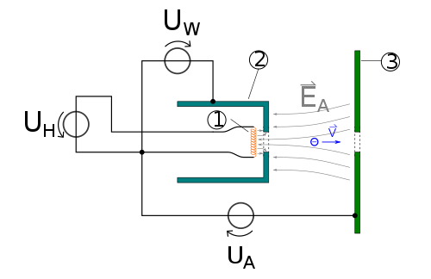
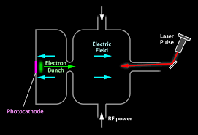
Sources of Electrons for Accelerators
DC guns
Uses high DC voltage (10’s kV) to accelerate beam from thermionic emission cathode
Electrostatic acceleration is 100% efficient
RF gun
Use RF for acceleration of electrons from cathode
Ohmic wall losses to cavity walls so acceleration efficiency not 100% efficient
Three cathode types, thermionic, photocathode and field emitter

Slide 6
Why RF Gun for Spaced Based Accelerator?
DC guns
Require high voltage (10’s kV)
Use ceramics which are not as mechanically robust as metal surfaces
Provide continuous source of electrons so difficult to achieve high capture ratio
Need heater power (~25W) and warmup time
RF gun
No high DC voltage
Potentially higher capture ratio since emission over less than half of RF cycle
Provide higher momentum beams than DC gun so lessens impact of space charge on beam quality
Multiple advantages to RF gun but RF power cost – we wish to quantify
that number to allow determination if advantages are worth the cost

Slide 7
Thermionic Emitter vs Field Emitter for RF Gun
Comparison of Emission Profile
Thermionic emitter
Requires heater power
Emission during 180 degrees of accelerating portion of rf cycle
Field emitter
Emission of electrons induced by high electric field - does not require heater
Emission more sensitive to applied electric field, narrower emission phase range

Slide 8
Preliminary Field Emitter Gun Design
Target 20-30 keV exit energy, 10 ma
Three RF cavities operating in the standing-wave π-mode
Average acceleration gradient set low (∼2 MeV/m) to enable the use of solid-state RF sources
Protruding nose cone is used to enhance the surface electric fields at the point of emission (21 MV/m) while maintaining a low average gradient

Slide 9
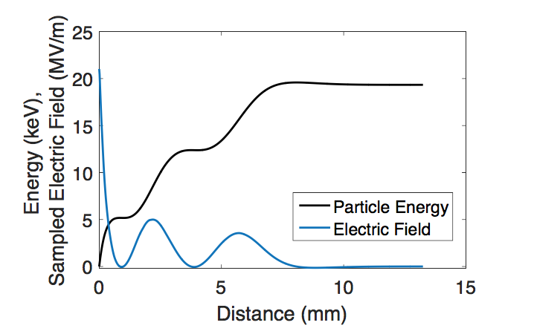
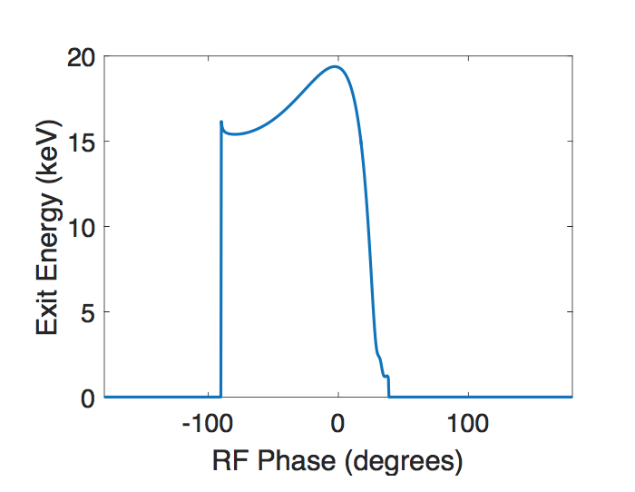
Single Particle Modeling Used for Initial Design
1.5 kW RF power peak, 150 W average during beam burst
~20 keV exit energy
Beam exits gun over 100º of RF launch phase

Slide 10
Modeling in 2D Charged Particle Tracking Code (Parmela)
Utilized measured experimental data for a diamond field emission array operating in a L- band RF gun*
Closely reproduced single particle results
~90% capture ratio obtained for gun current of 11 mA
Energy Gain vs Distance
Charge Density
* “Operation of an ungated diamond field-emission array cathode in a L-band radiofrequency electron source”, Applied Physics Letters 104, 263504 (2014)

Slide 11
Flight Heritage ☹️
Field emitter RF gun results presented at CONNEX team meeting at Goddard
Question about flight heritage of field emitters brought up
No known flight heritage so field emitter approach was suggested to be non-starter given Q1 estimate for MIDEX solicitation at that time
Reboot to look at thermionic version of RF gun…

Slide 12
Some Very Preliminary Results for 2 ½ Cell Thermionic RF Gun
7 / 3 / 3 MeV peak acceleration gradient
RF power 860 W
Cathode heating from back bombardment 58W
Capture ~30%
Initial results not encouraging but much optimization remains to be done

Slide 13
Beam Simulation for 2 ½ Cell RF Gun

Slide 14
Beam Simulation for 2 ½ Cell RF Gun Plus 8 LANL Cavities

Slide 15
Next Steps
Complete thermionic RF gun design
Compare against DC gun

