Slide 1
Overview of Ionospheric (and Magnetospheric) Control by High Power Radio Waves and Chemical Releases
unclassified/noforn
Paul A. Bernhardt
Plasma Physics Division
Naval Research Laboratory
Washington, DC 20735
Plus Major Contributions from:
Asti Bhatt, Frank Djuth, Phil Erickson, Keith Groves,
David Hysell, Joe Huba, Kate Zawdie, Miguel Larsen, Jonathan
Makela, Todd Pedersen, Rob Pfaff, Serafin Rodriguez,
Peter Schuck, David Sentman, Carl Siefring,
Roland Tsunoda, Robert Michell, and Others
2107 Workshop on Turbulence in Space
7 September 2017

Slide 2
Remote Sensing with Active Experiments
Ionospheric Modification Physics Overview
Ionospheric Modification Experiments
Chemical Releases
High Power Radio Waves
Ionospheric Modification Effects
Mid- and High-Latitude Density, Temperature, Composition, and Irregularities
Field Aligned Irregularity with HF Excitation
Enhanced VHF/UHF Scintillations
Artificial Plasma Clouds and Associated Plasma Glow
Stimulated Electromagnetic Emissions (SEE)
Plasma Wave Generation and Propagation
MHD Waves from Explosive Injection of Neutrals
Ion Acoustic Wave Turbulence from Streaming Pickup Ions
Applications of Ionospheric Modification
HF Radar Artificial Backscatter Generation and Clutter Generation
In Situ Sensor Tests with Chemical and Dust Injections

Slide 3
Ionospheric Modification Overview: References
High Power Radio Waves
Chemical Releases
Source
Heating
Nonlinear Interactions
Electron Enhancement
Electron Reduction
Basic Process
Current Modulation
Energize Electrons
Intermediate Process
Thermal Cavities
Plasma Irregularities
Plasma Waves
Artificial Ionization
Optical Clouds
Plasma Holes
Effects
Plasma Detection
Radiation Belt Remediation
Change EM Propagation
Change Conductivity
Utility
Reference Papers, Lectures and Tutorials
Chemical Release Applications, Observations and Modeling , http://cedarweb.vsp.ucar.edu/wiki/images/3/3e/Bernhardt04.pdf, CEDAR, 2004.
Using Active Experiments to SEE and HEAR the Ionosphere, (Video Lecture ), https://cedarweb.vsp.ucar.edu/wiki/index.php/Workshop:CEDAR_Prize, CEDAR Prize Lecture 2010.
Bernhardt, P. A., et al. (2016), Large ionospheric disturbances produced by the HAARP HF facility, Radio Sci., 51, 1081–1093, doi:10.1002/2015RS005883.
Paul A. Bernhardt, et al., A Physics Based Model for the Ionization of Samarium by the MOSC Chemical Releases in the Upper Atmosphere, Radio Science, (in press), 2017.

Slide 4
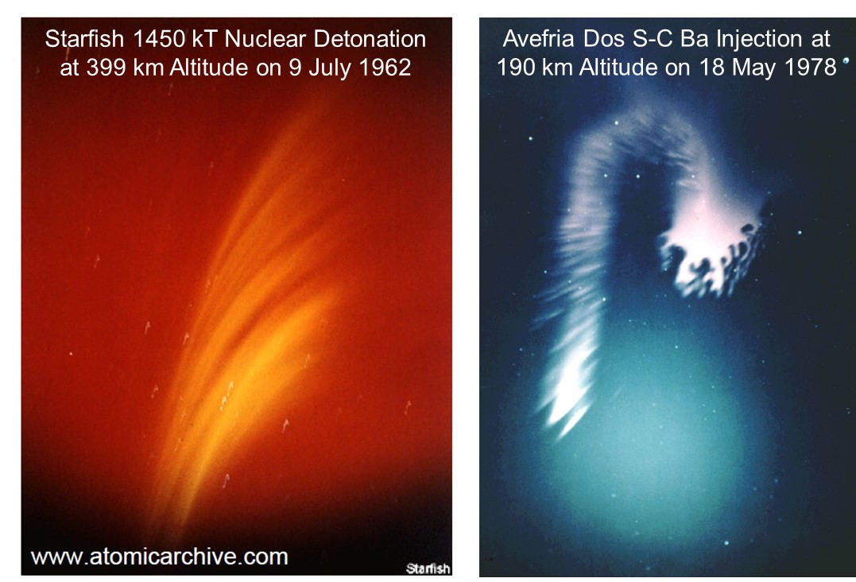
Barium Release in Sunlight as a Surrogate for a Nuclear Detonation

Slide 5
Chemicals Used in High Altitude Release Experiments
Purpose | Materials | Optical Emissions | Fastest Rate | Reaction
Plasma Clouds: Photo-ionization | Li, Na, Sr, Cs, Ba, Eu, U | 553.5 nm (Ba) 455.4 nm (Ba⁺) | 0.05 s⁻¹ (Ba) 0.005 s⁻¹ (Eu) 0.00029 s⁻¹ (Li) | Ba + hν → Ba⁺ + e⁻
Plasma Clouds: Associative Ionization | Sm, La, Nd, Ti | Molecular Bands of SmO (656 to 570 nm) | 3.7 x 10⁻¹⁰ (Sm) ~ 10⁻⁸ (Sm) | Sm + O → SmO⁺ + e⁻ + 0.22 eV SmO⁺ + e⁻→Sm + O
Plasma Holes: Electron Attachment | SF₆, CF₃Br, Ni(CO)₄ | 777.4 nm (SF₆) | 2.2 10⁻⁷ cm³/s (SF₆) | SF₆ + e- → SF₅⁻ + F - 0.25 eV SF₅⁻ + O⁺ → SF₅ + O* + 9.91 eV
Plasma Holes: Ion-Molecule Charge Exchange | H₂, H₂0, CO₂ | 630 nm (CO₂) | 3.2 10⁻⁹ cm⁻³ (H₂0) | H₂O + O⁺ → H₂O⁺ + O H₂O⁺ + e⁻ → OH* + H
Neutral Wind Tracer | Al, NO, Na, Al(CH₃)₃ , Fe(CO)₃, Ni(CO)₄ | Molecular Bands of AlO (484, 508, 465, 534 nm) | -- | Al(CH₃)₃ + O → AlO* + ...
unclassified

Slide 6
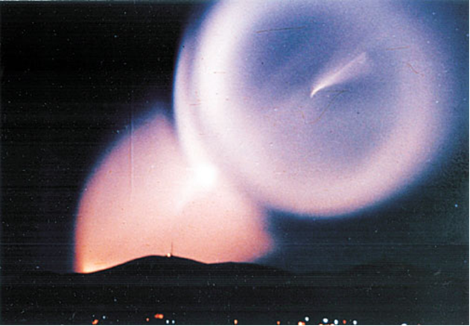
Motivation -- Dome of Light Observations
CARE II (NRL-0502)
Physics Today September 2008
1987 - US and the Soviet Union signed the Intermediate-Range Nuclear Forces Treaty
1988 - Iridescent spheres
Appeared above the atmosphere off Scandinavia and northern China
Domes expanded at around 3 km/s
Centers remaining quite transparent.
Mid 1991 - Stopped appearing
June 1991 - All missiles with ranges of 1000–5600 km eliminated
Could the light domes have been related to testing a defense system against incoming missiles?
Could they result from self-destruct mechanisms on the missiles?
To this day the origins of the domes of light are classified in Russia.
The dome phenomena happened
No one in the West really knows why.
Chinese Image of DOL (1989)
Source: Thomas C. Reed, Physics Today, p 47, September, 2008
(Acquired from Shanghai Institute of Nuclear Research (SINR), 4 April 1990 by Danny Stillman, Director of the Technical Intelligence Division, Los Alamos National Laboratory)

Slide 7
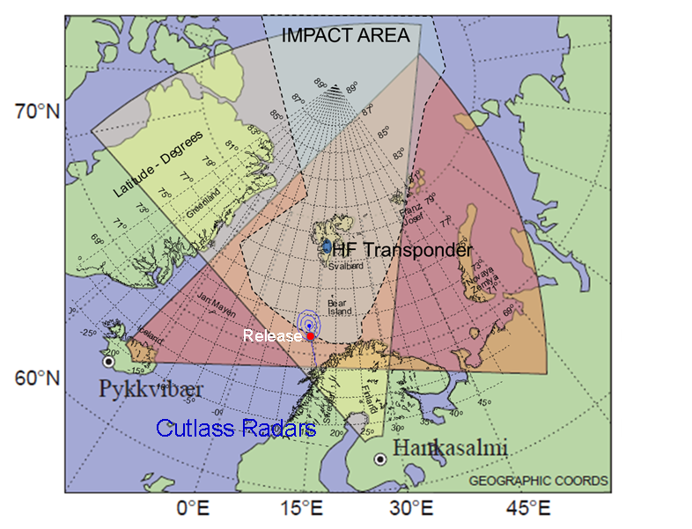
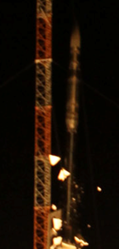
CARE II (NRL-0502)
CARE II Observations
(Launch 19:06 GMT, 16 September 2015)
Aircraft Images of Release
CARE II Diagnostics
Rocket Instruments
Aircraft Instruments
Ground Instruments
International Collaborators
Universities, Laboratories
(MOD England, IAP Germany, UIT Norway, SGO/FMI Finland, IRF Sweden)
Launch

Slide 8
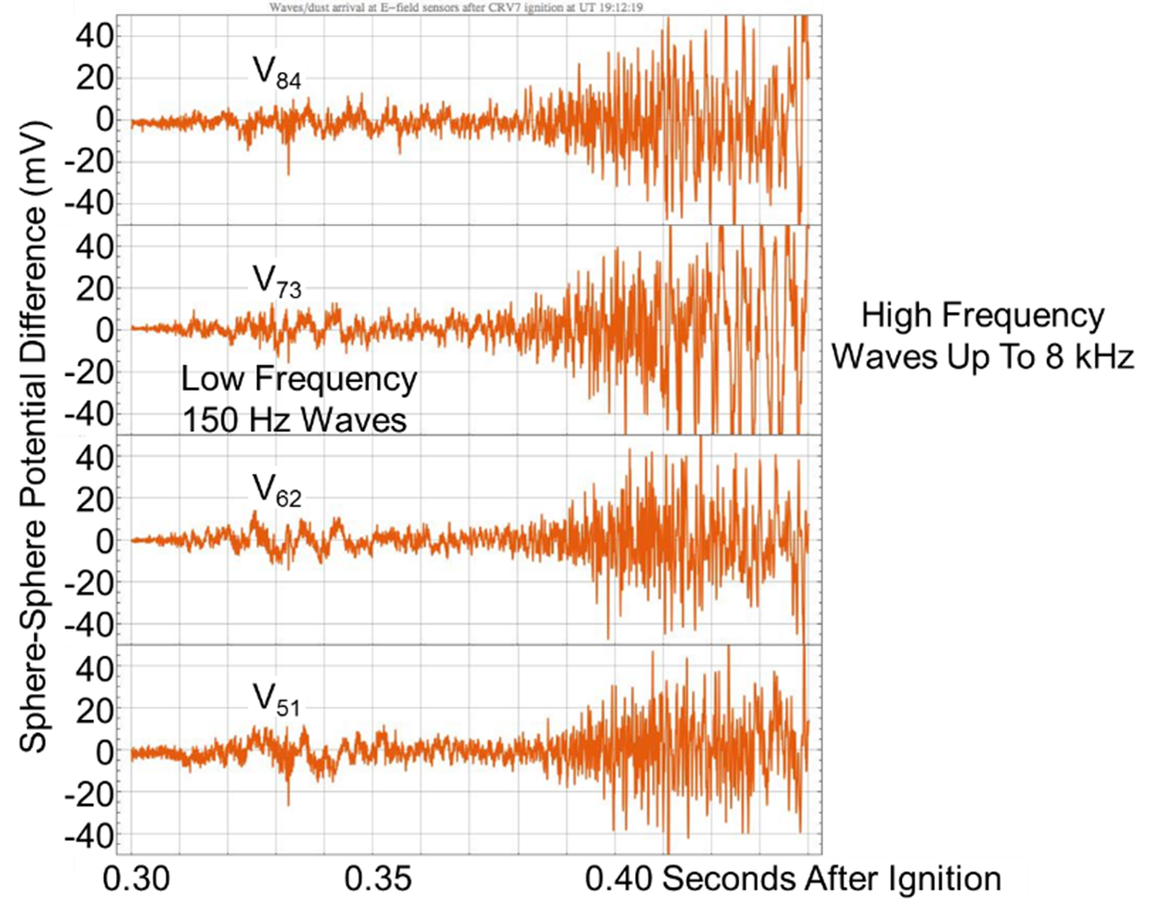
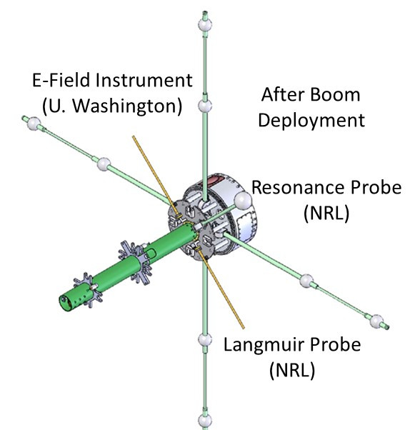
Electric Fields in Dust Release
CARE II (NRL-0502)
E-Field DATA RESULTS SHOWING PLASMA WAVES
Fast MHD
Ion Acoustic

Slide 9
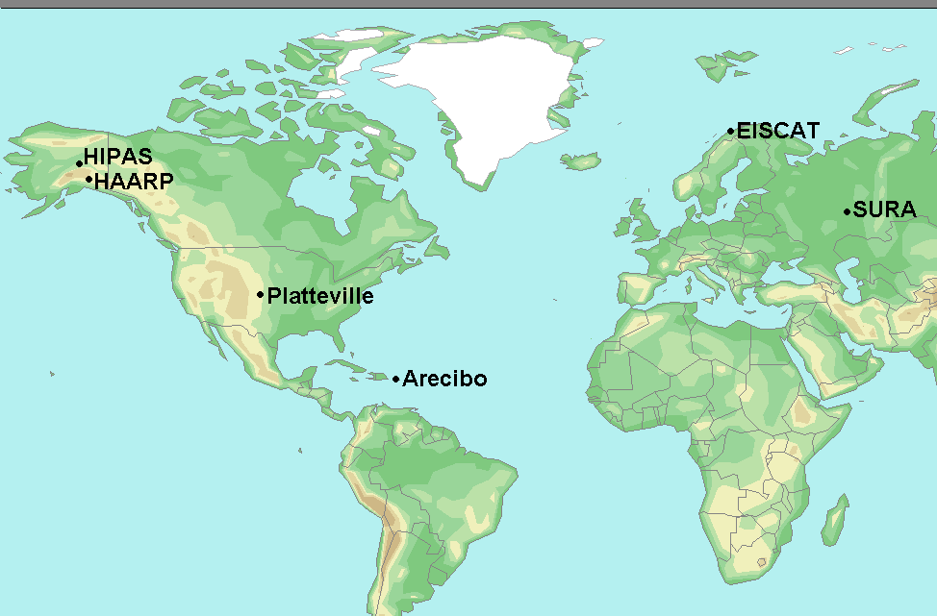
Past, Current and Future HF Ionospheric Modification Facilities
Jicamarca
Arecibo Conjugate
unclassified

Slide 10
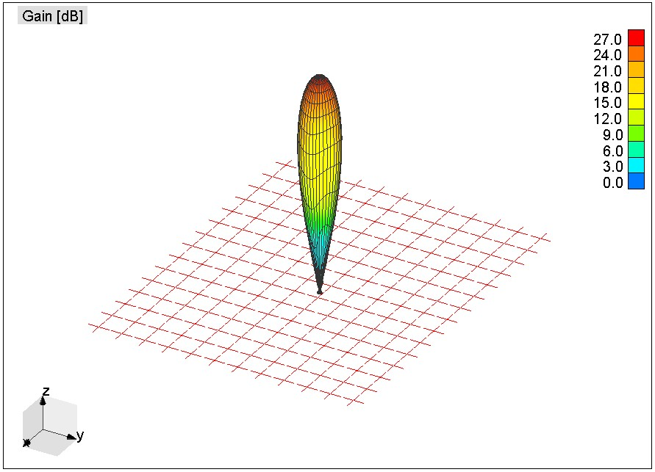
HAARP Array Pattern at 7 MHz with 1.8 Giga Watt ERP
Gain (dB)

Slide 11
Very High Power Plasma Pancake Formation with no Sunlight and no Photoelectrons
Neutral Atmosphere
Wave Heating
Collisional Ionization
High Power HF Waves
Plasma with 0.1 eV Thermal Electrons
Suprathermal
(1 eV) Electrons
Parametric Decay,
Langmuir Turbulence
LOW FREQUENCY
Ion Acoustic Waves
Lower Hybrid Waves
Ion Bernstein
HIGH FREQUENCY Langmuir Waves
Upper Hybrid Waves
Electron Bernstein
Resonance Acceleration
10 eV Ionizing Electrons

Slide 12
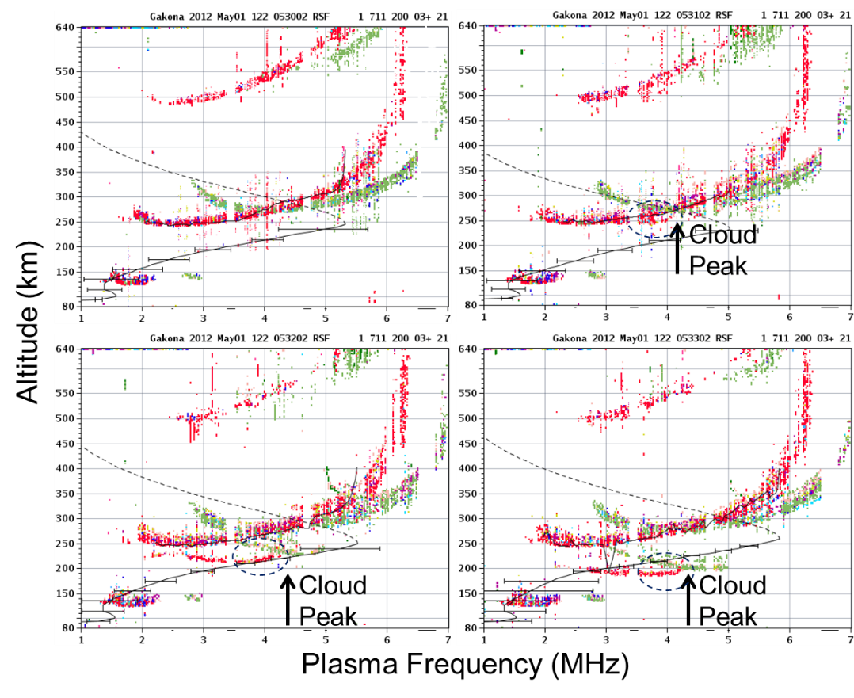
HAARP Artificial Ionization Cloud Formed Around 4.325 MHz
600
500
400
300
200
100
Gakona 1 May 2012
600
500
400
300
200
100
Gakona 1 May 2012
05:30
05:31
1 2 3 4 5 6 7
1 2 3 4 5 6 7
600
500
400
300
200
100
600
500
400
300
200
100
05:32
05:33
1 2 3 4 5 6 7
1 2 3 4 5 6 7

Slide 13
Simulations of Plane EM Wave Interactions with Plasma Plate and Ring
3 MHz Pump
0.9 km Diameter Cloud
Plasma Plate
Plasma Ring
|E| (V/m)
Enhanced Fields and AI on Bottom
Focused Fields and AI on Axis

Slide 14
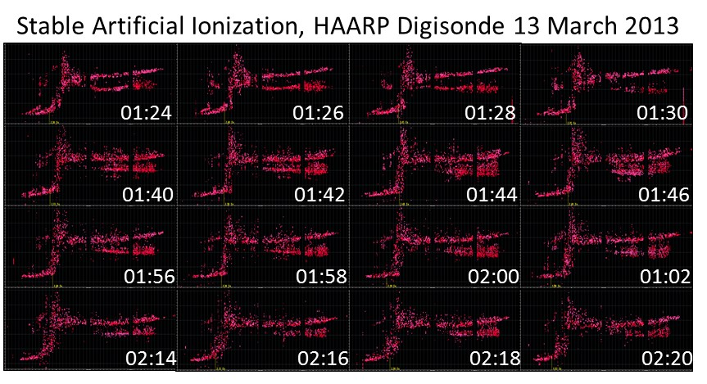
14 March 2013 01:00 to 01:20 GMT Extended Artificial Ionization with 5.8 MHz Twisted Beam

Slide 15
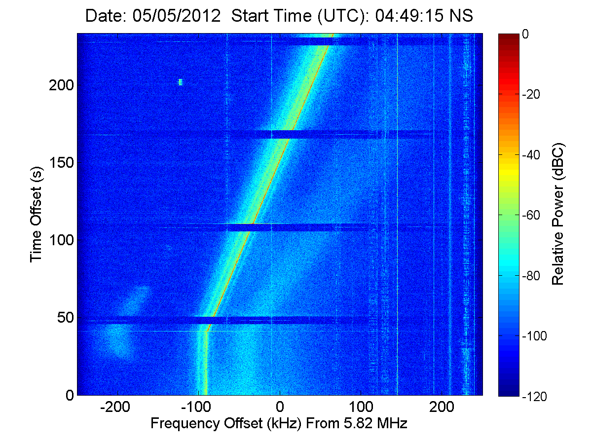
Plasma Cloud Formation Physics: Ionization by Beaming of High Power HF Waves
777.4 nm Artificial Plasma
Glow Discharge Ionization
Ionization Signature
Robert Michell, SWRI

Slide 17
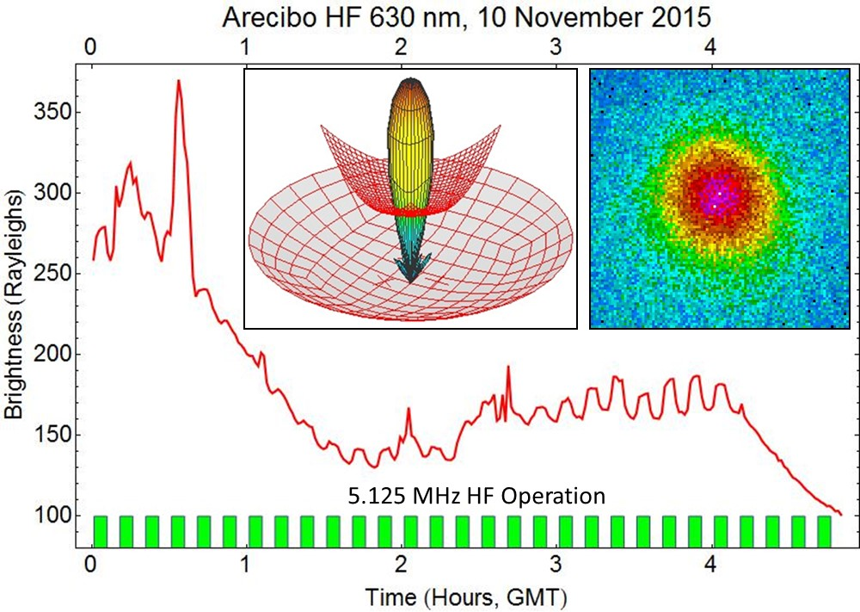
630 nm Airglow Modulated by 5.125 MHz 100 MW Transmissions from the Arecibo HF Facility (Sources: Jeff Baumgardner, Boston Univ. and Juanita Ricobono, Sci-Sol)
unclassified

Slide 18
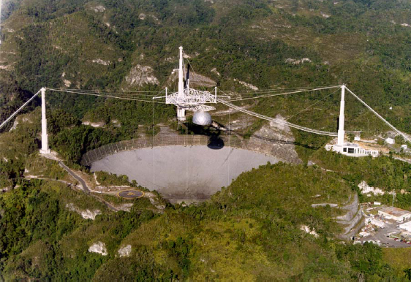
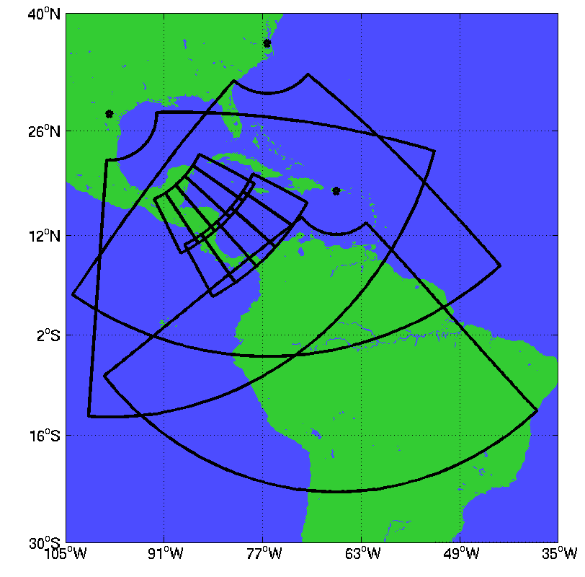
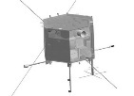
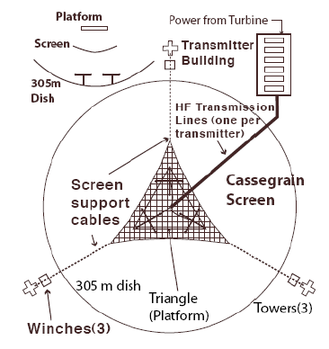
New Ionospheric Heating Facility at Arecibo Puerto Rico Modifies the Ionosphere of the Virginia/Texas ROTHR
NRL/QinetiQ HEX Campaign March 2017
Arecibo Dish in Puerto Rico
Operational ROTHR and Arecibo Heater
Virginia
Texas
Puerto Rico
Trinidad
Satellite Radio Receiver
600 kw HF Transmitters Feeding HF Antenna Suspended Over 324 m Arecibo Dish
Artificial Irregularities in the Path of the Virginia ROTHR
unclassified

Slide 19
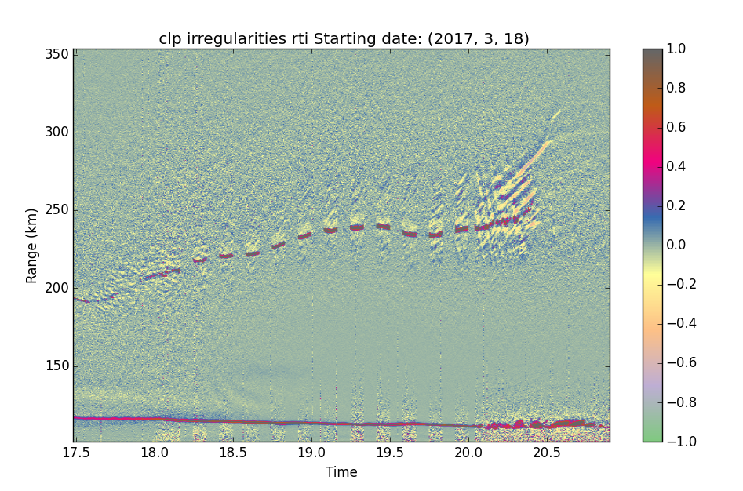
Radar Ion Line Data Over Arecibo 18 March 2017 AST
Large Scale Plasma Irregularities
HF Enhanced Ion Acoustic Waves
Altitude (km)
Local Time (AST)

Slide 20
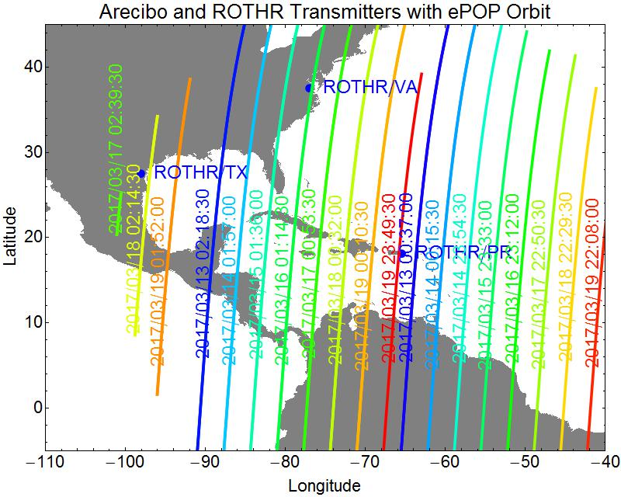
13-19 March 2017 ePOP Satellite Passes
f₀F2 ~ 5.1 MHz
Orbit Near 1260 km

Slide 21
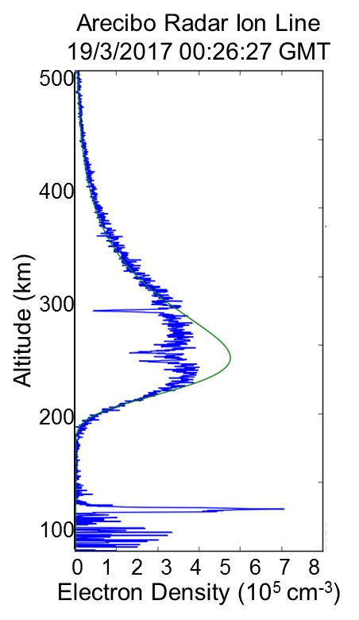
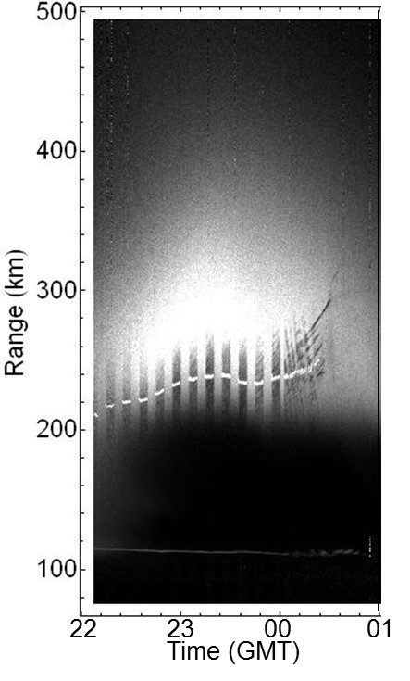
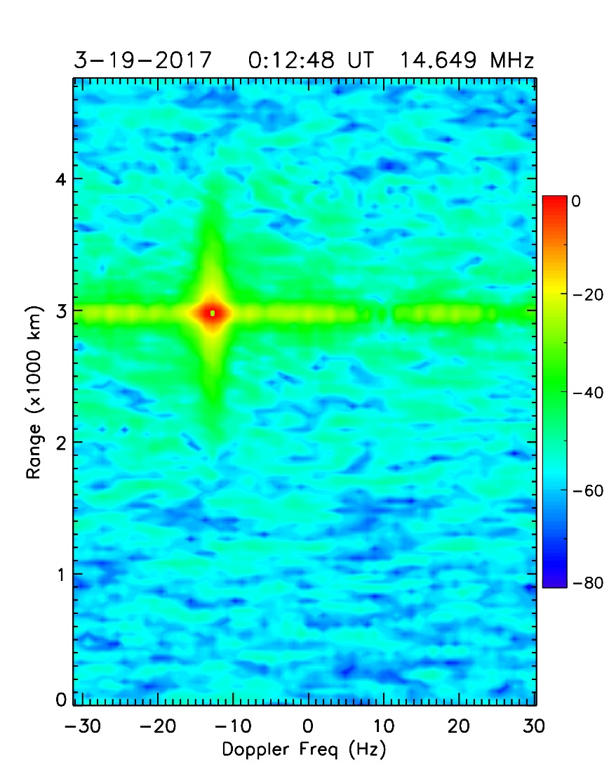
Arecibo Profile and ePOP Data 19 March 2017

Slide 22
Medium Power Plasma Pancake Formation Employing Photoionization
Solar Extreme Ultraviolet Radiation
Neutral Atmosphere
Collisional Ionization
Photoionization
High Power HF Waves
Plasma with 0.1 eV Thermal Electrons
~1 eV Photo- Electrons
Parametric Decay,
Langmuir Turbulence
LOW FREQUENCY
Ion Acoustic Waves
Lower Hybrid Waves
Ion Bernstein
HIGH FREQUENCY Langmuir Waves
Upper Hybrid Waves
Electron Bernstein
Resonance Acceleration
10 eV Ionizing Electrons

Slide 23
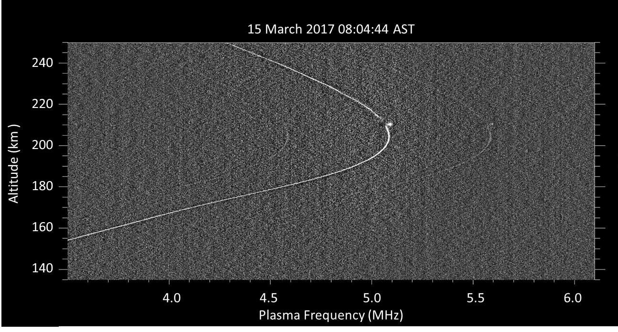
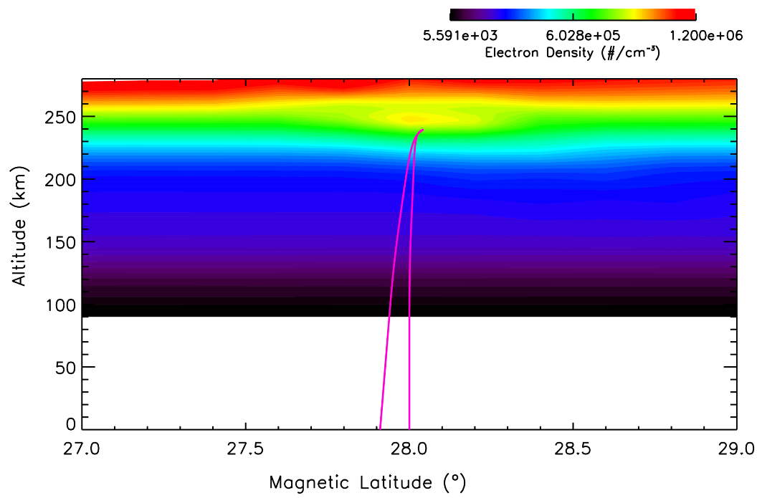
Plasma Line Profile Showing Descending Artificial Plasma Pancake Layers

Slide 24
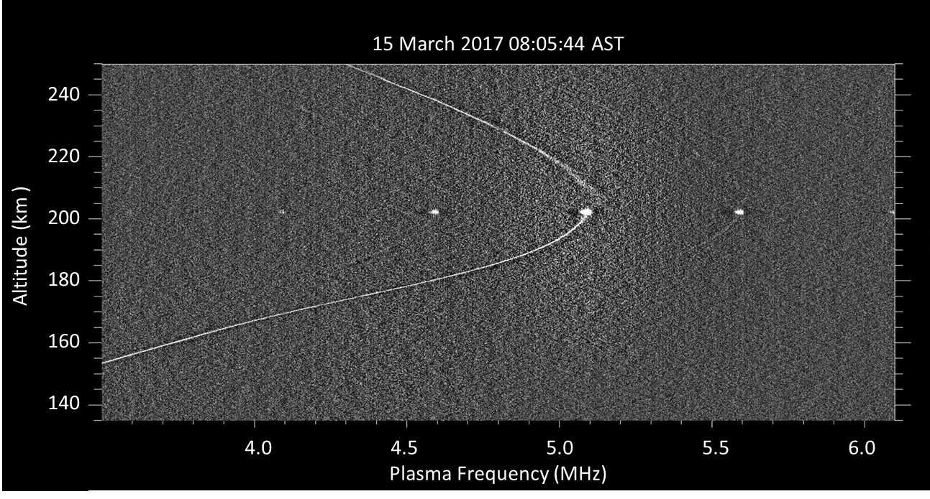
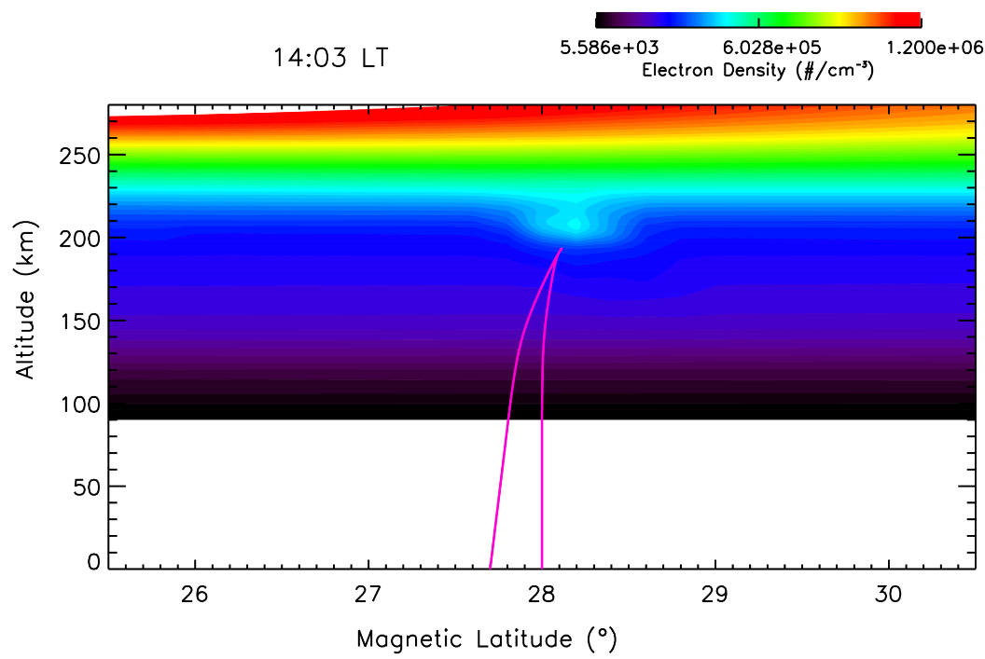
Plasma Line Profile Showing Descending Artificial Plasma Pancake Layers

Slide 25
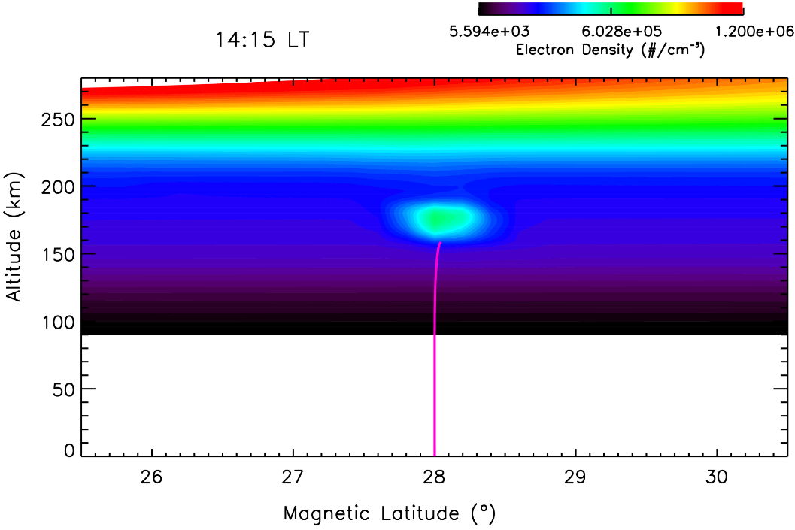
Plasma Line Profile Showing Descending Artificial Plasma Pancake Layers

Slide 26
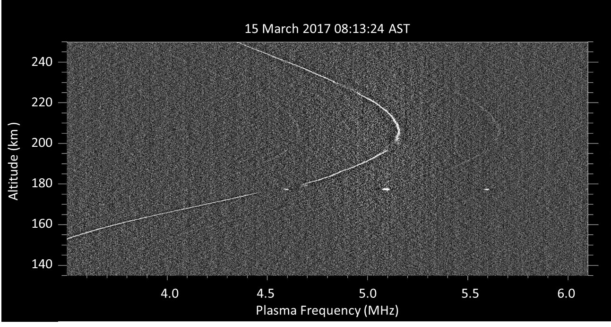
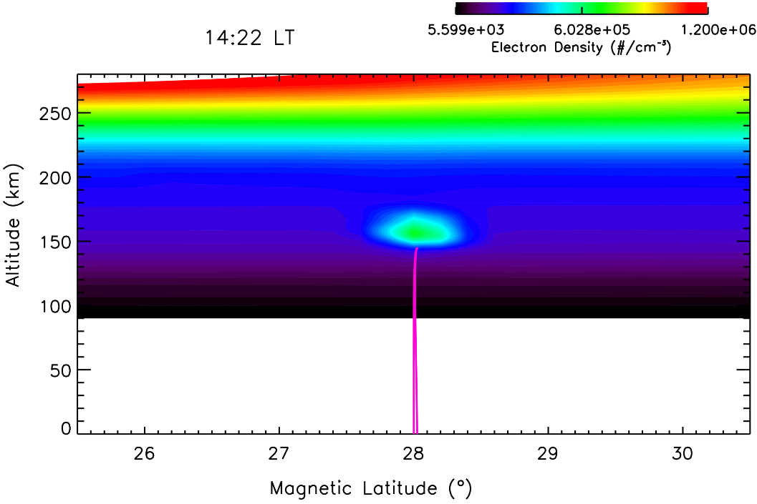
Plasma Line Profile Showing Descending Artificial Plasma Pancake Layers

Slide 27
Conclusions
Ionospheric Control by Chemical Releases
Dedicated Firings of On-Orbit Thrusters (SEITE/SIMPLEX)
Sounding Rocket Injection of Chemicals and Dust (CARE)
Ionospheric Control by High Power Radio Waves
Ground HF Facilities (Arecibo, HAARP)
Supporting Radar and Optical Diagnostics
Plasma Cloud Generation and Irregularity Formation with only 100 GW ERP
Tests of Ionospheric Modification Physics
Ionospheric Modification Supports DoD R&D Efforts
Simulates Components of Operational Systems
Radio Scintillations from High Altitude Nuclear Explosion
OTH Radar Clutter Sources
ICBM Thrust Termination Events
Low Cost Surrogates for Concept Testing and Demonstrations

Slide 28
