Slide 1
Spaceborne Electron Accelerators
J.W. Lewellen for the
LANL/SLAC AIS Team
Active Experiments in Space 2017
12 September 2017

Slide 2
Acknowledgements & Thanks
LANL LDRD, Program Development and Pathfinder funding
LANL/SLAC AIS Team: Robert Aragonez, Cindy Buechler, Greg Dale, Dale Dalmas, Mike Holloway, Jeff Neilson, Emilio Nanni, Dinh Nguyen, Doug Patrick, Harry Salazar, Sami Tantawi
Other LANL team members: Bruce Carlsten, Eric Dors, Reinhardt Friedel…
Colleagues at GSFC: Elizabeth MacDonald, Jean-marie Lauenstein and others
Workshop organizers for the invitation!

Slide 3
Please note…
This talk focuses on work performed at Los Alamos, intended to demonstrate viability of core technologies for the accelerator.
There has been very good work done elsewhere (SLAC, Goddard) that isn’t listed in detail here.

Slide 4
Outline
Why RF accelerators in space?
Constraints
Approach
Results to date
Future plans
Conclusions

Slide 5
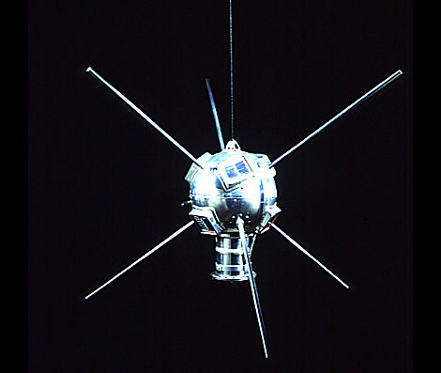
Consider a Spherical Satellite…
10 kJ = 200 mA
20 mA
1 mA
x
x
x
5 kV
50 kV
1000 kV
x 10 sec
x 10 sec
x 10 sec
→
→
→
2
0.2
0.01
C
C
C
For the same beam power, charge neutralization is easier with higher beam voltage.
But: DC voltages drive local plasma currents and corresponding currents in the satellite. Can lead to damage and breakdown.
For some satellites, 300 V = “high voltage”
Notes:
Satellite has a capacitance of around 0.2 nF. Oh, and by the way, needs to be light weight, compact and robust.

Slide 6
Why RF Accelerators?
V vs. I for 10-kW beam power
DC accelerators can approach
100% efficiency.
A very good RF accelerator can approach ~50% efficiency.
But RF accelerators can give:
access to higher beam voltages
lower system operating voltages
more flexible operation
Beam current (mA)
RF based
DC
based
Beam voltage (kV)
Notes:
Higher voltage means less problems with spacecraft charging

Slide 7
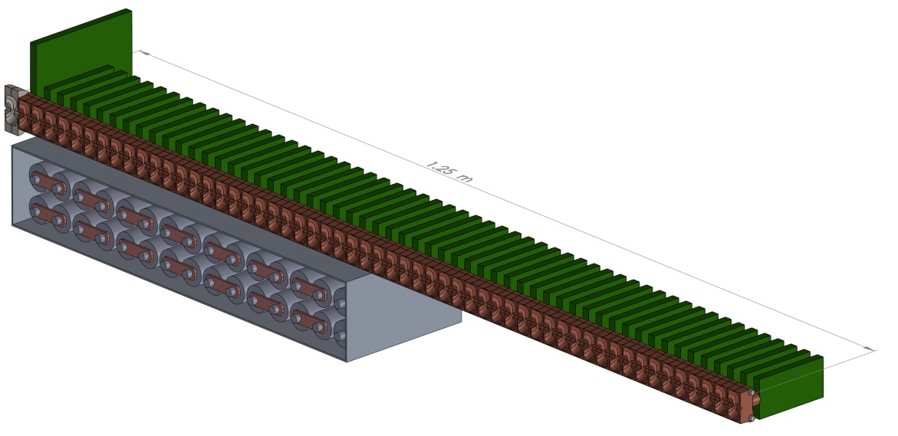
Artist’s Conception
System control board
 | Early Estimates
Length | 1.5 m
Weight | 31 kg (ex. batts.)
Beam Power | 10 kW peak 1 kW average
RF gun
RF drive / phase /
diagnostics cards
Battery bank
accelerator cavities

Slide 8
RF Linac: Bounding the Design
Nominal 1-MV beam
High power: 10 kW peak P_{beam}, 10% duty factor
Efficient (for an RF linac)
  50% RF power to beam, 50% to structure
  50% RF generator efficiency (final stage, ex. parasitic losses)
Ideally, that says we need ~40 kW peak power
Practically, bus-to-beam efficiency should be in the 15%-30% range (some details later)

Slide 9
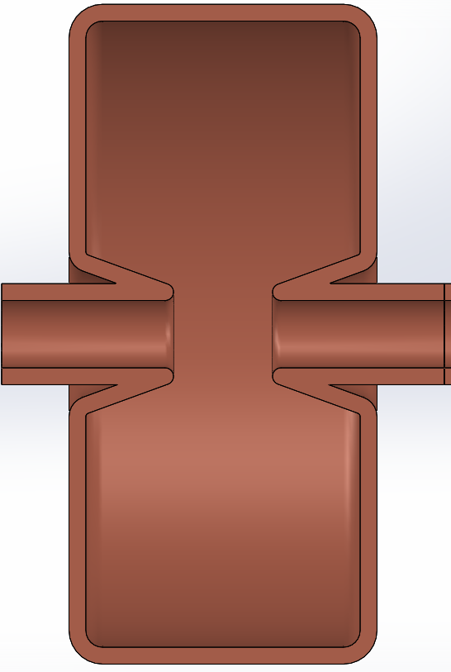
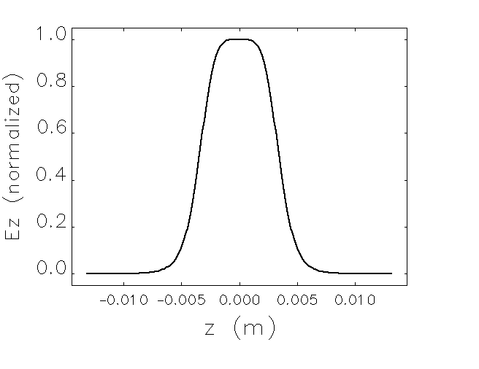
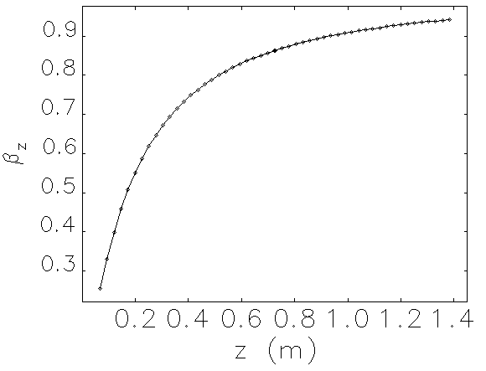
Building Block:
Low-β C-Band Cavity
resonant at 5.1 GHz
Power vs. energy gain: 170 W provides 10 – 20 kV gain per cell, depending on incoming beam voltage
Notes:
This cavity serves as the basic building block for the entire linac design

Slide 10
RF Linear Accelerator Power Needs
Structure power – “buy-in” cost to get the desired voltage
Beam loading – power delivered to electron beam
  Increase R_{s} as much as possible
  Use modest gradients – lower RF power, longer linac to get to a given voltage
  Moderate to heavy beam loading

Slide 11
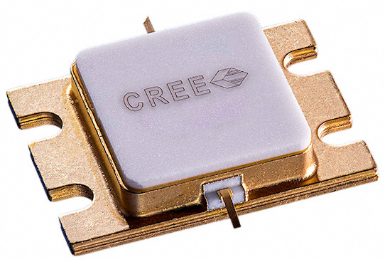
Can we Eliminate High Voltage?
0.6”
Wolfspeed (formerly Cree) High Electron Mobility Transistors
up to 500 W @ 10% DF (C-band)
up to 100 W @ 10% DF (X-band)
Very tolerant of reflected power
High quiescent power use (nominally)
power from 50 V DC
>50% efficient

Slide 12
Distributed RF Power
HEMTs
Circulator
φ
LLRF
Phase shifters
φ
HEMT Preamp
φ
370 W / cavity
φ
Injected electrons
E_{ini}
E_{ini} + (20 keV)N_{cav}
N individually driven RF cavities
20-keV energy gain per cavity
Notes:
This looks very much like the LCLS-II cavity powering scheme, in miniature, or like what is used for proton & ion linacs

Slide 13
Thermal Loading:
No Cooling System
50 cavities, 0.1 kg/copper cavity, 5 kg total structure mass
Copper heat capacity, C_{h,Cu} = 385 J/(kg K)
Structure absorption = 4.25 J per macropulse
There are 2,000 macropulses in each 10-s burst
  4.4 K/(10-s burst)
Frequency detune ~ -100 kHz/ºK @ 5.1 GHz
  ~ 44 kHz frequency droop per second
Total frequency detune in 10 seconds ~ -440 kHz
Cavity bandwidth ~ 600 kHz
Notes:
just talk over the slide

Slide 14
Getting from Here to There
RF systems
  HEMT performance
  Practical amplifier chain
Cavity systems
  Power coupling
  Frequency tuning
Beam acceleration
Radiation / space qualification

Slide 15
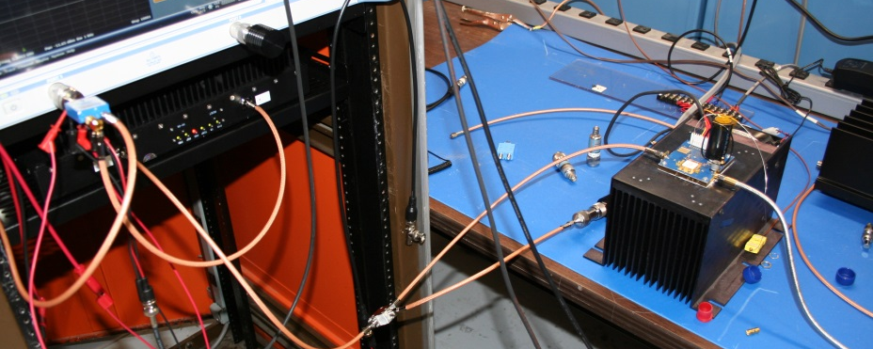
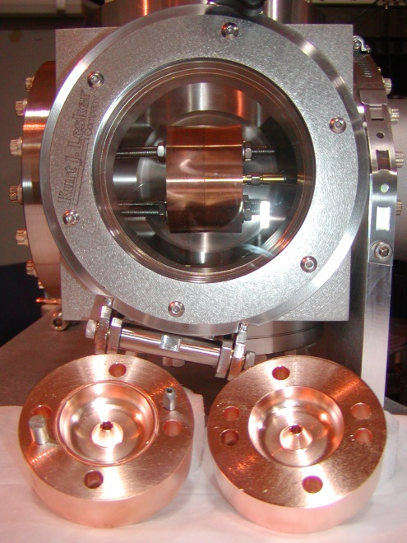
HEMT and Cavity Drive Testing
Network Analyzer
RF switch
HEMT
1 mW
30 W
‘scope
300 W
Pulser
500 μs
600 Hz
Preamp
CW signal
generator
fwd. power
mon.
bidrectional
coupler
refl. power mon.
cavity
or load

Slide 16
HEMT Measurements
C-Band HEMT exceeds peak power specs at low DF
here: (0.5 ms pulse length)·(10 ms period)=5% DF

Slide 17
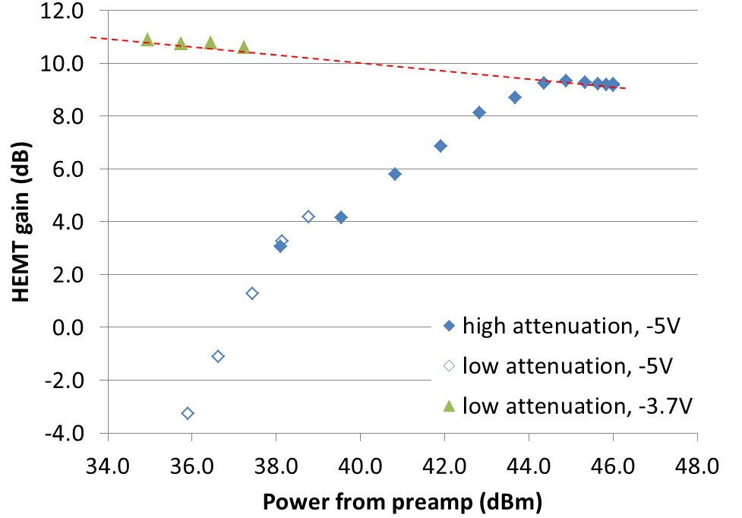
HEMT Operational Envelopes
Enhanced power output with
optimized gate voltage
Efficiency improvement with
optimized drain bias voltage
Both efficiency and power output can be improved without impacting
other metrics, e.g. harmonic power generation.

Slide 18
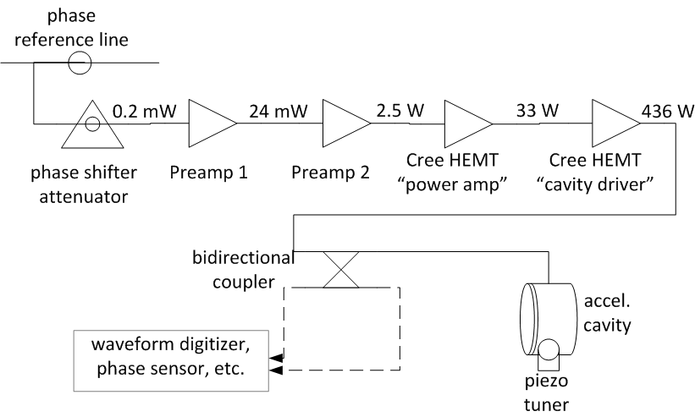
Strawman Single-Cell RF Driver

Slide 19
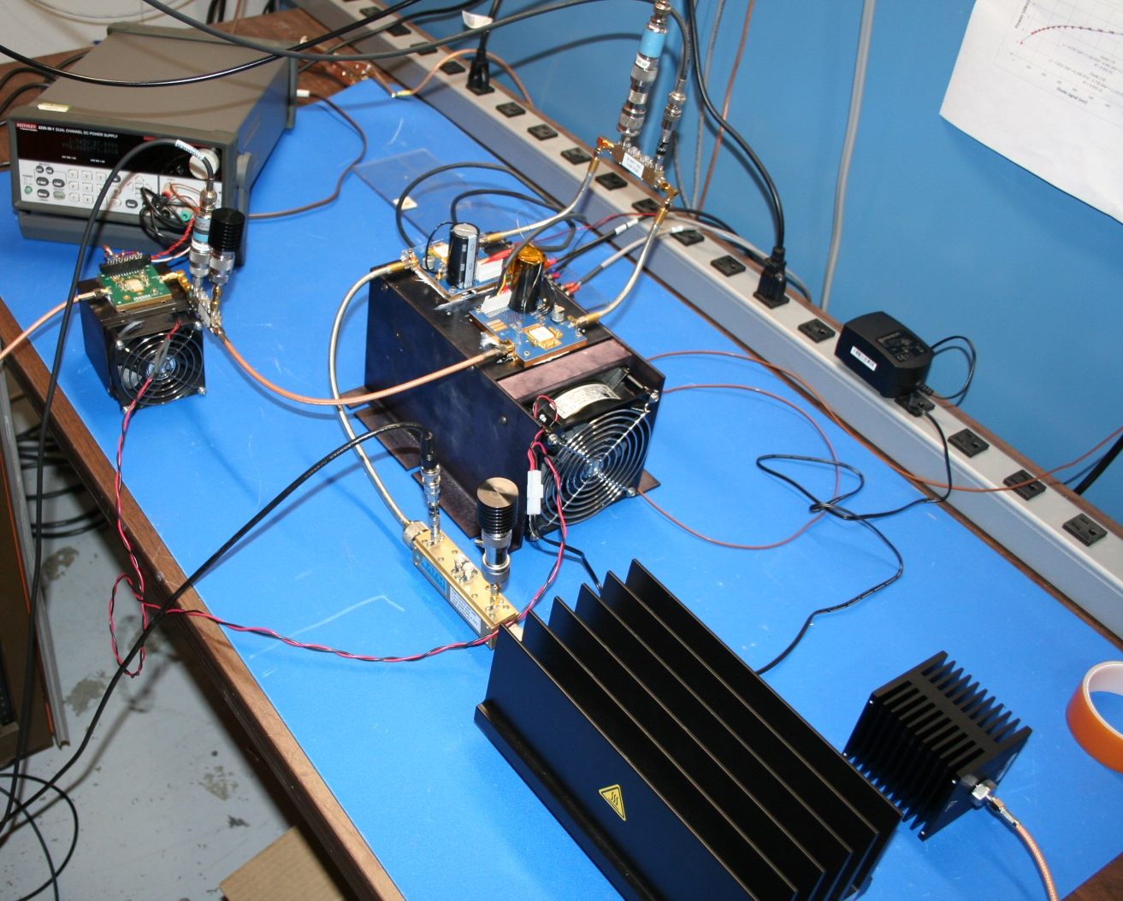
“Practical” Amplifier Chains
“cavity driver” HEMT
Intra-HEMT diagnostics (fwd, refl. power)
“power amp” HEMT
preamp
Bottom lines:
No issues found driving one HEMT off another
Currently preparing single-board prototype device

Slide 20
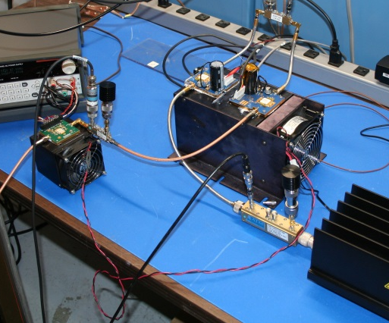
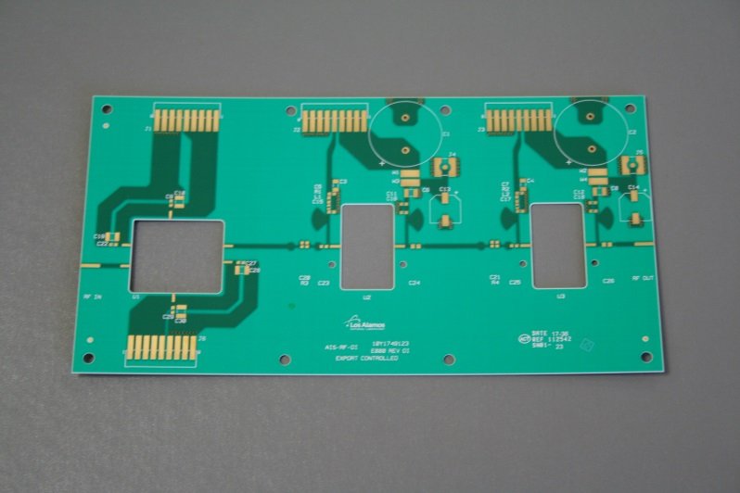
“Practical” → Practical
Next Week

Slide 21
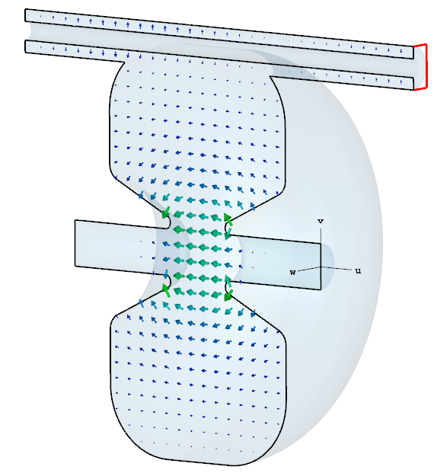
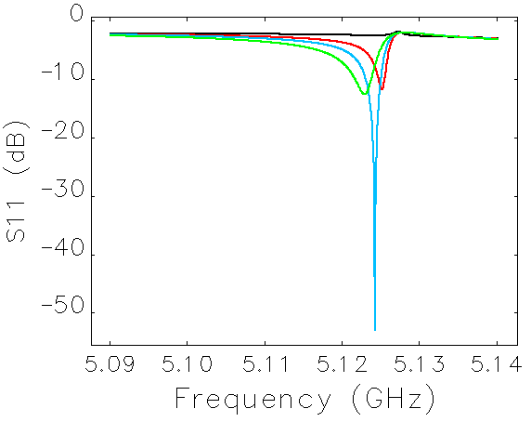
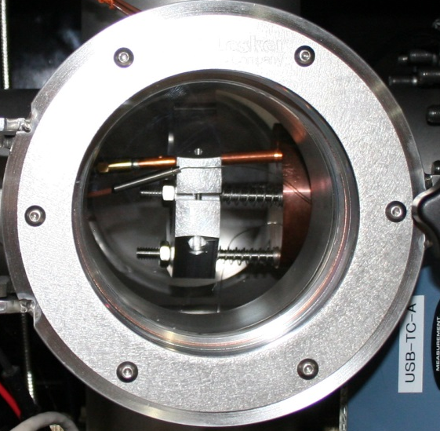
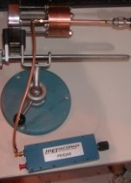
Cavity Systems – Power Coupling
New coupler design…
… to bench test …
… to beam test.
“Sideline” power couplers optimized to deliver power from HEMTs to cavity.
Operated up to 350W at 10% DF as part of beam test.
US Patent applied for.

Slide 22
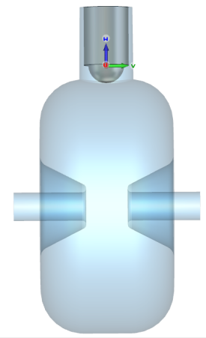
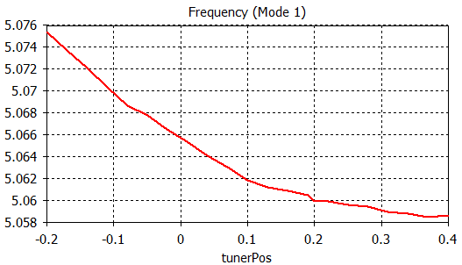
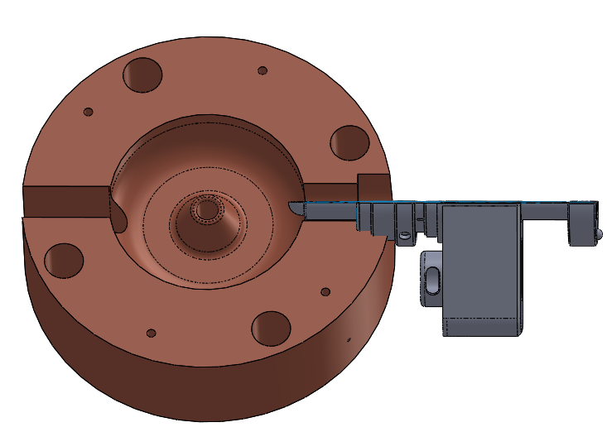
Cavity Frequency Control
Cavities are independent
Cavity tuner controls frequency as temperature changes.
Simple design with COTS vacuum-compatible hardware is being fabricated now will be tested next week.
Tune rate 4 MHz/mm
f (GHz)
Δf of 15 MHz ~ ΔT of 180° C
full in
full out

Slide 23
Acceleration Test
Goal: Demonstrate electron beam energy modulation
  with AIS cavity prototype… ✓
  …driven by an HEMT. ✓
“low-res”
in-line screen
Dipole spectrometer
V=∞
COTS e-gun from
Kimball Physics
V=20kV
Sideline
coupler
“high-res”
90-deg
screen
HEMT

Slide 24
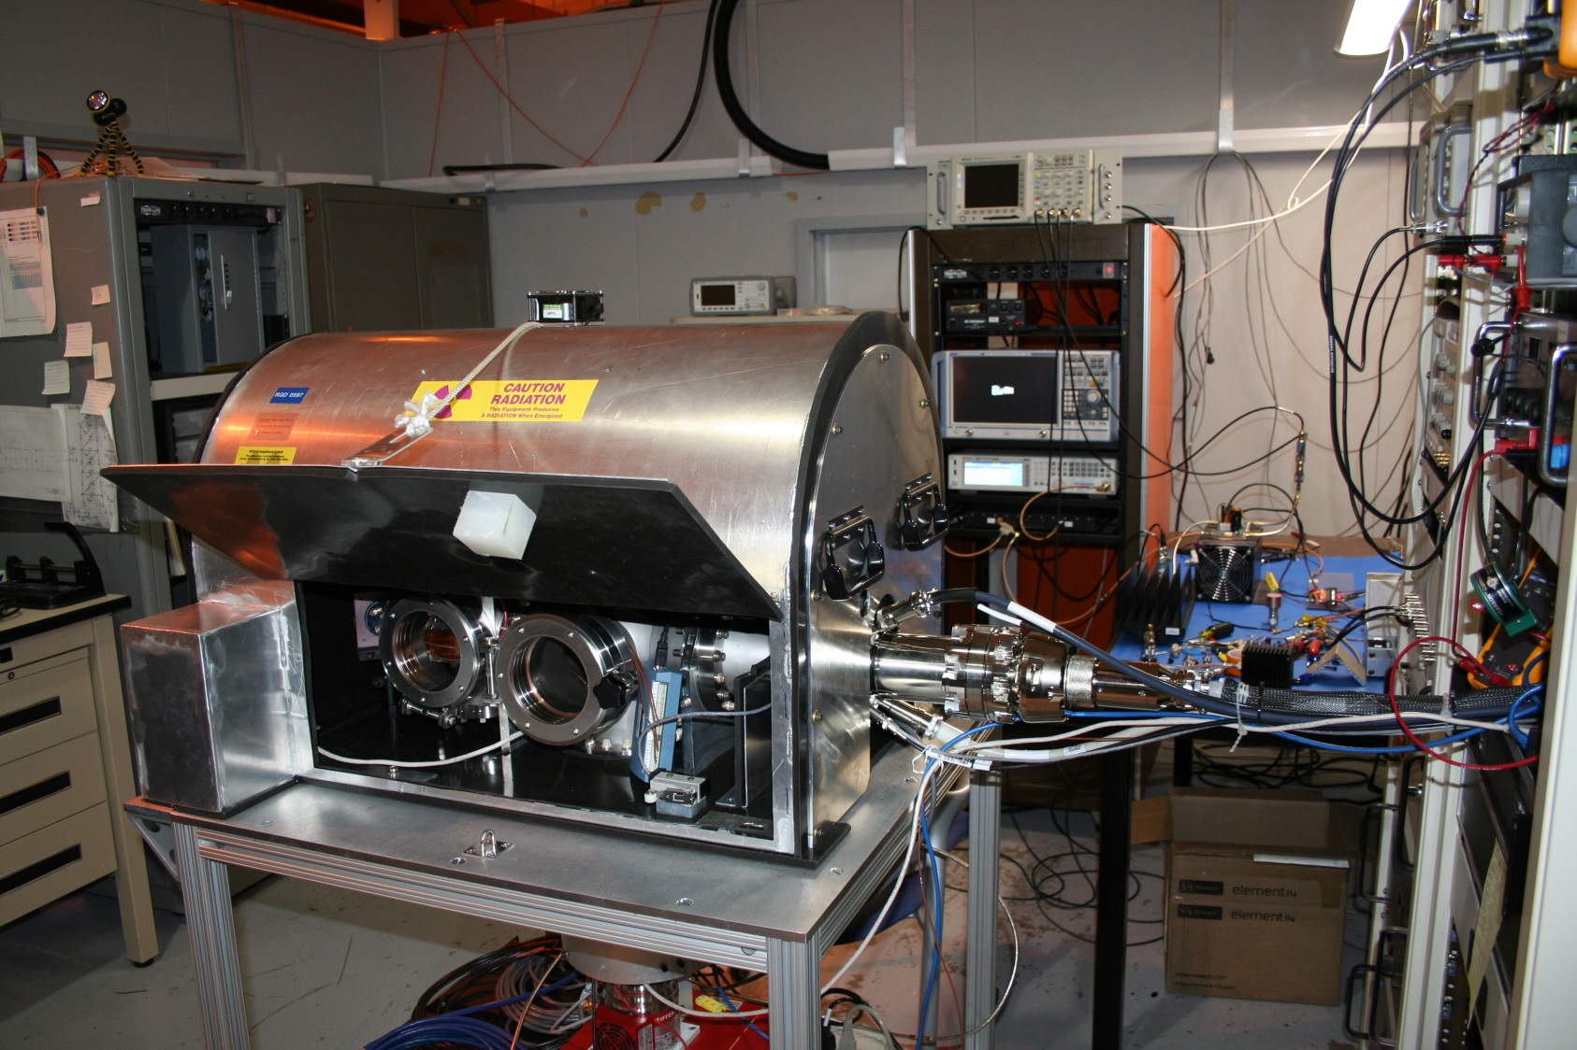
Experimental Setup (1)

Slide 25
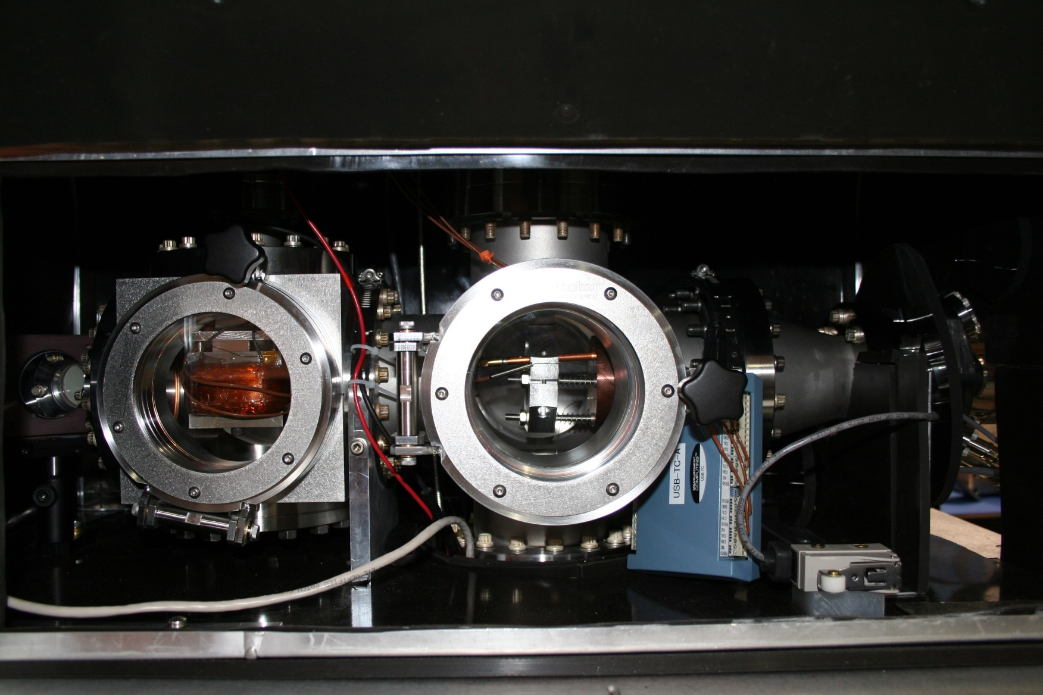
Experimental Setup (2)
Spectrometer
dipole
AIS cavity
Sideline
power
coupler
Electron gun
Inline
screen

Slide 26
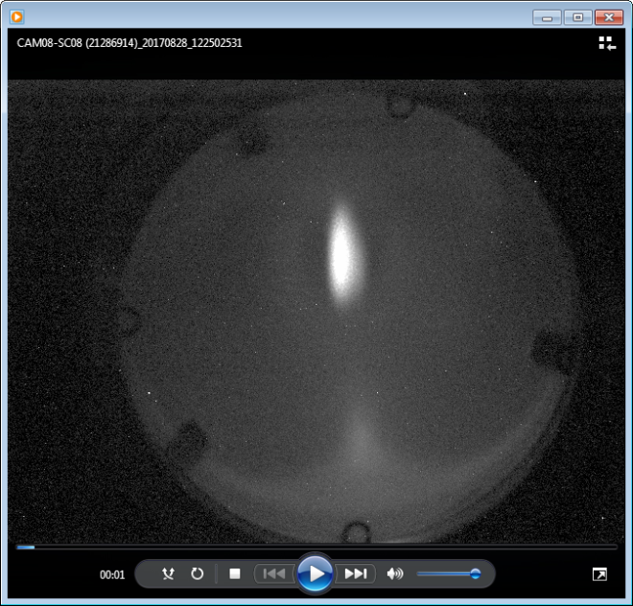
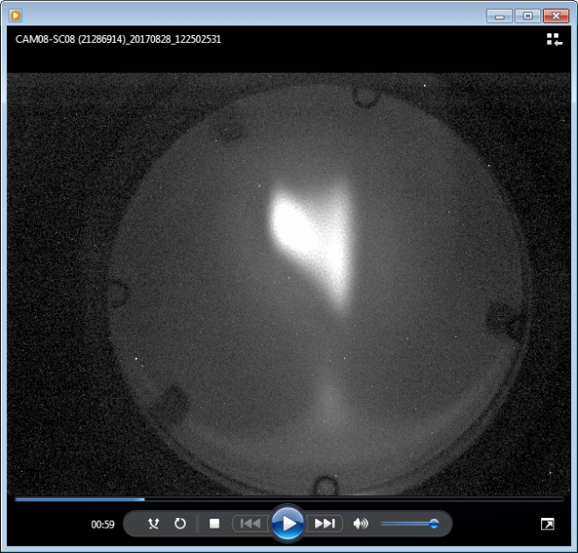
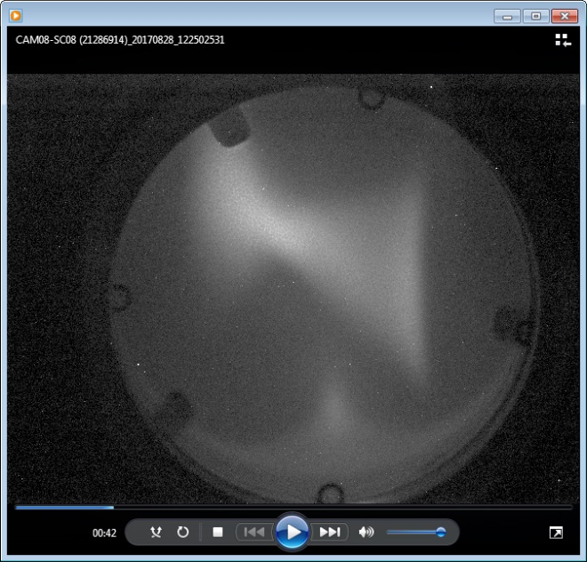
Beam at 90-deg “high-res” screen
← higher V_{beam} lower →
~ 7 kV “width”
~ 4 W RF
(~ 2 ½ W to cavity)
~ 6 W RF
(~4 W to cavity)
RF power off
In all cases, e-gun is generating a 20-kV beam
(Asymmetry is due to dynamics in cavity + dipole focusing effects)

Slide 27
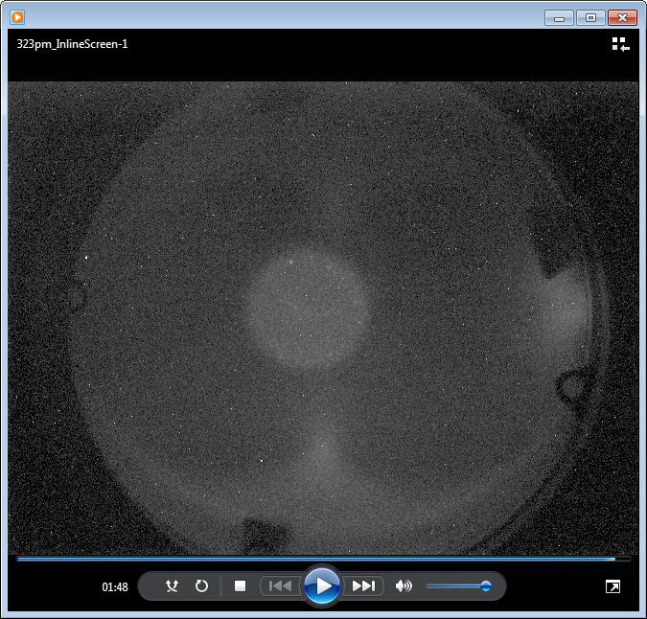
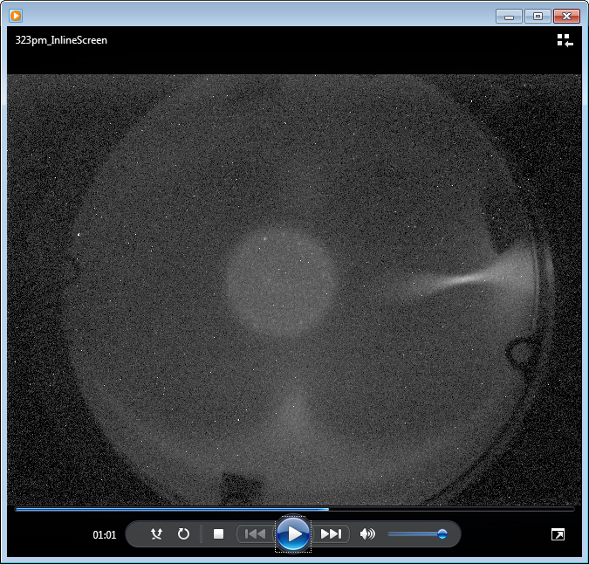
Beam at inline “low-res” screen
20-kV beam “parked” at right edge of screen.
RF off
~ 350 W delivered to cavity
high-energy “tail” extends
to an estimated 40 kV.
beam “halo”
light from cathode “glow”
shining through cavity aperture

Slide 28
Experimental Efforts Summary
Now
  Technology demonstration and validation
    Beam acceleration
    RF power train optimization
    Cavity tuning demonstration
    “Passive” radiation effects testing
Soon
  Multicell acceleration & energy gain measurement
  Long-term “burn-in” testing
  “Active” radiation effects testing

Slide 29
Conclusions
Accelerators in space can drive exciting new science, but are limited by achievable current & voltage
RF-based linacs appear highly promising as alternatives for CONNEX
  (relatively) efficient and compact
  high V_{beam} for low V_{sat}
  modular and highly redundant / fault tolerant
Initial results are very encouraging. Much work ahead but no show-stoppers seen yet.

