Slide 1
Enhanced Energetic Neutral Atom Imaging
Earl Scime
West Virginia University
Active Experiments in Space Meeting
September 2017

Slide 2
Evolution of an Active Space Experiment Concept
1. Scientific Questions Requiring Active Space Experiments
Wave interactions with trapped energetic electron populations: Radiation belts
Ionospheric-Magnetospheric mapping: Inner magnetospheric boundary
What about the rest of the magnetosphere? Spatially resolved energetic neutral imaging?
2. Key Geocoronal Properties
3. Neutral Atom Imaging Essentials
4. Enhancement of Neutral Density
5. Science Goals

Slide 3
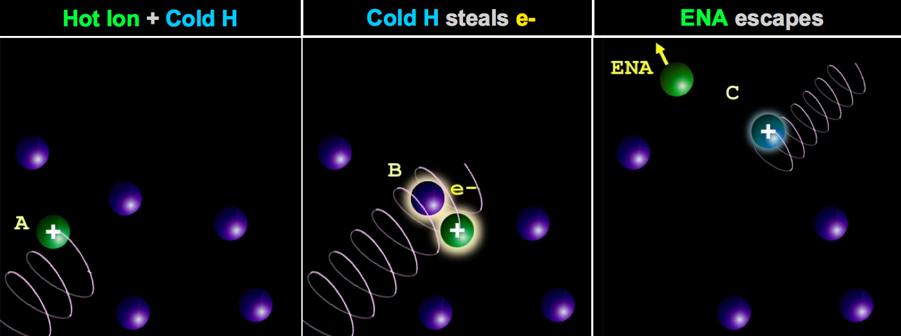
Bulk Plasma Doesn’t Radiate – Image Neutral Atoms
Photons - UV and EUV emission from plasmasphere. Bulk of magnetosphere is H⁺ - no emission. Too cold and/or thin for bremsstrahlung.
Charged Particles - Distorted by electric and magnetic fields
Neutral Atoms - Generated by charge exchange collisions and escape like photons. Detection methods have origins in fusion research [Afrosimov, et al., 1961; Barnett et al., 1961].
Neutral source: the Earth’s geocorona that extends out many R_{E}.
Ion source: the plasma trapped in the magnetosphere.

Slide 4
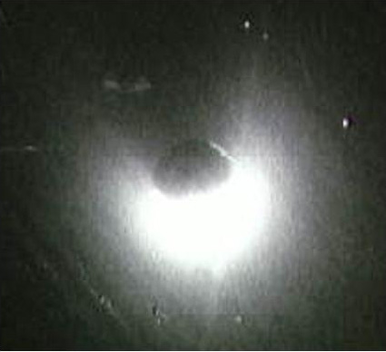
The Earth has a substantial hydrogen geocorona
Re-emission of solar
121.6 nm L_{α} light
- a background nightmare
as photographed during an Apollo mission

Slide 5
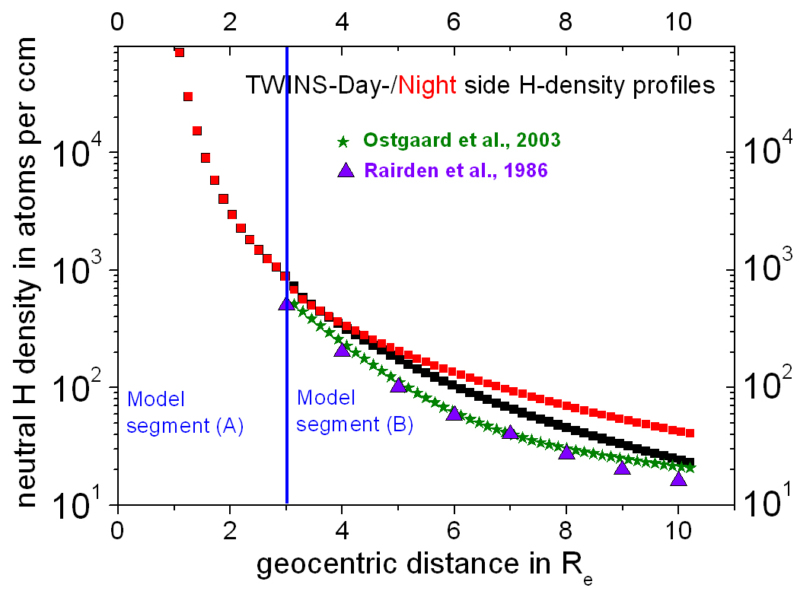
UV Inversions Yield Geocoronal Density Profiles
At geosynchronous orbit,
Hº density ~ 50-100 cm⁻³

Slide 6
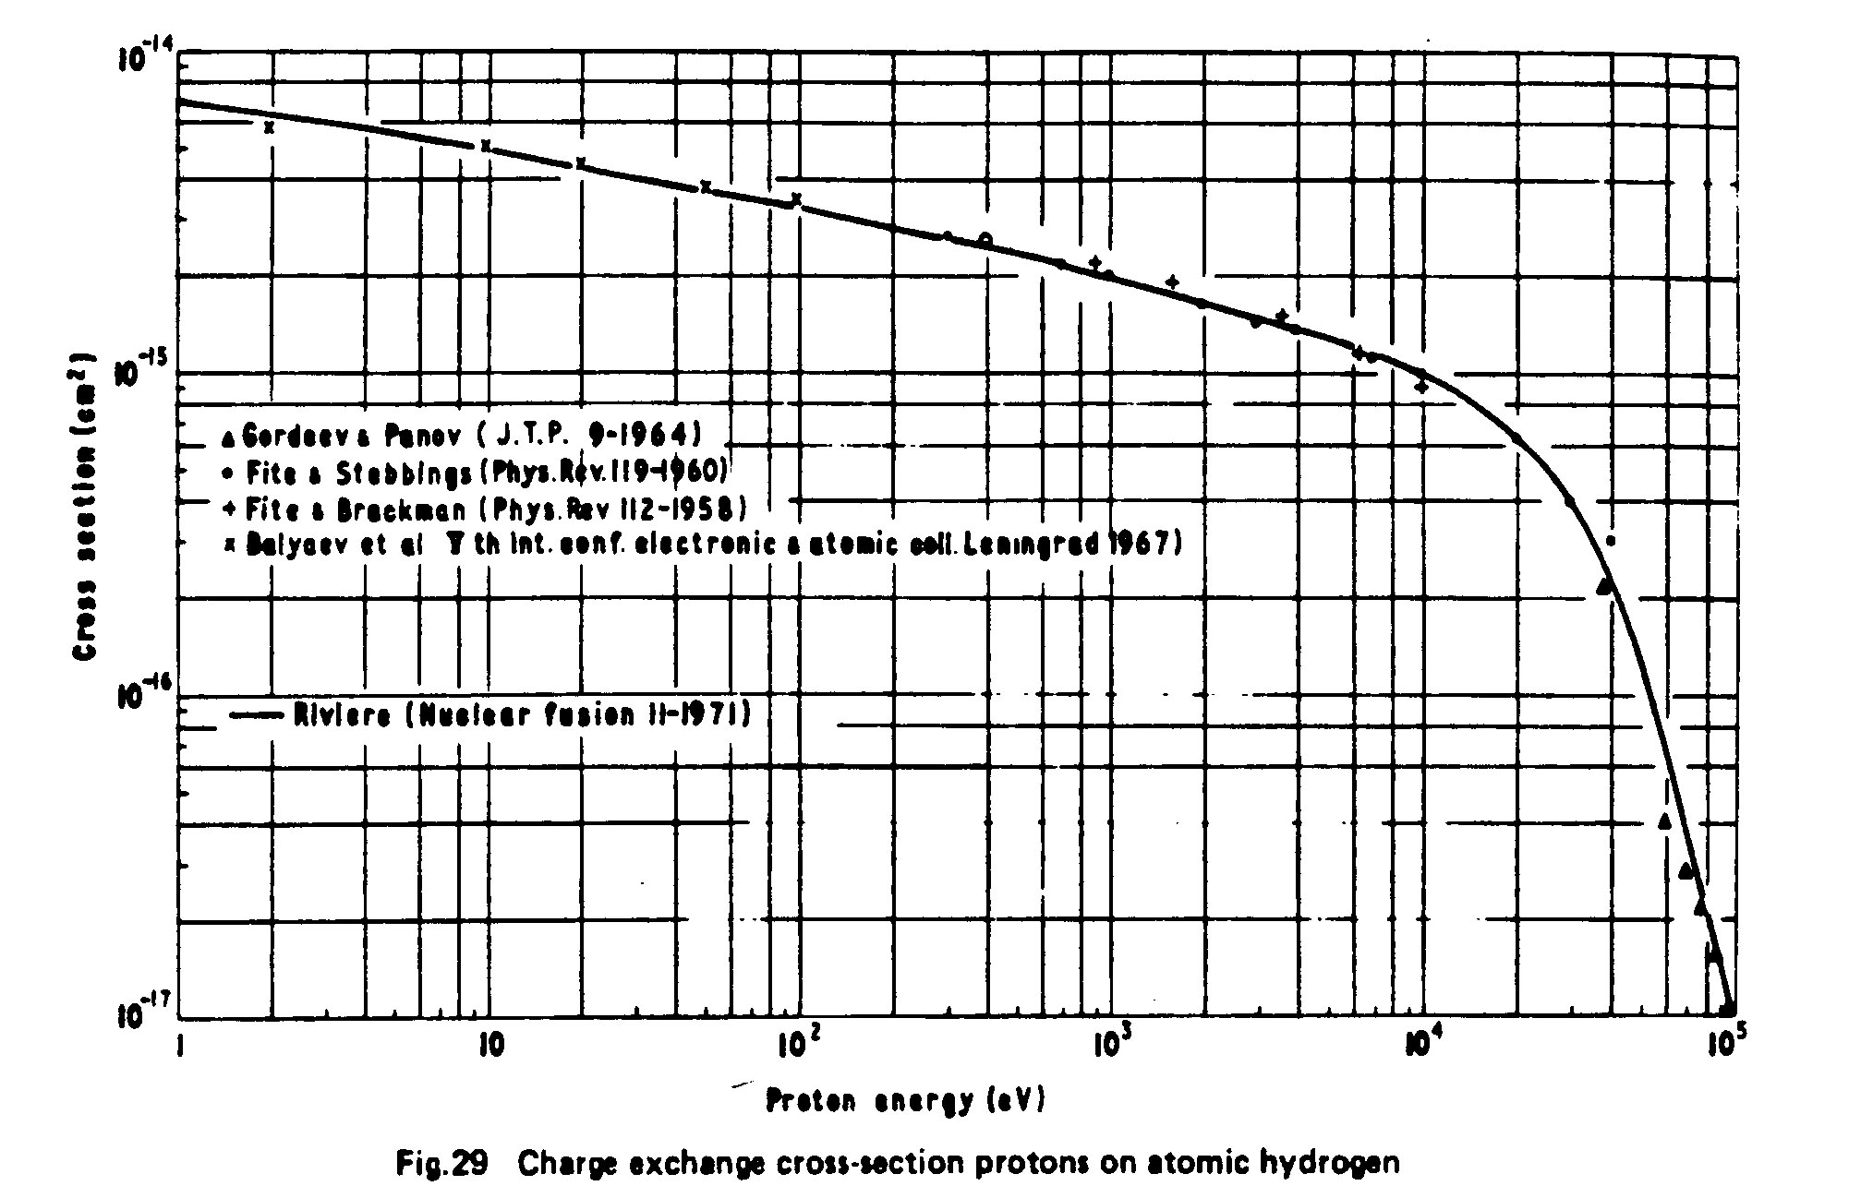
H⁺ on H⁰ Charge Exchange Cross Sections are Well Known
Sweet spot from 1 keV to ~ 50 keV
Ideal for
ring current ions
plasma sheet storm driven events.

Slide 7
Line Integrated Convolution of Ions and Neutrals
Attenuation along emission path
Source =
Direct view of parent ion distribution

Slide 8
Test the Approximation for Energetic neutral spectrum for E >> T_{i}
The high-energy portion of the neutral atom energy spectrum, F(E), generated via charge exchange collisions for a Maxwellian ion distribution of temperature T, is given by
C accounts for the geometrical viewing properties of the instrument and the volume of the hottest region along the line-of-sight at x, n₀(x) is the neutral density, n_{i}(x) is the ion density, (l) accounts for reduction of neutral flux due to additional collisions or ionization along the path from point x to the instrument located at a. Most of the magnetosphere is optically thin to energetic neutral atom emission so

Slide 9
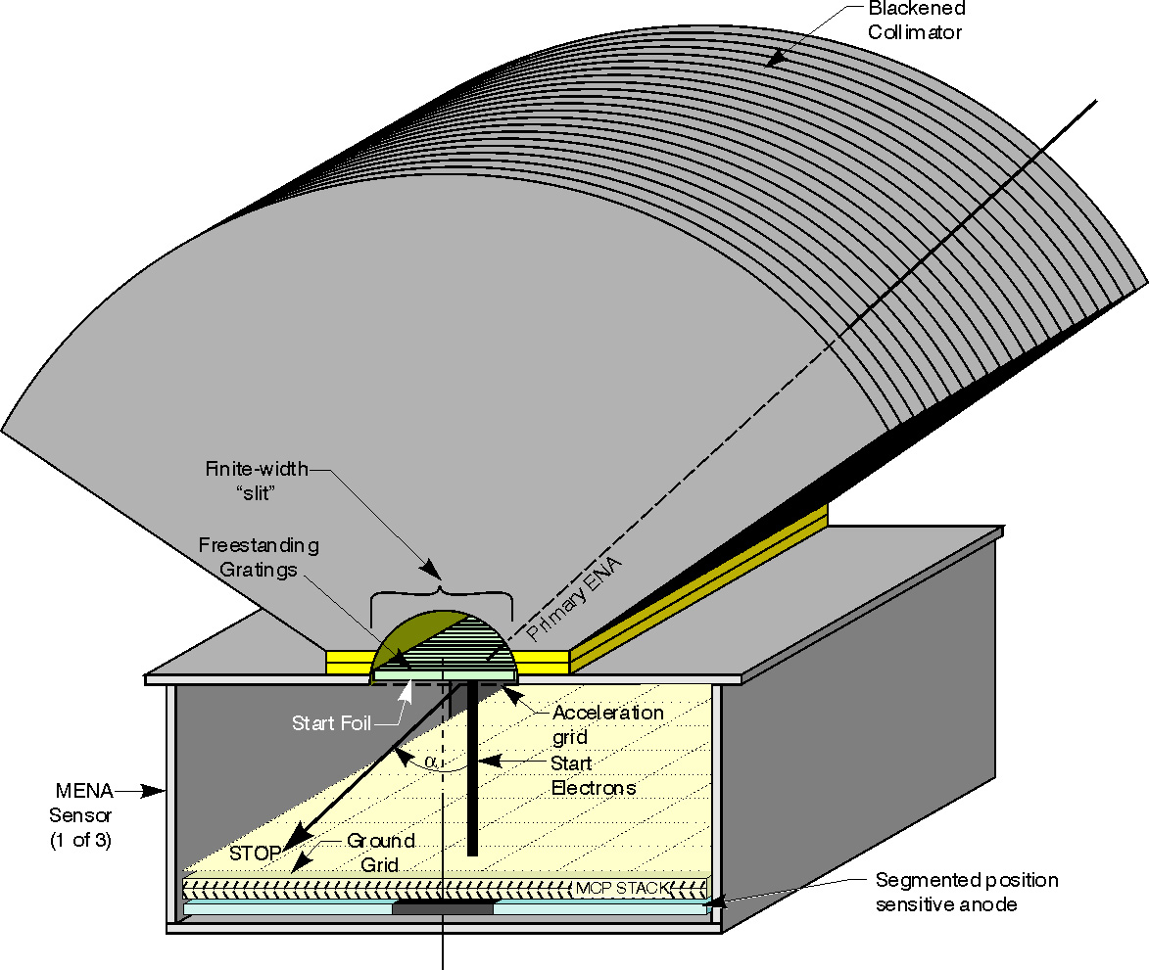
ENA Camera
Dual headed instrument on TWINS spacecraft currently in space – based on IMAGE mission instrument
One TWINS instrument has ceased working – sense of urgency
UV blocking structures
Charged particle rejecting collimators
Coincidence detection
TOF velocity measurement

Slide 10
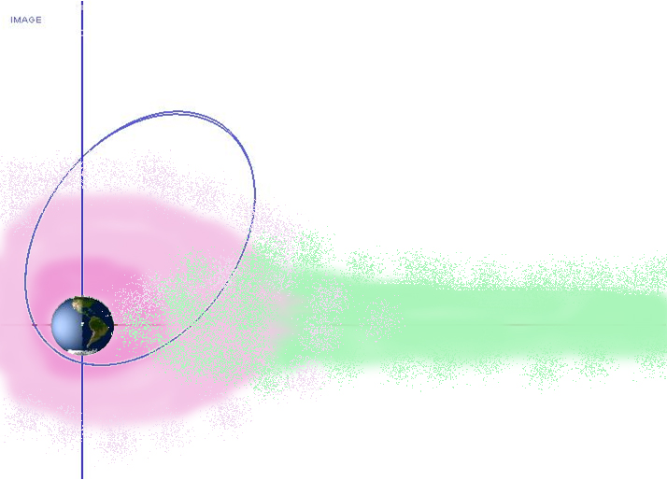
Field of View Sweeps Over the Inner and Outer Magnetosphere
plasma sheet ions
geocoronal
neutrals

Slide 11
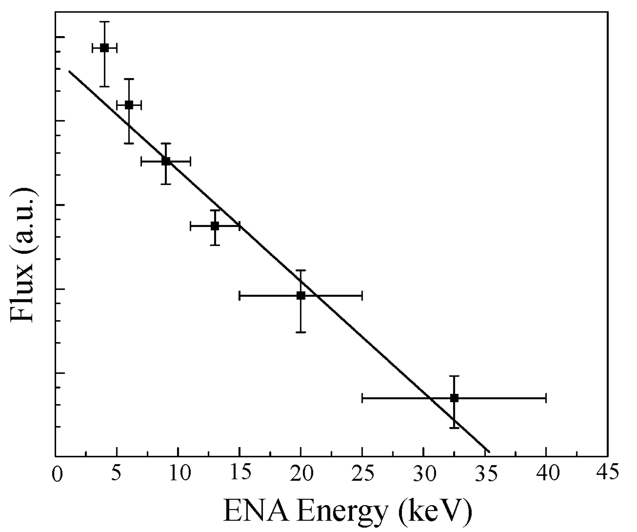
Ion Temperature from Neutral Energy Spectrum
Example neutral energy spectrum after correction for energy dependent charge exchange cross section
Perform this calculation along each look direction
Ideally provides a measurement of the ion temperature from the hottest location along the line of sight
Comparison with in-situ measurement for validation
Local source and/or oxygen effect

Slide 12
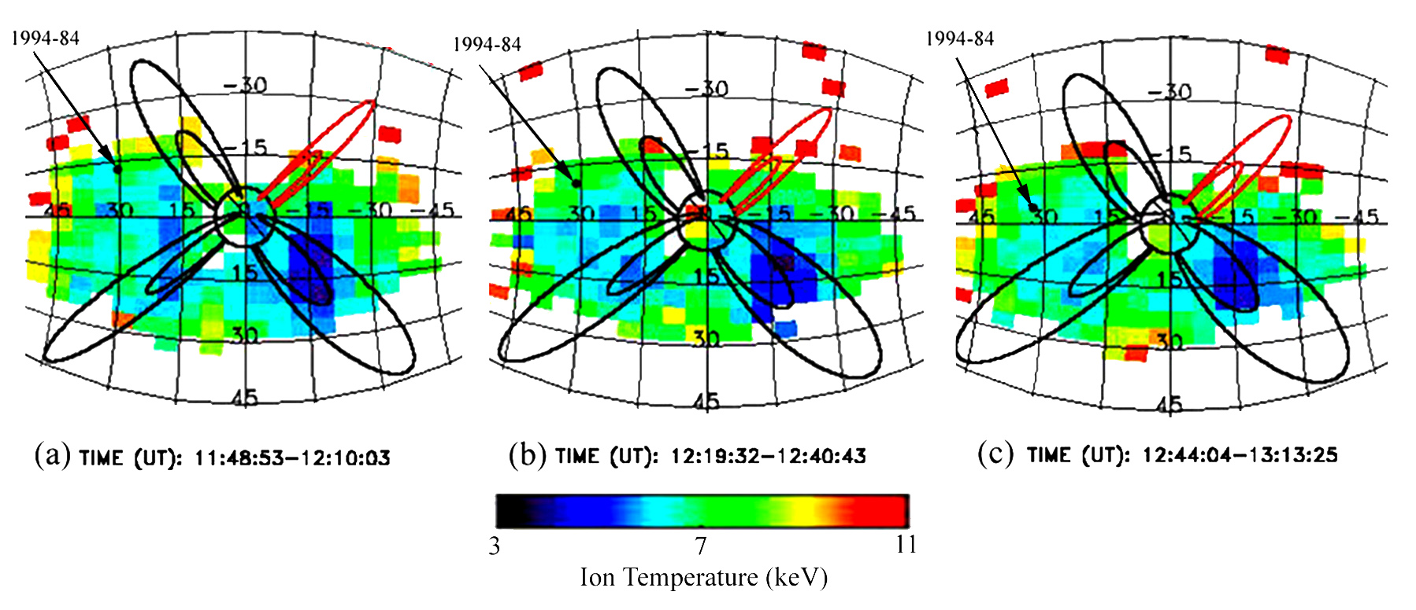
Validation with LANL-MPA Measurements During IMAGE Mission
In the MENA ion temperature images, the MPA spacecraft moves from a region of 7 keV to a region of 5 keV.

Slide 13
Local MPA and Remote ENA Yield Similar Temperatures
In-situ measurements made by the geosynchronous Magnetospheric Plasma Analyzer (MPA) 1994-84 instrument during the magnetospheric storm on August 12, 2000 are consistent with the remote ENA-based measurements.
Magnetic Local Time (MLT)
18.8
19.2
19.6
20
10
8
The MPA data have been averaged over twenty minute intervals to be consistent with the MENA ion temperature maps that are based on twenty-minute averages of the neutral atom flux. The temperature maps are centered at 12:00, 12:30, and 13:00 (UT).
6
Ion Temperature (keV)
4
2
Community not convinced
11:30
12:00
12:30
13:00
13:30
Universal Time (UT)

Slide 14
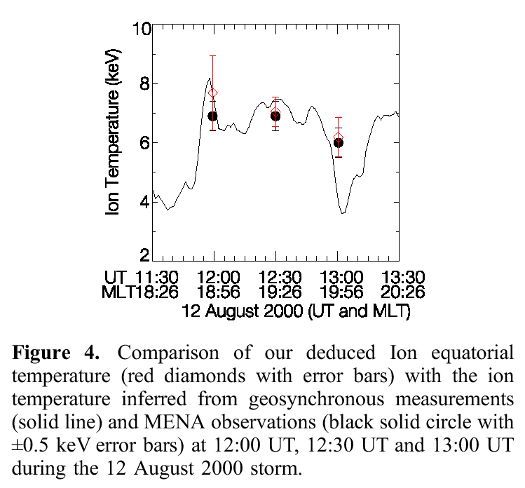
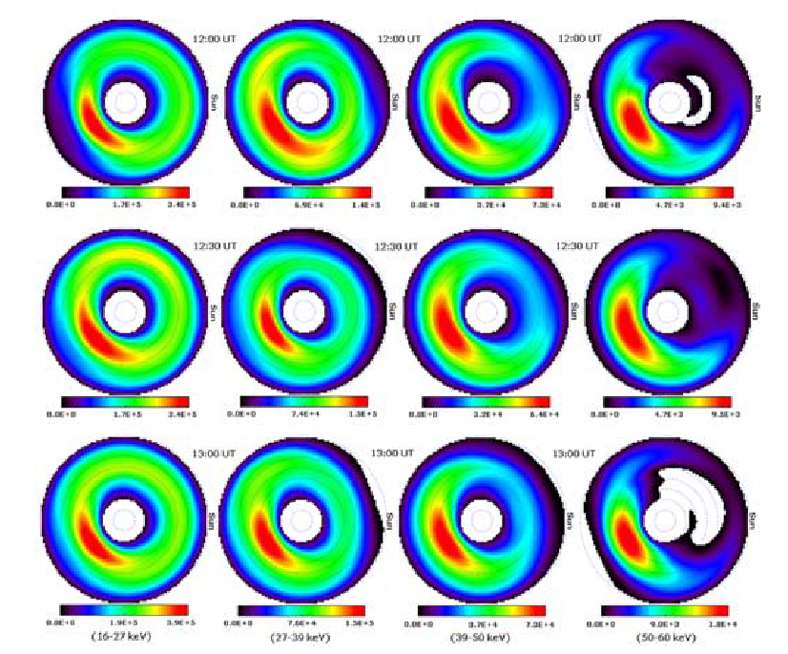
Equatorial ion temperatures deduced from inversions of HENA data yield the same ion temperatures
Energy
Time
Zheng, et al., GRL (2005)
Community not convinced

Slide 15
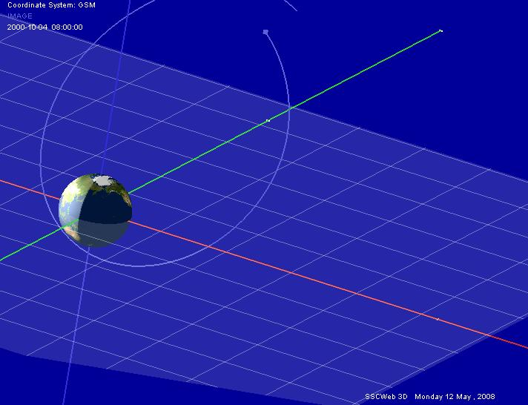
Compensate for blurring due to spacecraft motion, orbital precession, and seasonal changes by mapping fluxes from TWINS spacecraft to grid in equatorial plane (field of view binning)

Slide 16
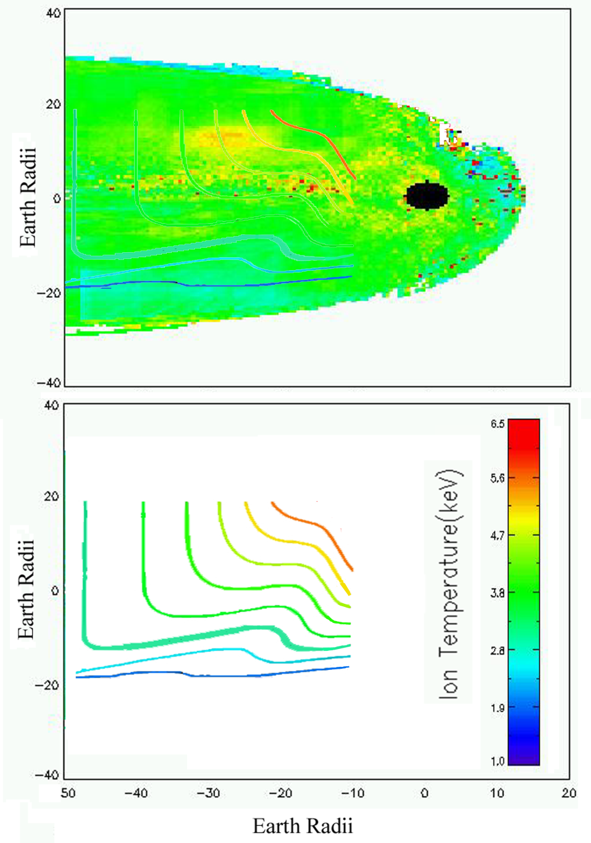
GSM-Mapped TWINS Ti Image of Quiet Magnetosphere Shows Considerable Structure
(a) Ion temperature image mapped onto the xy-plane in GSM coordinates for 6 days of TWINS data for northward or weak IMF, i.e., a weak cross-tail potential. A black disc with radius 3 R_{E}, centered at the Earth, indicates the region where our analysis is not applicable.
(b) Contours of constant ion temperature, with the same color bar as the ENA-based ion temperature measurements, as predicted by the finite tail width model of Spence and Kivelson [1993]. The underlying premise of the model is that as hot particles convect earthward under the influence of E x B motion, they also gradient and curvature drift across the tail in time stationary fields.
16

Slide 17
GSM-Mapped Data Consistent with Predictions
A key prediction of the finite tail width convection model is a strong dawn to dusk ion temperature asymmetry in the quiet-time magnetosphere.
these observations support the conclusion that duskward gradient/curvature drift and earthward E × B drift of ions lead to formation of a cross-tail pressure gradient from dawn to dusk.
The TWINS measurements obtained over a relatively short time demonstrate that the ion temperature gradient is an inherent feature of the quiet time magnetosphere.

Slide 18
What is Required to Localize a ENA Measurement?
A significant/detectable increase in ENA flux from a specific location in space
Increase (or modulate) ion density or neutral density to increase ENA signal
At geosynchronous orbit the Hº density ~ 50-100 cm⁻³
To double the neutral hydrogen density in a cubic Earth radius:
100 cm⁻³ x (637,100,000 cm)³ = 2.6 x 10²⁸ atoms of hydrogen
= 43,189 moles of hydrogen
= 21.6 kG of liquid H₂ (liquid H₂ density = 2.02 g/mol)
= 305 liters (liquid H₂ density = 70.85 g/l)
Fuel capacity of 2nd stage of a Falcon 9 rocket
= 27,600 Liters liquid O₂ and 17,400 Liters Propellant
= 0.7 % of fuel tank
→ 10% of fuel tank volume enough for 14 releases

Slide 19
Mission Concept
Minimal spacecraft just enough for orbit control, pressurized tanks, UV lamp, and gas release valves
Launch Vehicle single Falcon 9 launch with spacecraft as either a primary or ancillary vehicle
Orbit design orbit for passes through interesting magnetospheric regions with conjunctions between gas release spacecraft and constellation missions, e.g., MMS.
Hº Generation from H₂ use strong EUV light source (4.75 eV binding energy requires 261 nm light source – easy to do with frequency quadrupled, pulsed NdYAG laser)
ENA acquisition use existing TWINS spacecraft or specialized CubeSats in low Earth orbit for ENA measurements

Slide 20
Science Goals
1. Resolve integrated versus “hottest along line of sight” uncertainty of ENA measurements
2. Measure average ion temperature on spatial scales of 0.25 R_{E}³ to R_{E}³ scales.
3. Compare remotely measured ion energy distributions to those measured with in-situ, local, instruments during impulsive magnetospheric events
4. Benchmark models of geocoronal neutral density from comparative ENA flux measurements
5. Launch the field of “active” distant magnetospheric experiments
6. Challenges, rate of photoionization and impact ionization of released neutral H, detector sensitivity, timing of releases,….

