Slide 1
Nascap-2k, A Useful, Validated and Verified Spacecraft Surface Charging Code
Dale C. Ferguson
Lead for Spacecraft Charging Science and Technology
Space Vehicles Directorate
Air Force Research Laboratory
Active Experiments in Space: Past, Present, and Future
Sept. 12, 2017
Distribution A: Approved for public release; distribution unlimited

Slide 2
What Is Nascap-2k?
Nascap-2k is a full 3-D fully GUI computer code to calculate the interactions of a spacecraft with its LEO, GEO, Polar, or interplanetary plasma environment Interactions include:
  Surface potentials
    Charged particle spectra (electrons and ions)
    Secondary electron emission
    Bulk and surface conductivity
  Current collection
    Applied frame and distributed potentials
  Perturbation of near-field environment
    Space Potentials
    Thruster plumes
    Charge exchange ion flow
Calculations are analytic where possible, PIC (particle-in-cell) where desired
Code features
  Object and grid definition
  Simplified user interface for problem definition and execution
  Graphical display of results
Developed by Leidos, Inc. under AFRL and NASA sponsorship
Resides on your own computer, no web-login necessary
Distribution A: Approved for public release; distribution unlimited

Slide 3

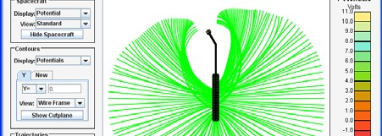

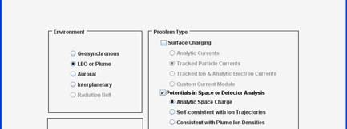
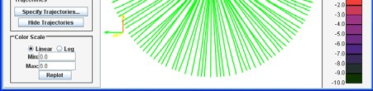
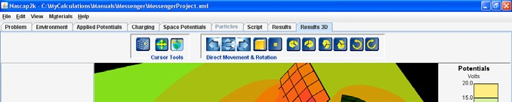
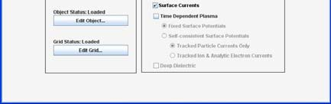
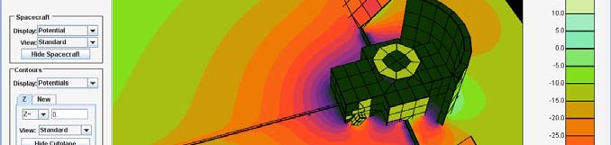

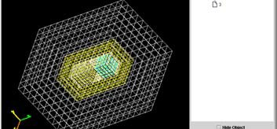
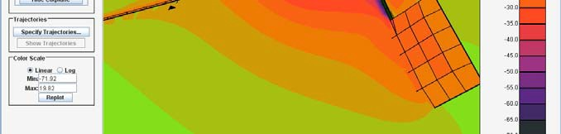
Nascap-2k Core Capabilities
Defines spacecraft surface geometry
Grids space surrounding spacecraft
Calculates environmentally induced time-dependent surface potentials
Calculates external potentials:
  Analytic space charge (5 models)
  Macroparticle space charge (4 models)
Generates and tracks macroparticles
  Uniform with boundary injection
  Sheath generation
  Charge exchange
Post-processing:
  Time-dependent surface potentials and currents
  Time-dependent volume potentials, currents, and densities
Distribution A: Approved for public release; distribution unlimited

Slide 4
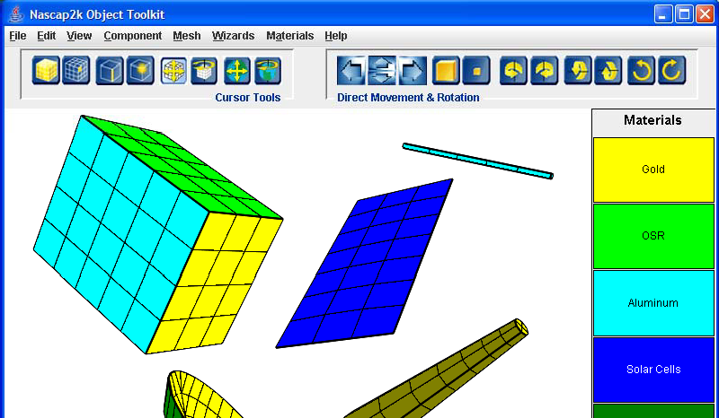
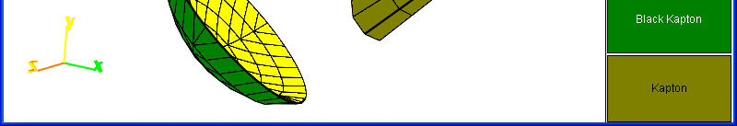
Object Toolkit
Builds spacecraft surface models
Uses intrinsic building blocks
Imports from finite-element preprocessors
Surface attributes from database or user-definable
  Material name
    Conductivity
    Secondary electron emission
    Thickness, etc.
  Conductor number
Customizable to other applications via an external file
Distribution A: Approved for public release; distribution unlimited

Slide 5
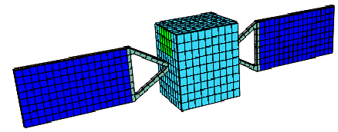
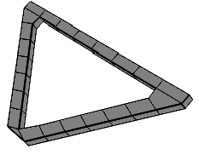

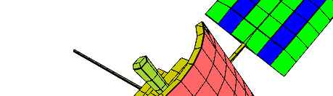

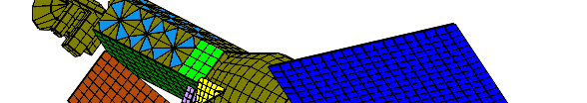
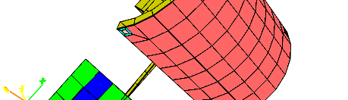
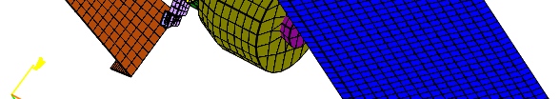

Object Toolkit Examples
Distribution A: Approved for public release; distribution unlimited

Slide 6
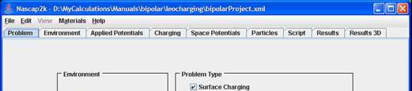
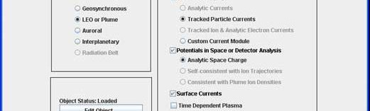
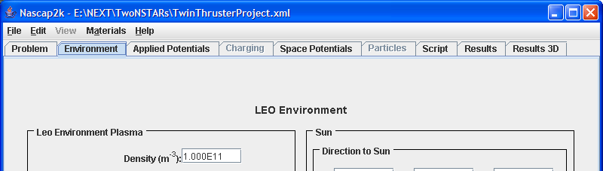
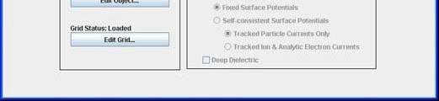
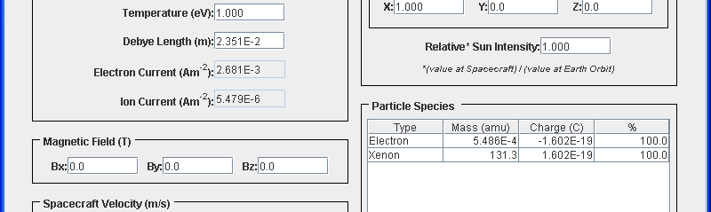
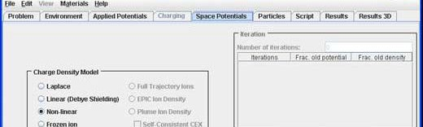

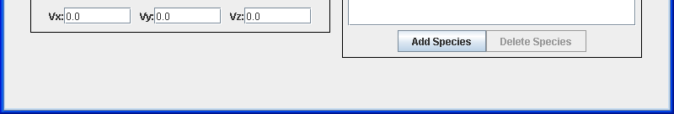
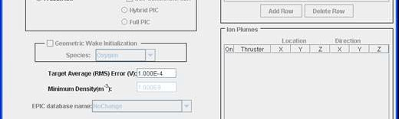
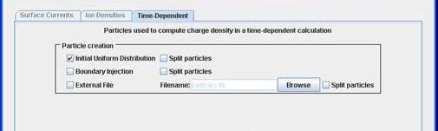

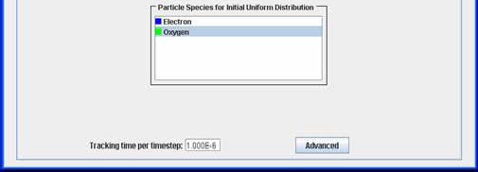
Nascap-2k GUI Input tabs
Problem
Environment
Charge Density Formulation
Particle Initialization
and Tracking
Distribution A: Approved for public release; distribution unlimited

Slide 7
VALIDATION
Distribution A: Approved for public release; distribution unlimited

Slide 8
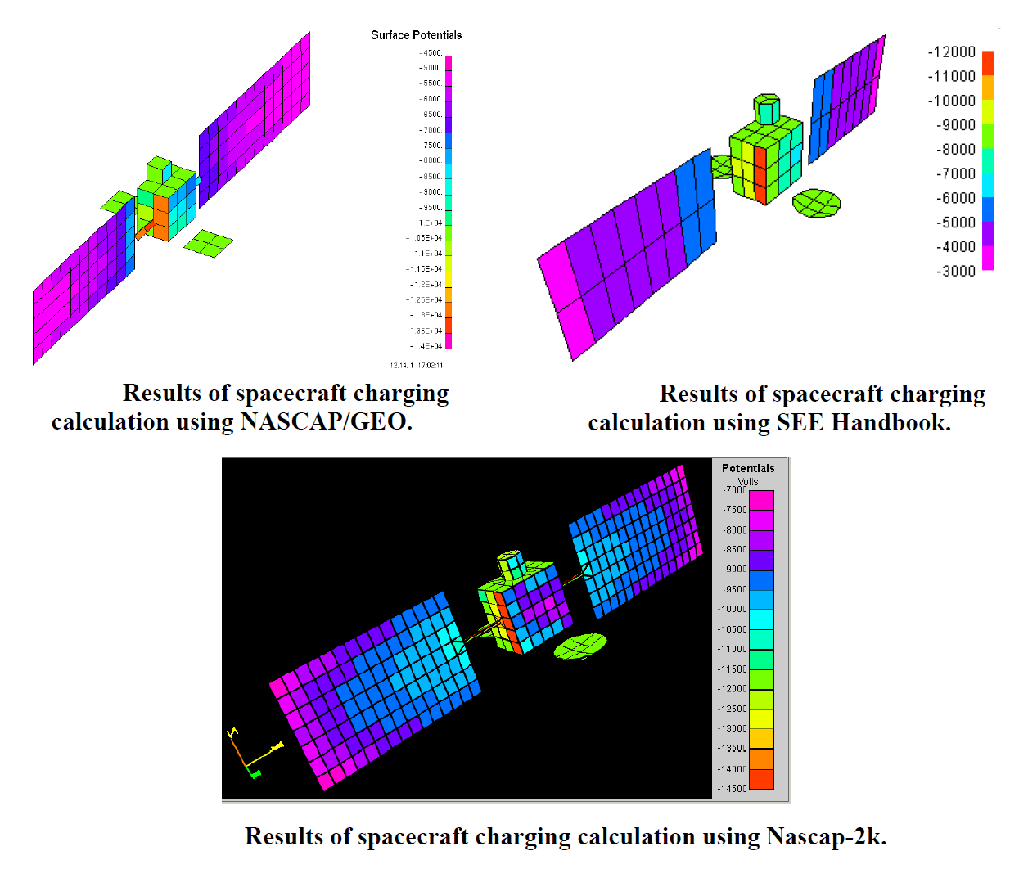
GEO Validation vs NASCAP/GEO and SEE Handbook
Distribution A: Approved for public release; distribution unlimited

Slide 9
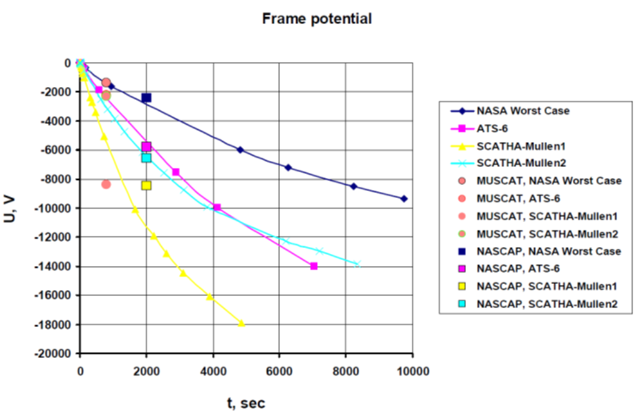
GEO Validation vs MUSCAT and Coulomb-2
Distribution A: Approved for public release; distribution unlimited

Slide 10
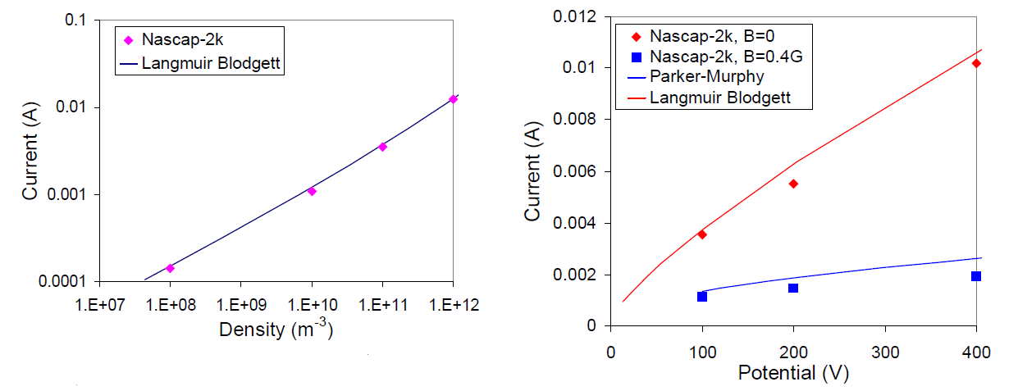
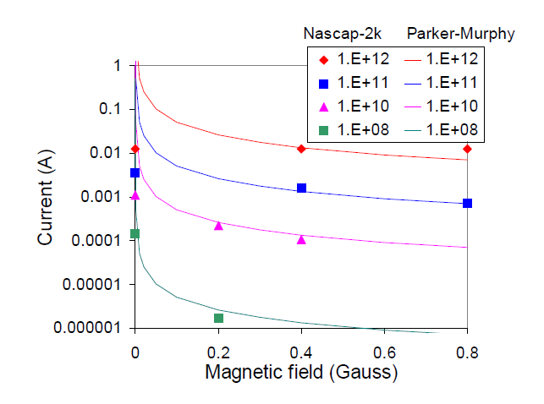
LEO Validation vs Langmuir Blodgett, Parker-Murphy
Upper left – I vs Number Density
  10 cm radius 100V sphere
  Te = 0.2 eV
Upper Right – I vs V
  10¹¹ m⁻³
  Te = 0.2 eV
Lower Left – I vs B
Distribution A: Approved for public release; distribution unlimited

Slide 11
VERIFICATION
Distribution A: Approved for public release; distribution unlimited

Slide 12

Derivation of F (E > Emin) as Charging Index (1)
From the Maxwellian differential flux equation, where we define the flux as the one-sided current flux over a hemisphere,
$f\left(E\right)=N e \sqrt{\frac{e}{2πmθ}}\left(\frac{E}{θ}\right)\exp\left(−\frac{E}{θ}\right)$
the flux above a minimum energy is F(E > E_{min}), which is
$\int_{Emin}^{∞}{f\left(E\right)dE=N}{e θ}^{\frac{1}{2}} \sqrt{\frac{e}{2πm}} \exp\left(−\frac{Emin}{θ}\right)\left(1+\frac{Emin}{θ}\right)$
the total flux F_{e} is given by
$\int_{0}^{∞}{f\left(E\right)dE=N}{e θ}^{1/2} \sqrt{\frac{e}{2πm}} ={2.68×10}^{−14} N θ^{1/2}$and
F(E > E_{min}) / F_{e} = (1+E_{min}/θ) exp(-E_{min}/θ).
Distribution A: Approved for public release; distribution unlimited
Notes:
Presenter: Do not speak to agenda.

Slide 13
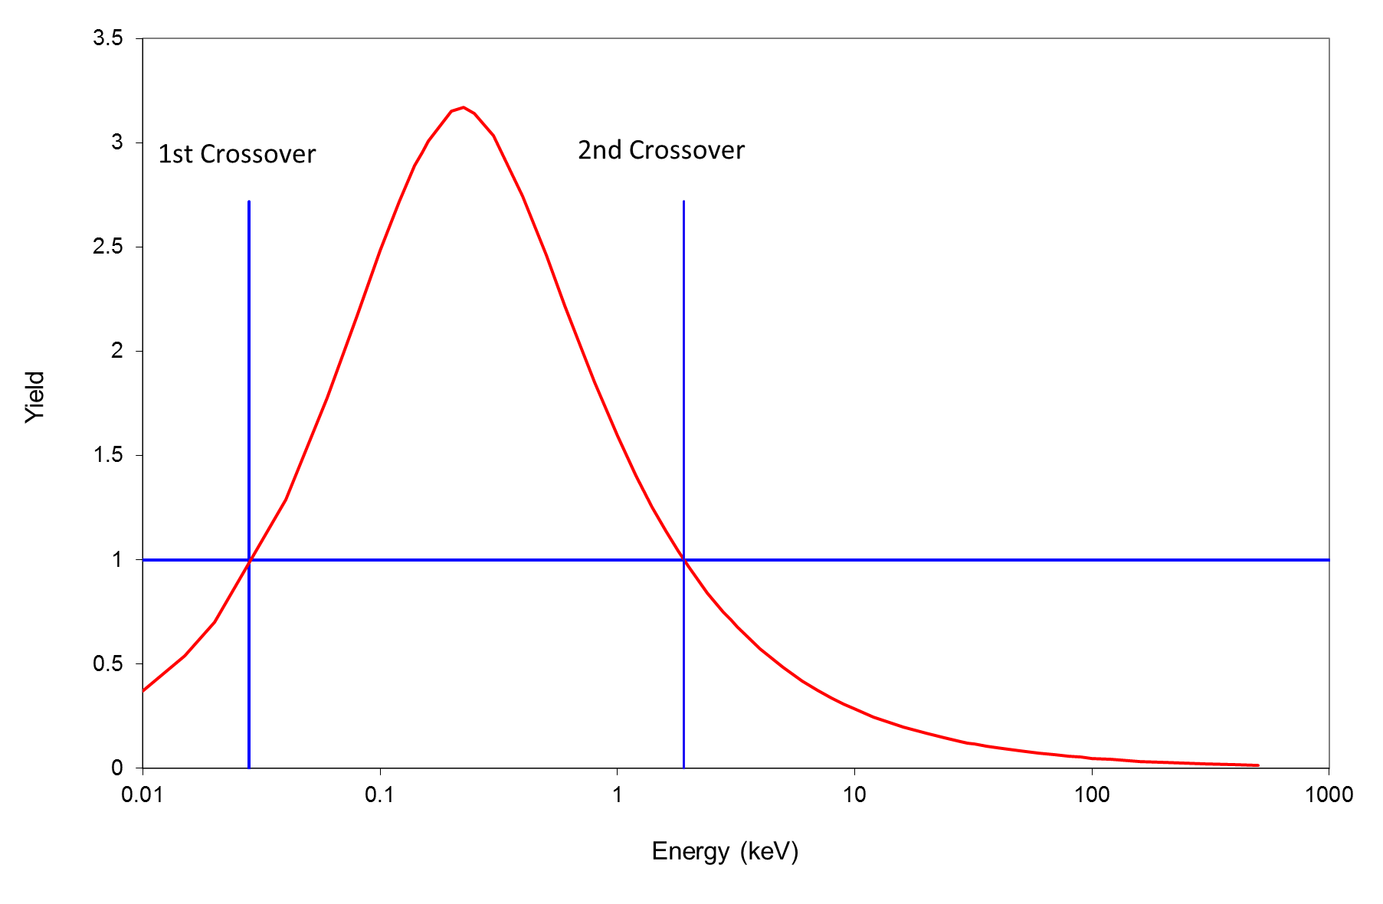
Secondary Electron Emission
Nominal secondary electron yield curve for a “typical” material
Distribution A: Approved for public release; distribution unlimited

Slide 14
Flux above Emin
Normalized differential fluxes for Maxwellians of the same electron density but different temperatures. A hypothetical Emin is shown by the dashed line
Distribution A: Approved for public release; distribution unlimited

Slide 15
Derivation of F (E > Emin) as Charging Index (2)
As the plasma temperature (θ) increases, the fraction of incident electrons above the second crossover point increases, until at some temperature, the net electron flux must be zero.
In sunlight, because of the added emitted electrons from the photoelectric effect, this temperature must be even greater, so E_{min} must be taken to be an energy well above the second crossover.
  It is this heightened temperature that Shu Lai called the critical temperature, below which no negative absolute charging can occur.
Photoemission and secondary electron emission are materials properties, so E_{min} is different for different materials.
As spacecraft vary in the relative areas of surface materials, E_{min} will vary between different spacecraft.
Distribution A: Approved for public release; distribution unlimited
Notes:
Presenter: Do not speak to agenda.

Slide 16
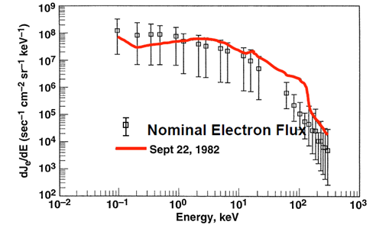
  Published data from satellites that measured charging - SCATHA
Differential electron fluxes on SCATHA for Sept. 22, 1982 (dashed line) compared with the average of two different one-week periods (“error bars”), from Roeder. Error bars show the extremes for the “nominal” two 7 day periods, and thus can be considered well over 1 sigma away from the mean
Distribution A: Approved for public release; distribution unlimited

Slide 17
  Nascap-2k Determination of E_{min} for the typical spacecraft model of Ferguson and Wimberly (FW)
Squared correlations of daytime charging values with absolute (frame) and differential charging for the single Maxwellian charging cases and spacecraft model of FW. Note the essentially perfect correlation of (-Abs Chg) at Emin=11 keV
Squared correlations of daytime charging values with absolute (frame) and differential charging for the double Maxwellian charging cases and spacecraft model of FW
Distribution A: Approved for public release; distribution unlimited

Slide 18
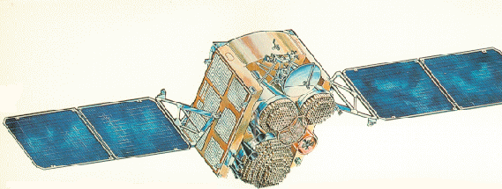
  Published data from satellites that measured charging – DSCS-III B7
Figure 13 of Kraus et al 2004, showing the differential voltage of the surface potential monitors (SPMs) for Kapton and Astroquartz with respect to the chassis potential.
DSCS-III
Distribution A: Approved for public release; distribution unlimited

Slide 19
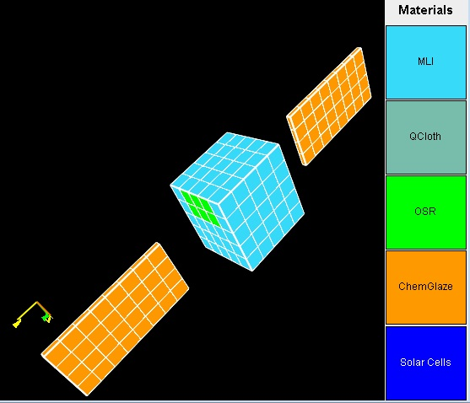
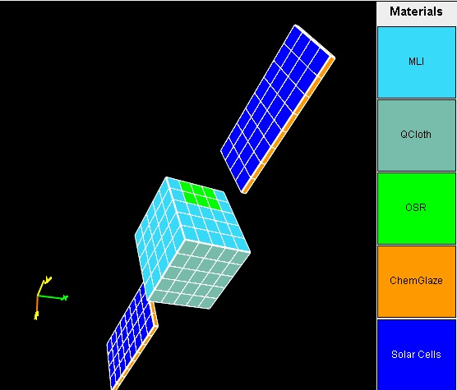
  The influence of spacecraft configurations 3-Axis Stabilized, dscsmini model
Simple Nascap-2k model of the DSCS-III satellite, named “dscsmini”
Distribution A: Approved for public release; distribution unlimited

Slide 20
  The influence of spacecraft configurations 3-Axis Stabilized, dscsmini model
Charging vs. electron number fluxes for 20 keV < E < 50 keV from dscsmini model for comparison with DSCS-III data
Distribution A: Approved for public release; distribution unlimited

Slide 21
  Published data from satellites that measured charging – DSCS-II B7
The Krause et al DSCS data normalized to 2 million electrons per second per cm² per count compared to the dscsmini Nascap-2k model predictions (dashed line)
Distribution A: Approved for public release; distribution unlimited

Slide 22
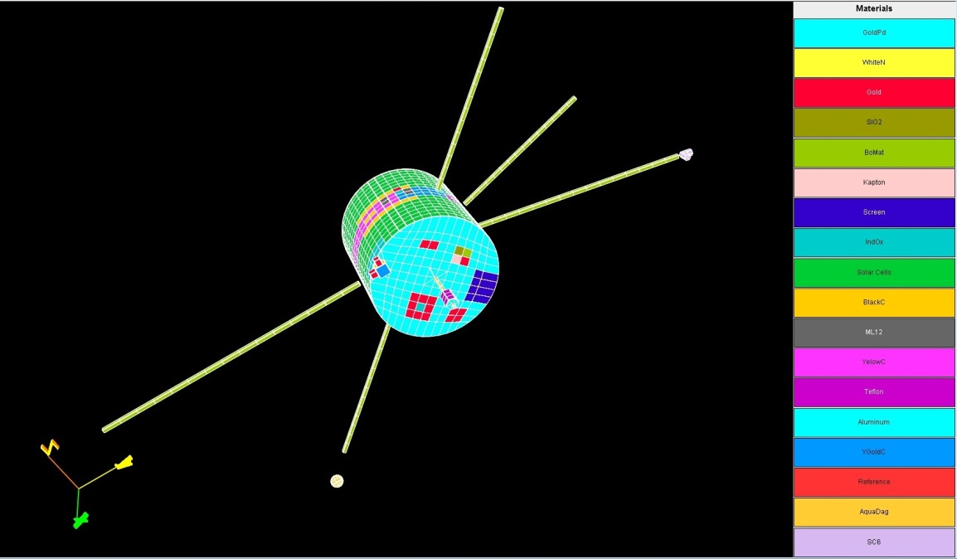
  The influence of spacecraft configurations - Spinners
False color Nascap-2k surface-materials model of SCATHA
Distribution A: Approved for public release; distribution unlimited

Slide 23
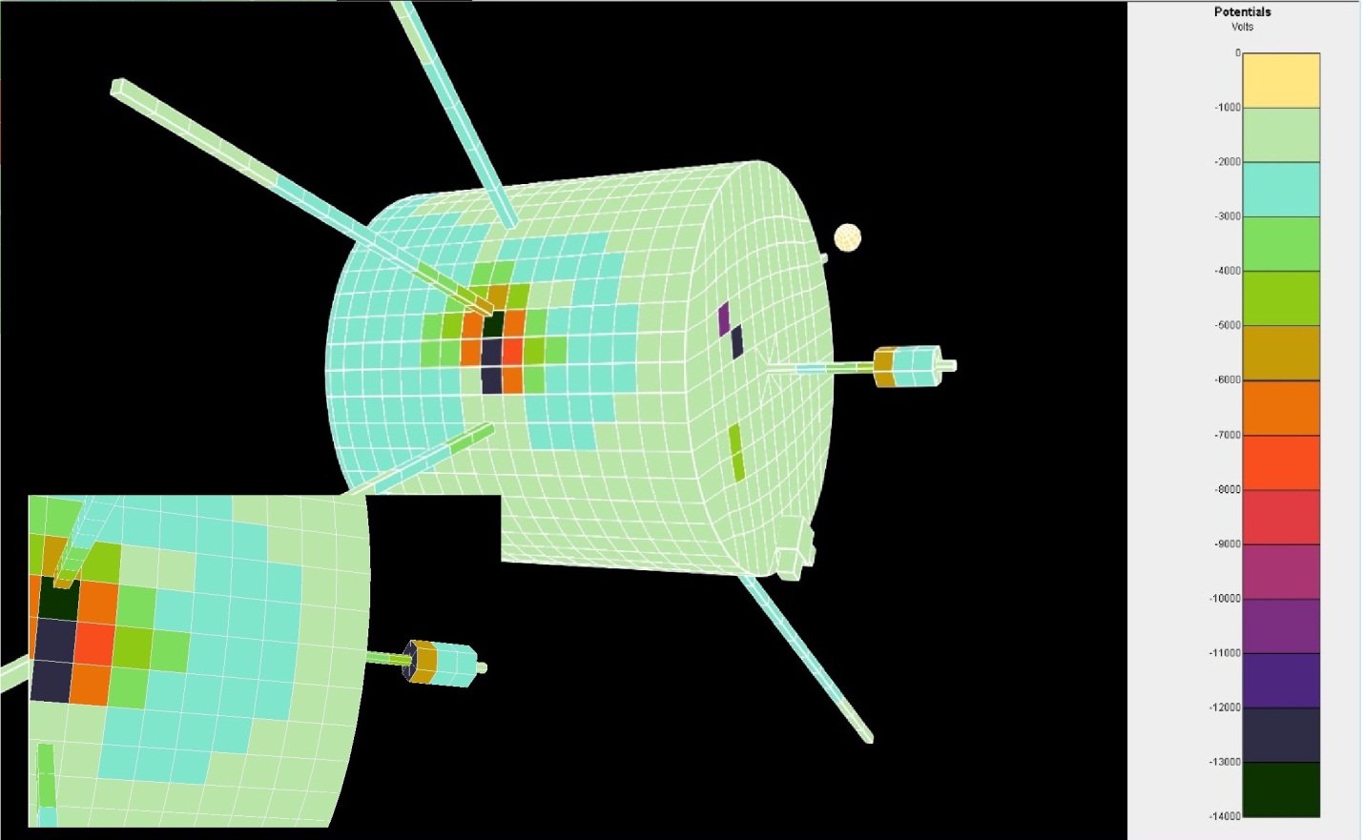
  The influence of spacecraft configurations - Spinners
Potentials after 2010 seconds, ATS-6 environment, rotating at 1 rpm. Inset at lower left shows the bottomside of the Teflon cylindrical antenna cover, from which ions are partially blocked
Distribution A: Approved for public release; distribution unlimited

Slide 24
  Published data from satellites that measured charging - SCATHA
Plot of SCATHA gold potential versus total electron flux
  The apparent threshold at about 1 microAmp/m² agrees with FW
  Noise may be partially due to the spacecraft rotation, which may be as much as a factor of two
  Since we have assumed the same plasma temperature for all of these data points, agreement with Nascap-2k predictions for total flux also applies to fluxes above any Emin
Distribution A: Approved for public release; distribution unlimited

Slide 25
  The influence of spacecraft configurations - Spinners
Potentials of the detailed rotating SCATHA model after 2010 seconds of charging. Note threshold in frame charging at about 3.9x10⁸ e⁻/cm²sec
Potentials for SCATHA model, rotating around axis pointed at Earth, for 2010 seconds. Note thresholds at about 3.9x10⁸ e⁻/cm²sec
Distribution A: Approved for public release; distribution unlimited

Slide 26
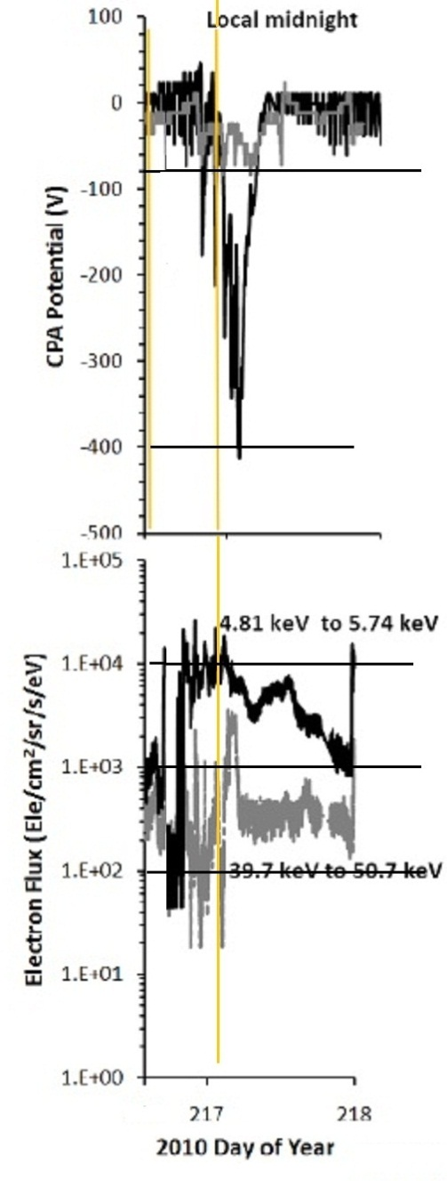
  Published data from satellites that measured charging – INTELSATs
The charging event on INTELSATs 806 (light lines) and 803 (dark lines) z-sensors on August 4, 2010. The colored lines indicate local midnight, so the spacecraft charged in the morning sector.
Nascap-2k calculated differential potentials for the CPA position on the geobird satellite model.
Distribution A: Approved for public release; distribution unlimited

Slide 27
Desirability of On-Board Sensors
Potential of the SCATHA Gold Surface Potential Monitor on Sept. 22, 1982 with respect to the spacecraft along with Pulse Analyzer arc detections.
Potential of other SPM sensors relative to gold (from Koons et al 1988).
Distribution A: Approved for public release; distribution unlimited

Slide 28
In terms of a Nascap-2k non-rotating SCATHA model in daylight (results not shown), we can make these generalizations:
1. Frame charging (-Abs) in the rotating case is only about ¼ that in the non-rotating case. This is because with rotation, many more surfaces see the sun and can be intermittently discharged by photoemission.
2. The differential charging (Max-Min) in the rotating case is ¼ to ½ of what it would be in the absence of rotation.
3. The differential charging (Abs-Min) in the rotating case is 1/3 to ½ of what it would be in the absence of rotation.
  The influence of spacecraft configurations - Spinners
Distribution A: Approved for public release; distribution unlimited

Slide 29
Summary
Nascap-2k has been well validated and verified
Object Toolkit is ideal for modeling spacecraft to the right level of detail
Nascap-2k is freely available to all US citizens and companies
Nascap-2k is useful in design, testing, and operations
It has tools that enable modeling in the presence of:
  changing plasma conditions
  spacecraft rotation
  high voltage solar arrays
  thruster plumes
Orbital environments it treats:
  LEO equatorial
  LEO polar
  MEO
  GEO
  Interplanetary
Depending on the level of accuracy desired, Nascap-2k is the fastest and most accurate spacecraft charging program in the world, and secure because it runs on your own computer
Distribution A: Approved for public release; distribution unlimited

Slide 30

Questions?
Distribution A: Approved for public release; distribution unlimited

