Slide 1
Beam-plasma coupling physics in support of active experiments
Gian Luca Delzanno (LANL)
Vadim Roytershteyn (SSI)

Slide 2
Outline
I. Motivation: electron beams for space physics
II. Radiation theory
III. Simulation results
  Coupling efficiency
IV. Wave-particle interaction (preliminary)
Summary

Slide 3
I. There is renewed interest in space experiments with e-beams, driven by new technological developments
Rich history of active space experiments with e-beams [from 70s to early 90s]: ~10s keV, ~100 mA
  Vehicle charging: CHARGE, SCATHA, STS 3
  VLF emissions: SEPAC, SPACELAB 1-2
  Beam-environment interactions: ARAKS, POLAR
  Magnetospheric (radiation belt) physics: ECHO
Vehicle charging is an issue
  All these experiments (but SCATHA) were in the high-density ionosphere
  6 mA beam on SCATHA caused permanent failure of 3 payloads
New emerging applications would require operating e-beams in the low-density magnetosphere
Compact relativistic beams have been developed and will substantially reduce vehicle charging issues

Slide 4
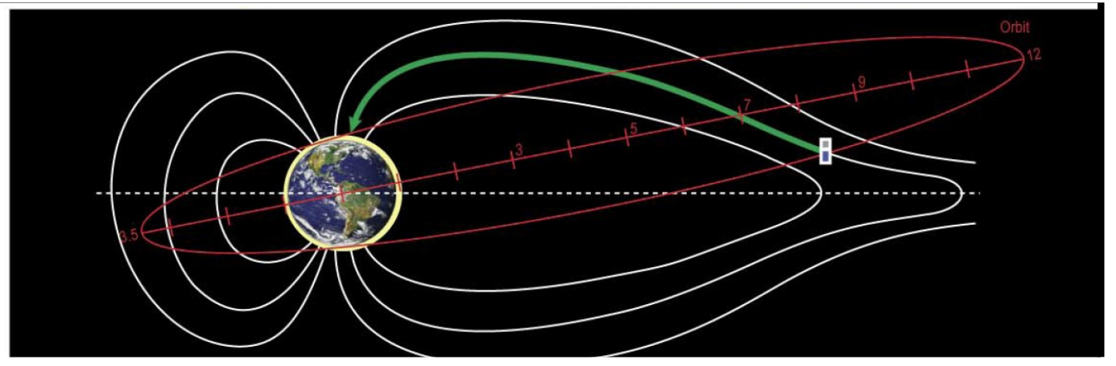
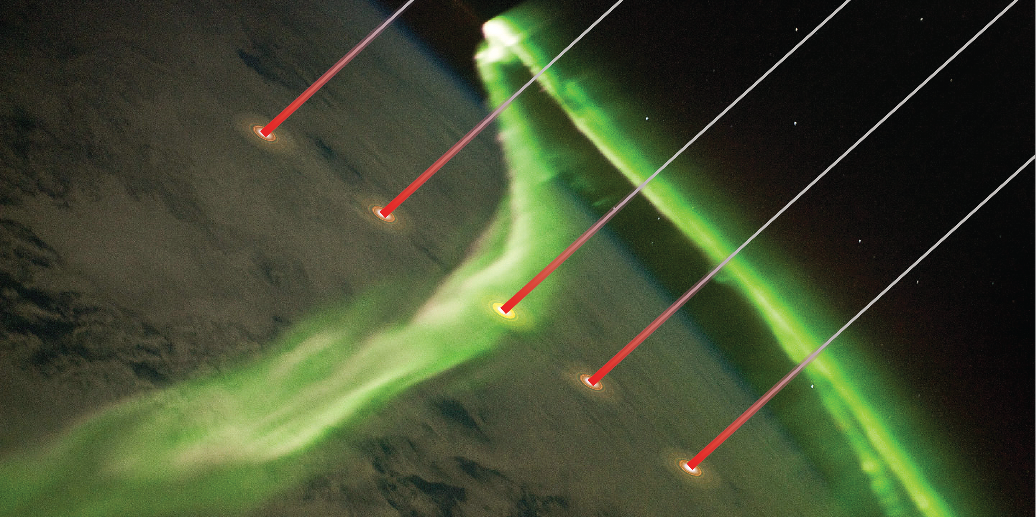
I. e-beam could be used to establish magnetic field line connectivity unambiguously, over vast regions of near Earth space, to address longstanding magnetosphere-ionosphere coupling questions
CONNection EXplorer
Needs to address:
Spacecraft charging
Beam-plasma coupling
Beam deposition

Slide 5
I. e-beams could be used for radiation belt remediation (RBR)
Use e-beams to stimulate wave emission
  Cherenkov or cyclotron emission
  Beam-plasma instabilities
Pitch-angle scattering to precipitate
energetic particles at the poles
Relativistic beams could offer some advantages (?)
NOTE:
  CONNEX: minimum beam-plasma coupling
  RBR: maximum beam-plasma coupling
In the following we will take a look
at Cherenkov (mostly) radiation theory

Slide 6
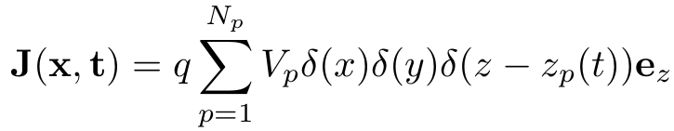
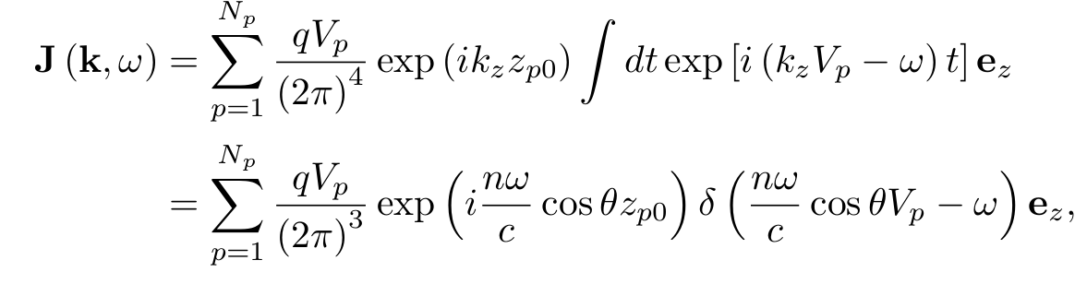
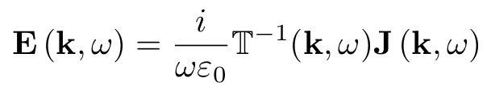
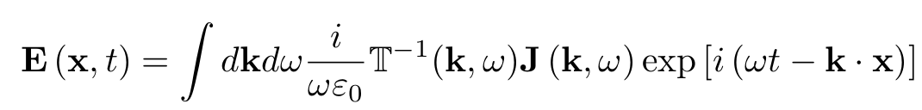
II. Radiation theory
Developed in the 60s [McKenzie, 63; Mansfield, 67; Harker&Banks, 84+]
Beam point pulses act as a current source
Plasma responds with characteristic frequencies driven by resonances
  Resonance
  Linear response: cold plasma theory
Beam aligned to B
k=n𝜔/c

Slide 7
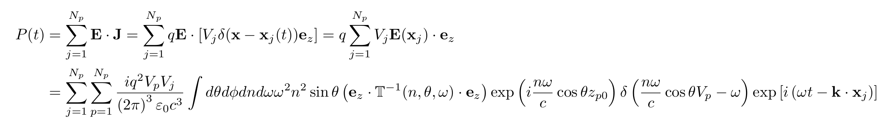
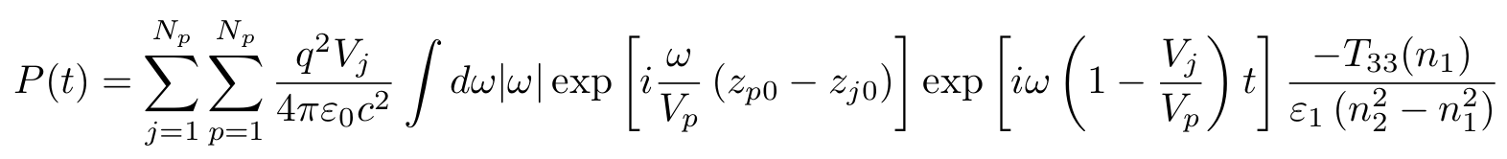
II. Beam aligned to B field: zero pitch angle
Radiated power
Carry out all integrations (using the Residue theorem): two-mode response
Single-mode regime
k=n𝜔/c
Spatial
coherence
Temporal
coherence
Farrell&Goertz 90
Harker&Banks 84, …

Slide 8

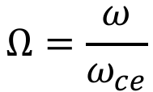
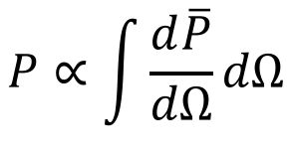




II. Two coupling regimes
$$ω_{uh}$$
Whistler and X modes
Resonances
  Lower-hybrid frequency
  Upper-hybrid frequency
Yields logarithmic singularities
The total power diverges
$$ω_{lh}$$
$$ω_{ce}$$
$$ω_{pe}$$
$$Ω=\frac{ω}{ω_{ce}}$$
$$P∝\int{\frac{d\overline{P}}{dΩ}dΩ}$$
𝜔_{pe}/𝜔_{ce}=2, m_{i}/m_{e}=1836

Slide 9
III. Finite pitch angle suggests radiation dominated by X mode
Several mechanisms can yield a finite radiated power:
  Finite pitch angle, nonlinearities, kinetic physics, collisions …
  Finite pitch angle: resonances are still present, but are now integrable
X mode
whistler mode
α pitch angle
Can we really trust total radiated power with finite pitch angle? In general NO!
Cold-plasma theory breaks down at resonances. Need simulations!

Slide 10

III. Simulations
SpectralPlasmaSolver (SPS): solves kinetic equations with spectral expansion of the distribution function in moments
Velocity discretization: Hermite or Legendre
Spatial discretization: Fourier or Finite Elements
Fully-implicit time discretization
Naturally bridges between fluid (few number of moments) and kinetic (large number of moments). Optimal way to include microscopic physics in large-scale simulations (?)
Delzanno, JCP 15; Vencels et al, J. Physics 16

Slide 11
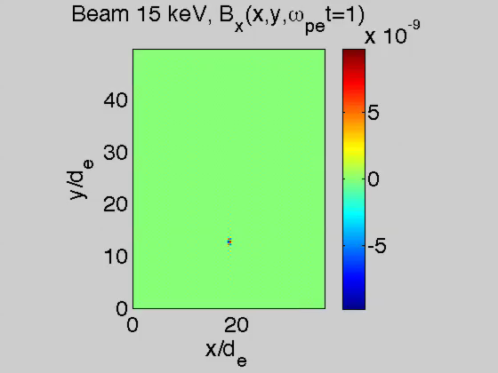
III. SPS simulations (used as a 2-fluid solver)
𝜔_{pe}/𝜔_{ce}=2,
m_{i}/m_{e}=1836,
𝛽_{||e}=10⁻⁴,
T_{||e}/T_{⟘e}=1,
T_{e}/T_{i}=1
B₀
Point pulse
SPS more
efficient
than PIC
(statistical
noise!)

Slide 12
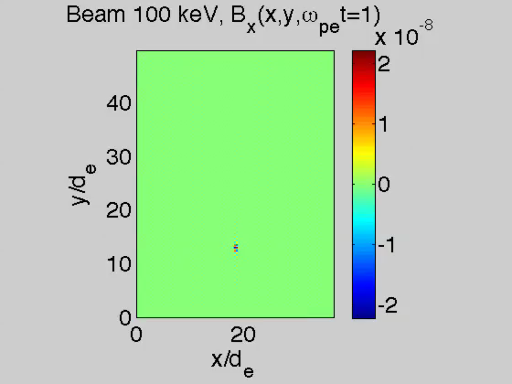
III. 100 keV beam
B₀

Slide 13
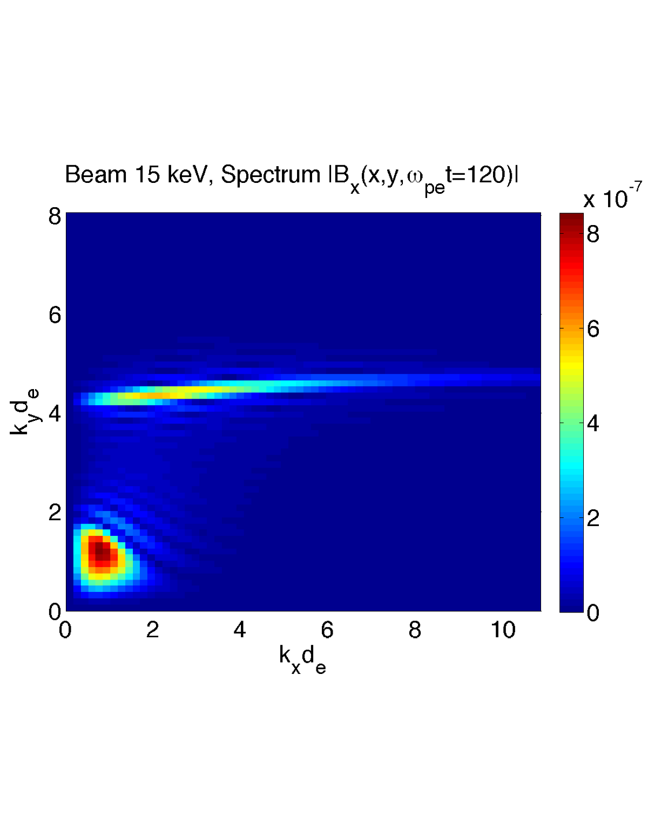
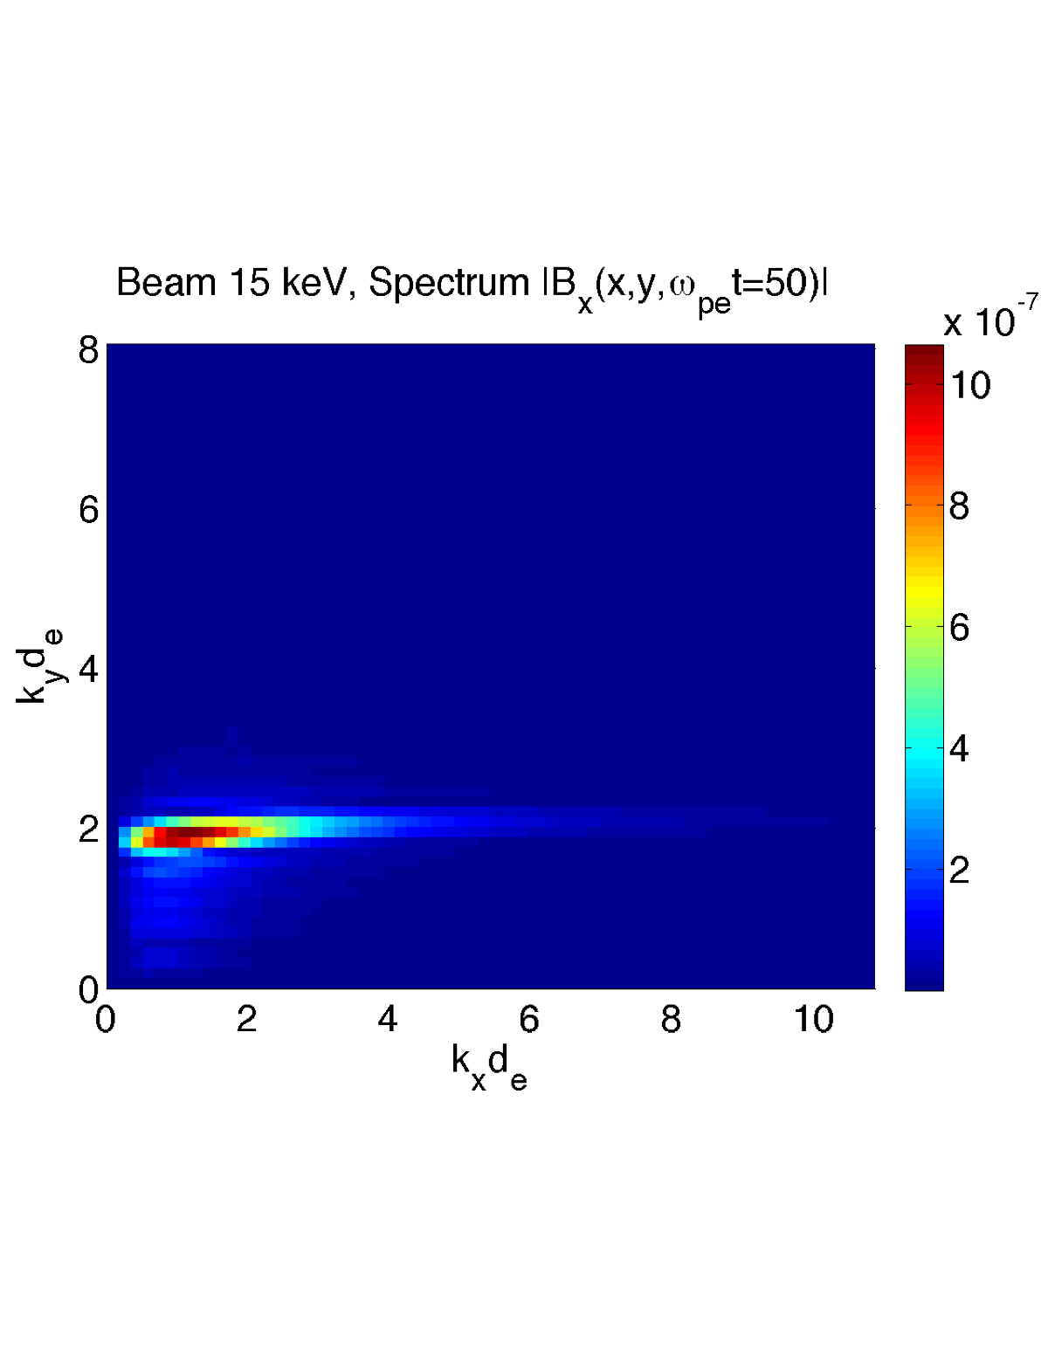
III. Spectra: 15 keV and 100 keV
100 keV
X
X
X
whistler
Very little power present for large k_{x}=k⟂
Theory might overestimate radiated power

Slide 14
III. Total radiated power
Whistler: good agreement between theory and simulations
  Contribution around resonance not important
X-mode: theory overestimates radiated power
Simulations confirm that X mode dominates radiation (20-100 higher)
  Many rocket/shuttle experiments focused on whistler

Slide 15
III. Efficiency (for a single pulse)
Parameters for the ionosphere: n=8⋅10⁴ 1/cc, B₀=45,000 nT
Beam parameters: 15 keV
Two sets of simulations
Minipulse: T_{mini}~0.1 µs. V_{beam}T_{mini}=7 m
 | I=0.8 A | I=8 A
Beam power [kW] | 12 | 120
Magnitude B_{x} | 6 nT | 63 nT
Whistler power [W] | 1.7 | 172
Total power [W] | 125 | 8918
Whistler efficiency | 0.014% | 0.14%
Total efficiency | 1% | 7.4%
X mode can dominate radiation, but coherence effects …

Slide 16
III. Coherence effects are important: beam modulation or pitch angle allow one to select between the 2 regimes
Minipulse: T_{mini}=1 µs. V_{beam}T_{mini}=71 m
100 pulses suitably separated
5 kHz modulation
Theory with
finite pitch angle
selects whistler
selects X

Slide 17

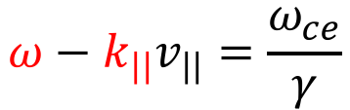
IV. Wave-particle interaction (preliminary)
Test particle simulations in a prescribed wave field
Single, monochromatic wave: fix B_{rms}=60 nT, use cold-plasma theory to fix other amplitudes. Fix background B_{z}=45,000 nT
Move 500 electrons with given initial energy and pitch angle, and random initial position and gyro-phase
For a given pitch angle, energy is computed from the first cyclotron resonance:
$$ω−k_{||}v_{||}=\frac{ω_{ce}}{γ}$$
beam
Background particle

Slide 18
Scattering: preliminaries
Assume L=6.3
Particles that are lost in the atmosphere (100 km) have pitch angles 66∘ at 500 km and 61∘ at 700 km
Particles that mirror at 200 km have pitch angles 69∘ at 500 km and 64∘ at 700 km
We have to reduce the pitch angle by 3∘ in 200 km
We will focus on the pitch angle at 600 km for particles mirroring at 200 km: 66∘
E=15 keV beam takes 2.8 ms to move 200 km
The reference gyrofrequency is 1.1 MHz

Slide 19
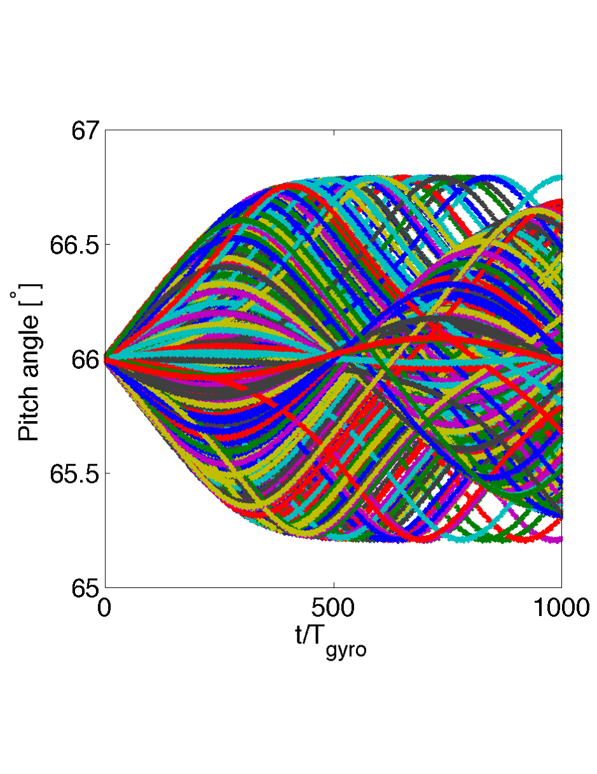

IV. Whistler mode:
E(0)=3.7 MeV; ⍺(0)=66∘; 𝜔=0.045𝜔_{ce}
With these parameters, can’t get 3 deg changes in pitch
angle necessary for precipitation

Slide 20
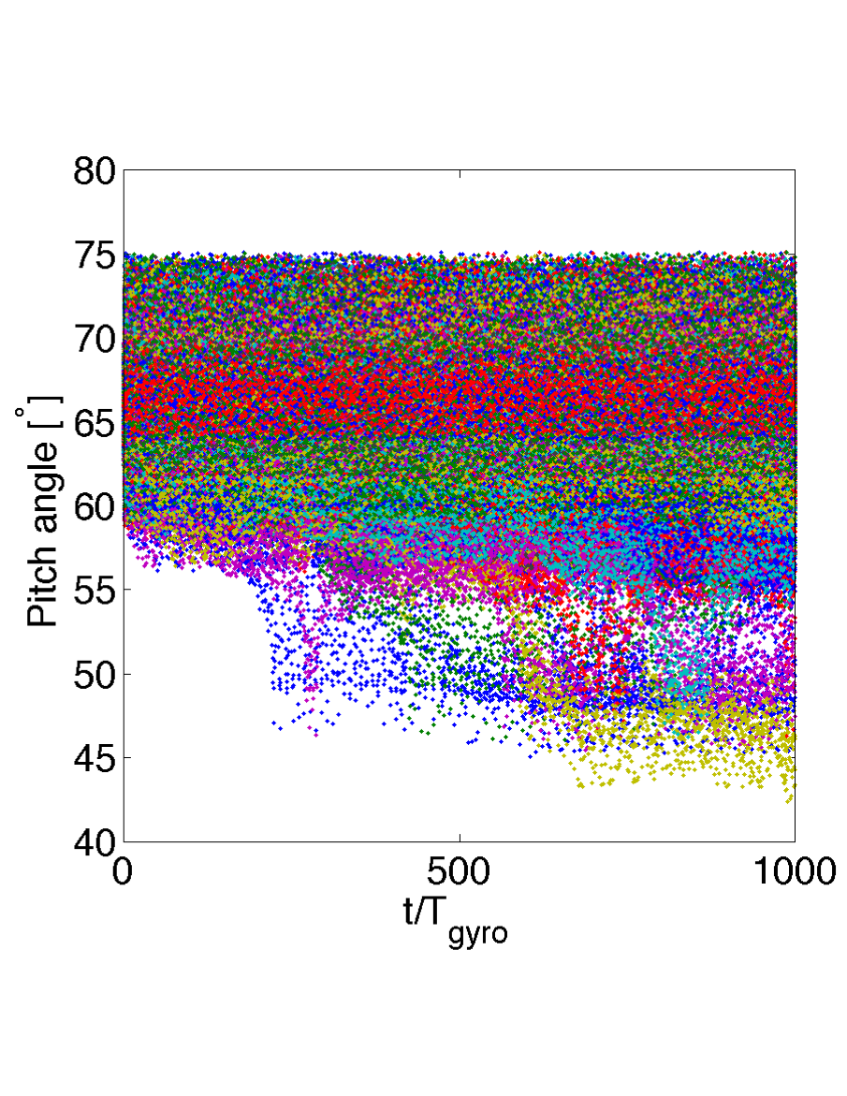
IV. X mode:
E(0)=31 keV; ⍺(0)=66∘; 𝜔=2.2𝜔_{ce}
With these parameters, 20% of the particles experience a
change in PA greater than 3 deg in the right direction

Slide 21
V. Summary
The simplest radiation theory was revisited and verified against numerical simulations
In addition to radiation in the whistler regime, well known and subject of many investigations, the analysis demonstrates the importance of radiation in the X mode and the need for simulations to compute efficiencies
  Potentially more efficient in terms of coupling with the plasma
  Potentially more efficient in terms of pitch angle scattering

